Slide 1
P088 :AZURE STORAGE OBJECT REPLICATION
FOR COMPLIANCE COPIES
Cloud-based replication of important audit and compliance data
Using Azure Storage Object Replication
1

Slide 2
TEAM NUMBERS :T190
TEAM MEMBERS :
Team leader :(2400080217) ULLENDULA KARTHIK
Name : (2400080235) K.Aasin Madhulika Reddy
Name: (2400080240) S.Niketha
Name: (2400080242) Y.Satya Nagalakshmi Srihitha

Slide 3
Problem Statement & Abstract
Problem Statement
  Companies require a proper means of ensuring that audit files and records are protected from failures.
  Storing all data together creates a risk because hardware problems or outages can affect data accessibility.
  Manual backup creation is difficult when dealing with huge volumes of data.
  This project applies Azure Storage Object Replication to create backup copies in a secondary region.
Abstract
  Organizations store large amounts of audit logs, compliance records, and important business data in cloud storage.
  Object Replication automatically creates copies of blob data from a source storage account to a destination account in another region.
  Replicated copies reduce data-loss risk and improve availability during regional outages or failures.
  Monitoring helps ensure critical data is successfully copied.
2

Slide 4
Azure Services & Project Objectives
Azure Services
  Azure Storage Account
  Azure Blob Storage
  Azure Storage Object Replication
  Azure Portal
Objectives
  Learn how Azure Storage Object Replication works.
  Create two storage accounts: one for original files and one for copies.
  Automatically copy blob files from one storage account to another.
  Keep important data available if one region faces issues.
  Improve data safety and support backup/recovery needs.
  Check whether files are replicated successfully and gain hands-on Azure experience.
3

Slide 5
Technologies Used
Technology | Purpose
Microsoft Azure | Cloud platform
Azure Blob Storage | Store audit/compliance data
Azure Object Replication | Replicate blobs between storage accounts
Blob Versioning | Maintain versions of blobs
Blob Change Feed | Track changes to blobs
Azure Monitor | Monitoring and observability
Replication Metrics | Track replication activity
Azure Portal | Configuration and management
4

Slide 6
Use Cases
1. Financial Services
  Transaction logs, login records, audit trails, and compliance reports can be replicated to a secondary account.
2. Healthcare
  Secondary copies support data availability, disaster recovery, and compliance data management.
  Regions and retention policies must follow applicable healthcare and data-protection requirements.
3. Government Applications
  Geographically controlled copies can be maintained in approved Azure regions.
4. E-Commerce
  Order logs, payment audit logs, user activity, and transaction records can be replicated.
5. Enterprise Applications
  Useful for application audit logs, security logs, system activity records, and compliance documents.
5

Slide 7
Key Features
Automatic Replication — New eligible blobs can be asynchronously replicated to the destination container.
Regional Copy — The destination account can be placed in another Azure region based on organizational requirements.
Versioning — Blob versioning helps maintain previous versions when supported by the configured workflow.
Monitoring — Replication metrics provide visibility into replication activity and pending replication.
Private Storage — Containers can remain private rather than publicly accessible.
Scalable — Azure Blob Storage can handle large quantities of unstructured data without traditional storage infrastructure.
6

Slide 8
Architecture & Advantages
Audit File
Primary Blob Storage
Object Replication
Secondary Blob Storage
Compliance Copy
Advantages
  Improved data availability
  Geographically separated copies
  Automated replication
  Cloud scalability
  Reduced manual copying
  Monitoring capabilities
  Supports compliance-oriented architectures
  Useful for disaster-recovery scenarios
  Pay-as-you-use Azure storage model
7

Slide 9
Future Enhancements
Real-time compliance dashboard
Email / Teams alerts
Automated replication health reports
Azure Functions for automated workflows
Power BI visualization
Automated backfill for historical audit data
Role-Based Access Control (RBAC)
Advanced retention policies
Immutable / WORM storage for applicable compliance scenarios
Integration with enterprise logging systems
8

Slide 10
Expected Outcome
Audit File
Primary Blob Storage
Object Replication
Secondary Blob Storage
Compliance Copy
The expected outcome is a working Azure-based architecture that automatically maintains a secondary compliance copy of important audit files.
This supports data availability, protection, monitoring, and disaster-recovery needs.
9

Slide 11
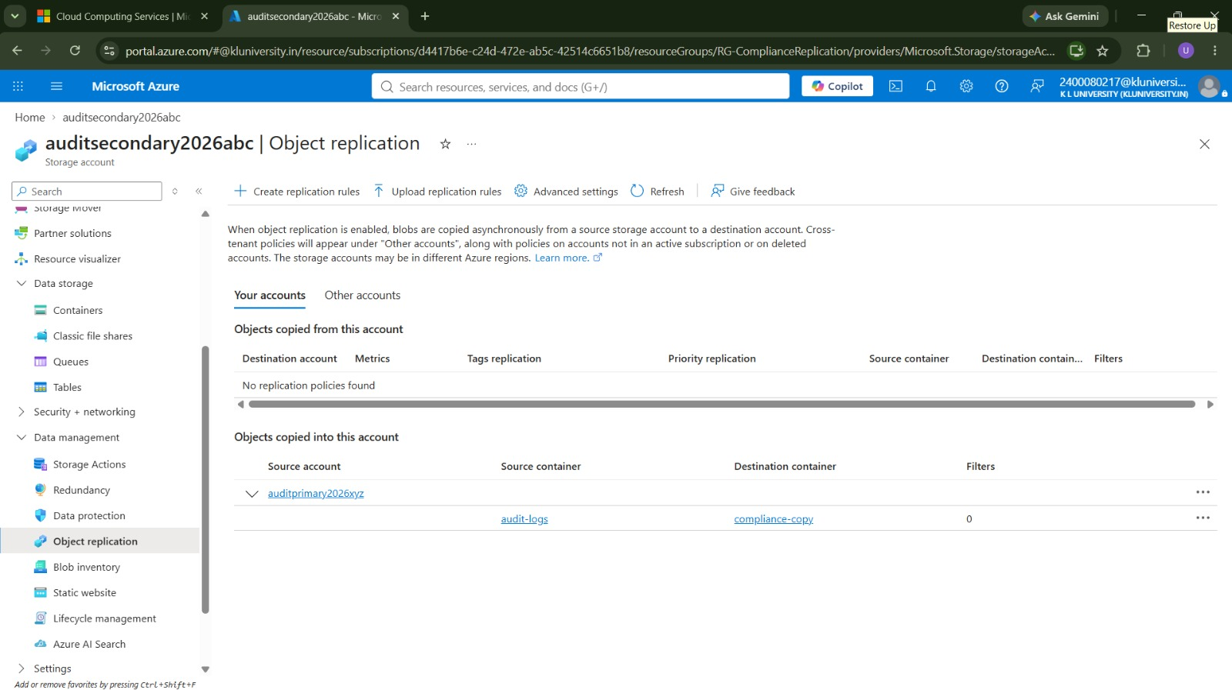
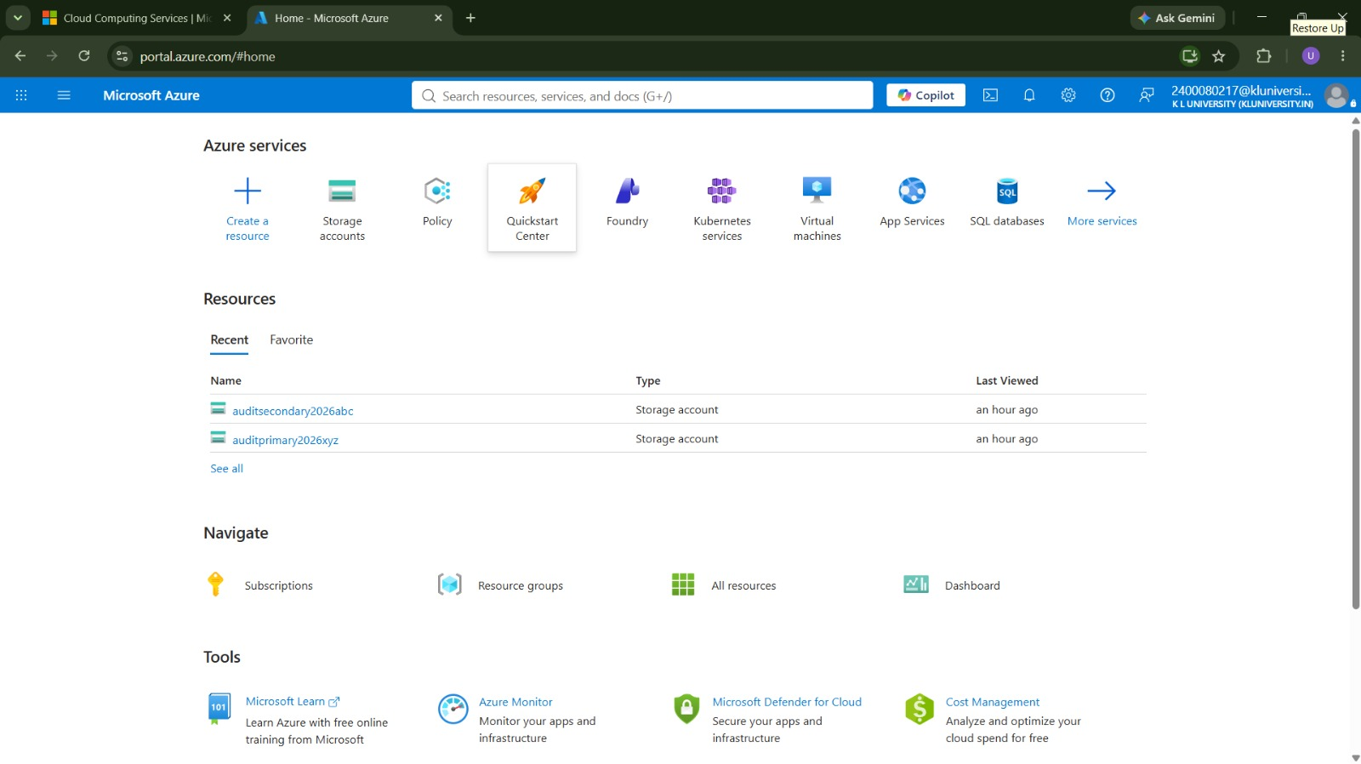

Slide 12
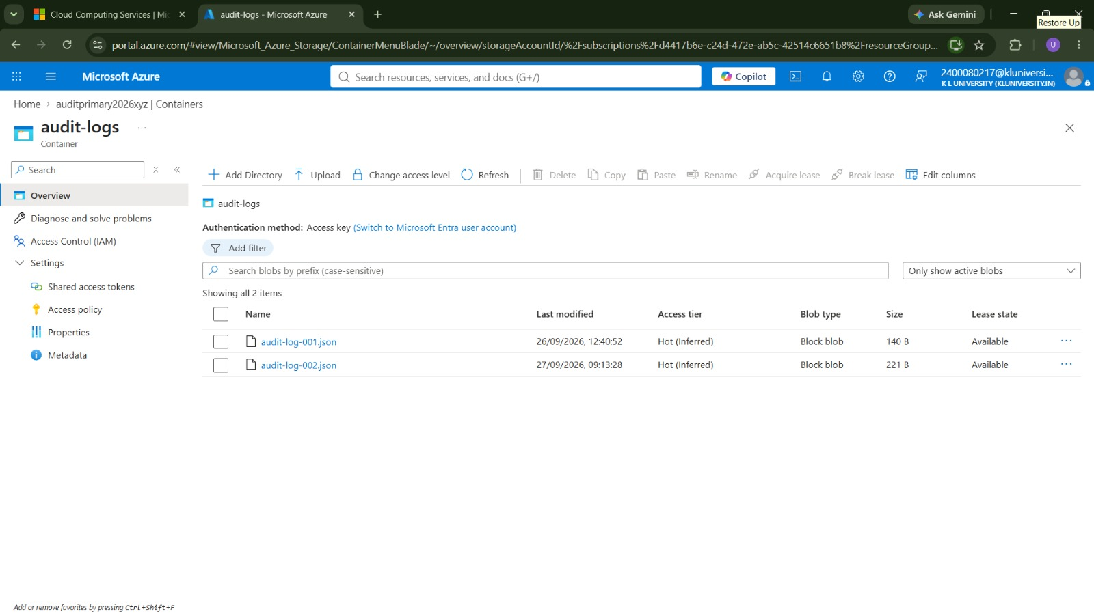
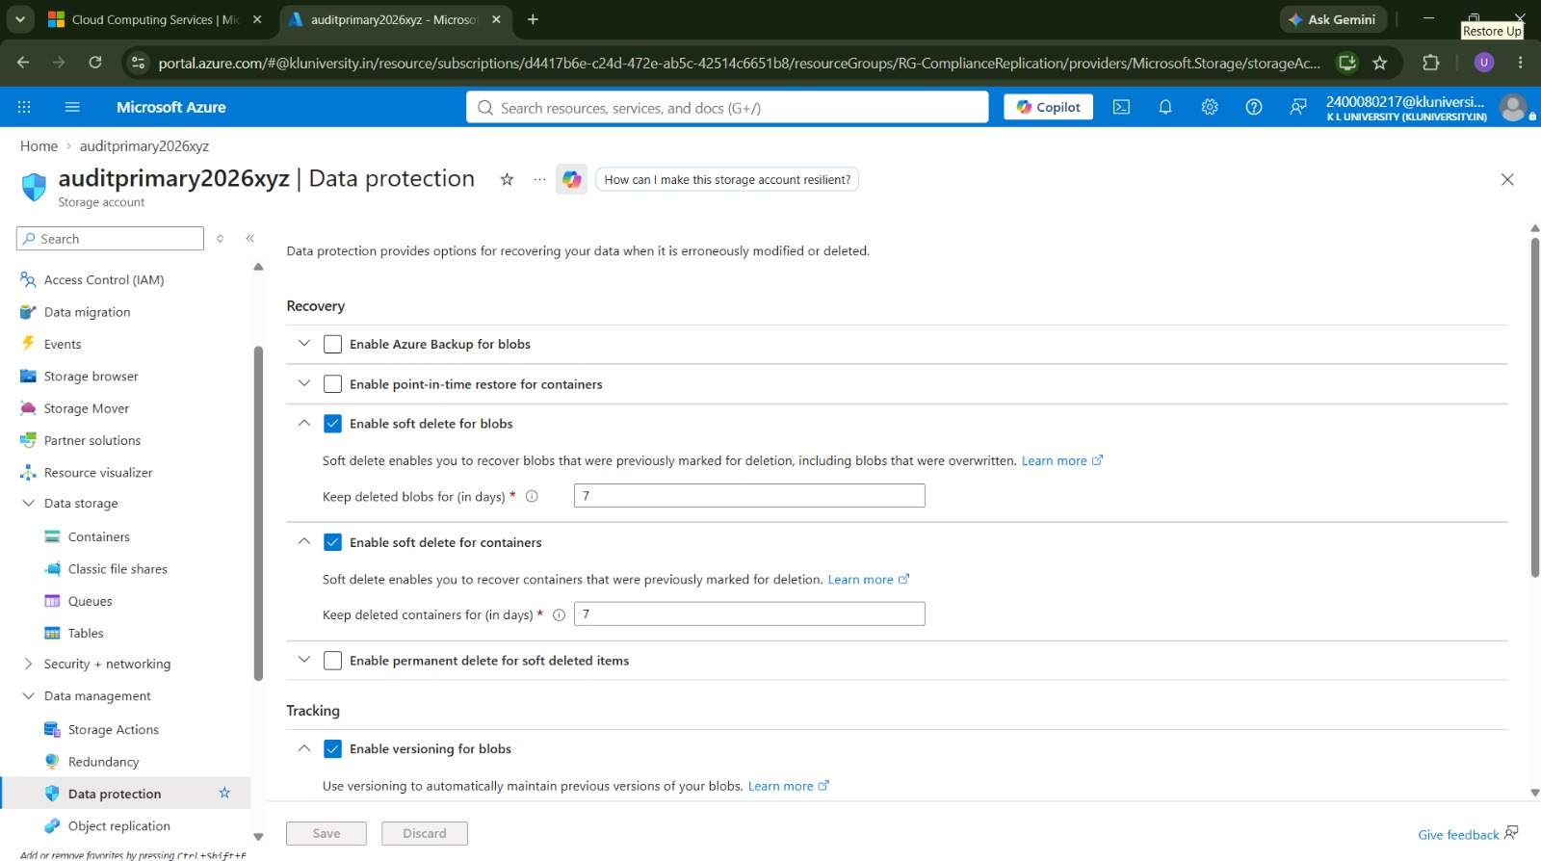

Slide 13
Conclusion
Azure Storage Object Replication provides an automated way to maintain copies of important blob data.
Using separate storage accounts and regions helps reduce the risk associated with regional failures.
The approach supports compliance-oriented data protection, availability, monitoring, and disaster recovery.
The architecture can be extended with dashboards, alerts, automation, RBAC, retention controls, and enterprise integrations.
10

