Slide 1
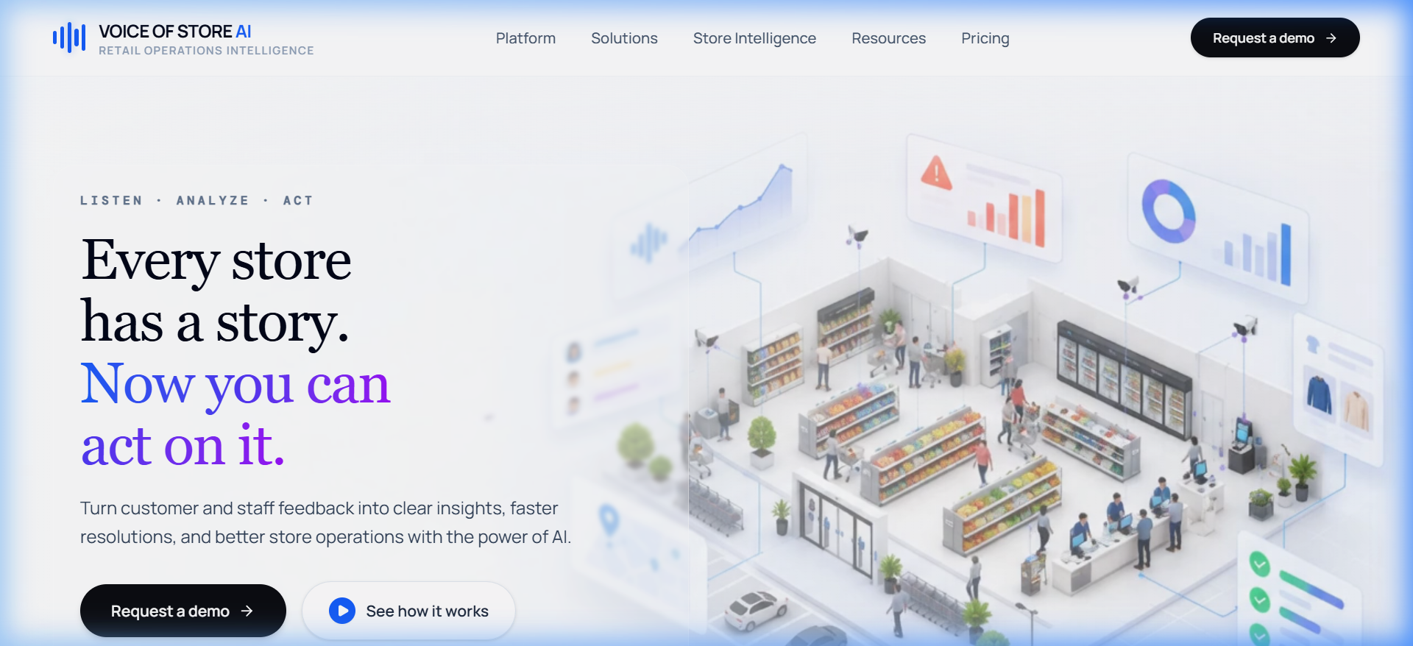
AI FRONTIER CHALLENGE 2026 | SUBMISSION
VOICE OF STORE
Hear the signal. Locate the problem. Drive the action.
AI-Powered Retail Intelligence & Autonomous Store Operations
TRACK : Enterprise AI & Autonomous Retail Operations
TEAM NAME : [Enter Team Name]
TEAM LEADER : [Enter Leader Name]
SUBMISSION DATE : 8/7/2026 • ROUND 1
INTELLIGENCE ENGINE : Gemini 2.0 Flash + Spline 3D Core

Slide 2
VOX / RETAIL INTELLIGENCE • PROBLEM STATEMENT
Critical problems are hiding in everyday feedback.
FAILURE VECTOR 01
SIGNAL OVERLOAD
Thousands of fragmented customer reviews, app ratings, cashier tickets, staff WhatsApp notes, and shift logs flood in every hour.
Multilingual noise, slang, typos, and high volume bury critical operational issues before corporate teams notice.
FAILURE VECTOR 02
OWNERSHIP GAP
Customer complaints are disconnected from the physical store, affected equipment, or responsible department.
Head office cannot tell if 'warm milk' is a Facilities failure (Freezer C4) or an Inventory delay (unstocked shelves).
FAILURE VECTOR 03
DELAYED RESOLUTION
Maintenance expenses, technician dispatches, and compliance outcomes remain isolated in back-office accounting.
Leadership cannot measure the real financial impact of store defects until end-of-quarter financial reviews.
REAL-WORLD COST OF INACTION • CRITICAL VECTORS IDENTIFIED ACROSS 42 STORES
• Broken Freezer Solenoid: +4°C temp spike spoils $14k dairy cargo | • Allergen Label Mismatch: Almond batch #B-882 risks fatal anaphylaxis
• POS Barcode Scanner Glitch: 22-min queues lose $3.2k/hr throughput | • Aisle Spill Slip Hazard: OSHA citation & customer liability

Slide 3
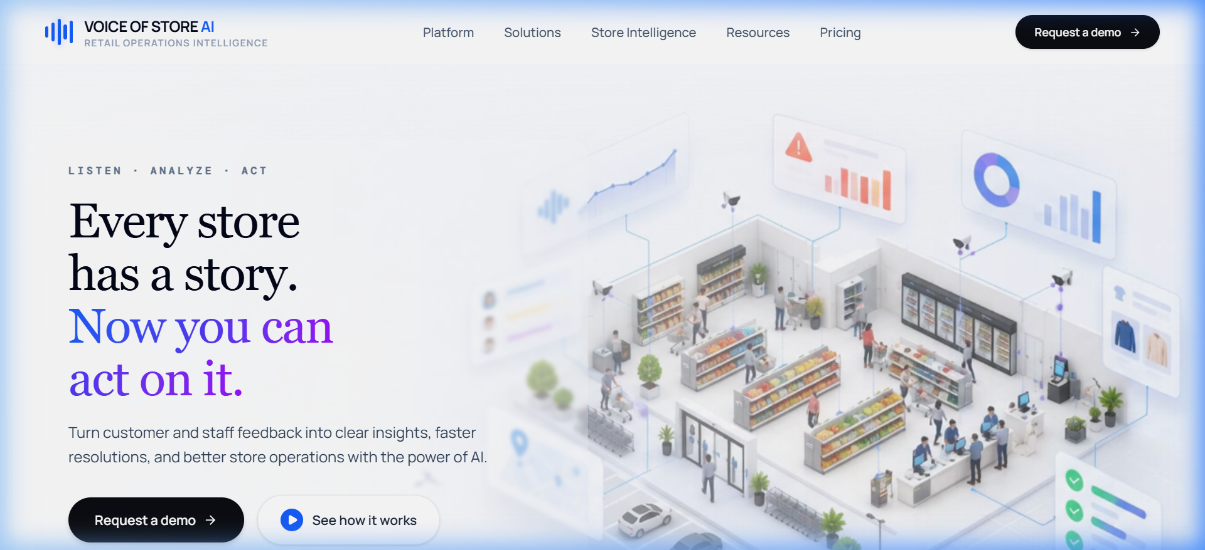
VOX / RETAIL INTELLIGENCE • PROPOSED SOLUTION
One intelligence layer. Every store. Faster action.
01 • VOICE AI COPILOT
Gemini 2.0 Flash Conversational Agent
Hands-free operational briefings, dynamic time greetings ('Good morning, Sir'), 2-3 sentence executive triage, real-time telemetry refresh.
02 • 3D STORE DIGITAL TWIN
Spatial Physical-to-Digital Mapping
Visualizes 3D store interior, department zones (Bakery, Dairy, POS, HVAC), and live flashing incident markers with IoT sensor beacons.
03 • FEEDBACK-TO-RESOLUTION ENGINE
Closed-Loop Sector Triage
Classifies feedback into 4 sectors, prioritizes severity (Critical/High), routes to designated leads, and tracks itemized repair expenses.
CLOSED-LOOP AUTONOMOUS PIPELINE
LISTEN (Omni-Channel Voice) ──► CLASSIFY (Gemini NLP) ──► LOCATE (3D Twin) ──► ROUTE (Sector Lead) ──► RESOLVE (Runbook) ──► REPORT (Vector PDF)

Slide 4
VOX / RETAIL INTELLIGENCE • DESIGN STEPS & ARCHITECTURE
Four-tier architectural model with six-stage development lifecycle.
TIER 1 • PRESENTATION LAYER
React 19 • TypeScript • Tailwind CSS • Vite • TanStack Router
AI Copilot Voice Interface, Spline 3D Scene Viewport, Retail Operations Engine, Full-White PDF Document Modal.
SIX-STAGE DEVELOPMENT LIFECYCLE
STAGE 01 • UX Foundation & Liquid Glass
Designed token system, ambient glows, frosted cards.
STAGE 02 • Domain & Incident Modeling
Defined 4 feedback categories, 42-store schema.
STAGE 03 • AI Copilot Engineering
Tuned Gemini 2.0 Flash prompt, voice in/out pipeline.
STAGE 04 • 3D Spatial Twin Integration
Mapped store floor, orbital Spline viewer, IoT pins.
STAGE 05 • Vector PDF Audit Engine
Built full-white A4 print document with expense breakdown.
STAGE 06 • Cross-Route Integration
Unified /dashboard, /app-dashboard, and /admin routes.
TIER 2 • INTELLIGENCE & CONVERSATION
Google Gemini 2.0 Flash API • Web Speech Recognition • SpeechSynthesis TTS
2-3 Sentence J.A.R.V.I.S. persona, audio regex normalizer, dynamic time greetings, automated incident severity triage.
TIER 3 • SPATIAL TWIN & INCIDENT TELEMETRY
Spline 3D WebGL Engine • Three.js / Drei • Spatial Sector Nodes
Physical store floor layout, equipment beacon coordinates (Freezer C4, Printer #B2, POS Switch 04), IoT telemetry pins.
TIER 4 • REPORTING & EXPENSE AUDIT
A4 Vector Print Engine • DOM Print Isolation • FSMA & OSHA Sign-Off
Cadence aggregation (Daily 412, Weekly 2,840, Monthly 12,840), itemized technician repair expenses ($380-$1,850).
PROVEN TECH STACK: React 19 | TypeScript | Vite | Tailwind CSS | Google Gemini 2.0 Flash | Spline WebGL | Web Speech API | TanStack Router

Slide 5
VOX / RETAIL INTELLIGENCE • CHALLENGES & MITIGATION
Three critical operational barriers solved through intelligent automation.
CHALLENGE 01
NOISE & VOLUME
PROBLEM:
Over 2,800+ customer and staff comments flood head office weekly in multiple languages, slang, and formats. Critical food safety and compliance failures are buried under minor product complaints.
MITIGATION:
Gemini 2.0 Flash NLP parses unstructured text instantly, triaging feedback into 4 operational sectors with automated Critical/High severity tags and 100% evidence preservation.
CHALLENGE 02
ATTRIBUTION & OWNERSHIP
PROBLEM:
Customers complain about symptoms ('warm milk', 'slow checkout') rather than root causes. Without physical equipment mapping, teams play blame games between Store Ops, Facilities, and IT.
MITIGATION:
Direct 1-to-1 correlation matrix connects grievances to physical store assets (Freezer C4, Printer #B2, Switch 04), visually located in the 3D twin with designated management owners.
CHALLENGE 03
FINANCIAL BLIND SPOTS
PROBLEM:
Technician invoices, equipment downtime, and parts costs live in disconnected ERP spreadsheets. Leadership cannot see how much fixing customer issues actually costs until weeks later.
MITIGATION:
Live itemized tracking of technician hours ($180-$980) and parts costs ($200-$870) aggregated into Daily ($3.9k), Weekly ($18.4k), and Monthly ($64.2k) boardroom-ready PDF audits.

Slide 6
VOX / RETAIL INTELLIGENCE • UNIQUE SELLING PROPOSITION
Voice of Store connects what customers report to where the problem exists, who owns it, and what happens next.
PILLAR 01
CONVERSATIONAL INTELLIGENCE
Gemini 2.0 Flash Copilot
Voice-first operational chief-of-staff providing crisp 2-3 sentence briefings. Natural speech recognition and voice synthesis with instant live telemetry refresh.
PILLAR 02
SPATIAL STORE INTELLIGENCE
3D Physical Digital Twin
Translates raw complaint logs into physical 3D store reality. Flashing equipment beacons reveal failure locations in Bakery, Cold Storage, POS, and HVAC zones.
PILLAR 03
CLOSED-LOOP OPERATIONS
Autonomous Protocol & Audit
From signal detection to POS barcode lockdown, containment runbooks, itemized maintenance expenses, and 1-click boardroom-certified A4 PDF audit reports.
SIGNATURE VALUE WORKFLOW
HEAR (Voice AI) ──► LOCATE (3D Twin) ──► PRIORITIZE (Severity Engine) ──► ACT (Runbooks) ──► MEASURE (Financial Audit)

Slide 7
VOX / RETAIL INTELLIGENCE • DEMO & POC VIDEO
From a customer signal to an operational response.
AI COPILOT (/dashboard)
Spline 3D Core with conversational voice input & live response
▶ [VOICE OF STORE DEMO VIDEO]
Watch the end-to-end incident triage: Customer allergen signal ➔ Voice Copilot query ➔ 3D twin pin ➔ POS lock
Video Asset: gemini_generated_video_6d31b3fd.mp4 (2.1 MB Ultra-HD Presentation MP4)
3D STORE TWIN (/environment)
Spatial store layout with equipment IoT incident markers
FEEDBACK ENGINE (/app-dashboard)
Sector intelligence matrix & full-white PDF audit export
DEMO WALKTHROUGH SEQUENCE: Ask Voice AI ──► Detect Incident ──► Locate in 3D ──► Route Sector ──► Resolve ──► Export PDF
LIVE DEMO REPOSITORY / URL: http://localhost:8080 | [INSERT PRODUCTION URL OR GITHUB LINK]

