Slide 1
DESIGN AND ANALYSIS OF ALGORITHMS
PACKAGE - CHINESE POKER
USING GREEDY APPROACH
- Shyam 20PW34
- Karthik 20PW15

Slide 2
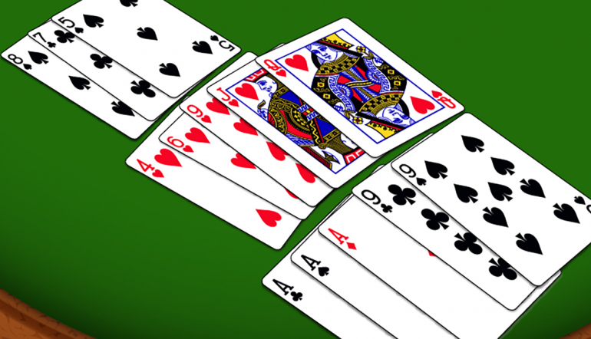
RULES
A deck of 52 cards is distributed, A player gets 13 cards.
Cards have points.
The 13 cards haS to Be arranged in 3,5,5 sequences.
High priorities are given to straights, pairs and high value cards.

Slide 3
ARRANGEMENT
Straight – 5 consecutive cards (8c,9d,10d,jc,qh,ks)
Pair – 2 cards of same points (4d,4c)
High value card – card with highest point among other cards

Slide 4
POINTS DISTRIBUTION
2=>2
3=>3
.
.
.
10=>10
J=>11
Q=>12
K=>13
A=>14

