Slide 1
IBM University Engagement Project Submission
“Exploring the Power of Agentic AI with IBM Granite and LangFlow”

Slide 2

Project Tile – Interview Trainer Agent
Domain of Project – Education
Student Name | Recent Passport Photo | Email ID | Mobile number [WhatsApp]
Mannem Karthik |  | Mannemkarthik30@gmail.com | 9440477558
Collage Name – Mohan Babu University

Slide 3
Problem Statement -
Problem Statement : Interview Trainer Agent
The Challenge:
An Interview Trainer Agent, powered by RAG (Retrieval-Augmented Generation), prepares users for job interviews by generating tailored question sets and preparation strategies based on their profile name, experience level, and job role. It retrieves role-specific interview questions, industry expectations, behavioral scenarios, and HR guidelines from recruitment portals, professional networks, and company interview databases. Users can input their resume or job title, and the agent provides targeted questions, model answers, and improvement tips.
It supports both technical and soft skill assessment, ensuring a comprehensive interview prep experience. This AI-driven assistant builds user confidence, sharpens responses, and increases success rates in
competitive hiring environments.
Objective:
To develop an AI-powered Interview Trainer Agent using IBM Granite and Retrieval-Augmented Generation (RAG) on IBM Cloud Lite that delivers personalized interview preparation by generating role-specific interview questions, model answers, behavioral scenarios, HR guidance, and improvement suggestions based on a user's resume, job title, and experience level.

Slide 4
Proposed Solution - Proposed Solution: AI-Powered Interview Trainer
Overview:
Our solution is an AI-powered Interview Trainer Agent developed using IBM Build on IBM (BOB) and IBM Granite Foundation Models on IBM Cloud Lite. The platform provides an intelligent and personalized interview preparation experience by adapting interview questions according to the candidate's job role, experience level, and interview type.
The application begins by collecting the candidate's profile information and generating a customized interview session. Throughout the interview, IBM Granite evaluates each response in real time by analyzing technical accuracy, relevance, clarity, and completeness. Along with detailed feedback, the system also generates an ideal answer for every question, enabling users to compare their responses with industry-standard expectations and identify areas for improvement.
After completing the interview, the platform automatically calculates performance scores and presents a comprehensive interview summary, highlighting strengths, weaknesses, and overall readiness. This continuous feedback mechanism helps candidates improve both technical knowledge and communication skills through repeated practice.
Built using Flask, IBM Granite APIs, and IBM Build on IBM, the solution delivers a scalable, AI-driven interview coaching platform that simulates realistic interview scenarios, provides instant evaluation, and enables candidates to prepare confidently for technical, HR, and mixed interview rounds while significantly improving their chances of success in competitive hiring processes.

Slide 5
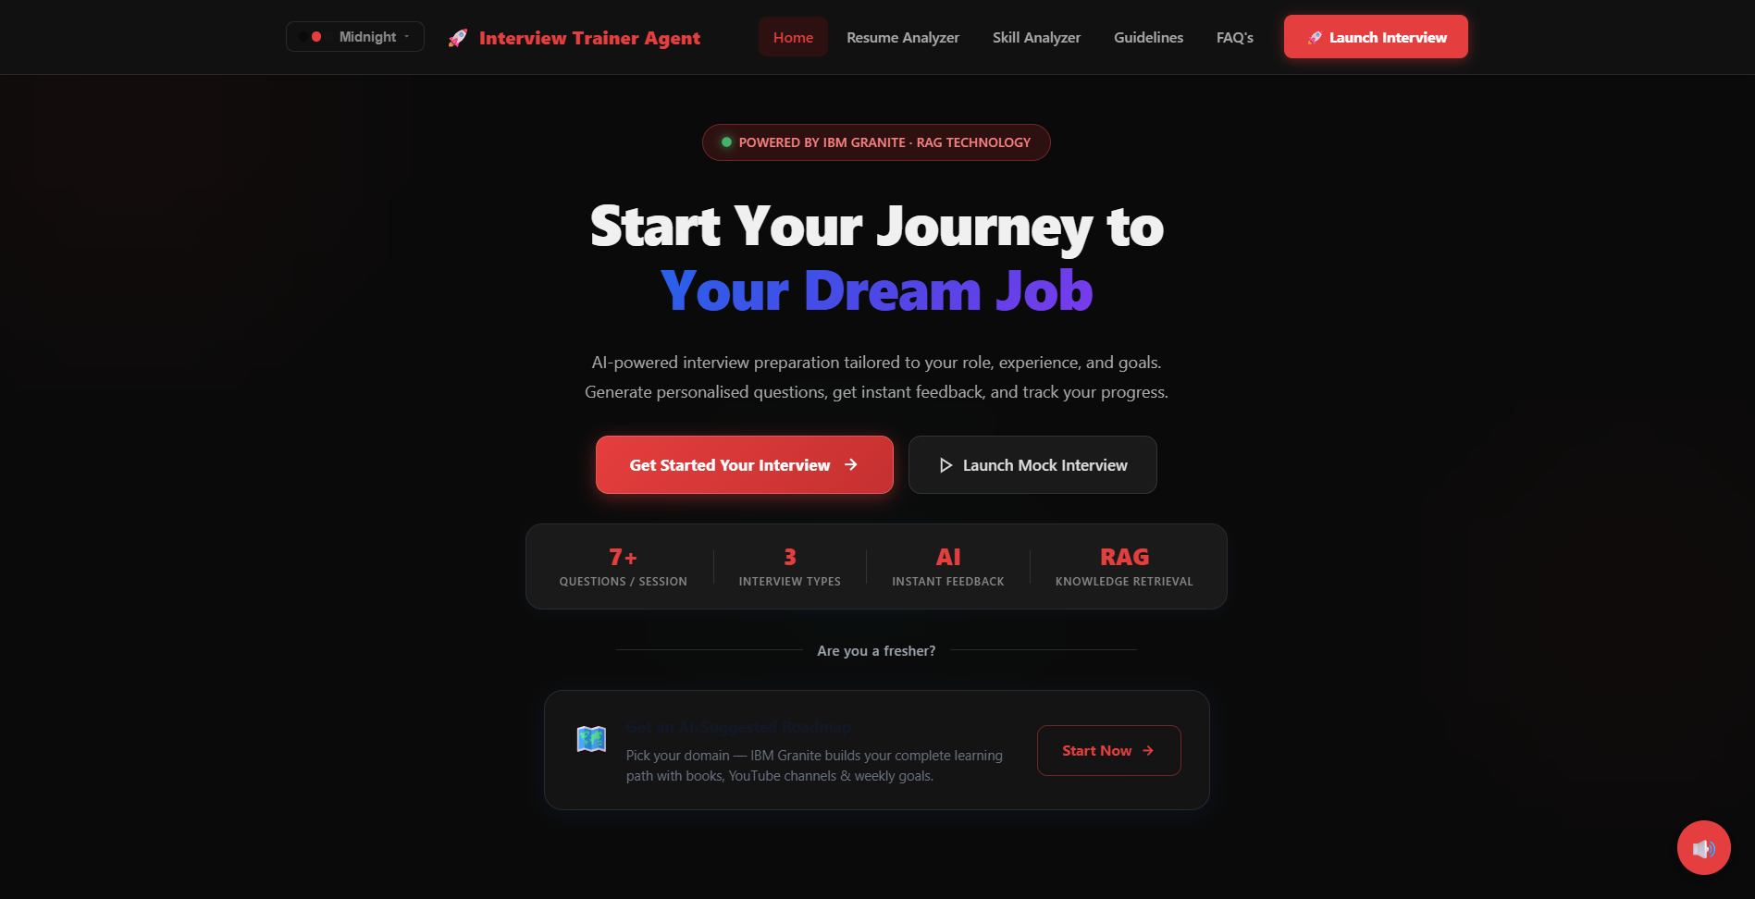
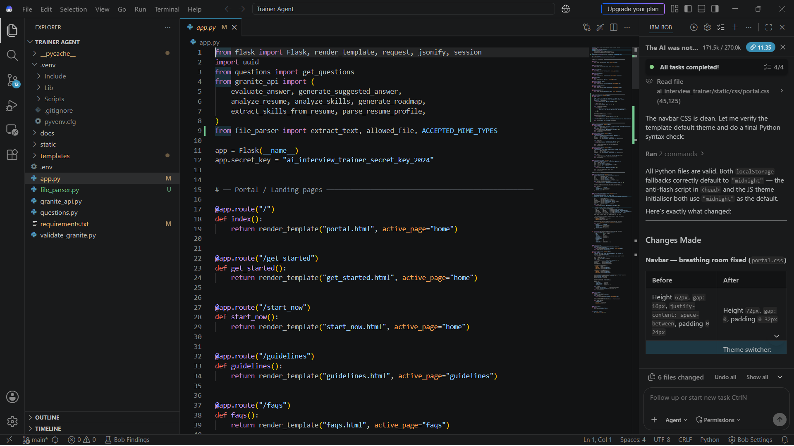
Interview Trainer Agent Dashboard
IBM Bob

Slide 6
Technology Used
IBM Build on IBM (BOB) – Used to design, develop, and orchestrate the AI-powered Interview Trainer Agent with an intuitive workflow and seamless integration of IBM AI services.
IBM Granite Model (Granite 13B Chat V2) – Powers intelligent interview question generation, answer evaluation, personalized feedback, and interview performance analysis using advanced natural language understanding and reasoning.
IBM Cloud Lite – Provides a secure, reliable, and scalable cloud environment for hosting and deploying the Interview Trainer Agent while enabling easy access to IBM AI services.
Generative AI – Generates role-specific technical, HR, and behavioral interview questions, model answers, and personalized improvement suggestions based on the candidate's profile.
Flask (Python) – Serves as the backend framework for handling user requests, managing interview sessions, processing responses, and integrating with IBM Granite APIs.
HTML, CSS & JavaScript – Used to build a responsive and user-friendly web interface that allows candidates to interact with the Interview Trainer Agent seamlessly.
Hosting Runtime – Render Platform Deployment

Slide 7
Langflow component Used -
1) Chat Input – Allows users to enter their job role, experience level, interview type, or upload their resume to begin a personalized interview session.
2) IBM watsonx AI Agent – Processes the user's profile and leverages IBM Granite to generate intelligent interview questions, evaluate responses, and provide personalized feedback.
3) IBM Granite Model (Granite-3.3-8B-Instruct / Granite-4.0) – Used for interview question generation, answer assessment, model answer generation, and performance analysis through advanced natural language understanding.
4) Chat Output – Displays AI-generated interview questions, evaluation scores, model answers, improvement suggestions, and the final interview summary.
5) File Component – Enables candidates to upload their resume (PDF/DOCX), allowing the agent to analyze skills, experience, and generate role-specific interview questions.
6) Prompt Template / System Prompt – Defines the interview flow, evaluation criteria, scoring methodology, and response format to ensure consistent and accurate AI-generated outputs.

Slide 8
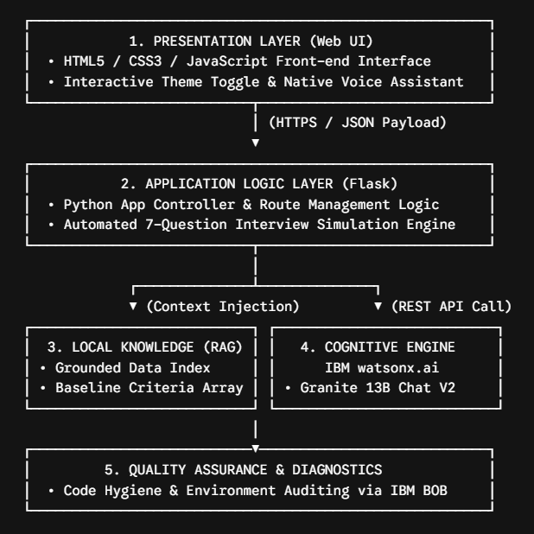
Architecture Blueprint

Slide 9

Role of Agentic AI in the solution
Autonomous Multi-Agent Coordination: Shifting from a basic chat interface to an independent system where specialized processes complete distinct phases automatically:
*The Profile Capture Agent registers user targets and calculates background baselines.
*The Evaluation Agent scores answers independently, extracting metric scores based on required context keywords.
*The Curating Road mapping Agent identifies user deficiencies, instantly parsing educational video arrays and literature references to address gaps.
Proactive Assistance: Interacts directly with the user, pacing the interview structure seamlessly step-by-step.

Slide 10
Responsibilities
✔ Generates interview questions
✔ Evaluates answers
✔ Detects missing concepts
✔ Provides personalized feedback
✔ Analyzes resumes
✔ Suggests missing skills
✔ Generates career roadmap
✔ Recommends learning resources
✔ Improves interview confidence
IBM Granite acts as the reasoning engine while RAG retrieves accurate interview knowledge from trusted sources.

Slide 11
Novelty and Uniqueness
The proposed Interview Trainer Agent stands out by combining Agentic AI, RAG, and personalization into a single intelligent system.
7-Question Comprehensive Mock Test: Simulates structured live evaluation checkpoints tracking answers, grading accuracy automatically, and assigning targeted scores along with Feedback.
AI Resume Analyzer & Skill Scorer: Critiques credentials against competitive global domains, delivering explicit alignment scores and necessary optimizations.
Interactive Fresher Roadmaps: Curates personalized learning loops complete with directly accessible YouTube courses and expert-recommended textbooks.
Integrated Voice Assistant: Boosts accessibility by reading out headings, questions, and essential evaluation points aloud.
Eye Comfort Visibility Toggle: Features a dynamic theme-switching control to adjust user workspace aesthetics effortlessly.

Slide 12
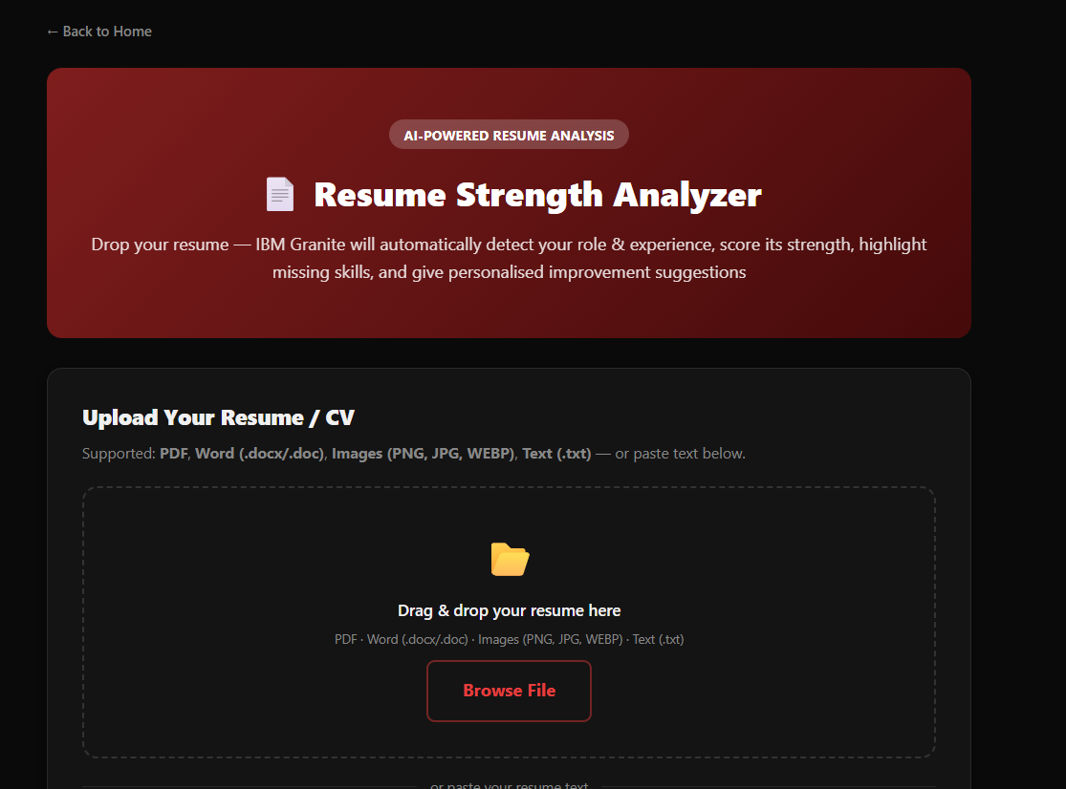
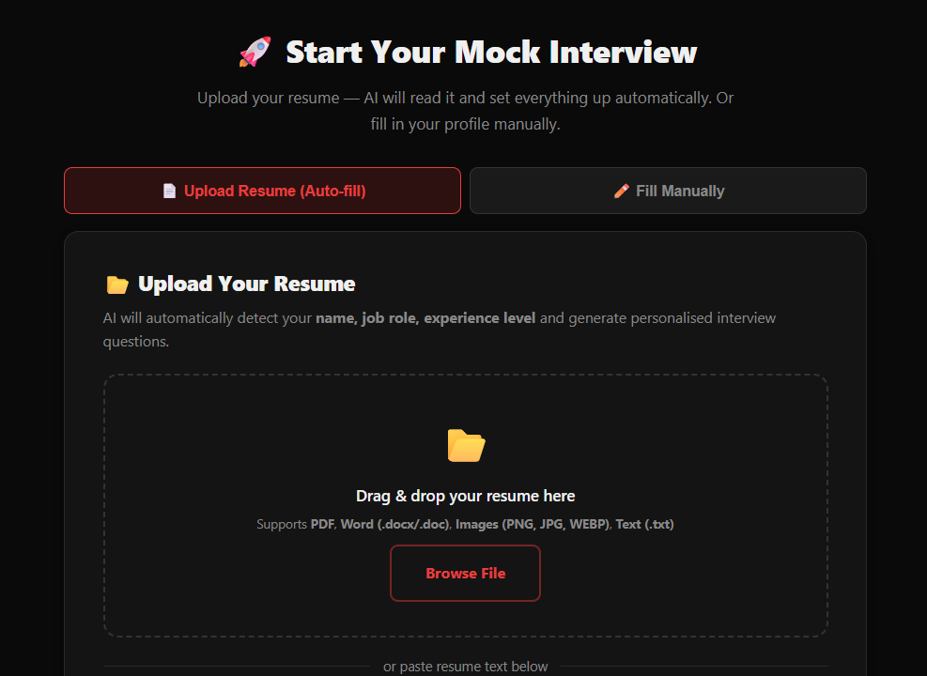
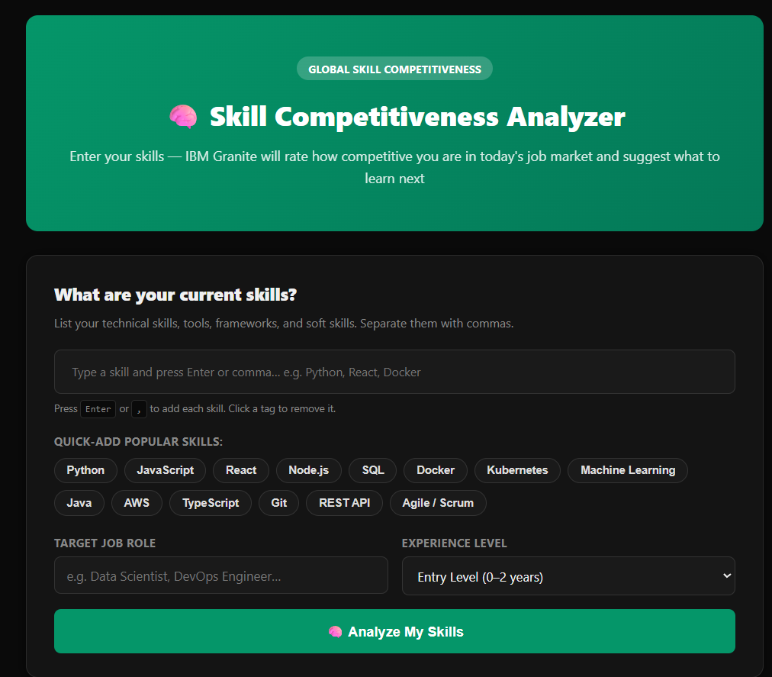
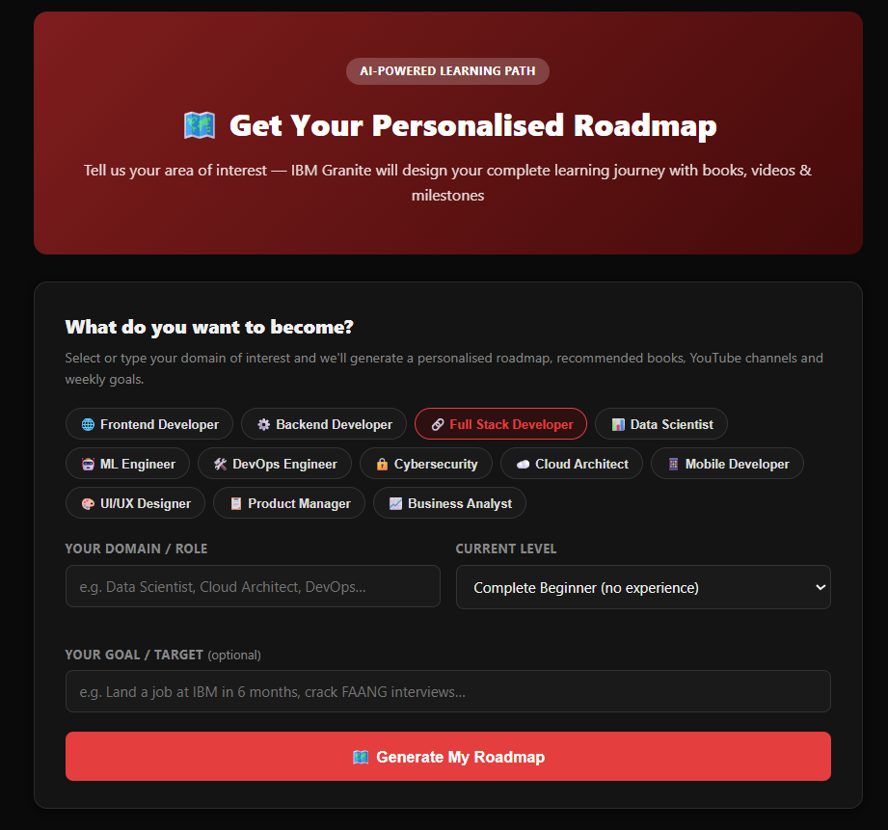

Slide 13
Future Scope
The Interview Trainer Agent can be further enhanced by introducing AI-powered live mock interviews with voice interaction, enabling students to practice real-time HR and technical interviews. The system can analyze speech clarity, confidence, communication skills, pronunciation, and body language (through webcam integration) to provide detailed performance reports. Additionally, company-specific interview preparation can be incorporated by generating customized question sets based on recruitment patterns of organizations such as TCS, Infosys, Accenture, Amazon, and Google, helping students prepare more effectively for their target companies.
Another major enhancement is the integration of an Advanced Resume & Career Guidance System that includes ATS (Applicant Tracking System) compatibility analysis, LinkedIn profile evaluation, and personalized career recommendations. Based on the student's skills, interview performance, and career goals, the platform can automatically generate learning roadmaps, recommend certification courses, YouTube tutorials, books, and coding practice resources. These improvements will transform the Interview Trainer Agent into a comprehensive AI career mentor, providing end-to-end guidance from resume building to successful placement preparation.
·
·
·

Slide 14
Git Hub Link - https://github.com/Karthik-3006/Edunet_AICTE_Project.git
Live Link - https://edunet-aicte-project.onrender.com
·
·

Slide 15
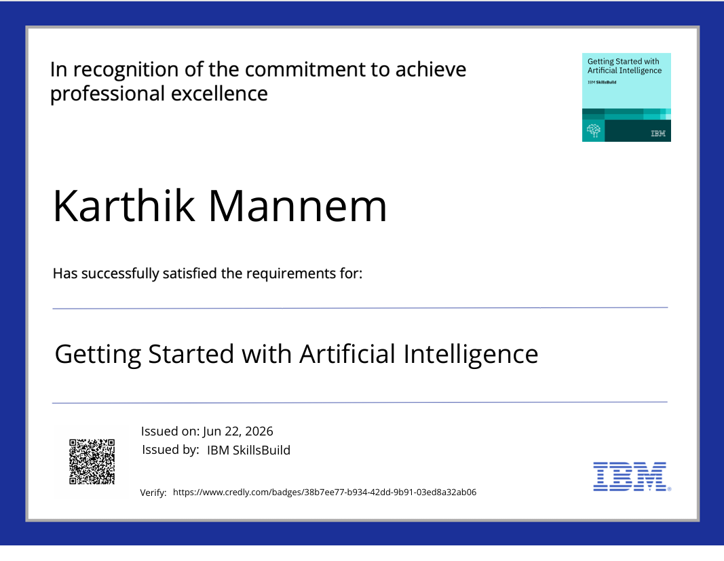
Certificates Earned:
Please add your credly certificate

Slide 16
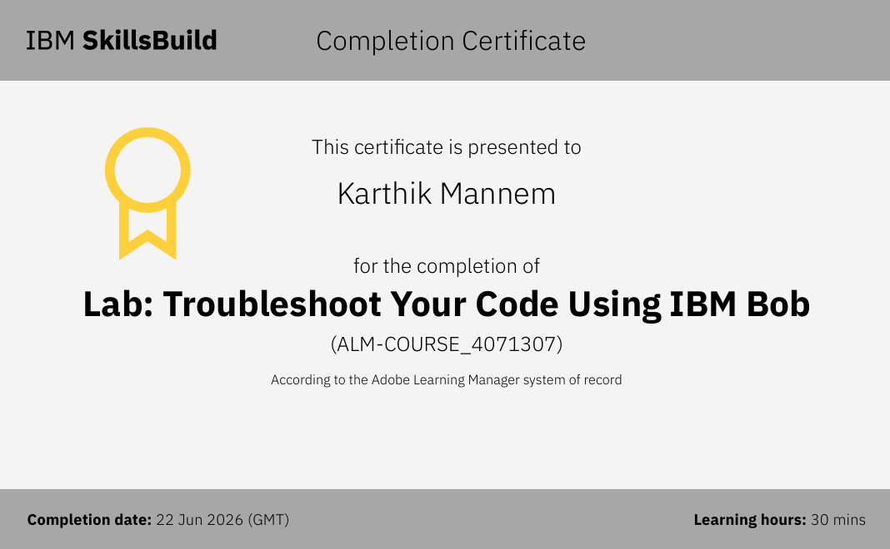
Certificates Earned:​
Add your IBM BOB Certificate

Slide 17
✨ THANK YOU! ✨

