Slide 1


NETWORK PROTOCOLS AND SECURITY
ACO IMPLEMENTATION IN WSN USING MATLAB
P. Karthik- 2320040019
S.D.M Vamsi-2320040032
K. Ram Charan Varma- 2320040040
G.V. Naga Jahnavi Yadav – 2320040026
Niharika reddy-2320040042

Slide 2

INTRODUCTION:
Wireless Sensor Networks (WSNs) are used for monitoring and communication in various applications like healthcare, smart cities, and environmental monitoring.
Efficient data routing is critical to minimize energy consumption and extend the network lifespan.
This project implements Ant Colony Optimization (ACO) in MATLAB to find an optimal energy-efficient path for data transmission.
The proposed method helps in reducing energy consumption, enhancing network performance, and improving communication efficiency in WSNs.

Slide 3
Problem Statement
Wireless Sensor Networks (WSNs) consist of multiple sensor nodes that collect and transmit data. However, energy consumption is a major challenge, as sensor nodes are battery-powered and have limited energy. Inefficient routing leads to energy depletion, network failure, and reduced lifespan of the WSN. Therefore, an optimized routing technique is required to ensure efficient data transmission with minimal energy consumption.

Slide 4
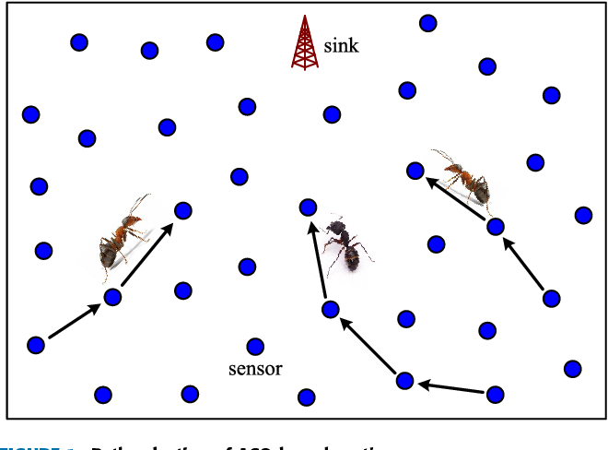

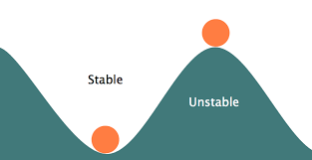
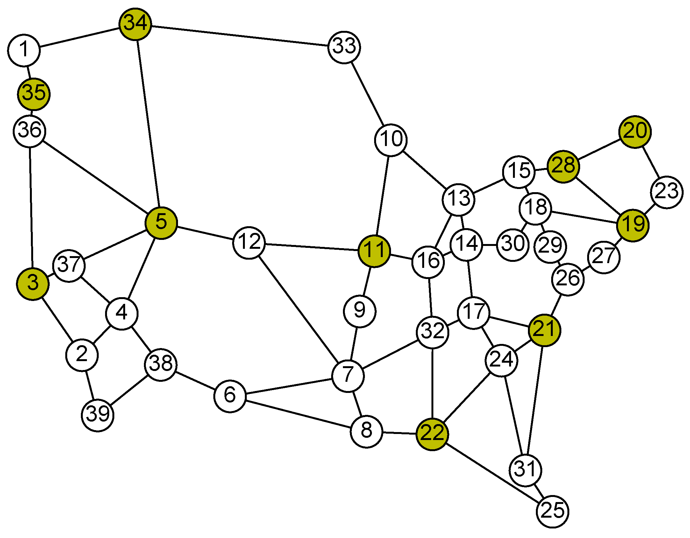
Objectives:
2. To minimize energy consumption during data transmission
1. To implement ACO for optimized routing
3. To allow routing for both stable and unstable nodes
4. To allow dynamic area and node selection

Slide 5
BLOCK DIAGRAM
Initialize Parameters
Generate Sensor Nodes
Visualize Network
Compute Distance Matrix
Start
Final Best Path Selection
Initialize Pheromone Levels
End
Save Results
Begin ACO Iterations

Slide 6
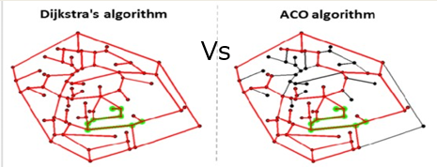
Why not other routing algorithms?
Now, let’s compare ACO with Dijkstra’s algorithm to understand their efficiency in routing. While Dijkstra finds the shortest path deterministically, ACO adapts dynamically and performs better in large-scale networks.
Dijkstra faces memory and time complexity issues as node count increases, while ACO handles large-scale networks efficiently.
ACO considers energy consumption, making it ideal for WSN applications, whereas Dijkstra focuses only on distance.
ACO dynamically adjusts paths based on network conditions, making it more robust in real-time applications.
ACO finds multiple efficient routes, reducing congestion and increasing network reliability.
Dijkstra selects a single shortest path, which can lead to overuse and network failures.

Slide 7
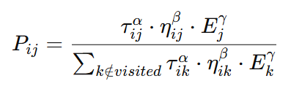

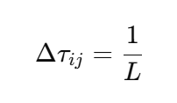
ACO FORMULAS
1. Transition Probability Formula
Used to determine the probability of an ant moving to a neighboring node.
probabilities = ((pheromone(current, :) .^ alpha) .* ...
((1 ./ (distances(current, :) + 1e-6)) .^ beta) .* ...
((energy ./ (max(energy) + 1e-6)) .^ gamma));
2. Pheromone Update Rule
Pheromone levels are updated using:
pheromone = (1 - decay) * pheromone;
if ~isempty(bestPath)
for i = 1:length(bestPath)-1
pheromone(bestPath(i), bestPath(i+1)) = pheromone(bestPath(i), bestPath(i+1)) + (1 / bestPathLength);
end
end

Slide 8
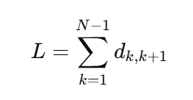

ACO FORMULAS
3. Path Length Calculation Formula
The total path length L is calculated as:
pathLengths(ant) = sum(distances(sub2ind(size(distances), path(1:end-1), path(2:end))));
4. Energy Consumption Calculation
Energy consumption is computed based on transmission and reception costs:
energyUsed = energyUsed + distances(current, nextNode) * transmissionCost + receptionCost;
energy(current) = max(energy(current) - distances(current, nextNode) * transmissionCost, 0);
energy(nextNode) = max(energy(nextNode) - receptionCost, 0);

Slide 9




USE CASES FOR OUR PROJECT
1)Wireless Sensor Networks (WSNs): A smart agriculture system with more moisture sensors consumes more battery power as each sensor collects and transmits data.
2)Mobile Communication Networks (5G/4G Towers):Expanding 5G coverage to rural areas requires more base stations, increasing energy consumption.
3)IoT Smart Homes: A home with 50 smart devices will use more power than one with only 10 devices.
4)Expanding a cloud service like Google Drive requires additional servers, which leads to higher electricity usage

Slide 10
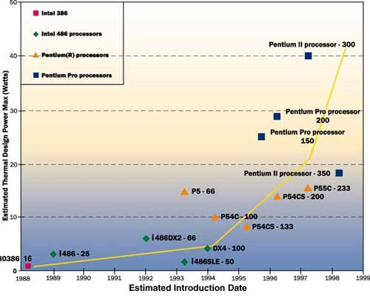
Power Consumption in Integrated Circuits (ICs) – Moore’s Law Perspective
According to Moore’s Law, the number of transistors on a chip doubles approximately every two years. This growth allows more complex processing and faster computing, but it also increases the density of components, leading to challenges like:
Higher power consumption
Thermal dissipation issues
Need for optimized routing of current and signals
When transistor count increases, the routing paths between transistors become more complex, and the design tools need to find energy-efficient pathways for data and signal transfer. This is similar to our ACO application, where nodes find the best path with minimal energy cost.
As per Moore's Law, the exponential increase in transistors in integrated
circuits leads to greater energy consumption due to denser interconnections
and complex signal routing. Just like in wireless sensor networks, more “nodes” result in higher power needs. Techniques like Ant Colony Optimization (ACO) are applicable in both domains to identify the most energy-efficient paths, thus reducing overall power consumption.

Slide 11
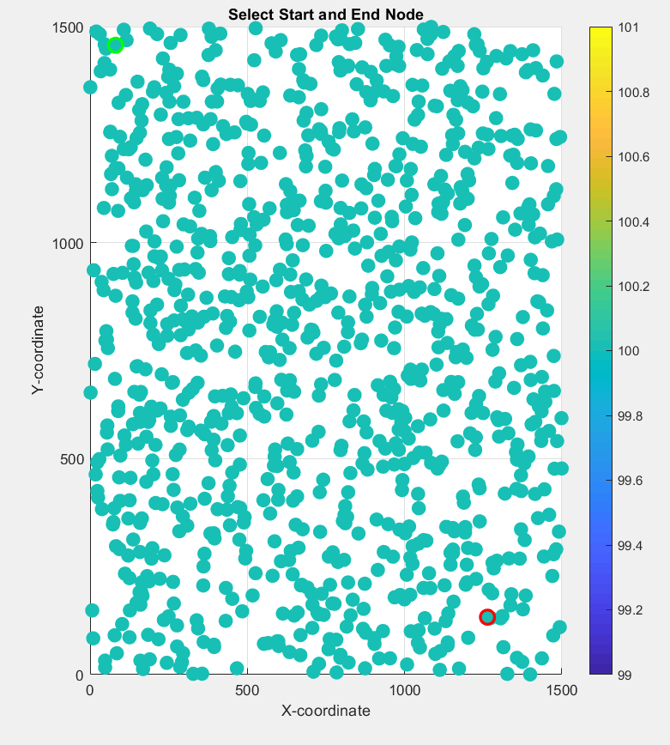
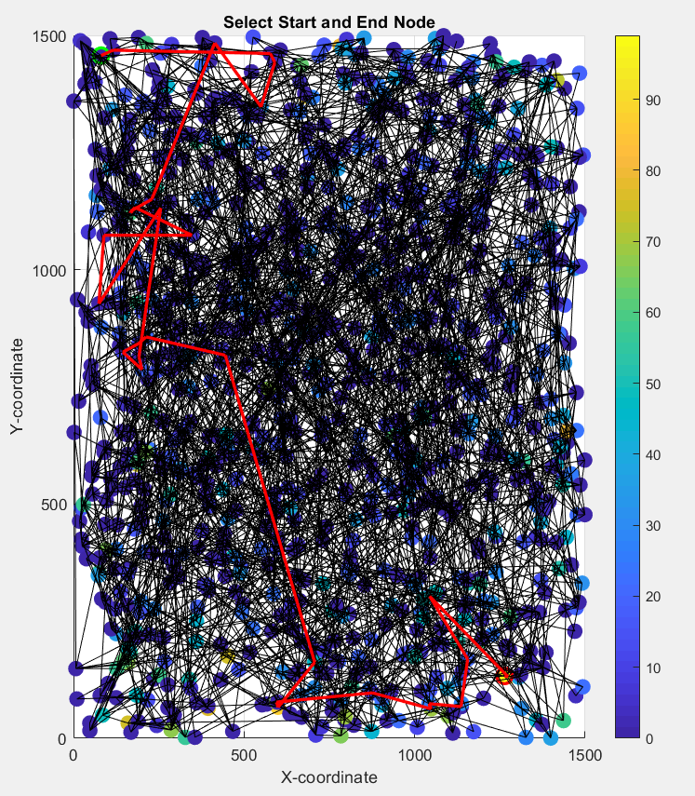
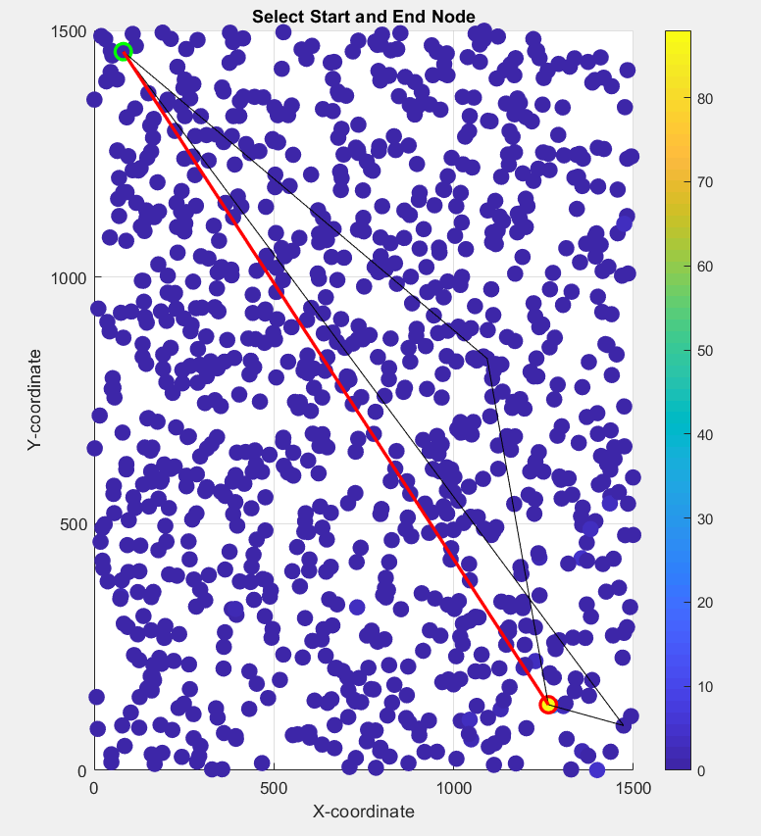
OUTPUT
For unstable nodes:
Figure 1:
Figure 2:
Figure 3:
()a
Selecting source and destination
Searching for the least energy path
Representation of the best path among 3

Slide 12
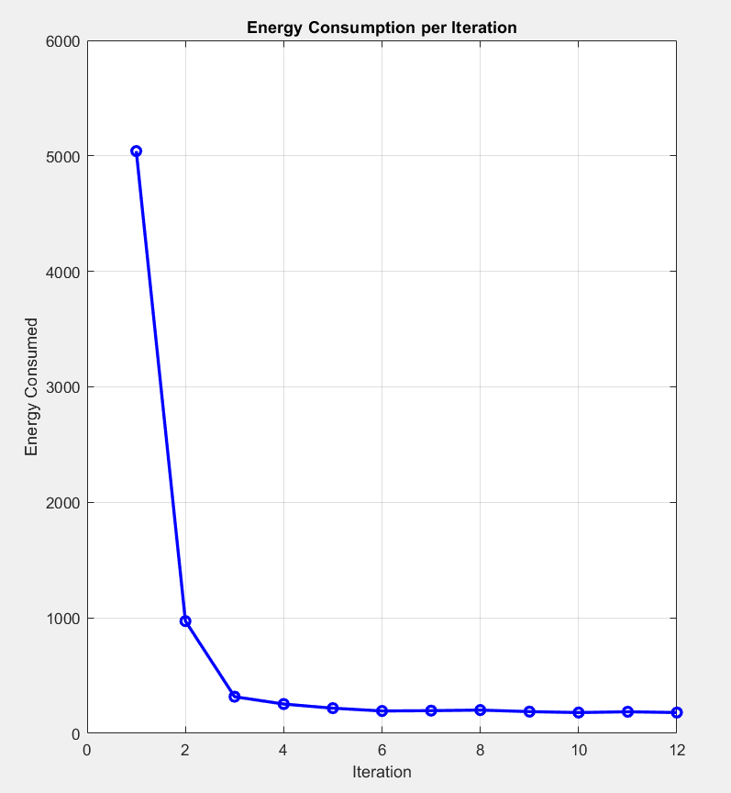
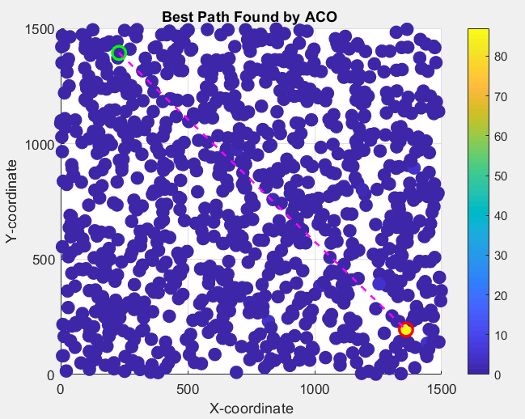
Figure 4:
Figure 5:
Graphical representation of energy consumption per iteration
Best Path found by ACO Algorithm

Slide 13
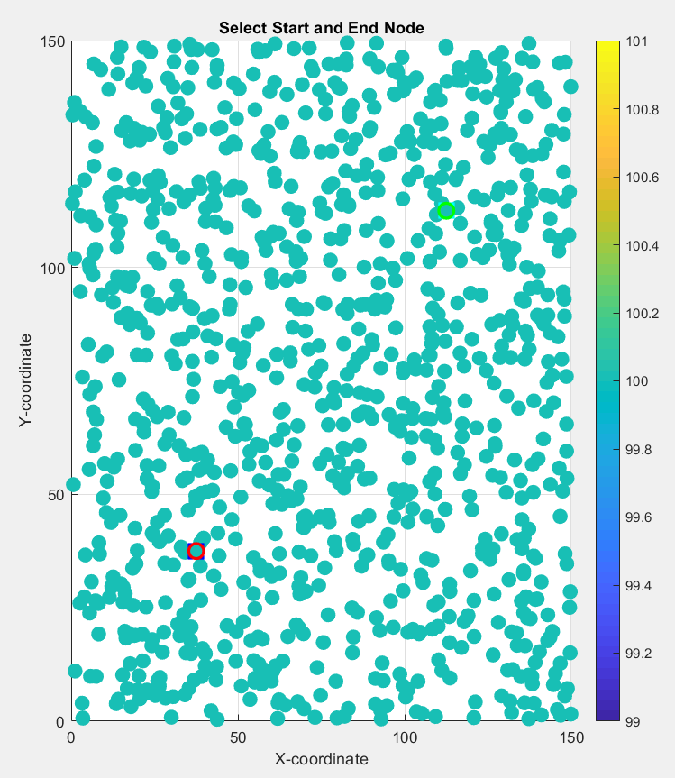
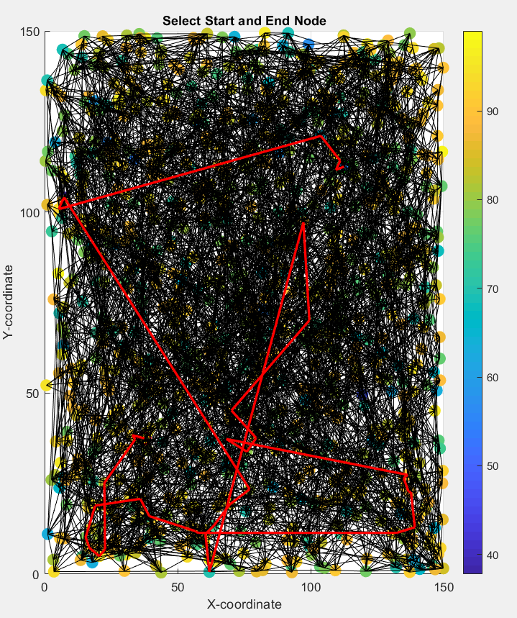
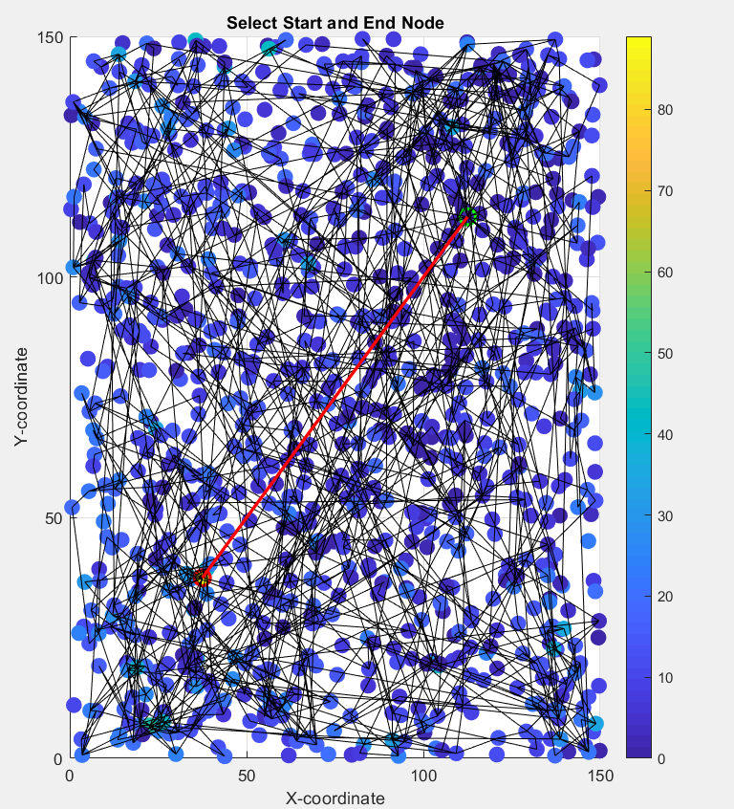
OUTPUT
For stable nodes:
Figure 1:
Figure 2:
Figure 3:
Selecting source and destination
Searching for the least energy path
Reducing the no. of paths after every iteration

Slide 14
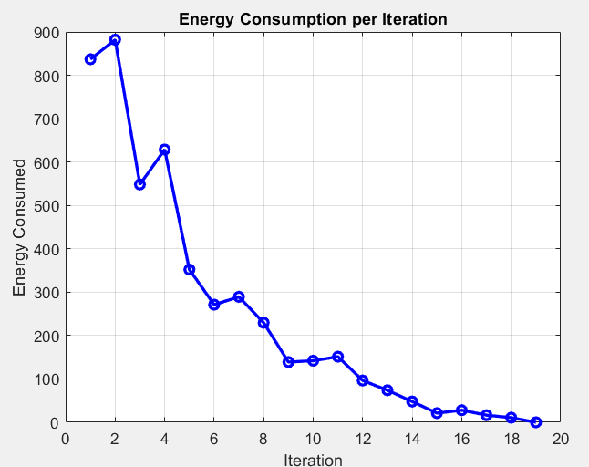
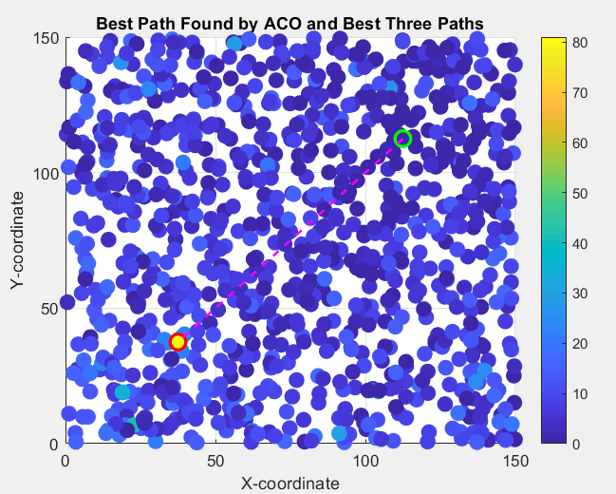
Figure 4:
Figure 5:
Graphical representation of energy consumption per iteration
Best Path found by ACO Algorithm

Slide 15

CONCLUSION
The implementation of Ant Colony Optimization (ACO) in Wireless Sensor Networks (WSN) demonstrates its effectiveness in finding optimized paths dynamically.
ACO, inspired by ant foraging behavior, efficiently discovers shortest and energy-efficient routes in a distributed manner.
It adapts to network changes and node failures, making it suitable for real-time applications.
The algorithm enhances network lifetime and performance by balancing load distribution across multiple paths.
Overall, ACO proves to be a robust and scalable solution for optimizing routing in WSNs.

Slide 16


