Slide 1
DESIGN AND IMPLEMENTATION OF 8-BIT PRNG USING VERILOG HDL
1. Internship Project at University of Hyderabad 2. Under Chip2Startup (C2S) Program 3. Centre for Advanced Studies in Electronics Science and Technology (CASEST) 4. School of Physics
By P. Karthik – 2320040019 R. Vinay Vardhan Naidu – 2320040117 Under the Esteemed Guidance of Samrat L. Sabat Sir

Slide 2



What is a random number ?
A random number is a number that is unpredictable and does not follow any fixed rule or pattern. Each time you generate a random number, the outcome is independent of the previous ones — making it impossible to guess what will come next.

Slide 3
Problem Statement : This project focuses on the design and implementation of a Pseudo-Random Number Generator (PRNG) capable of generating all 65,536 unique (x, y) 8-bit pairs using a deterministic logic-based approach. The objective is to ensure a repeatable, full-period pseudo-random sequence using minimal hardware resources and implement the design on an FPGA platform for verification and testing.
Generating random numbers from 1 to 256 is different from generating random pairs within the same range.
1 2 40 78 35 256
(1,2)
(2,4)
(3,6)
(4,8)
(5,10)
(6,12)
These are random numbers but not deterministic
These are random pairs and deterministic

Slide 4
Formula Used in PRNG Design
Step | hi=floor(step/256) | lo=step%256 | x=(hi+lo)%256 | y=(x+lo)%256
0 | f(0/256)=0 | 0%256=0 | (0+0)%256=0 | (0+0)%256=0
1 | f(1/256) = 0.003 =0 | 1%256=1 | (0+1)%256=1 | (1+1)%256=2
2 | f(2/256)=0.007=0 | 2%256=2 | (0+2)%256=2 | (2+2)%256=4
3 | f(3/256)=0.011=0 | 3%256=3 | (0+3)%256=3 | (3+3)%256=6
4 | f(4/256)=0.01=0 | 4%256=4 | (0+4)%256=4 | (4+4)%256=8
Pair
(0,0)
(1,2)
(2,4)
(3,6)
(4,8)
hi = floor(step/256) lo = step%256
x = (hi + lo) % 256 y = (x + lo) % 256
The same pattern will repeat only up-to step 127, because 128*2=256>255 (0-255)
256 | f(256/256)=1 | 256%256=0 | (1+0)%256=1 | (1+0)%256=1 | (1,1)
65536 | f(65536/256)=256 | 65536%256=0 | (256+0)%256=0 | (0+0)%256=0 | (0,0)
The same pattern will repeat from step 65536 as repeated up-to 65535 (256x256=65535)

Slide 5

How Can This Logic Be Realized as a Hardware Architecture?
?
?
hi = floor(step/256) lo = step%256
adder1
x = (hi + lo) % 256 y = (x + lo) % 256
adder2

Slide 6
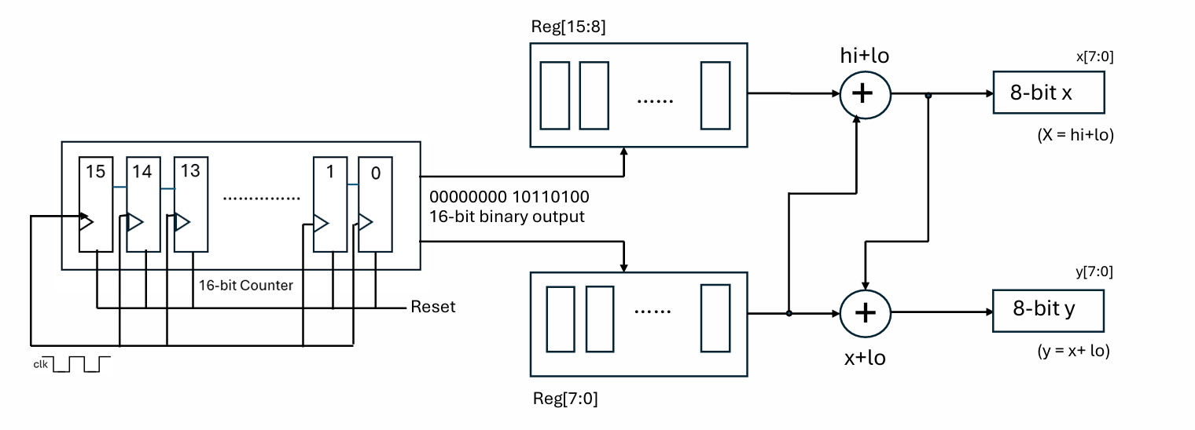
Architecture of 8-bit PRNG

Slide 7
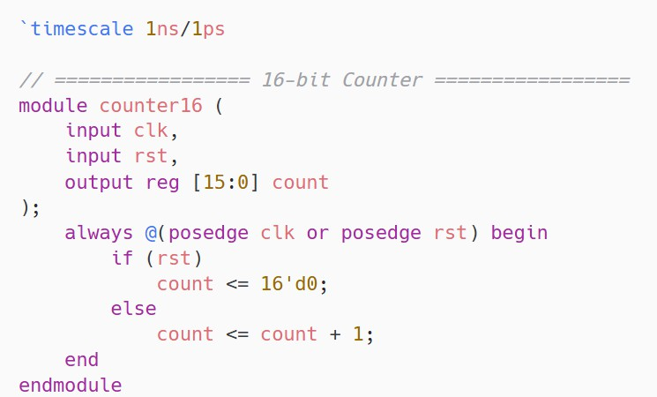
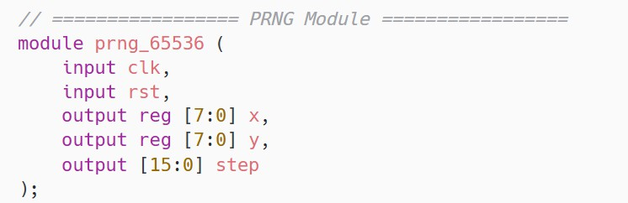
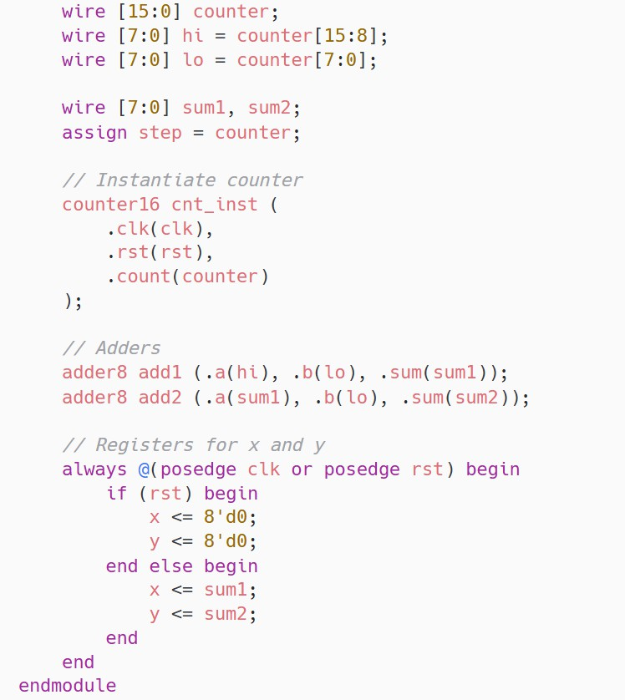
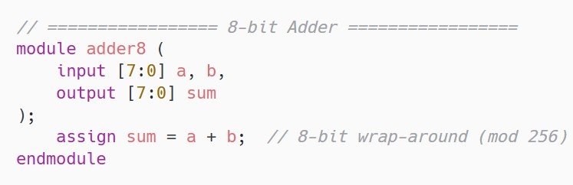
Verilog Code for PRNG Architecture

Slide 8
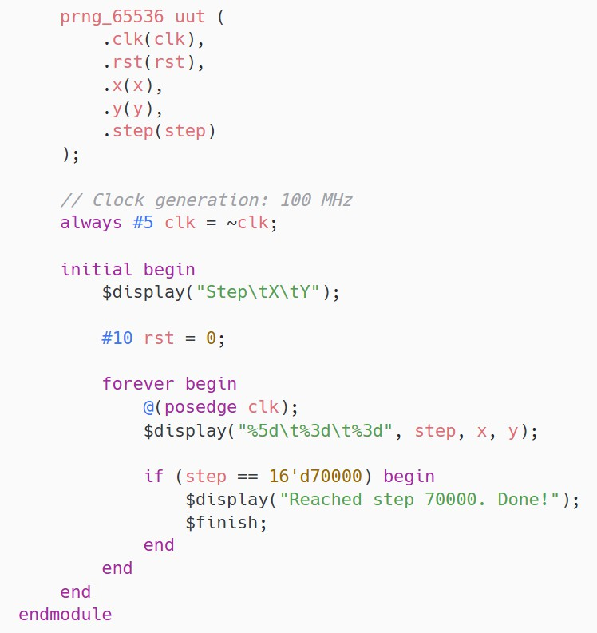
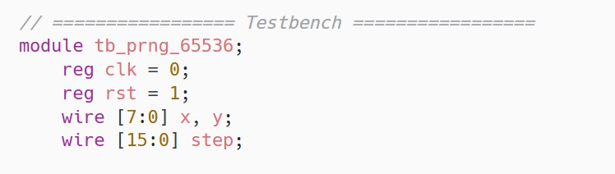

Slide 9
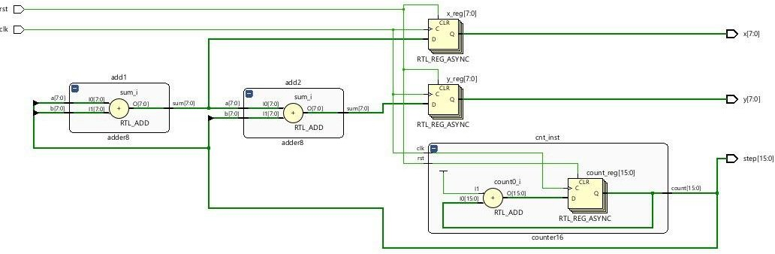
Architecture of 8-bit PRNG in Xilinx Vivado

Slide 10
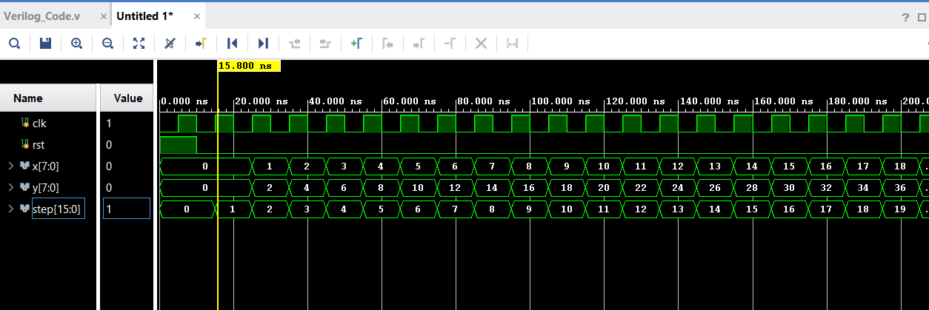
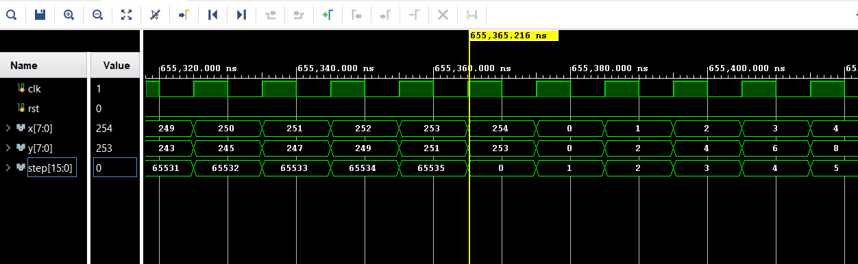
Output Verification in Vivado

Slide 11
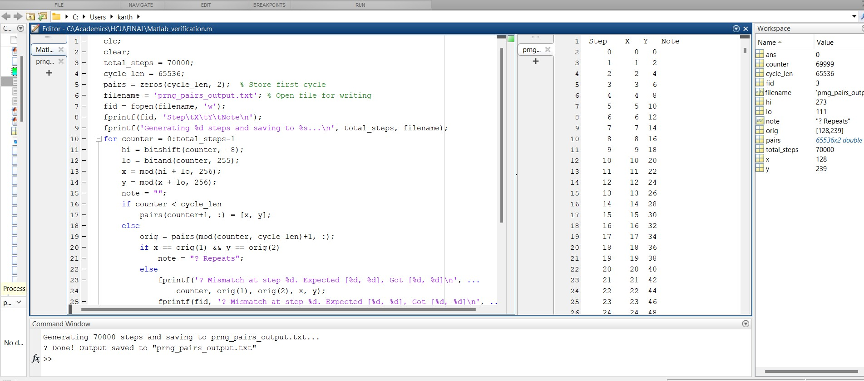
Output Verification using MATLAB

Slide 12
Conclusion
This project successfully demonstrates the design and simulation of a simple yet effective pseudo-random number generator (PRNG) using Verilog HDL. By combining a 16- bit counter with modular arithmetic through 8-bit adders, the system generates a sequence of 8-bit values (x and y) that simulate randomness across 65,536 steps. Although the design is deterministic, the mathematical structure ensures a varied and non-repeating pattern within the given range, making it suitable for testbench generation, hardware simulations, and learning environments. The project also provided hands-on experience with simulation tools like Vivado, and practical challenges like observing high-speed outputs through FPGA debugging tools such as the ILA. Overall, this work strengthened understanding of counter-based designs, arithmetic logic, and hardware-oriented pseudo-randomness.

