Slide 1
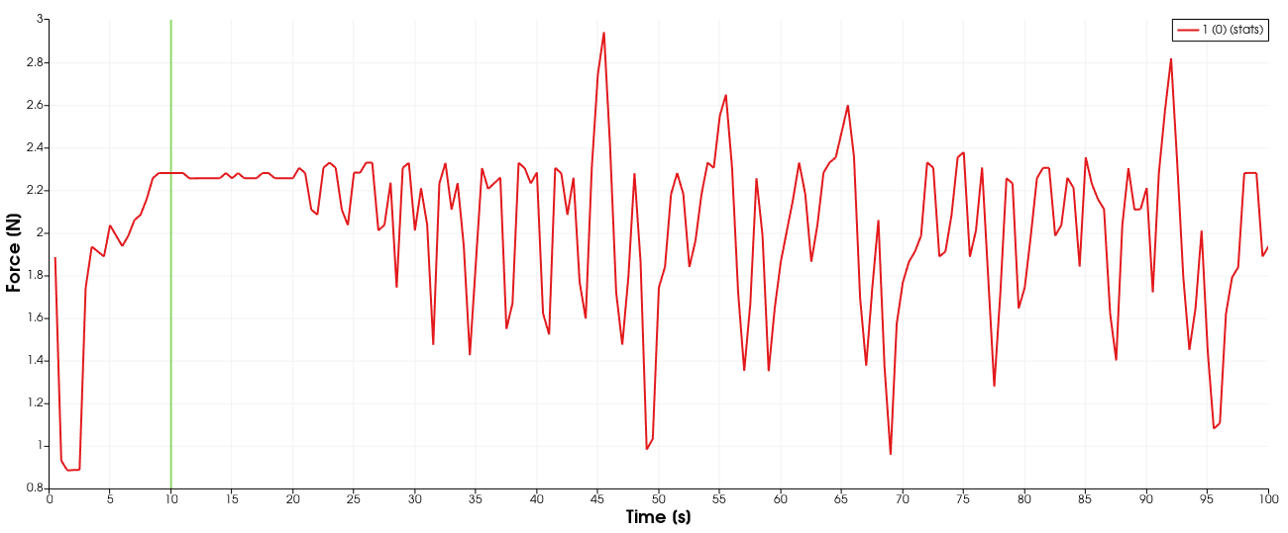
Drag v Time
Case 1

Slide 2
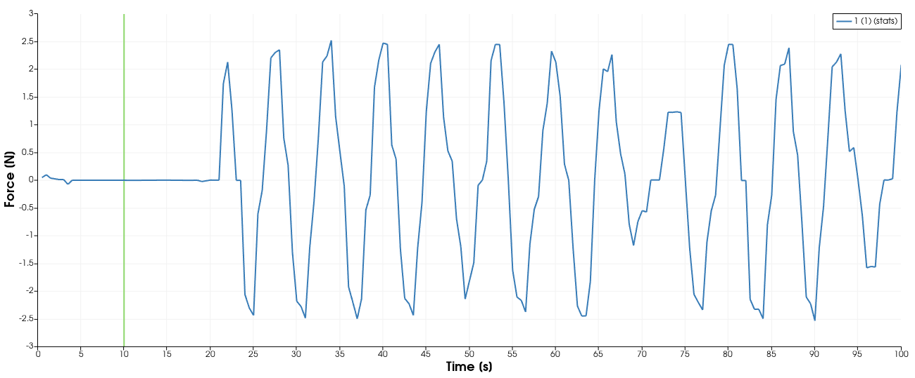
Lift v Time
Case 1

Slide 3
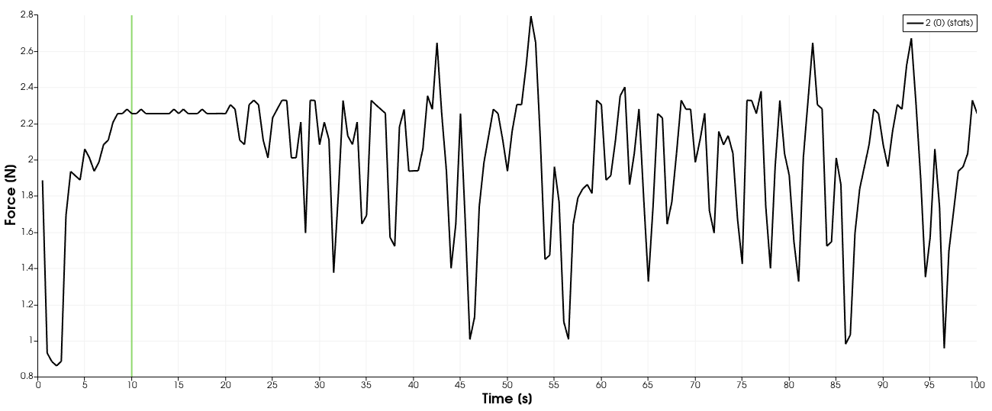
Drag v Time
Case 2

Slide 4
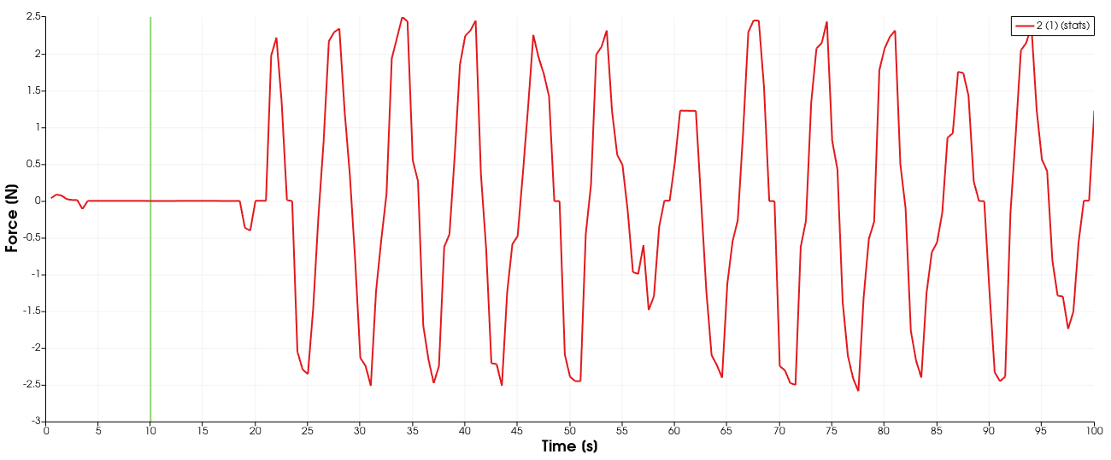
Lift v Time
Case 2

Slide 5
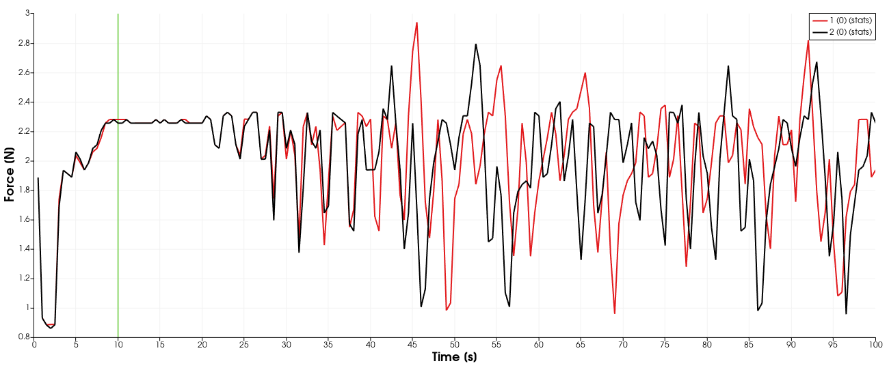
Drag v Time

Slide 6
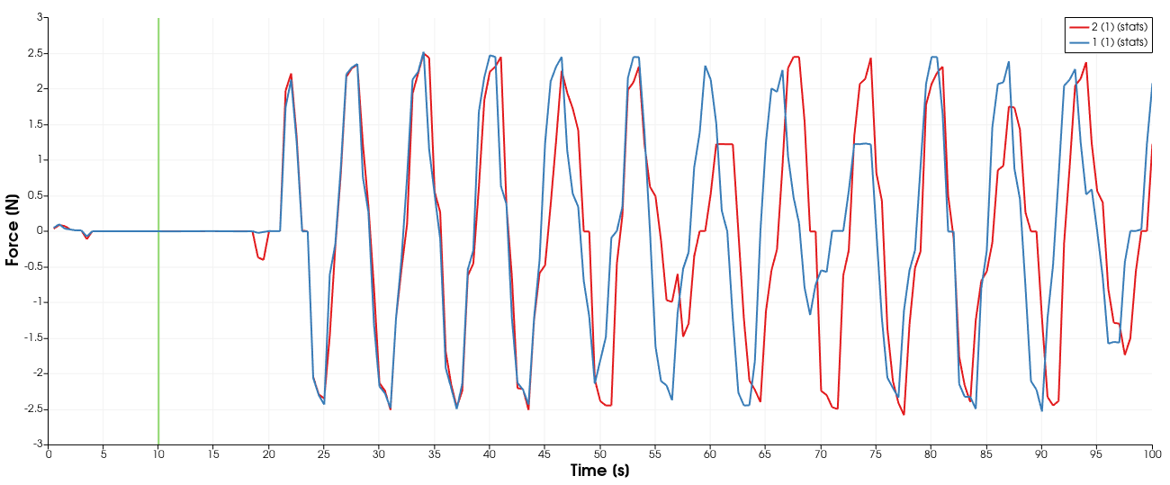
Lift v Time

Slide 7
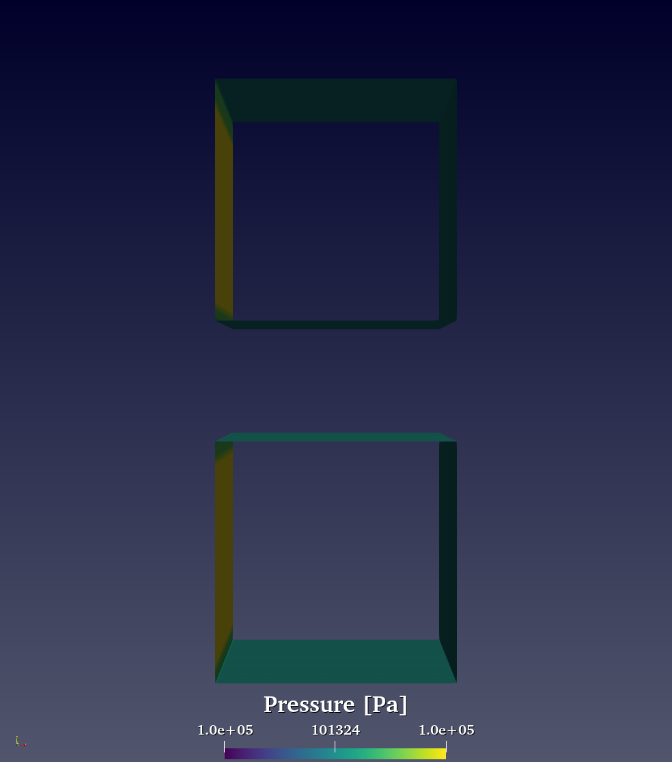

Slide 8
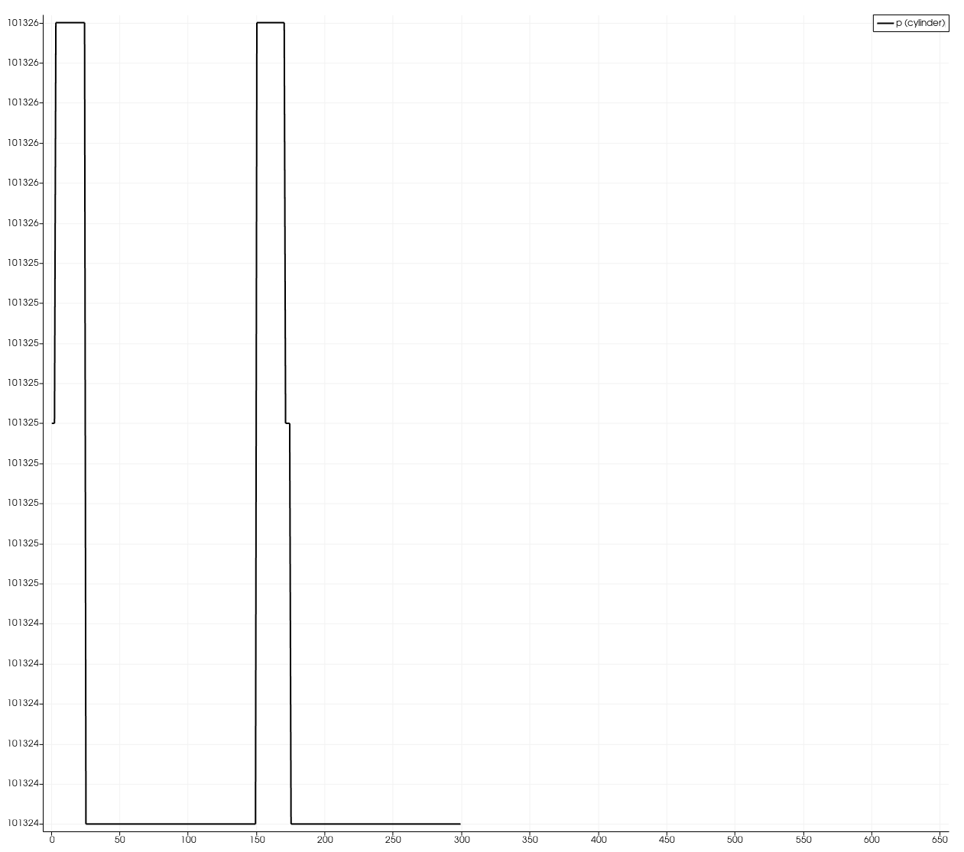
Pressure
Case 1

Slide 9
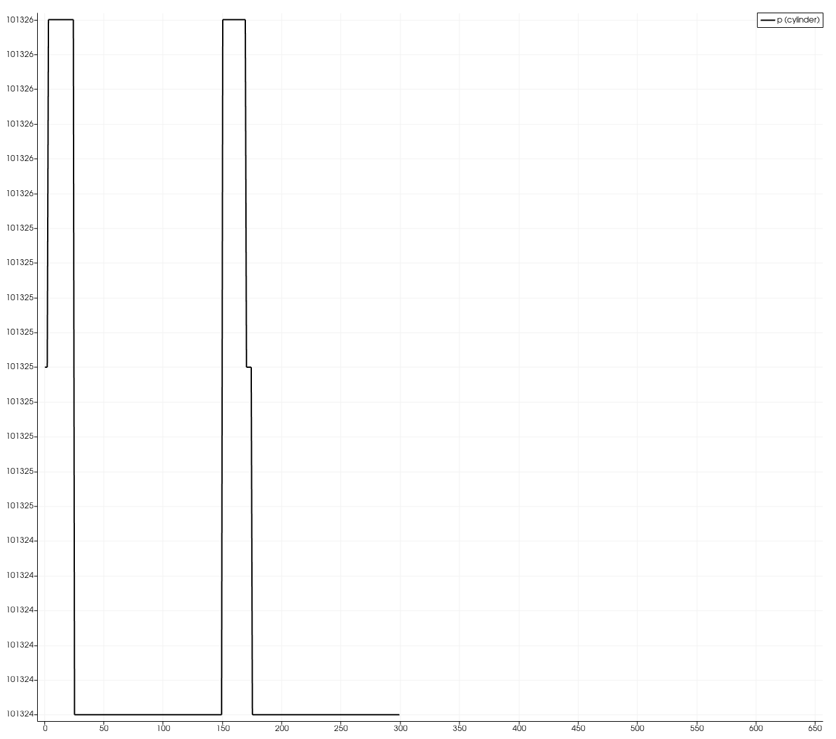
Pressure
Case 2

