Slide 1

Grafana Loki
A log collector straight from Greek Mythology

Slide 2
Executive Overview
Grafana Loki is a cutting-edge, cloud-native log aggregation system engineered for scalability, efficiency, and cost savings. It enables robust observability at scale, seamlessly integrating with Grafana for enhanced monitoring and visualization. Introduced by Grafana Labs in December 2018.
Open-source and horizontally scalable
Label-based indexing (metadata-only) ensures efficient storage
Fully compatible with Prometheus monitoring workflows
Perfectly suited for cloud-native, multi-tenant, and Kubernetes environments

Slide 3
Strategic Value Proposition
Cost-Optimized Log Management
Reduces total cost of ownership by indexing only metadata (labels), not full log text.
Unified Observability
Natively integrates with Grafana for consolidated dashboards (metrics, logs, traces).
Built for Scale
Supports log ingestion at hundreds of terabytes/day with dynamic horizontal scaling.
Multi-Tenancy by Design
Enables isolated log pipelines for different business units, teams, or clients.
DevOps & SRE Friendly
PromQL-like query language (LogQL) simplifies log search and alerting.

Slide 4
Core Architecture & Components
Component
Role
Logstash
Agents to collect and forward logs from kafka
Distributor
Validates and routes logs via consistent hashing
Ingester
Temporarily buffers logs and writes to storage
Querier
Retrieves log data from ingesters and storage
Query Frontend
Load-balances and parallelizes queries
Ruler
Evaluates and triggers alerting rules
Compactor
Deduplicates and compresses stored log chunks

Slide 5

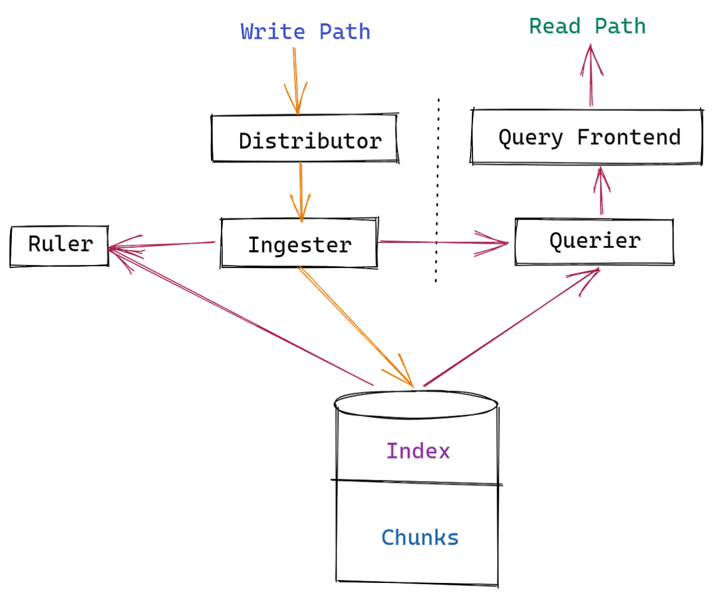
Write & Ingest Path – From Logs to Storage
Log Collection – Logs are gathered via Fluent Bit, or Logstash
Distribution – The Distributor ensures validated, load-balanced routing
Ingestion – Logs are ingested in-memory, chunked, and persisted to object storage
Replication & Quorum – High availability through replicated ingestion and write acknowledgment

Slide 6

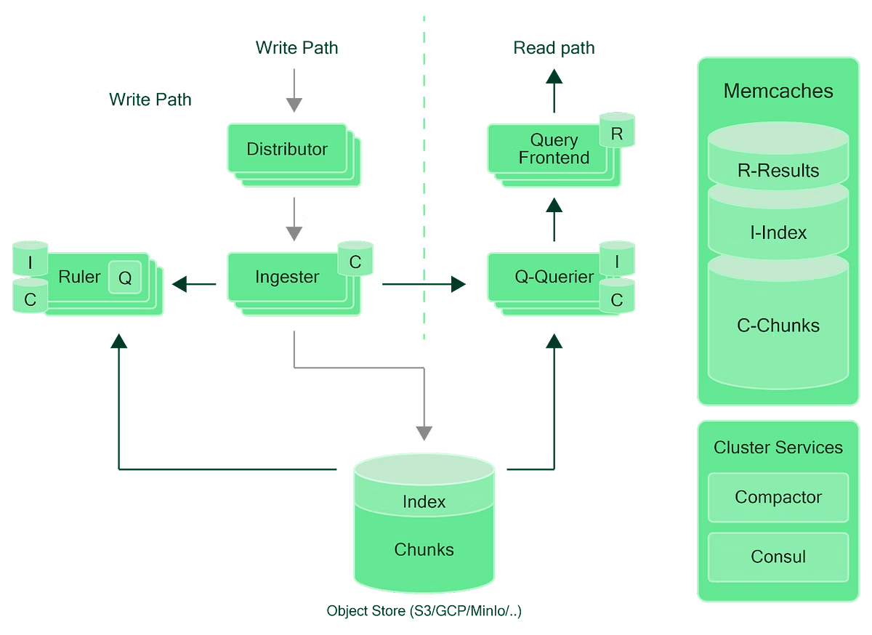
Read Path & Query Optimization
LogQL Query Initiated – The user sends a query to the Query Frontend.
Query Decomposition – The query is broken down into parallelizable subtasks for efficiency.
Execution – The Querier retrieves data from ingesters and persistent storage.
Aggregation – Results are deduplicated and combined for accuracy.
Response – Final data is delivered to the client or dashboard within milliseconds.

Slide 7
Deployment Models – Scalable by Design
Mode
Description
Scale
Complexity
Use Case
Monolithic
All components in a single binary
~20GB/day
Low
Dev/test environments
Simple Scalable
Components split into read/write/backend
TBs/day
Moderate
Mid-size clusters
Microservices
Independent services for each component
100s TBs/day
High
Enterprise-grade production

Slide 8

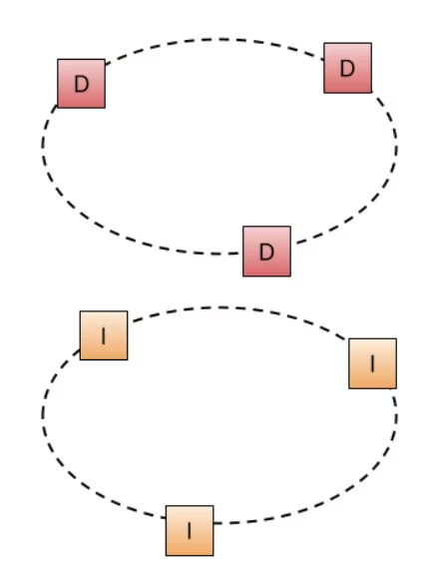
Loki Ring Architecture – Ensuring High Availability at Scale
Consistent Hashing guarantees even distribution of logs across nodes
Dynamic Membership enables seamless node addition and removal in real time
Fault Tolerance achieved through automatic reassignment and replication of logs
Backpressure & Batching techniques maintain ingestion stability under heavy load
Horizontal Scalability by simply adding more ingester nodes

Slide 9
Multi-Tenant Management & Security
Tenant Isolation via X-Scope-OrgID Header
Feature
Benefit
Label-based isolation
Full separation of logs between tenants
Per-tenant quotas
Control ingestion, storage, and query load
Role-based access
Teams see only their own logs
API-based header injection
Enables custom access workflows
Reverse proxy or Grafana Enterprise
For secure, scalable, dynamic tenant handling
Enterprise Strategy: Use multiple datasources in Grafana per tenant and leverage "Mixed" panels for unified dashboards.

Slide 10
Key Differences – Grafana Loki vs OpenSearch
Aspect
Grafana Loki
OpenSearch
Purpose
Purpose-built log aggregation system
General-purpose search and analytics
Indexing
Label-based (metadata-only)
Full-text indexing (high resource use)
Storage Efficiency
Compressed chunks on object storage
Heavy storage on local disks
Scalability
Lightweight, Kubernetes-native, microservices
Heavier cluster, complex sharding
Multi-Tenancy
Native tenant isolation via headers
Limited, index-level access control
Integration
Native with Grafana
Plugin-based, lacks deep integration
Operational Overhead
Low – stateless components
High – JVM tuning, sharding, etc.

Slide 11
Enterprise Architecture Overview
Log Pipeline:
Fluent Bit / Promtail — Lightweight agents responsible for efficient log collection and forwarding.
Kafka — Decouples producers and consumers, providing fault tolerance and buffering of log data.
Logstash — Performs log transformation and enrichment before forwarding to the Loki Distributor.
Loki Stack:
Distributor, Ingester, Querier — Modular components that scale independently to handle log ingestion and queries.
Object Storage (S3, GCS, Azure) — Provides durable long-term storage for log data.
Grafana — Used for visualizing logs through dashboards, setting alerts, and auditing access.

