Slide 1

MService MSCTD-721
Confidential to Selfservit Solutions

Slide 2
Checklist
1.Handover Documents .

Slide 3
Repository Name:
1.kobcr-nl_LIVE

Slide 4
TEST ENVIRONMENT DETAILS: URL : https://kobcr-nl-uat.mservice.net/ Co-ordinator login : kobcrsecorrd/welcome

Slide 5
Impact Analysis:
The files which is going to add and modify is
CVS/access_package/kobcr/nl/app_version_com.selfservit.kobelco_Android_GooglePlayStore.json
CVS/access_package/kobcr/nl/last_change_timestamp.xml
CVS/configuration_package/kobcr/nl/controller/controller_machine_life_kobcr_nl.json
CVS/configuration_package/kobcr/nl/controller/controller_my_MGENIS_kobcr_nl.json
CVS/configuration_package/kobcr/nl/controller/controller_my_activities_closed_kobcr_nl.json
CVS/configuration_package/kobcr/nl/controller/controller_my_activities_open_kobcr_nl.json
CVS/configuration_package/kobcr/nl/controller/controller_my_asset_kobcr_nl.json
CVS/configuration_package/kobcr/nl/controller/controller_my_home_kobcr_nl.json
CVS/configuration_package/kobcr/nl/controller/controller_my_service_call_complete_kobcr_nl.json
CVS/configuration_package/kobcr/nl/controller/controller_my_service_call_fsr_form_kobcr_nl.json
CVS/configuration_package/kobcr/nl/controller/controller_my_service_call_kobcr_nl.json
CVS/configuration_package/kobcr/nl/controller/controller_my_service_call_start_kobcr_nl.json
CVS/configuration_package/kobcr/nl/controller/controller_my_service_call_trip_finish_kobcr_nl.json
CVS/configuration_package/kobcr/nl/controller/controller_my_service_call_trip_start_kobcr_nl.json
CVS/configuration_package/kobcr/nl/controller/controller_my_service_call_workcomplete_kobcr_nl.json
CVS/configuration_package/kobcr/nl/controller/controller_operator_log_book_kobcr_nl.json
CVS/configuration_package/kobcr/nl/fonts/js/mobile.fonts.reference_kobcr_nl.json

Slide 6
Impact Analysis:
The files which is going to add and modify is
CVS/configuration_package/kobcr/nl/label/label_home_layout_kobcr_nl_en-us.json
CVS/configuration_package/kobcr/nl/label/label_machine_life_kobcr_nl_en-us.json
CVS/configuration_package/kobcr/nl/label/label_my_activities_closed_kobcr_nl_en-us.json
CVS/configuration_package/kobcr/nl/label/label_my_activities_open_kobcr_nl_en-us.json
CVS/configuration_package/kobcr/nl/label/label_my_asset_kobcr_nl_en-us.json
CVS/configuration_package/kobcr/nl/label/label_my_home_kobcr_nl_en-us.json
CVS/configuration_package/kobcr/nl/label/label_my_notification_kobcr_nl_en-us.json
CVS/configuration_package/kobcr/nl/label/label_my_permission_kobcr_nl_en-us.json
CVS/configuration_package/kobcr/nl/label/label_my_profile_kobcr_nl_en-us.json
CVS/configuration_package/kobcr/nl/label/label_my_service_call_call_details_kobcr_nl_en-us.json
CVS/configuration_package/kobcr/nl/label/label_my_service_call_scroll_attachments_kobcr_nl_en-us.json
CVS/configuration_package/kobcr/nl/label/label_my_service_call_scroll_attachments_new_kobcr_nl_en-us.json
CVS/configuration_package/kobcr/nl/label/label_my_service_call_scroll_details_kobcr_nl_en-us.json
CVS/configuration_package/kobcr/nl/label/label_my_service_call_start_kobcr_nl_en-us.json
CVS/configuration_package/kobcr/nl/label/label_my_service_call_trip_finish_kobcr_nl_en-us.json
CVS/configuration_package/kobcr/nl/label/label_my_service_call_trip_start_kobcr_nl_en-us.json
CVS/configuration_package/kobcr/nl/label/label_my_service_call_workcomplete_kobcr_nl_en-us.json
CVS/configuration_package/kobcr/nl/label/label_my_settings_kobcr_nl_en-us.json

Slide 7
Impact Analysis:
The files which is going to add and modify is
CVS/configuration_package/kobcr/nl/label/label_operator_log_book_kobcr_nl_en-us.json
CVS/configuration_package/kobcr/nl/label/label_system_messages_kobcr_nl_en-us.json
CVS/configuration_package/kobcr/nl/label/label_view_kobcr_nl_en-us.json
CVS/configuration_package/kobcr/nl/last_change_timestamp.xml
CVS/configuration_package/kobcr/nl/rule/rule_my_activities_open_kobcr_nl.txt
CVS/configuration_package/kobcr/nl/rule/rule_my_home_kobcr_nl.txt
CVS/configuration_package/kobcr/nl/rule/rule_my_service_call_attachments_new_kobcr_nl.txt
CVS/configuration_package/kobcr/nl/rule/rule_my_service_call_complete_kobcr_nl.txt
CVS/configuration_package/kobcr/nl/rule/rule_my_service_call_fsr_form_kobcr_nl.txt
CVS/configuration_package/kobcr/nl/rule/rule_my_service_call_start_kobcr_nl.txt
CVS/configuration_package/kobcr/nl/rule/rule_my_service_call_trip_finish_kobcr_nl.txt
CVS/configuration_package/kobcr/nl/rule/rule_my_service_call_trip_start_kobcr_nl.txt
CVS/configuration_package/kobcr/nl/rule/rule_my_service_call_workcomplete_kobcr_nl.txt
CVS/configuration_package/kobcr/nl/rule/rule_operator_log_book_kobcr_nl.txt
CVS/configuration_package/kobcr/nl/template/my_activities_closed_template_kobcr_nl.html
CVS/configuration_package/kobcr/nl/template/my_activities_open_template_kobcr_nl.html
CVS/configuration_package/kobcr/nl/template/my_asset_template_kobcr_nl.html
CVS/configuration_package/kobcr/nl/template/my_notification_template_kobcr_nl.html

Slide 8
Impact Analysis:
The files which is going to add and modify is
CVS/configuration_package/kobcr/nl/template/my_service_call_attachments_template_kobcr_nl.html
CVS/configuration_package/kobcr/nl/template/my_service_call_call_details_template_kobcr_nl.html
CVS/configuration_package/kobcr/nl/template/my_service_call_details_template_kobcr_nl.html
CVS/configuration_package/kobcr/nl/template/my_service_call_fsr_form_template_kobcr_nl.html
CVS/configuration_package/kobcr/nl/template/my_service_call_template.html
CVS/configuration_package/kobcr/nl/template/my_service_call_template_kobcr_nl.html
CVS/configuration_package/kobcr/nl/template/my_service_call_template_kobcr_nl_for_inlist.html
CVS/configuration_package/kobcr/nl/template/my_service_call_template_kobcr_nl_for_popup.html
CVS/configuration_package/kobcr/nl/template/operator_log_book_template_kobcr_nl.html
CVS/configuration_package/kobcr/nl/ui/ui_my_MGENIS_kobcr_nl.html
CVS/configuration_package/kobcr/nl/ui/ui_my_asset_kobcr_nl.html
CVS/configuration_package/kobcr/nl/ui/ui_my_asset_kobcr_nl.json
CVS/configuration_package/kobcr/nl/ui/ui_my_home_kobcr_nl.html
CVS/configuration_package/kobcr/nl/ui/ui_my_service_call_attachments_new_kobcr_nl.html
CVS/configuration_package/kobcr/nl/ui/ui_my_service_call_complete_kobcr_nl.html
CVS/configuration_package/kobcr/nl/ui/ui_my_service_call_fsr_form_kobcr_nl.html
CVS/configuration_package/kobcr/nl/ui/ui_my_service_call_start_kobcr_nl.html

Slide 9
Impact Analysis:
The files which is going to add and modify is
CVS/configuration_package/kobcr/nl/ui/ui_my_service_call_trip_finish_kobcr_nl.html
CVS/configuration_package/kobcr/nl/ui/ui_my_service_call_trip_start_kobcr_nl.html
CVS/configuration_package/kobcr/nl/ui/ui_my_service_call_workcomplete_kobcr_nl.html
CVS/configuration_package/kobcr/nl/ui/ui_operator_log_book_kobcr_nl.html
CVS/configuration_package/kobcr/nl/ui/ui_product_info_kobcr_nl.html
DB/DATA SCRIPTS/FR-2199/01.company_feature.sql
DB/DATA SCRIPTS/FR-2199/02.package_feature.sql
DB/DATA SCRIPTS/FR-2199/03.functional_access_profile.sql
DB/DATA SCRIPTS/FR-2199/04.company_feature_group_id_link.sql
DB/DATA SCRIPTS/FR-2199/05.company_feature_group.sql
DB/DATA SCRIPTS/FR-2199/06.grant_permission.sql
DB/DATA SCRIPTS/FR-2199/07.company_subscription_matrix.sql
DB/DATA SCRIPTS/FR-2199/08.entity_organogram_mapping.sql
DB/DATA SCRIPTS/FR-2199/09.code_table.sql
DB/DATA SCRIPTS/FR-2199/10.code_table_mlingual_translation.sql
DB/DATA SCRIPTS/FR-2199/11.workflow_eventverb_list.sql
DB/DATA SCRIPTS/FR-2199/12.workflow_status_link.sql
DB/DATA SCRIPTS/FR-2199/13.workflow_stage_master.sql

Slide 10
Impact Analysis:
The files which is going to add and modify is
DB/DATA SCRIPTS/FR-2199/14.workflow_status_master.sql
DB/DATA SCRIPTS/FR-2199/15.company_configuration_matrix.sql
DB/DATA SCRIPTS/FR-2199/16.company_notification.sql
DB/DATA SCRIPTS/FR-2199/17.company_notification_mode_preference.sql
DB/DATA SCRIPTS/FR-2199/18.company_notification_recipients_list.sql
DB/DATA SCRIPTS/FR-2199/19.company_notification_template_master.sql
DB/DATA SCRIPTS/FR-2199/20.Insert.sql
DB/DATA SCRIPTS/FR-2199/21.category_type_link.sql
DB/FUNCTIONS/FR-2199/dbo.fn_client_specific_stamping_request_ref_no.UserDefinedFunctions.sql
DB/FUNCTIONS/FR-2199/dbo.fn_get_client_specific_fields_for_my_activities.UserDefinedFunction.sql
DB/FUNCTIONS/FR-2199/dbo.fn_get_client_specific_fields_for_my_activities_kobcr_nl.UserDefinedFunction.sql
DB/PROCEDURES/dbo.sp_activate_deactivate_user_access.StoredProcedure.sql
DB/PROCEDURES/dbo.sp_create_asset_service_schedule_basedon_contract.StoredProcedure.sql
DB/PROCEDURES/dbo.sp_execute_at_middletier.StoredProcedure.sql
DB/PROCEDURES/dbo.sp_fixdata_create_asset_contractandschedule.StoredProcedure.sql
DB/PROCEDURES/dbo.sp_generate_customer_survey.sql
DB/PROCEDURES/dbo.sp_get_notification_event_code_for_campaign.StoredProcedure.sql
DB/PROCEDURES/dbo.sp_load_indiamart_kobcr_nl.StoredProcedure.sql
DB/PROCEDURES/dbo.sp_recalculate_asset_service_visit_projected_revenue.StoredProcedure.sql
DB/PROCEDURES/dbo.sp_retrieve_listof_notifications_for_delivery.StoredProcedure.sql

Slide 11
Impact Analysis:
The files which is going to add and modify is
DB/PROCEDURES/dbo.sp_retrieve_listof_values_for_searchcondition.StoredProcedure.sql
DB/PROCEDURES/dbo.sp_retrieve_manage_asset_master_details.StoredProcedure.sql
DB/PROCEDURES/dbo.sp_retrieve_manage_call_register.StoredProcedure.sql
DB/PROCEDURES/dbo.sp_retrieve_manage_call_register_details.StoredProcedure.sql
DB/PROCEDURES/dbo.sp_retrieve_manage_custom_info_detail_campaign_register.StoredProcedure.sql
DB/PROCEDURES/dbo.sp_retrieve_manage_custom_info_detail_customer_location_contacts.StoredProcedure.sql
DB/PROCEDURES/dbo.sp_retrieve_manage_custom_info_detail_customer_timeline_kobcr.StoredProcedure.sql
DB/PROCEDURES/dbo.sp_retrieve_manage_custom_info_list_campaign_register.StoredProcedure.sql
DB/PROCEDURES/dbo.sp_retrieve_manage_custom_info_list_campaign_register_coverage_import.StoredProcedure.sql
DB/PROCEDURES/dbo.sp_retrieve_manage_custom_info_list_customer_location_contacts.StoredProcedure.sql
DB/PROCEDURES/dbo.sp_retrieve_manage_custom_info_list_customer_timeline_kobcr.StoredProcedure.sql
DB/PROCEDURES/dbo.sp_retrieve_manage_custom_info_list_file_attachment_path.StoredProcedure.sql
DB/PROCEDURES/dbo.sp_retrieve_manage_custom_info_list_mserviceAI_actionList.StoredProcedure.sql
DB/PROCEDURES/dbo.sp_retrieve_manage_custom_info_list_mserviceAI_attachmentList.StoredProcedure.sql

Slide 12
Impact Analysis:
The files which is going to add and modify is
DB/PROCEDURES/dbo.sp_retrieve_manage_custom_info_list_mserviceAI_recipientList.StoredProcedure.sql
DB/PROCEDURES/dbo.sp_retrieve_manage_custom_info_list_mserviceAI_suggestionList.StoredProcedure.sql
DB/PROCEDURES/dbo.sp_retrieve_manage_custom_info_list_mserviceAI_transactionMessagesList.StoredProcedure.sql
DB/PROCEDURES/dbo.sp_retrieve_manage_custom_info_list_my_activities.StoredProcedure.sql
DB/PROCEDURES/dbo.sp_retrieve_manage_custom_info_list_my_machines.StoredProcedure.sql
DB/PROCEDURES/dbo.sp_retrieve_manage_custom_info_list_my_notice_board.StoredProcedure.sql
DB/PROCEDURES/dbo.sp_retrieve_manage_custom_info_list_operator_log_report.StoredProcedure.sql
DB/PROCEDURES/dbo.sp_retrieve_manage_custom_info_list_security_purpose_code.StoredProcedure.sql
DB/PROCEDURES/dbo.sp_retrieve_manage_customer_loc_details.StoredProcedure.sql
DB/PROCEDURES/dbo.sp_retrieve_manage_customer_master_list.StoredProcedure.sql
DB/PROCEDURES/dbo.sp_save_manage_asset_master.StoredProcedure.sql
DB/PROCEDURES/dbo.sp_save_manage_custom_info_campaign_register.StoredProcedure.sql
DB/PROCEDURES/dbo.sp_save_manage_custom_info_customer_location_contacts.StoredProcedure.sql
DB/PROCEDURES/dbo.sp_save_manage_custom_info_delete_my_account.StoredProcedure.sql
DB/PROCEDURES/dbo.sp_save_manage_custom_info_generate_security_code.StoredProcedure.sql
DB/PROCEDURES/dbo.sp_save_manage_custom_info_mserviceAI.StoredProcedure.sql

Slide 13
Impact Analysis:
The files which is going to add and modify is
DB/PROCEDURES/dbo.sp_save_manage_custom_info_operator_log_book.StoredProcedure.sql
DB/PROCEDURES/dbo.sp_save_manage_custom_info_validate_security_code.StoredProcedure.sql
DB/PROCEDURES/dbo.sp_save_manage_custom_info_visitor_profile.StoredProcedure.sql
DB/PROCEDURES/dbo.sp_save_manage_customer_loc_details.StoredProcedure.sql
DB/PROCEDURES/dbo.sp_save_manage_customer_master.StoredProcedure.sql
DB/PROCEDURES/dbo.sp_update_call_start.StoredProcedure.sql
DB/PROCEDURES/dbo.sp_update_call_wfeventverb_status_change.StoredProcedure.sql
DB/PROCEDURES/dbo.sp_update_campaign_wfeventverb_status_change.StoredProcedure.sql
DB/PROCEDURES/dbo.sp_update_campaign_wfeventverb_status_change_kobcr.StoredProcedure.sql
DB/PROCEDURES/dbo.sp_update_product_udf_values_customer_location_nl.StoredProcedure.sql
Website/common/components/Notification/Html/FORGOT_PASSWORD_EMAIL_body.html
Website/common/components/Notification/Html/FORGOT_PASSWORD_EMAIL_sub.html
Website/common/components/Notification/Html/VISITOR_PROFILE_EMAIL_body.html
Website/common/components/Notification/Html/VISITOR_PROFILE_EMAIL_sub.html
Website/common/components/Notification/Html/kobcr_nl_ACTIVATE_USER_EMAIL_body.html
Website/common/components/Notification/Html/kobcr_nl_ACTIVATE_USER_EMAIL_sub.html
Website/common/components/Notification/Html/kobcr_nl_VISITOR_PROFILE_EMAIL_body.html
Website/common/components/Notification/Html/kobcr_nl_VISITOR_PROFILE_EMAIL_sub.html

Slide 14
Impact Analysis:
The files which is going to add and modify is
Website/common/components/Notification/Xsl/FORGOT_PASSWORD_EMAIL.xsl
Website/common/components/Notification/Xsl/VISITOR_PROFILE_EMAIL.xsl
Website/common/components/Notification/Xsl/kobcr_nl_ACTIVATE_USER_EMAIL.xsl
Website/common/components/Notification/Xsl/kobcr_nl_VISITOR_PROFILE_EMAIL.xsl
Website/common/components/msvMsg/CallDB.aspx
Website/common/components/msvMsg/SaveToken.aspx
Website/common/components/msvMsg/SendNotification.aspx
Website/common/components/msvMsg/escalationAI.aspx
Website/common/components/msvMsg/mserviceAI.aspx
Website/common/images/kobcr/nl/favicon.ico
Website/common/images/kobcr/nl/login.jpg
Website/common/images/kobcr/nl/login.png
Website/common/scripts/js/common_functions.js
Website/common/scripts/js/mserviceUtilities.library.js
Website/common/scripts/js/rule_engine_functions.js
Website/common/scripts/js/webScreenController.library.js
Website/common/scripts/js/webWidgetInitializer.library.js
Website/content_store/kobcr/nl/msvCache/cache_controller_com.selfservit.kobelco_kobcr_nl.json
Website/content_store/kobcr/nl/msvMsg/history/com.selfservit.kobelco/my_notice_board/2022-11-03-19-11-02-NB-2022-web/2022-11-03-19-11-02-NB-2022-web.txt
Website/fmt/export/manage_asset_master_fmt.json
Website/fmt/export/manage_call_register_se_fmt.json

Slide 15
Impact Analysis:
The files which is going to add and modify is
Website/fmt/export/manage_customer_master_fmt.json
Website/fmt/export/manage_users_fmt.json
Website/fmt/msvCache/cache_controller_com.selfservit.kobelco_kobcr_nl.json
Website/fmt/msvInfoX/inbound/email_kobcr_nl.xml
Website/fmt/msvInfoX/inbound/googlesheet_kobcr_nl.xml
Website/fmt/msvMsg/com.selfservit.kobelco/fcmautoreply_kobcr_nl.json
Website/fmt/msvMsg/com.selfservit.kobelco/fcmautoreply_my_activities_open_kobcr_nl.json
Website/fmt/msvMsg/com.selfservit.kobelco/fcmautoreply_my_notice_board_kobcr_nl.json
Website/fmt/msvMsg/com.selfservit.kobelco/fcmmsg_kobcr_nl.json
Website/fmt/msvNotification/EMAIL_AUTHUSER_SECURITY_CODE.xslt
Website/fmt/msvNotification/EMAIL_VERIFYEMAIL_SECURITY_CODE.xslt
Website/fmt/msvNotification/SMS_AUTHUSER_SECURITY_CODE.xslt
Website/fmt/msvNotification/SMS_VERIFYMOBILE_SECURITY_CODE.xslt
Website/mservice/retrieve_manage_call_register_details.OutputMessage.xsd
Website/webui/configuration/label/label_generate_invoice_kobcr_nl_en-us.xml
Website/webui/configuration/label/label_manage_asset_master_kobcr_nl_en-us.xml
Website/webui/configuration/label/label_manage_campaign_register_edit_child_kobcr_nl_en-us.xml

Slide 16
Impact Analysis:
The files which is going to add and modify is
Website/webui/configuration/label/label_manage_campaign_register_edit_kobcr_nl_en-us.xml
Website/webui/configuration/label/label_manage_campaign_register_kobcr_nl_en-us.xml
Website/webui/configuration/label/label_manage_campaign_register_wfeventverb_status_change_kobcr_nl_en-us.xml
Website/webui/configuration/label/label_manage_customer_contacts_edit_kobcr_nl_en-us.xml
Website/webui/configuration/label/label_manage_customer_contacts_kobcr_nl_en-us.xml
Website/webui/configuration/rule/rule_manage_call_register_edit_kobcr_nl.txt
Website/webui/configuration/rule/rule_manage_call_register_pe_edit_kobcr_nl.txt
Website/webui/configuration/rule/rule_manage_call_register_sa_edit_kobcr_nl.txt
Website/webui/configuration/rule/rule_manage_call_register_se_edit_kobcr_nl.txt
Website/webui/configuration/rule/rule_manage_call_register_vi_edit_kobcr_nl.txt
Website/webui/configuration/rule/rule_manage_campaign_register_edit_child_kobcr_nl.txt
Website/webui/configuration/rule/rule_manage_campaign_register_edit_kobcr_nl.txt
Website/webui/configuration/rule/rule_manage_campaign_register_kobcr_nl.txt
Website/webui/configuration/rule/rule_manage_campaign_register_wfeventverb_status_change_kobcr_nl.txt
Website/webui/configuration/rule/rule_manage_customer_contacts_edit_kobcr_nl.txt
Website/webui/configuration/rule/rule_manage_customer_location_edit_kobcr_nl.txt
Website/webui/configuration/rule/rule_manage_customer_master_edit_kobcr_nl.txt
Website/webui/configuration/rule/rule_manage_employee_master_edit_kobcr_nl.txt
Website/webui/configuration/ui/ui_manage_campaign_register_edit_child_kobcr_nl.xml

Slide 17
Impact Analysis:
The files which is going to add and modify is
Website/webui/configuration/ui/ui_manage_campaign_register_edit_kobcr_nl.xml
Website/webui/configuration/ui/ui_manage_campaign_register_kobcr_nl.xml
Website/webui/configuration/ui/ui_manage_campaign_register_wfeventverb_status_change_kobcr_nl.xml
Website/webui/configuration/ui/ui_manage_customer_contacts_edit_kobcr_nl.xml
Website/webui/configuration/ui/ui_manage_customer_contacts_kobcr_nl.xml
Website/webui/html/manage_call_register_edit.html
Website/webui/html/manage_call_register_pe_edit.html
Website/webui/html/manage_call_register_sa_edit.html
Website/webui/html/manage_call_register_se_edit.html
Website/webui/html/manage_call_register_vi_edit.html
Website/webui/html/manage_campaign_register.html
Website/webui/html/manage_campaign_register_edit.html
Website/webui/html/manage_campaign_register_edit_child.html
Website/webui/html/manage_campaign_register_wfeventverb_status_change.html
Website/webui/html/manage_customer_contacts.html
Website/webui/html/manage_customer_contacts_edit.html
Website/webui/html/manage_customer_location_edit.html
Website/webui/html/manage_customer_master_edit.html

Slide 18
Impact Analysis:
The files which is going to add and modify is
Website/webui/html/manage_employee_master_edit.html
Website/webui/scripts/js/fn_manage_call_register_edit.js
Website/webui/scripts/js/fn_manage_call_register_pe_edit.js
Website/webui/scripts/js/fn_manage_call_register_sa_edit.js
Website/webui/scripts/js/fn_manage_call_register_se_edit.js
Website/webui/scripts/js/fn_manage_call_register_vi_edit.js
Website/webui/scripts/js/fn_manage_campaign_register.js
Website/webui/scripts/js/fn_manage_campaign_register_edit.js
Website/webui/scripts/js/fn_manage_campaign_register_edit_child.js
Website/webui/scripts/js/fn_manage_campaign_register_wfeventverb_status_change.js
Website/webui/scripts/js/fn_manage_customer_contacts.js
Website/webui/scripts/js/fn_manage_customer_contacts_edit.js
Website/webui/scripts/js/fn_manage_customer_location_edit.js
Website/webui/scripts/js/fn_manage_customer_master_edit.js
Website/webui/scripts/js/fn_manage_employee_master_edit.js
Website/www/app_settings.xml
Website/www/configuration/controller/kobcr/nl/controller_manage_customer_survey_kobcr_nl.json
Website/www/configuration/controller/kobcr/nl/controller_manage_others_kobcr_nl.json
Website/www/configuration/controller/kobcr/nl/controller_manage_parts_enquiry_kobcr_nl.json
Website/www/configuration/controller/kobcr/nl/controller_manage_sales_kobcr_nl.json
Website/www/configuration/controller/kobcr/nl/controller_manage_service_call_kobcr_nl.json

Slide 19
Impact Analysis:
The files which is going to add and modify is
Website/www/configuration/controller/kobcr/nl/controller_my_activities_closed_kobcr_nl.json
Website/www/configuration/controller/kobcr/nl/controller_my_activities_logging_kobcr_nl.json
Website/www/configuration/controller/kobcr/nl/controller_my_activities_open_kobcr_nl.json
Website/www/configuration/controller/kobcr/nl/controller_my_notice_board_kobcr_nl.json
Website/www/configuration/controller/kobcr/nl/controller_my_queries_closed_kobcr_nl.json
Website/www/configuration/controller/kobcr/nl/controller_my_queries_open_kobcr_nl.json
Website/www/configuration/default_value/timezone_index_list.txt
Website/www/configuration/label/kobcr/nl/en-us/label_form_handler_operator_log_book_kobcr_nl_en-us.txt
Website/www/configuration/label/kobcr/nl/en-us/label_home_kobcr_nl_en-us.json
Website/www/configuration/label/kobcr/nl/en-us/label_home_layout_kobcr_nl_en-us.json
Website/www/configuration/label/kobcr/nl/en-us/label_inapp_alerts_kobcr_nl_en-us.json
Website/www/configuration/label/kobcr/nl/en-us/label_manage_customer_survey_kobcr_nl_en-us.json
Website/www/configuration/label/kobcr/nl/en-us/label_manage_others_kobcr_nl_en-us.json
Website/www/configuration/label/kobcr/nl/en-us/label_manage_parts_enquiry_kobcr_nl_en-us.json
Website/www/configuration/label/kobcr/nl/en-us/label_manage_sales_kobcr_nl_en-us.json
Website/www/configuration/label/kobcr/nl/en-us/label_manage_service_call_kobcr_nl_en-us.json
Website/www/configuration/label/kobcr/nl/en-us/label_my_activities_closed_kobcr_nl_en-us.json

Slide 20
Impact Analysis:
The files which is going to add and modify is
Website/www/configuration/label/kobcr/nl/en-us/label_my_activities_open_kobcr_nl_en-us.json
Website/www/configuration/label/kobcr/nl/en-us/label_system_messages_kobcr_nl_en-us.json
Website/www/configuration/rule/kobcr/nl/rule_form_handler_operator_log_book_kobcr_nl.txt
Website/www/configuration/rule/kobcr/nl/rule_my_activities_open_kobcr_nl.txt
Website/www/configuration/template/kobcr/nl/template_manage_customer_survey_kobcr_nl.html
Website/www/configuration/template/kobcr/nl/template_manage_others_kobcr_nl.html
Website/www/configuration/template/kobcr/nl/template_manage_parts_enquiry_kobcr_nl.html
Website/www/configuration/template/kobcr/nl/template_manage_sales_kobcr_nl.html
Website/www/configuration/template/kobcr/nl/template_manage_service_call_kobcr_nl.html
Website/www/configuration/template/kobcr/nl/template_my_activities_closed_kobcr_nl.html
Website/www/configuration/template/kobcr/nl/template_my_activities_logging_kobcr_nl.html
Website/www/configuration/template/kobcr/nl/template_my_activities_open_kobcr_nl.html
Website/www/configuration/template/kobcr/nl/template_my_notice_board_kobcr_nl.html
Website/www/configuration/template/kobcr/nl/template_my_queries_closed_kobcr_nl.html
Website/www/configuration/template/kobcr/nl/template_my_queries_open_kobcr_nl.html
Website/www/configuration/ui/kobcr/nl/ui_form_handler_operator_log_book_kobcr_nl.txt
Website/www/configuration/ui/kobcr/nl/ui_home_dashboard_kobcr_nl.txt
Website/www/configuration/ui/kobcr/nl/ui_manage_customer_survey_kobcr_nl.json

Slide 21
Impact Analysis:
The files which is going to add and modify is
Website/www/configuration/ui/kobcr/nl/ui_manage_others_kobcr_nl.json
Website/www/configuration/ui/kobcr/nl/ui_manage_parts_enquiry_kobcr_nl.json
Website/www/configuration/ui/kobcr/nl/ui_manage_sales_kobcr_nl.json
Website/www/configuration/ui/kobcr/nl/ui_manage_service_call_kobcr_nl.json
Website/www/content/calldb.html
Website/www/content/calldb_old.html
Website/www/content/chat.html
Website/www/content/customer_timeline.html
Website/www/content/home_dashboard.html
Website/www/content/images/calldb/PRODUCTINFO_banner.jpg
Website/www/content/login.html
Website/www/content/my_machines.html
Website/www/content/my_queries.html
Website/www/content/product_information.html
Website/www/content/product_information_detail_prod1.html
Website/www/content/product_information_detail_prod2.html
Website/www/js/calldb.js
Website/www/js/chat.js
Website/www/js/customer_timeline.js
Website/www/js/home_dashboard.js
Website/www/js/manage_customer_survey.js
Website/www/js/manage_others.js
Website/www/js/manage_parts_enquiry.js

Slide 22
Impact Analysis:
The files which is going to add and modify is
Website/www/js/manage_sales.js
Website/www/js/manage_service_call.js
Website/www/js/my_machines.js
Website/www/js/my_queries.js
Website/www/js/product_information.js
Website/www/lib/bootstrap/js/bootstrap.min.js
Website/www/lib/bootstrap/styles/bootstrap-float-label.css
Website/www/lib/bootstrap/styles/bootstrap.min.css
Website/www/lib/bootstrap/styles/font-awesome.min.css
Website/www/lib/encryption/aes.js
Website/www/lib/fonts/js/mobile.fonts.reference.json
Website/www/lib/fonts/js/web.fonts.reference.json
Website/www/lib/fonts/styles/all.css
Website/www/lib/fonts/styles/webfonts/brands.svg
Website/www/lib/fonts/styles/webfonts/duotone.svg
Website/www/lib/fonts/styles/webfonts/fa-brands-400.ttf
Website/www/lib/kendoui/js/jquery.min.js
Website/www/lib/kendoui/js/kendo.all.min.js
Website/www/lib/kendoui/js/kendo.all.min.js
Website/www/lib/kendoui/styles/Material/imagebrowser.png

Slide 23
Impact Analysis:
The files which is going to add and modify is
Website/www/lib/mservice/.DS_Store
Website/www/lib/mservice/js/api.lib.js
Website/www/lib/mservice/js/config.lib.js
Website/www/lib/mservice/js/containR.lib.js
Website/www/lib/mservice/js/cvs.lib.js
Website/www/lib/mservice/js/dSource.lib.js
Website/www/lib/mservice/js/eventHandler.lib.js
Website/www/lib/mservice/js/fcm.lib.js
Website/www/lib/mservice/js/formHandler.lib.js
Website/www/lib/mservice/js/layout.lib.js
Website/www/lib/mservice/js/mobile.mservice.lib.js
Website/www/lib/mservice/js/nfs.lib.js
Website/www/lib/mservice/js/pre_signup_messages.json
Website/www/lib/mservice/js/presentR.lib.js
Website/www/lib/mservice/js/queue.lib.js
Website/www/lib/mservice/js/security.lib.js
Website/www/lib/mservice/js/settings.lib.js
Website/www/lib/mservice/js/util.lib.js
Website/www/lib/mservice/js/web.mService.lib.js
Website/www/lib/mservice/js/widgets.lib.js

Slide 24
Impact Analysis:
The files which is going to add and modify is
Website/www/lib/mservice/pattern/query/query.lib.js
Website/www/lib/mservice/pattern/query/templates/page/mobile/msPatternQueryChat.html
Website/www/lib/mservice/pattern/query/templates/page/mobile/msPatternQueryList.html
Website/www/lib/mservice/pattern/query/templates/page/web/msPatternQuery.html
Website/www/lib/mservice/pattern/workflow/styles/css/mobile.ms.workflow_pattern_theme.css.template.html
Website/www/lib/mservice/pattern/workflow/templates/page/mobile/msPatternWorkflowAttachments.html
Website/www/lib/mservice/pattern/workflow/templates/page/mobile/msPatternWorkflowDetails.html
Website/www/lib/mservice/pattern/workflow/templates/page/mobile/msPatternWorkflowList.html
Website/www/lib/mservice/pattern/workflow/workflow.lib.js
Website/www/lib/mservice/styles/css/mobile.form_widgets_ui.css
Website/www/lib/mservice/styles/css/mobile.kendo.theme.css.template.html
Website/www/lib/mservice/styles/css/mobile.kendo_ui.css
Website/www/lib/mservice/styles/css/mobile.ms.theme.css.template.html
Website/www/lib/mservice/styles/css/mobile.ms_ui.css
Website/www/lib/mservice/styles/css/mobile.widgets.theme.css.template.html
Website/www/lib/mservice/styles/css/web.form_widgets_ui.css
Website/www/lib/mservice/styles/css/web.kendo.theme.css.template.html
Website/www/lib/mservice/styles/css/web.kendo_ui.css

Slide 25
Impact Analysis:
The files which is going to add and modify is
Website/www/lib/mservice/styles/css/web.kendo_ui.css.bak
Website/www/lib/mservice/styles/css/web.ms.theme.css.template.html
Website/www/lib/mservice/styles/css/web.ms_ui.css
Website/www/lib/mservice/styles/css/web.widgets.theme.css.template.html
Website/www/lib/mservice/styles/image/image_reference.xml
Website/www/lib/mservice/styles/layout/mobile.home.functional.drawer.filter.template.default.html
Website/www/lib/mservice/styles/layout/mobile.home.functional.drawer.template.default.html
Website/www/lib/mservice/styles/layout/mobile.home.layout.template.bottomnav.html
Website/www/lib/mservice/styles/layout/mobile.home.layout.template.default.html
Website/www/lib/mservice/styles/layout/mobile.home.layout.template.tile.html
Website/www/lib/mservice/styles/layout/mobile.home.popup.template.default.html
Website/www/lib/mservice/styles/layout/my_permission.template.html
Website/www/lib/mservice/styles/layout/my_settings.template.html
Website/www/lib/mservice/styles/layout/spinner.template.html
Website/www/lib/mservice/styles/layout/version_update.template.html
Website/www/lib/mservice/styles/layout/web.home.layout.template.layout_1.html
Website/www/lib/mservice/styles/layout/web.home.layout.template.layout_2.html

Slide 26
Impact Analysis:
The files which is going to add and modify is
Website/www/lib/mservice/styles/layout/web.home.popup.template.layout_1.html
Website/www/lib/mservice/styles/template/widgets/mobile/attachment_view_template.html
Website/www/lib/mservice/styles/template/widgets/mobile/msAttachmentTemplate.html
Website/www/lib/mservice/styles/template/widgets/mobile/msAudioplayerTemplate.html
Website/www/lib/mservice/styles/template/widgets/mobile/msBarcodeTemplate.html
Website/www/lib/mservice/styles/template/widgets/mobile/msCameraTemplate.html
Website/www/lib/mservice/styles/template/widgets/mobile/msChatTemplate.html
Website/www/lib/mservice/styles/template/widgets/mobile/msCheckboxTemplate.html
Website/www/lib/mservice/styles/template/widgets/mobile/msCheckboxgroupTemplate.html
Website/www/lib/mservice/styles/template/widgets/mobile/msComboboxTemplate.html
Website/www/lib/mservice/styles/template/widgets/mobile/msDateboxTemplate.html
Website/www/lib/mservice/styles/template/widgets/mobile/msDisplayboxTemplate.html
Website/www/lib/mservice/styles/template/widgets/mobile/msDropdownlistTemplate.html
Website/www/lib/mservice/styles/template/widgets/mobile/msFlipswitchTemplate.html
Website/www/lib/mservice/styles/template/widgets/mobile/msGalleryTemplate.html
Website/www/lib/mservice/styles/template/widgets/mobile/msGeotagTemplate.html
Website/www/lib/mservice/styles/template/widgets/mobile/msImagepickerTemplate.html
Website/www/lib/mservice/styles/template/widgets/mobile/msListviewTemplate.html
Website/www/lib/mservice/styles/template/widgets/mobile/msLoopTemplate.html
Website/www/lib/mservice/styles/template/widgets/mobile/msMlingualtextareaTemplate.html
Website/www/lib/mservice/styles/template/widgets/mobile/msMobileNumberTemplate.html

Slide 27
Impact Analysis:
The files which is going to add and modify is
Website/www/lib/mservice/styles/template/widgets/mobile/msMultiselectTemplate.html
Website/www/lib/mservice/styles/template/widgets/mobile/msNumerictextboxTemplate.html
Website/www/lib/mservice/styles/template/widgets/mobile/msParentgroupTemplate.html
Website/www/lib/mservice/styles/template/widgets/mobile/msPdfviewerTemplate.html
Website/www/lib/mservice/styles/template/widgets/mobile/msQrcodeTemplate.html
Website/www/lib/mservice/styles/template/widgets/mobile/msRadiogroupTemplate.html
Website/www/lib/mservice/styles/template/widgets/mobile/msRatingTemplate.html
Website/www/lib/mservice/styles/template/widgets/mobile/msSearchpopupTemplate.html
Website/www/lib/mservice/styles/template/widgets/mobile/msSignaturepadTemplate.html
Website/www/lib/mservice/styles/template/widgets/mobile/msSliderTemplate.html
Website/www/lib/mservice/styles/template/widgets/mobile/msSubpageTemplate.html
Website/www/lib/mservice/styles/template/widgets/mobile/msTextareaTemplate.html
Website/www/lib/mservice/styles/template/widgets/mobile/msTextboxTemplate.html
Website/www/lib/mservice/styles/template/widgets/mobile/msTimeboxTemplate.html
Website/www/lib/mservice/styles/template/widgets/mobile/msVideoplayerTemplate.html
Website/www/lib/mservice/styles/template/widgets/web/msAttachmentTemplate.html
Website/www/lib/mservice/styles/template/widgets/web/msAudioplayerTemplate.html
Website/www/lib/mservice/styles/template/widgets/web/msCameraTemplate.html
Website/www/lib/mservice/styles/template/widgets/web/msChatAttachmentTemplate.html

Slide 28
Impact Analysis:
The files which is going to add and modify is
Website/www/lib/mservice/styles/template/widgets/web/msChatTemplate.html
Website/www/lib/mservice/styles/template/widgets/web/msChatTemplate_old.html
Website/www/lib/mservice/styles/template/widgets/web/msCheckboxTemplate.html
Website/www/lib/mservice/styles/template/widgets/web/msCheckboxgroupTemplate.html
Website/www/lib/mservice/styles/template/widgets/web/msComboboxTemplate.html
Website/www/lib/mservice/styles/template/widgets/web/msDateboxTemplate.html
Website/www/lib/mservice/styles/template/widgets/web/msDisplayboxTemplate.html
Website/www/lib/mservice/styles/template/widgets/web/msDropdownlistTemplate.html
Website/www/lib/mservice/styles/template/widgets/web/msFlipswitchTemplate.html
Website/www/lib/mservice/styles/template/widgets/web/msGalleryTemplate.html
Website/www/lib/mservice/styles/template/widgets/web/msImagepickerTemplate.html
Website/www/lib/mservice/styles/template/widgets/web/msImageviewerTemplate.html
Website/www/lib/mservice/styles/template/widgets/web/msMlingualtextareaTemplate.html
Website/www/lib/mservice/styles/template/widgets/web/msMobileNumberTemplate.html
Website/www/lib/mservice/styles/template/widgets/web/msMultiselectTemplate.html
Website/www/lib/mservice/styles/template/widgets/web/msNotificationTemplate.html
Website/www/lib/mservice/styles/template/widgets/web/msNumerictextboxTemplate.html
Website/www/lib/mservice/styles/template/widgets/web/msPdfviewerTemplate.html
Website/www/lib/mservice/styles/template/widgets/web/msRadiogroupTemplate.html

Slide 29
Impact Analysis:
The files which is going to add and modify is
Website/www/lib/mservice/styles/template/widgets/web/msRatingTemplate.html
Website/www/lib/mservice/styles/template/widgets/web/msSliderTemplate.html
Website/www/lib/mservice/styles/template/widgets/web/msTextareaTemplate.html
Website/www/lib/mservice/styles/template/widgets/web/msTextboxTemplate.html
Website/www/lib/mservice/styles/template/widgets/web/msTimeboxTemplate.html
Website/www/lib/mservice/styles/template/widgets/web/msTimelineTemplate.html
Website/www/lib/mservice/styles/template/widgets/web/msVideoplayerTemplate.html
Website/www/lib/mservice/utils/country_codes.json
Website/www/lib/mservice/utils/pre_signup_messages.json
Website/www/lib/onesignal/OneSignalSDK.js
Website/www/lib/pdf/js/pdf.min.js
Website/www/lib/pdf/js/pdf.worker.min.js
Website/www/lib/signature/flashcanvas.js
Website/www/lib/signature/flashcanvas.swf
Website/www/lib/signature/jquery.signaturepad.css
Website/www/lib/signature/jquery.signaturepad.js
Website/www/lib/signature/jquery.signaturepad.min.js
Website/www/lib/signature/json2.min.js
Website/www/lib/signature/pen.cur

Slide 30
Impact Analysis:
The files which is going to add and modify is
Website/www/lib/webcamera/js/webcam.js
Website/www/ux/fonts/js/web.fonts.reference.json
Website/www/ux/image/audio.png
Website/www/ux/image/chat_empty.png
Website/www/ux/image/chat_poster.png
Website/www/ux/image/company_favicon.png
Website/www/ux/image/company_logo.png
Website/www/ux/image/company_logo_light.png
Website/www/ux/image/login_bg.png
Website/www/ux/image/login_user.png
Website/www/ux/image/security_code_error.gif
Website/www/ux/image/security_code_success.gif
Website/www/ux/image/select_arw.png
Website/www/ux/image/system_icon.png
Website/www/ux/image/system_icon_1.png
Website/www/ux/layout.settings.json
Website/www/ux/spinner/loading-image.gif
Website/www/ux/theme.settings.json

Slide 31
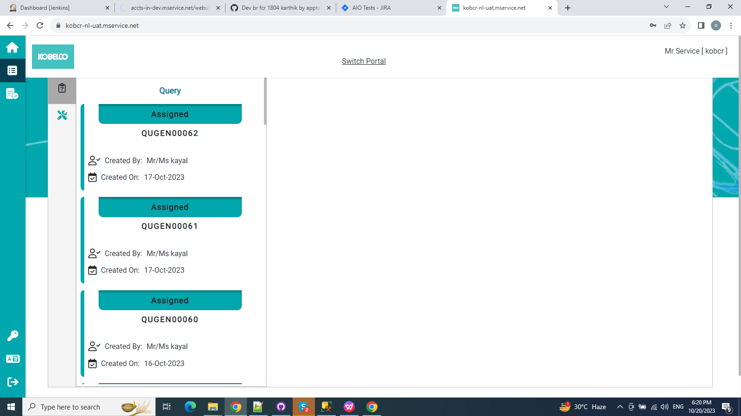

Slide 32
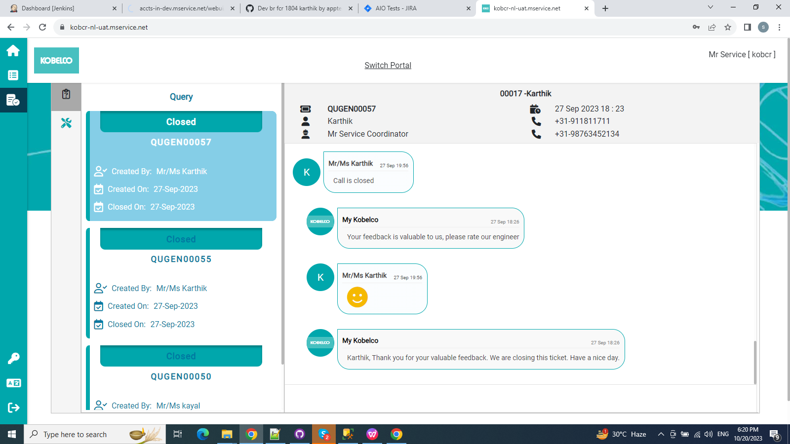

Slide 33
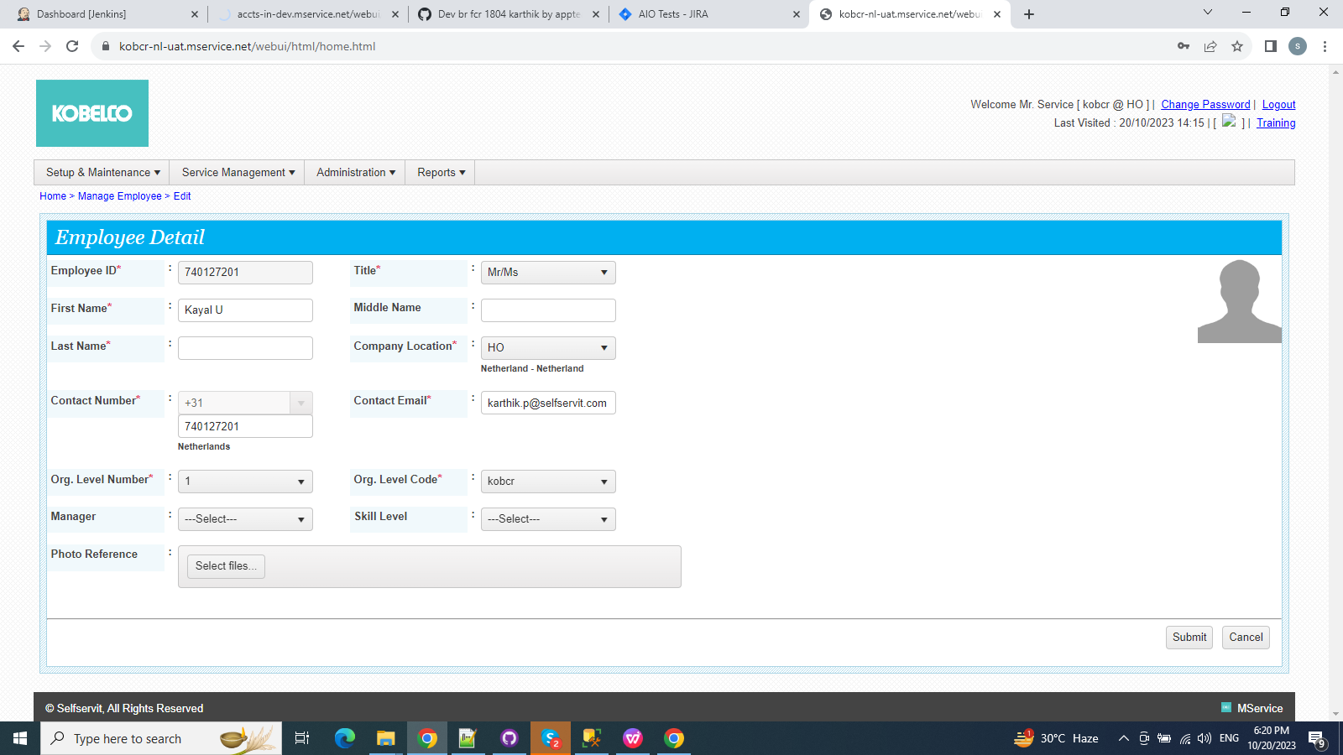

Slide 34
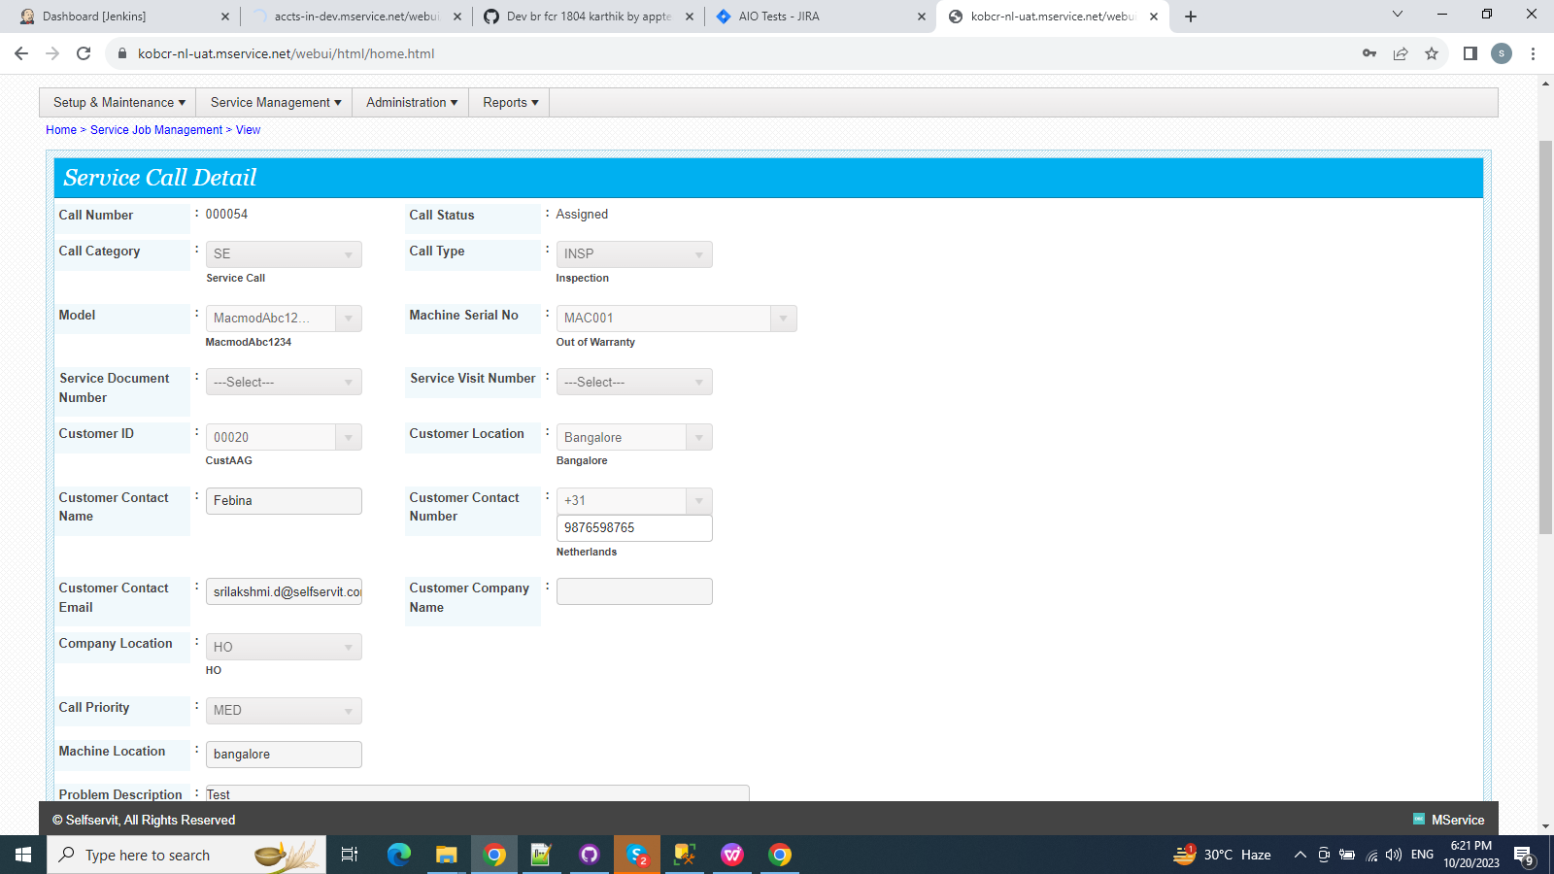

Slide 35
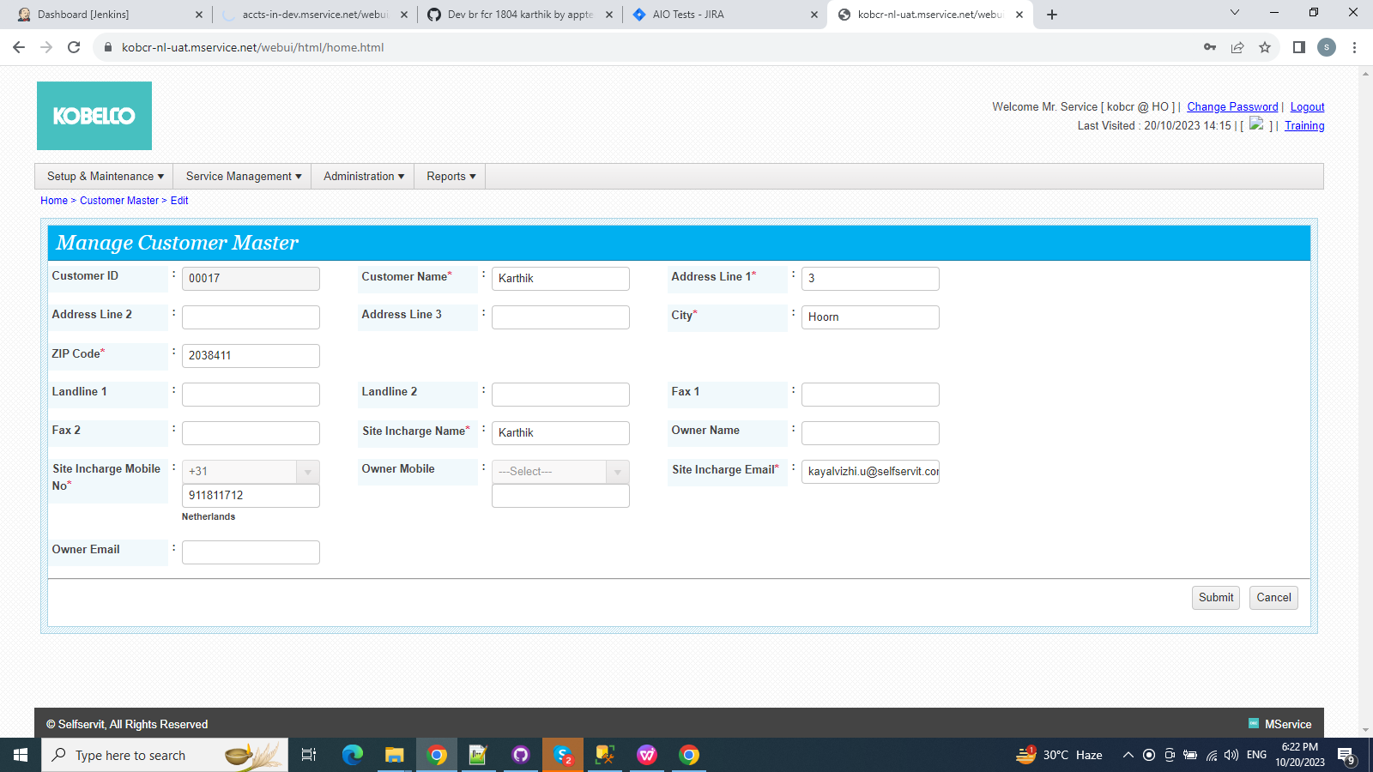

Slide 36
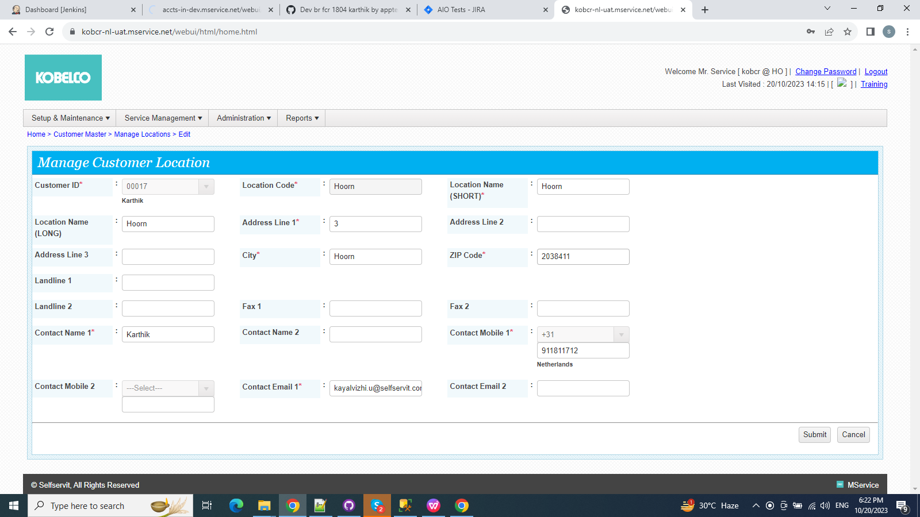

Slide 37
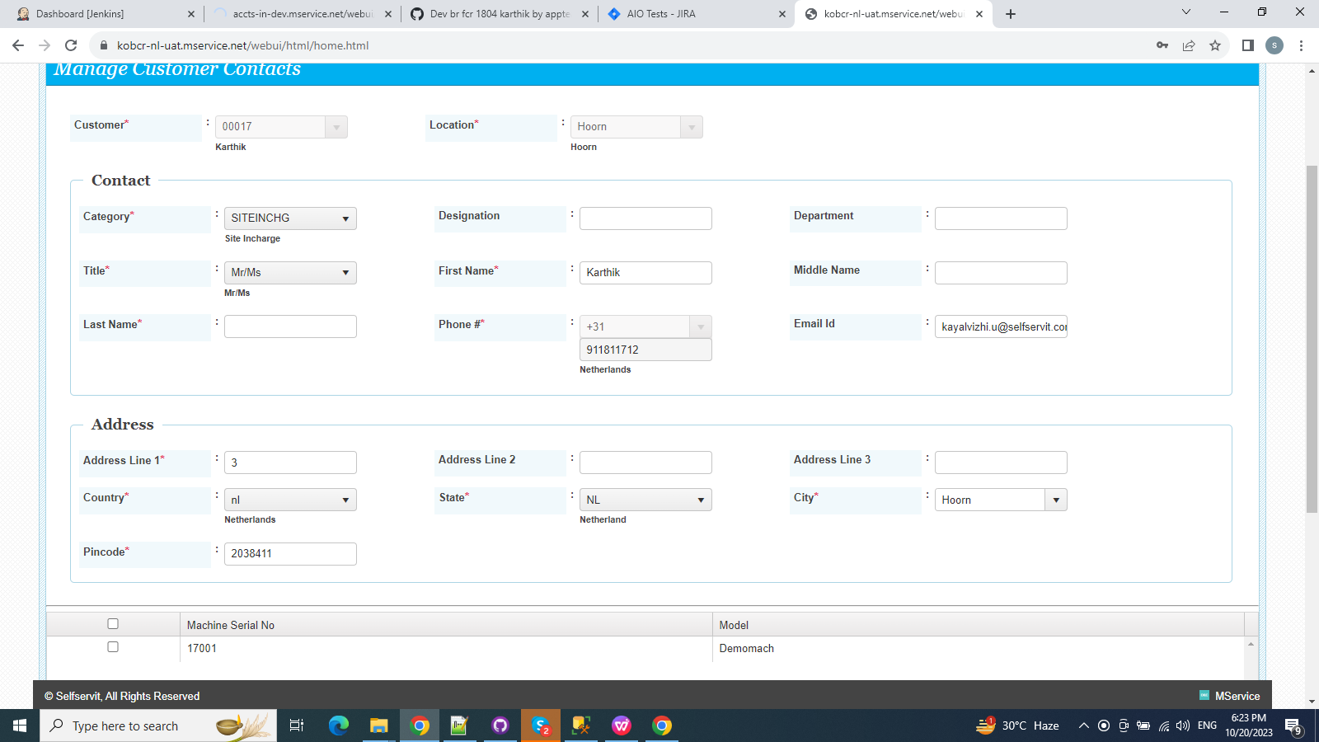

Slide 38
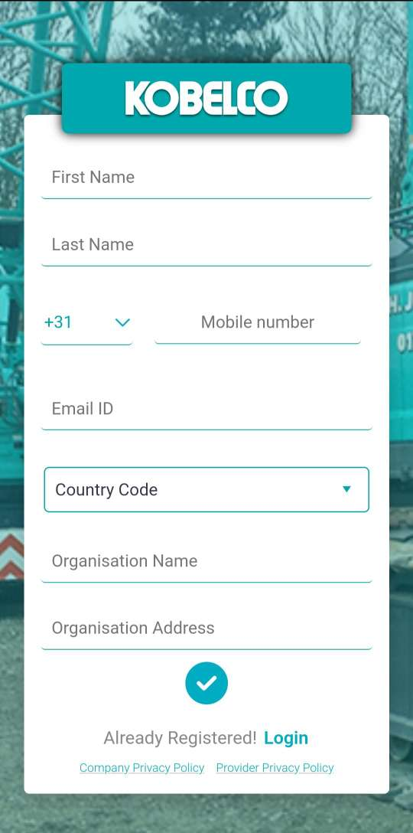
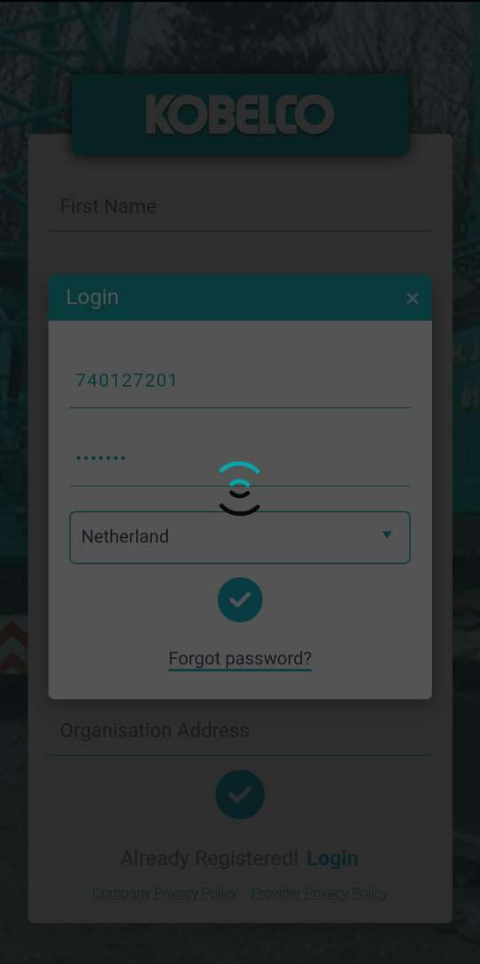
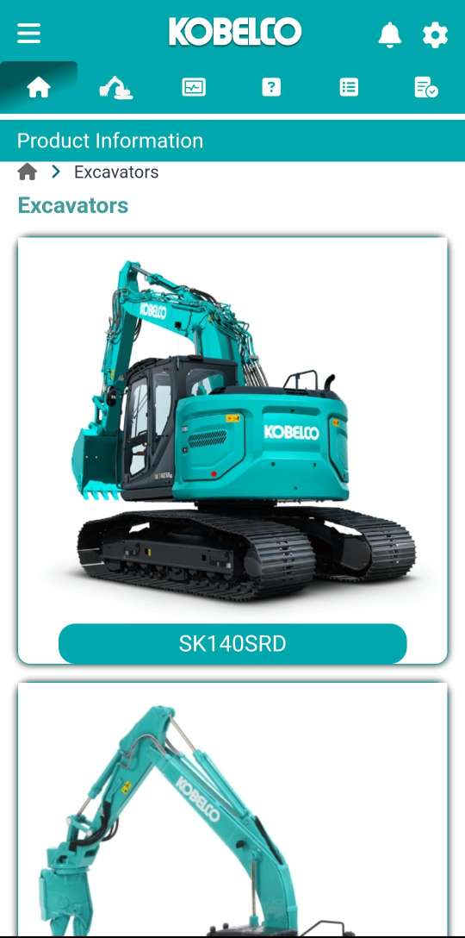

Slide 39
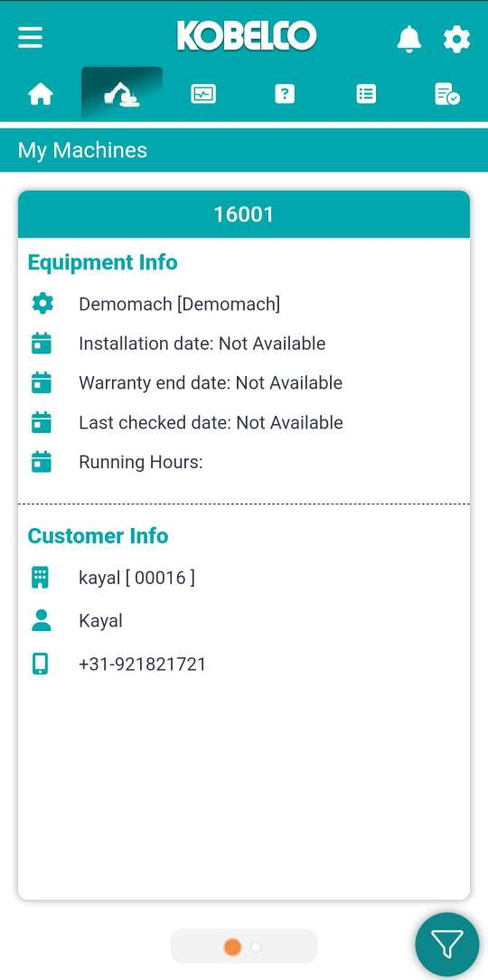
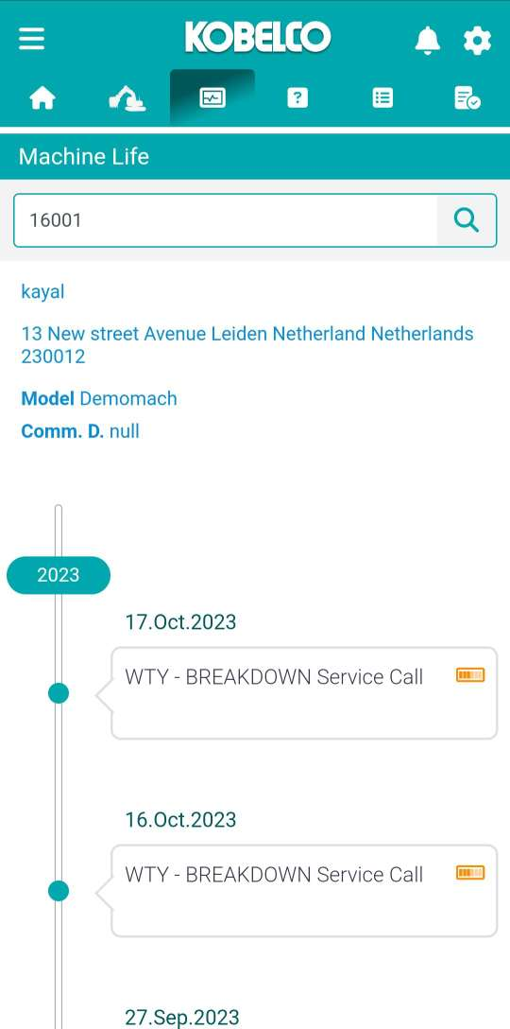
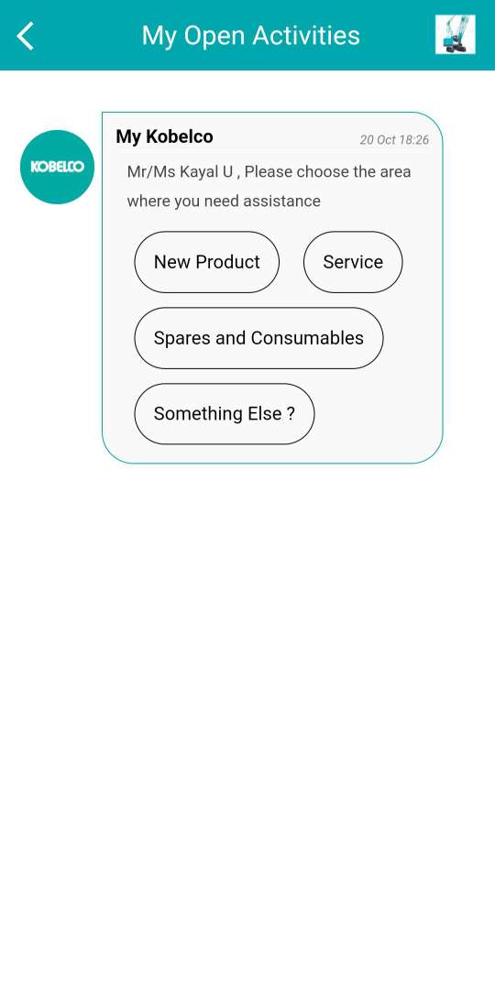

Slide 40
