Slide 1
AUTOMATIC RAIN SENSING CAR WIPERS

Slide 2
ABSTRACT
Driver safety is a important aspect in todays cars.
In many cases, a lack of proper vision is responsible for accidents during heavy rainfall.
We proposed an automatic rain sensing wiper system that detects rain and starts automatically and stops when the rain stops

Slide 3
PROPOSED METHOD
We have proposed an automated wiper system that turns on automatically when it rains and stops when it stops raining.
We used a servomotor, rain sensor, Arduino, and LCD module to control the wiper system.
Whenever it rains, the rain sensor detects the intensity of the rain and sends that information to the Arduino.

Slide 4
PROPOSED METHOD
The information collected by the rain sensor is processed by Arduino and the processed information is sent to the servo motor to perform the desired action.
The information sent to the microcontroller controls the speed of the wiper and speed is based on the intensity of the rain.

Slide 5
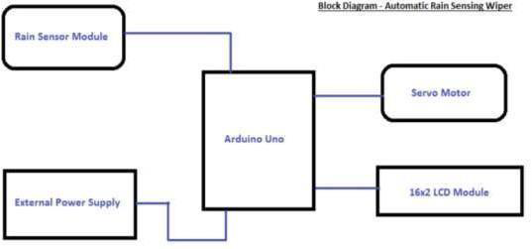
BLOCK DIAGRAM

Slide 6
Hardware Specifications
Arduino Uno
Rain Sensor
Servo Motor
Lcd Display
Resistors

Slide 7
Software Specifications
Arduino Compiler
MC Programming Language: C

Slide 8
Arduino Uno
The Arduino Uno is a microcontroller board that can be controlled by sending instructions in code format.
The Arduino Uno is based on the ATmega328.It has fourteen digital input/output pins, six analog inputs, a sixteen megacycle oscillator, a USB association, an influence jack, associate degree ICSP header, and a push button.

Slide 9
Rain Sensor
A rain sensor is a device used to detect raindrops. These are electrically separated and can be used as printed circuit boards.
The function of the rain sensor can be properly compared with the function of the switch. This rain sensor unit consists of a rain board and a control board.

Slide 10
Servo Motor
Servo motors are small and can be placed on the device to perform the desired action more effectively.
These servo motors are controlled by pulse width modulation.
Servo motors rotate both clockwise and counterclockwise.

Slide 11
IMPLEMENTATION
The rain sensor, which senses the rainfall, is placed at the side corner of the windshield outside the car.
The wiper blades are connected with the servo motor and are powered by it.
The rain sensor, LCD module, and the servo motor are connected with Arduino, which is present in the car connected to a dc source.

Slide 12
IMPLEMENTATION
The speed of the servo motor is increased whenever the intensity rises from low to high.
There are three different speeds for the Low, Medium and High intensity of the rainfall.
When the intensity of the rainfall increases, the rotation speed of the wiper will decrease automatically.

Slide 13
APPLICATIONS
Rain Sensing wipers can used in all 4-wheeler vehicles.
It is more useful in marine applications.
It is used in aircrafts and trains.

Slide 14
RESULT
SIMULATION RESULT
.

Slide 15
THANK YOU

