Slide 1
Object-Oriented Analysis
and Design
Unified Modeling Language

Slide 2
Modeling
Why Modeling ?
A model is a simplification at some level of abstraction
We build models to better understand the systems we are developing.
To help us visualize to specify structure or behavior
To provide template for building system to document decisions we have made
Principles of Modeling:
The models we choose have a profound influence on the solution we provide
Every model may be expressed at different levels of abstraction
The best models are connected to reality

Slide 3
Unified Modeling Language
“A picture is worth a thousand words.” - old saying
“A language provides a vocabulary and the rules for combining words for the purpose of communication”
A modeling language is a language whose vocabulary and rules focus on the conceptual and physical representation of a system. A modeling language such as the UML is thus a standard language for software blueprints.”
Brief History: It was developed in 1990s as an amalgamation of several techniques, prominently OOAD technique by Grady Booch, OMT (Object Modeling Technique) by James Rumbaugh, and OOSE (Object Oriented Software Engineering) by Ivar Jacobson.
UML attempted to standardize semantic models, syntactic

Slide 4
Static Models
Static models, such as UML class diagrams, help design the definition of packages, class names, attributes, and method signatures (but not method bodies).
Static models, such as UML class diagrams, help design the definition of packages, class names, attributes, and method signatures (but not method bodies).

Slide 5
Dynamic Models
Dynamic models, such as UML interaction diagrams (sequence diagrams or communication diagrams), help design the logic, the behavior of the code or the method bodies.
They tend to be the more interesting, difficult, important diagrams to create.

Slide 6
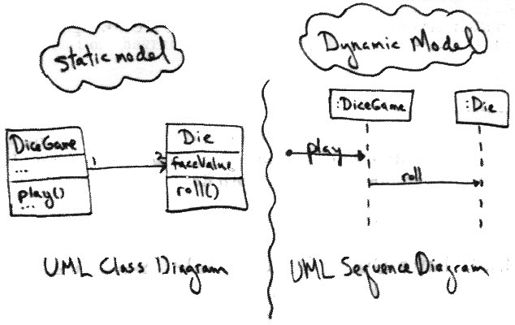
Static and Dynamic Modeling

Slide 7
UML Diagrams
The unified modeling language become the standard modeling language for object-oriented modeling. It has many diagrams, however, the most diagrams that are commonly used are:
Use case diagram: It shows the interaction between a system and it’s environment (users or systems) within a particular situation.
Class diagram: It shows the different objects, their relationship, their behaviors, and attributes.
Sequence diagram: It shows the interactions between the different objects in the system, and between actors and the objects in a system.
State machine diagram: It shows how the system respond to external and internal events.
Activity diagram: It shows the flow of the data between the processes in the system.
List of Tools : https://en.wikipedia.org/wiki/List_of_Unified_Modeling_Language_tools

Slide 8
Use Case Diagram
A use case describes how a user uses a system to accomplish a particular goal. A use case diagram consists of the system, the related use cases and actors and relates these to each other to visualize: what is being described? (system), who is using the system? (actors) and what do the actors want to achieve? (use cases), thus, use cases help ensure that the correct system is developed by capturing the requirements from the user's point of view.

Slide 9
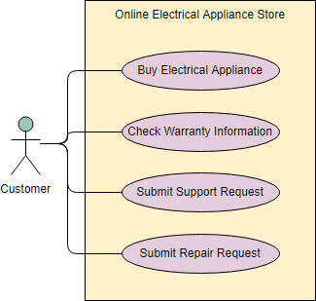
Use Case Diagram (Contd.)

Slide 10
Use Case Diagram
Actors are usually individuals involved with the system defined according to their roles. The actor can be a human or other external system.
A use case describes how actors uses a system to accomplish a particular goal. Use cases are typically initiated by a user to fulfill goals describing the activities and variants involved in attaining the goal.
The relationships between and among the actors and the use cases.
The system boundary defines the system of interest in relation to the world around it.

Slide 11
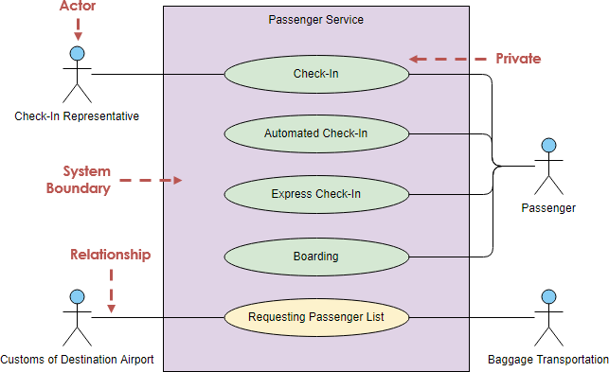
Use Case Diagram (Contd.)

Slide 12
Class Diagrams
A class diagram describes the structure of an object-oriented system by showing the classes in that system and the relationships between the classes. A class diagram also shows constraints, and attributes of classes.
Attribute
The attribute section of a class lists each of the class's attributes on a separate line. The attribute section is optional, but when used it contains each attribute of the class displayed in a list format. The line uses this format: name : attribute type (e.g. cardNumber : Integer).
Operation
The operations are documented in the bottom compartment of the class diagram's rectangle, which also is optional. Like the attributes, the operations of a class are displayed in a list format, with each operation on its own line. Operations are documented using this notation: name (parameter list) : type of value returned (e.g. calculateTax (Country, State) : Currency).

Slide 13
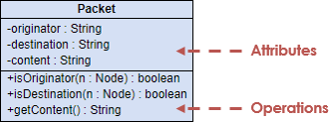
Class Diagrams

Slide 14
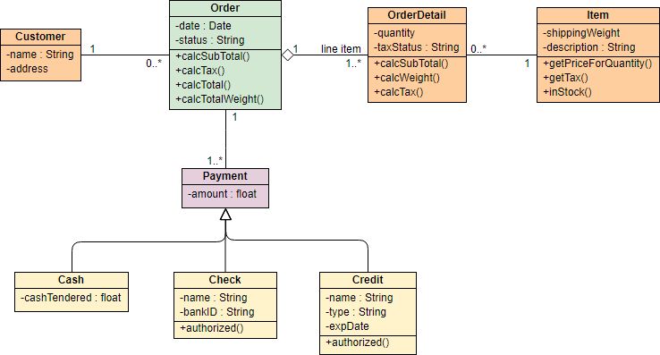
Class Diagrams – Case Study

Slide 15
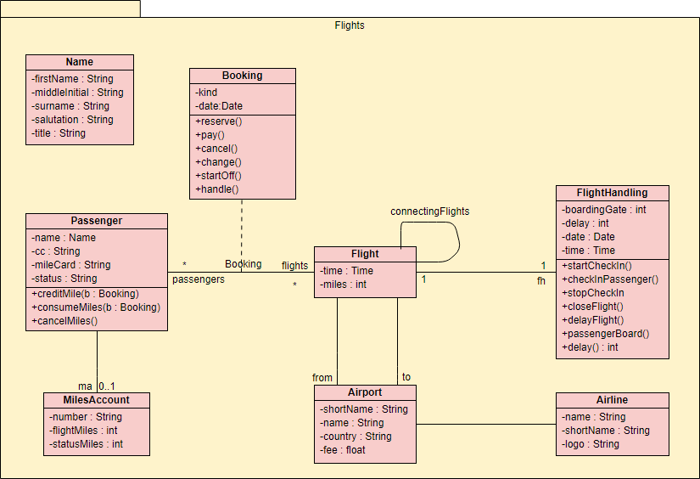
Class Diagrams – Case Study

Slide 16
UML Objects
Identify
Refine
Draw

Slide 17
1. Identify Objects
What we do is to start collecting our use cases, user stories, and any other written requirements together.
Now, we are going to identify the most important parts of our software; the most important things, or objects.
Objects will be in form of nouns. Those are the candidate objects, some of them will be actual objects in the system, and the rest won’t, as you’ll see later.

Slide 18
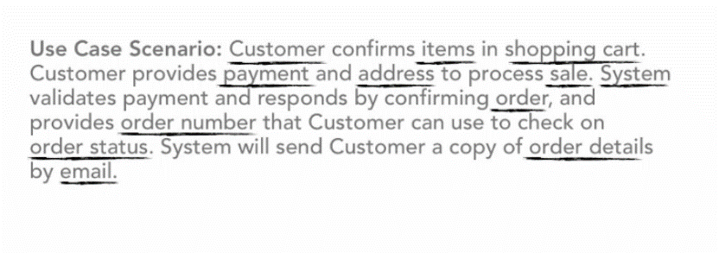
1. Identify Objects (Contd.)

Slide 19
2. Refine Objects
After underlying on your candidate objects, you start refining them, you start choosing your actual objects that will be in the system. So, to do that
Remove any duplicates. We may find same objects with different names, but they actually mean the same thing.
You may need to combine some objects, or, even splitting them into some other objects.
You may identify an attribute as an object instead.
You may identify a behavior as an object instead.
An attribute is a property or characteristic of the object. For example, when we say “A car is red”, red here is a property for the car, which is the actual object.
A behavior is something an object can do (responsibility). For example, when we say, “A bird can fly”, fly here is a behavior, while the bird is the actual object.

Slide 20
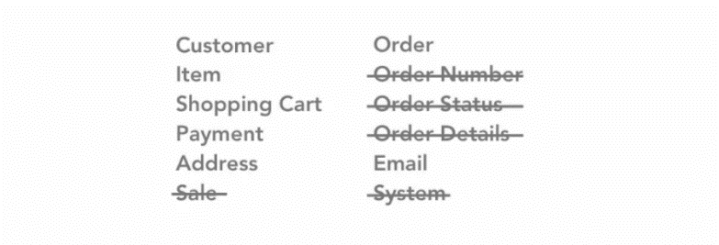
2. Refine Objects (Contd.)

Slide 21
3. Draw Objects
What you need to do now is using your pencil and paper, just draw the conceptual model by box all objects.
There are some tools you may use, but for now, a pencil, and piece of paper are more than enough.

Slide 22
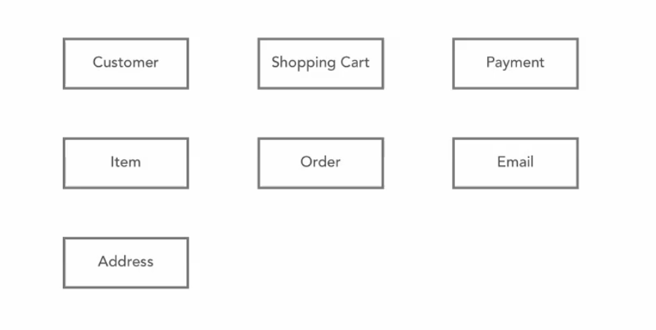
3. Draw Objects (Contd.)

Slide 23
4. Identify Relationships
You start indicate the relationships between your objects.
It’s very obvious that these objects will interact with each other. For example, a customer can place an order, a student can enroll in a course, an admin can update a post, and so on.
Drawing a line between objects, and writing the relationship verbs is enough to denote there is a relationship.

Slide 24
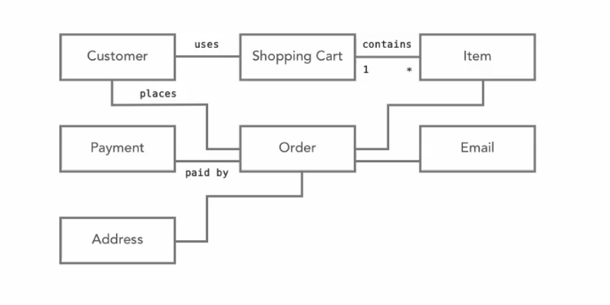
4. Identify Relationships (Contd.)

Slide 25
Sequence Diagrams
A sequence diagram describes an interaction among a set of objects participated in a collaboration (or scenario), arranged in a chronological order; it shows the objects participating in the interaction by their "lifelines" and the messages that they send to each other.

Slide 26
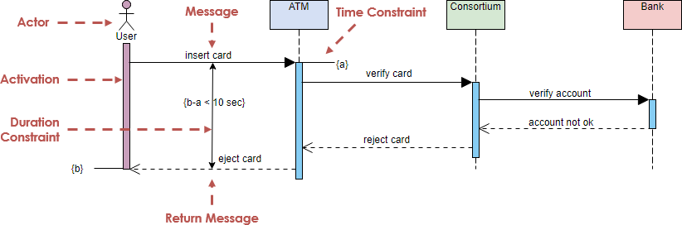
Sequence Diagrams (Contd.)

Slide 27
Activity Diagram
Activity Diagram is similar to a business work flow diagram or simply a flowchart with much richer semantics. It describes the system activities, or the person who does the activity, and the sequential flow of these activities. The activity diagram is one of the UML diagrams associated with object oriented approach, through it can be used in any other software development paradigm

Slide 28
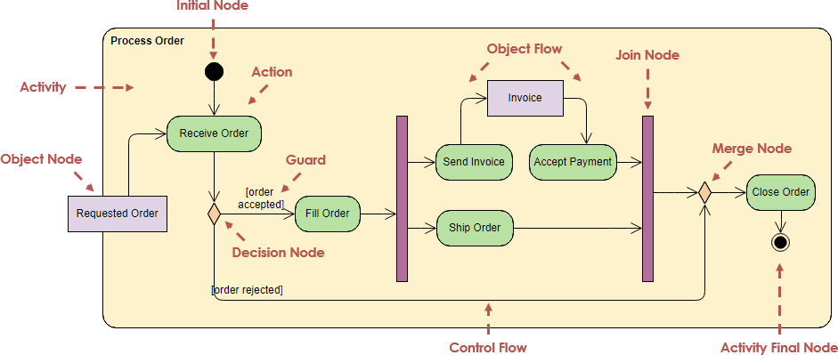
Activity Diagram

Slide 29
State Machine Diagram
A state machine diagram is used to model the dynamic behavior of individual class objects, use cases, and entire systems. In other words, when a state machine created where the object it is attached to, that object becomes the owner of the state machine, for example, the object to be attached by the state machine could be a class, use case or even the entire system.

Slide 30
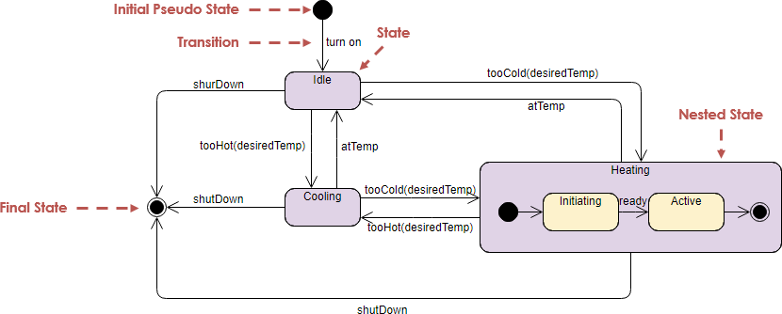
State Machine Diagram Packages (Contd.)

Slide 31
Packages
Package diagram shows the arrangement and organization of model elements in middle to large scale project that can be used to show both structure and dependencies between sub-systems or modules.

Slide 32
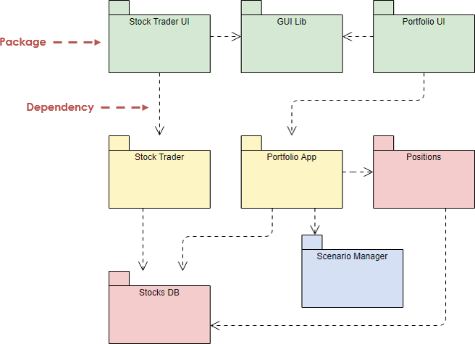
Packages (Contd.)

Slide 33
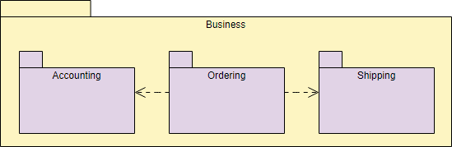
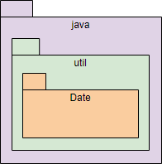
Packages (Contd.)

Slide 34
UML Extensibility
UML defines three extensibility mechanisms to allow modelers to add extensions without having to modify the underlying modeling language.
Stereotypes
Constraints
Tagged Values

Slide 35
UML Meta Model
Relationship between model and meta-model:
The meta class Class is a model for the class Person
Since Person is a model (for the instance aPerson), Class is a meta model (model for models)

Slide 36
Thank You!

