Slide 1
IBM SkillsBuild | AICTE | BharatCares - Machine Learning & Applied AI Internship 2026
AI Shield
A unified, explainable fraud detection platform for scam messages, phishing URLs and emails using machine learning
Karthik Siraparapu - Internship ID IBMUEML004123
Marwadi University - B.Tech CSE (AI & ML), Semester 5
SDG 9 - Industry, Innovation & Infrastructure | SDG 16 - Peace, Justice & Strong Institutions

Slide 2
Problem: scams reach users faster than filters adapt
■ Fake KYC, OTP, lottery, courier, UPI and 'digital arrest' messages arrive by SMS, WhatsApp, links and email
■ Rule-based spam filters miss newly worded scams
■ Users must decide in seconds and rarely know why a message is dangerous
■ Most tools output a bare yes/no with no explanation
Example scam text
'Dear customer, your SBI account will be blocked today. Update KYC immediately: http://sbi-kyc-update.xyz/login and share the OTP to verify.'
OTP + KYC + urgency + bank impersonation + suspicious link
AI Shield | Karthik Siraparapu | IBM SkillsBuild - AICTE - BharatCares 2026
2

Slide 3
Motivation
■ Rapid growth of UPI and mobile banking brings many first-time digital users
■ Victims lose money and personal data within minutes of one wrong tap
■ A free 'second opinion' tool can interrupt a scam before money moves
■ Explanations teach users to recognise scam patterns themselves
■ Applied ML is a practical way to learn from past scams instead of hand-writing rules
AI Shield | Karthik Siraparapu | IBM SkillsBuild - AICTE - BharatCares 2026
3

Slide 4
Objectives
■ Detect fraudulent messages, phishing URLs and emails with machine learning
■ Compare several algorithms and pick the best by evidence
■ Explain every prediction: reasons, key terms and URL red flags
■ Audit all datasets first; remove duplicates, leakage and unusable labels
■ Deliver a simple web app, tests, documentation and a deployable GitHub repository
■ Report limitations honestly
AI Shield | Karthik Siraparapu | IBM SkillsBuild - AICTE - BharatCares 2026
4

Slide 5
SDG alignment
SDG 9 Industry, Innovation & Infrastructure
SDG 16 Peace, Justice & Strong Institutions
■ AI-based innovation that makes digital payment infrastructure safer
■ Open-source, reusable modules
■ Helps reduce cyber-enabled financial crime
■ Guides users to official reporting: cybercrime.gov.in, helpline 1930
AI Shield | Karthik Siraparapu | IBM SkillsBuild - AICTE - BharatCares 2026
5

Slide 6
Existing systems and their gaps
Existing solution | Strength | Gap
Telecom / email spam filters | Automatic, at scale | Miss new wording; no explanation to user
Blocklists / Safe Browsing | Accurate for known URLs | New phishing domains are not yet listed
Bank awareness SMS, helplines | Trusted advice | Reactive; needs the victim to ask
Asking friends / searching the web | Free | Slow and unreliable
AI Shield | Karthik Siraparapu | IBM SkillsBuild - AICTE - BharatCares 2026
6

Slide 7
Proposed system: AI Shield
Scam-message analyzer
Phishing-URL detector
Email checker (experimental)
Explainable-AI layer
TF-IDF + calibrated Linear SVM
Lexical features + 2 Random Forests
TF-IDF + Linear SVM
Verdict, probability, reasons
■ Streamlit web app: Home, Scam, URL, Email, Threat Dashboard, Model Report, About
■ Output: Legitimate / Suspicious / Fraudulent + fraud probability + 'Why?' panel
AI Shield | Karthik Siraparapu | IBM SkillsBuild - AICTE - BharatCares 2026
7

Slide 8
Datasets supplied (10 files)
Dataset | Rows | Used for
Composite Scam Transcripts | 36,751 + 9,188 | Scam-text model
GCT 100K | 100,000 | Audited - excluded (random labels)
Phishing URL features (basic) | 2,488 | URL model A
UCI phishing features | 11,055 | URL model B (8 lexical features)
Enron fraud-labelled emails | 447,417 | Email text model (sample 10,451)
Email features | 524,846 | Supplementary experiment
Email spam (independent) | 84 | External validation
Global Cyber Threats | 3,000 | Dashboard
CryptoScamDB URIs | 17 | Demo only
AI Shield | Karthik Siraparapu | IBM SkillsBuild - AICTE - BharatCares 2026
8

Slide 9
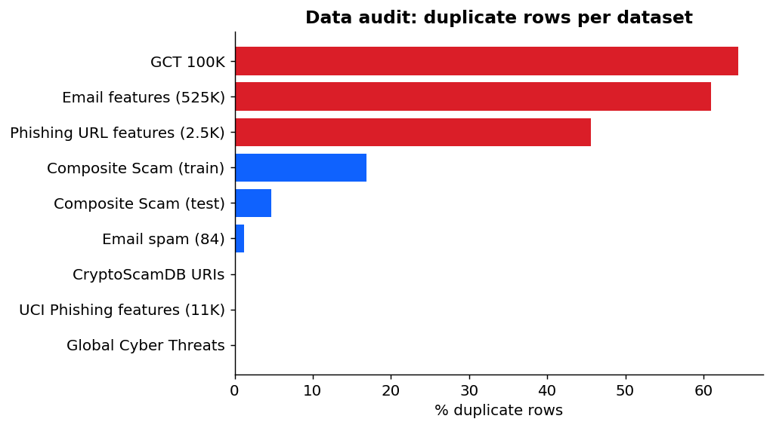
Data audit: five problems found before training
■ GCT 100K labels are random: text-only model 49.9% = chance
■ Composite: 17% duplicate rows; 2,900 test texts leaked from train
■ URL datasets hold features, not URLs
■ Email feature table: 61% duplicates, 3% positive
■ Enron: 0.5% fraud, corporate-only negatives
AI Shield | Karthik Siraparapu | IBM SkillsBuild - AICTE - BharatCares 2026
9

Slide 10
Data cleaning
■ Drop exact duplicates and conflicting labels
■ Remove test rows that also appear in train
■ Text: strip HTML, mask URLs and long numbers, lower-case, normalise spaces
■ URL: normalise scheme, parse host, compute only features a pasted URL can provide
■ Fixed random seed (42), stratified splits
Scam text | Rows
Train raw | 36,751
Train clean | 30,540
Test raw | 9,188
Test clean (no leak) | 5,949
AI Shield | Karthik Siraparapu | IBM SkillsBuild - AICTE - BharatCares 2026
10

Slide 11
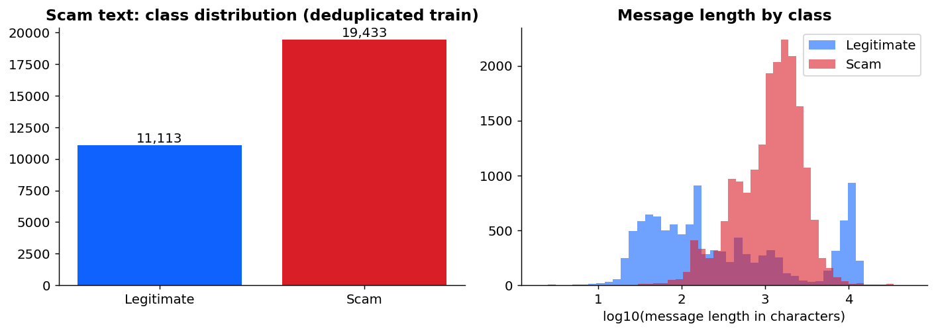
EDA: scam text
■ Scam transcripts are far longer than genuine messages
■ Length alone gives 85% accuracy - a shortcut
■ So results are also reported by length bucket
AI Shield | Karthik Siraparapu | IBM SkillsBuild - AICTE - BharatCares 2026
11

Slide 12
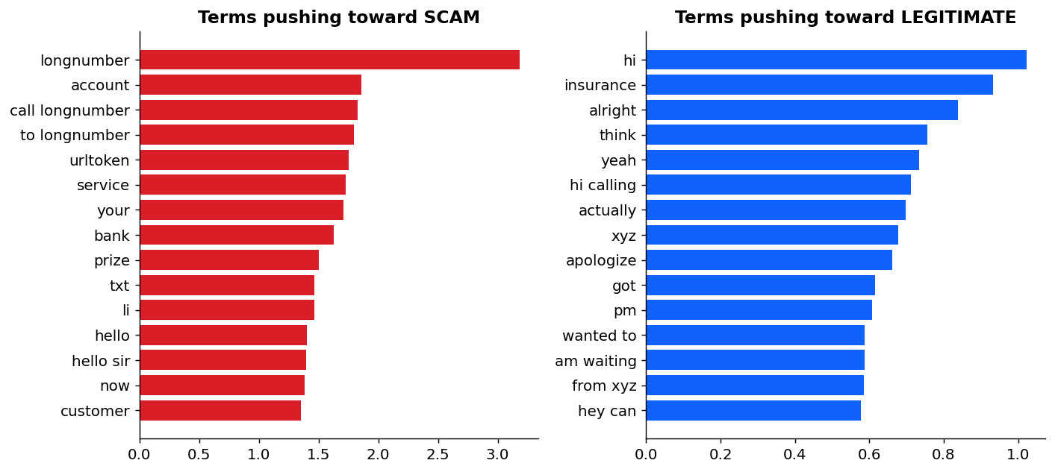
EDA: top terms the model learned
■ Scam side: masked long numbers (phone numbers), account, bank, prize, customer, links
■ Legit side: casual conversation words (hi, alright, yeah, think)
■ 'longnumber' and 'urltoken' are cleaning placeholders for numbers and links
■ These weights feed the 'Why?' panel
AI Shield | Karthik Siraparapu | IBM SkillsBuild - AICTE - BharatCares 2026
12

Slide 13
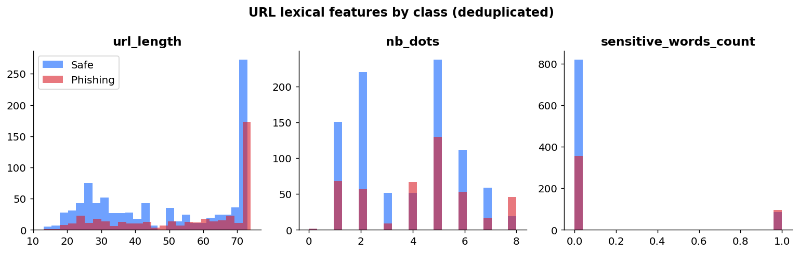
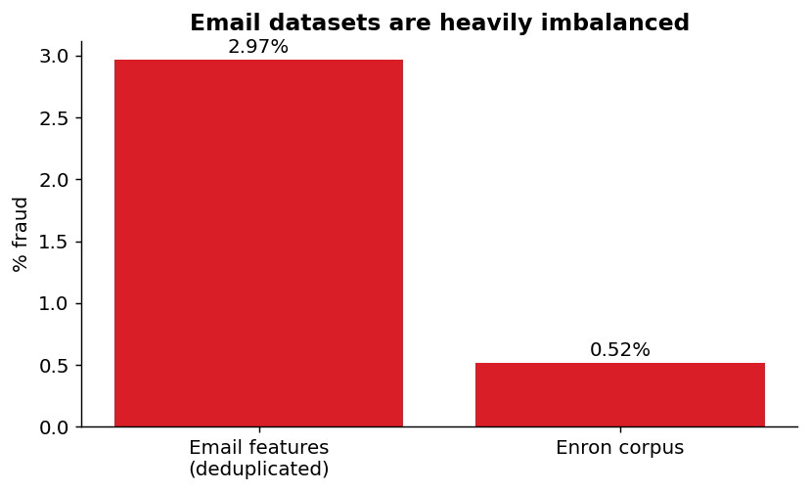
EDA: URL features and email imbalance
■ Phishing URLs: more dots, longer, more sensitive words
■ Email data are heavily imbalanced, so PR-AUC is reported
AI Shield | Karthik Siraparapu | IBM SkillsBuild - AICTE - BharatCares 2026
13

Slide 14
Machine-learning pipeline
Raw data
Audit &
cleaning
Feature
extraction
Model
comparison
Hold-out
test
Save model
(joblib)
Streamlit
app
Text: TF-IDF word 1-2 grams | URL: lexical features | Metrics: accuracy, precision, recall, F1, ROC-AUC, PR-AUC, confusion matrix
Model chosen on validation data; test set used once
AI Shield | Karthik Siraparapu | IBM SkillsBuild - AICTE - BharatCares 2026
14

Slide 15
Algorithms compared
Algorithm | Scam text | URL | Email text
Logistic Regression | yes | yes | yes
Naive Bayes (Complement) | yes | - | yes
Linear SVM (calibrated) | yes (selected) | - | yes (selected)
Decision Tree | yes | yes | -
Random Forest | yes | yes (selected) | -
Gradient Boosting | - | yes | -
AI Shield | Karthik Siraparapu | IBM SkillsBuild - AICTE - BharatCares 2026
15

Slide 16
Results: scam-text module
99.7%
0.998
0.9997
4 / 13
accuracy (leak-free test)
F1 score
ROC-AUC
false positives / false negatives
■ By length: <200 chars (SMS-like) 98.8%; 200-1000 99.7%; >1000 (long dialogue) 100.0%
■ Selected model: TF-IDF 1-2 grams + calibrated Linear SVM
■ Caution: templated scripts may leave near-duplicates, so real-world accuracy is likely lower
AI Shield | Karthik Siraparapu | IBM SkillsBuild - AICTE - BharatCares 2026
16

Slide 17
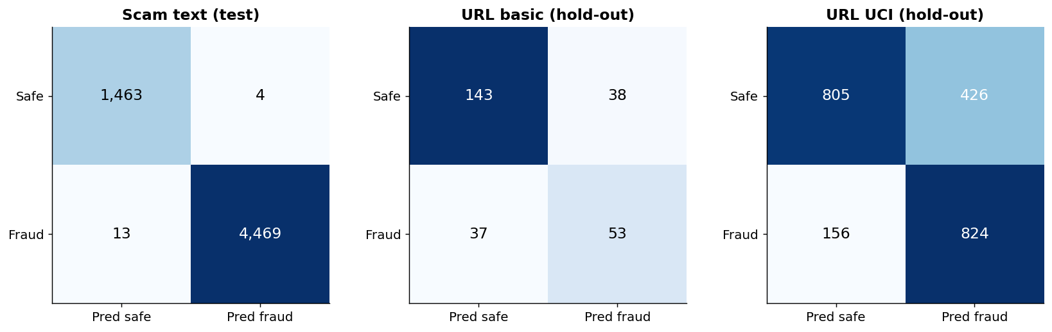
Results: URL module
 | Basic | UCI
Rows | 1,354 | 11,055
ROC-AUC | 0.81 | 0.83
F1 | 0.59 | 0.74
Recall | 0.59 | 0.84
■ Only lexical features: a screening aid, not a verdict
■ App averages both models and always lists red flags
AI Shield | Karthik Siraparapu | IBM SkillsBuild - AICTE - BharatCares 2026
17

Slide 18
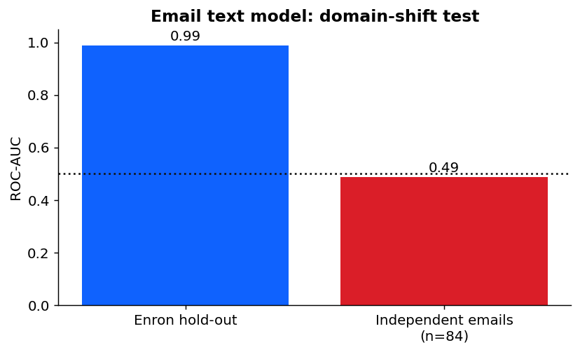
Results: email module and the domain-shift finding
■ Enron hold-out: F1 0.88, ROC-AUC 0.99
■ Independent emails (n=84): ROC-AUC 0.49 = chance
■ Model learned corporate style, not fraud
■ Shipped as 'experimental' with a warning - a negative result reported honestly
AI Shield | Karthik Siraparapu | IBM SkillsBuild - AICTE - BharatCares 2026
18

Slide 19
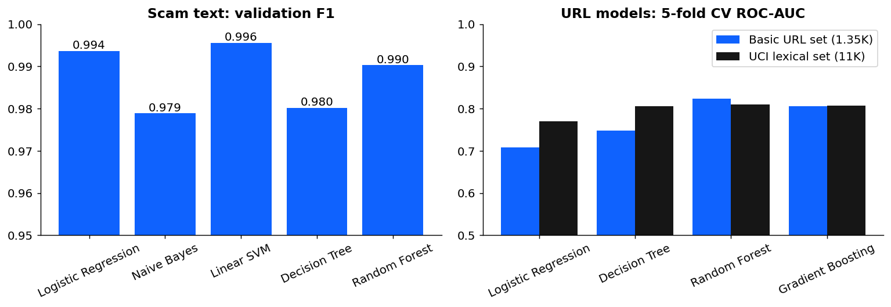
Model comparison
AI Shield | Karthik Siraparapu | IBM SkillsBuild - AICTE - BharatCares 2026
19

Slide 20
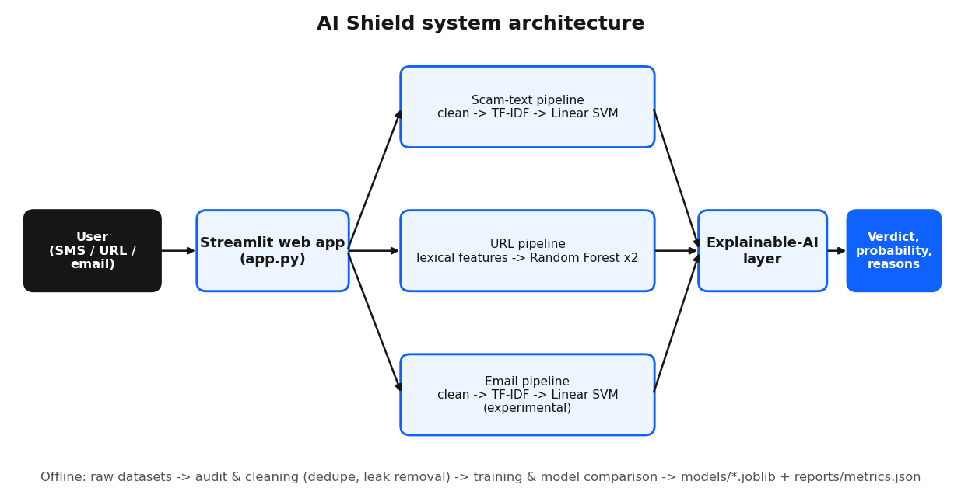
System architecture
AI Shield | Karthik Siraparapu | IBM SkillsBuild - AICTE - BharatCares 2026
20

Slide 21
Explainable output (from predict.py)
Scam message
Suspicious URL
Safe URL
Fraudulent
Fraudulent
Legitimate
Fraud probability 99.0%
Fraud probability 58.0%
Fraud probability 4.4%
Why:
- Credential / OTP request
- KYC / account threat
- Urgency
- Authority impersonation
- Contains a link
Why:
- Does not use HTTPS
- Many subdomains (3 dots in host)
- Hyphen in domain name (common in look-alike domains)
- Sensitive keywords: account, paypal, secure, update, verify
- Domain ends in a TLD frequently abused for scams (.info)
Why:
- No lexical red flags
AI Shield | Karthik Siraparapu | IBM SkillsBuild - AICTE - BharatCares 2026
21

Slide 22
Deployment
■ Repository includes trained models (~11 MB), tests and requirements.txt
■ Push to a public GitHub repo
■ Streamlit Community Cloud: New app -> repo -> main file app.py
■ Copy the live URL into the README and the submission form
■ Local run: pip install -r requirements.txt, then streamlit run app.py
AI Shield | Karthik Siraparapu | IBM SkillsBuild - AICTE - BharatCares 2026
22

Slide 23
Limitations and future scope
Limitations
Future scope
■ No labelled Indian SMS corpus supplied
■ URL models see only the string
■ Email model does not generalise
■ English only
■ Labelled SMS data, Hindi/Gujarati
■ Real phishing-email corpora
■ WHOIS / reputation features, QR scams
■ Browser extension, WhatsApp bot
■ Transformer models
AI Shield | Karthik Siraparapu | IBM SkillsBuild - AICTE - BharatCares 2026
23

Slide 24
Conclusion
■ AI Shield delivers explainable fraud detection across messages, URLs and emails
■ Scam-text hold-out F1 0.998; URL ROC-AUC 0.81-0.83
■ Data auditing prevented inflated results and revealed where data is missing
■ Aligned with SDG 9 and SDG 16
■ Next: better Indian SMS and email data, deployment feedback loop
AI Shield | Karthik Siraparapu | IBM SkillsBuild - AICTE - BharatCares 2026
24

Slide 25
Thank you - Questions?
Karthik Siraparapu | IBMUEML004123
GitHub: <add repo link> | Live app: <add Streamlit link>

