Slide 1

Cars24 Analytics project
K KARTHIK(cds04_028)
28/07/24

Slide 2
Introduction on Cars24
Founded in 2015 by Vikram Chopra
To sale , purchase and financing of pre-owned cars
Selling and buying a cars is key freature and service

Slide 3
Summary
This analysis provides valuable insights into car pricing dynamics and consumer preferences. The data suggests significant regional price variations, trends in vehicle usage based on model age, and a clear preference for petrol vehicles. Understanding these factors can aid potential buyers and sellers in making informed decisions, while also highlighting areas for further investigation, such as the growing trend of increasing EMIs and the relatively low market share of electric vehicles.

Slide 4
Introduction to web scraping
scrape data from the Cars24 website for two different metro locations.
Attributes to scrape: Car Model , Brand, Car Name ,Car Variant , Car Transmission , KM Driven
Collect data from cars24 using python language and libraries such as selenium, beautifulsoup, pandas etc.

Slide 5
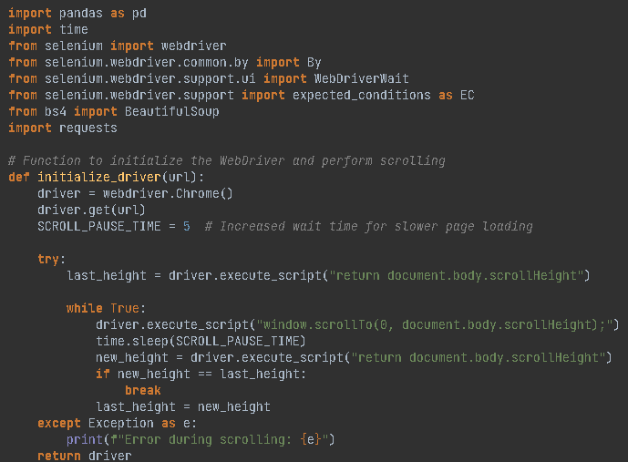
Sample python code

Slide 6
Data cleaning using mysql
Importing and cleaning of data is done
Summarizing the key insights from cars24 data based on the attributes such as car model etc
Highlight major trends, patterns from the cars24 data.

Slide 7
Excel dashboard
Created different columns based on the cars24 data.
Use slicer such as brand, price classification,etc.
Classification on the low car price and location
Use line chart to see Monthly EMI by car model
Use tree chart to see most cars are petrol fuel type.

Slide 8
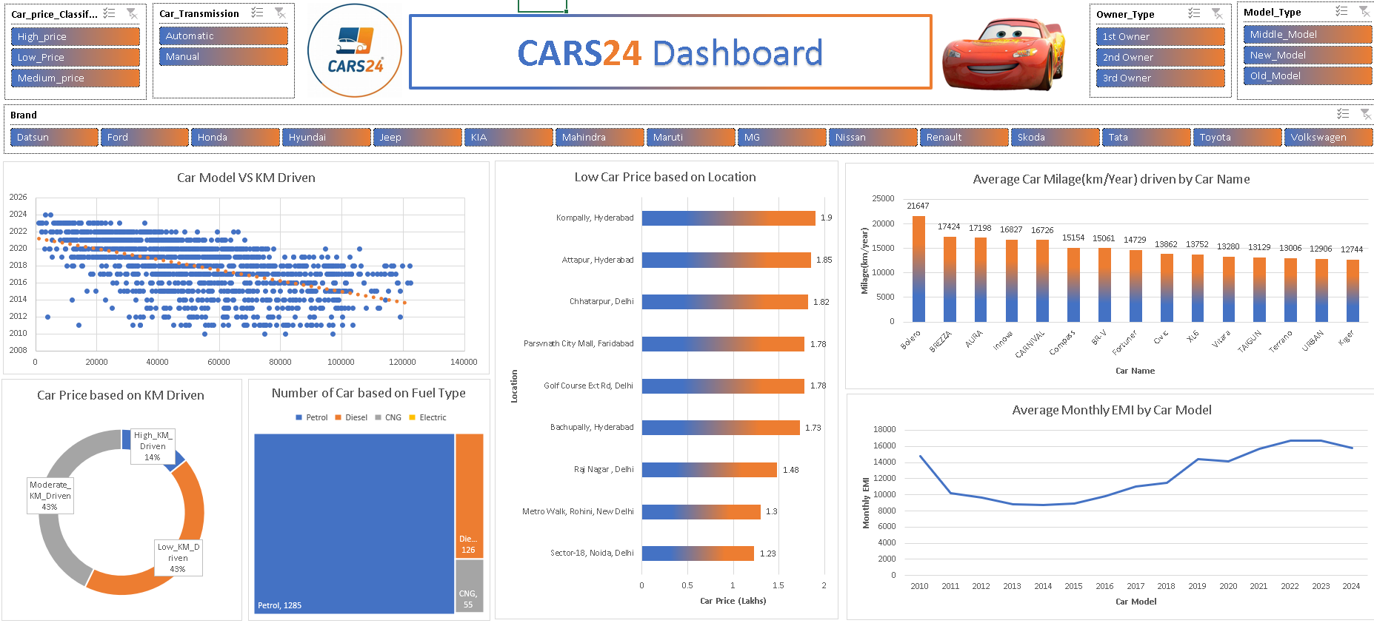
Cars24 dashboard

Slide 9
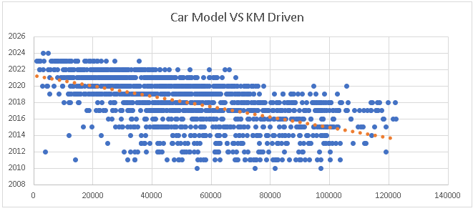
Car Model vs Km Driven
we can see that as car model decreases km driven increases
i.e more km driven by car model like 2012, 2013, 2014 etc

Slide 10
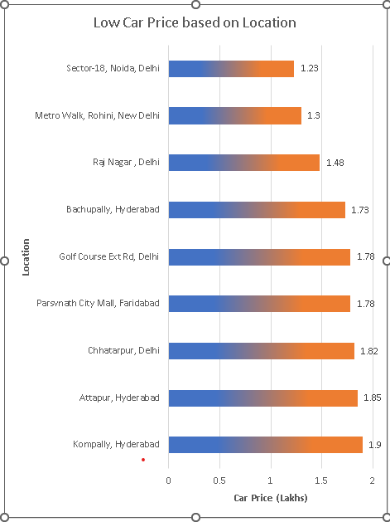
Regional Price Differences
we can see that lowest car price is in the location Noida , Delhi with the price of 1.29 lakhs and then Rohini , Delhi etc.
I.e north region have low car price than south region.

Slide 11
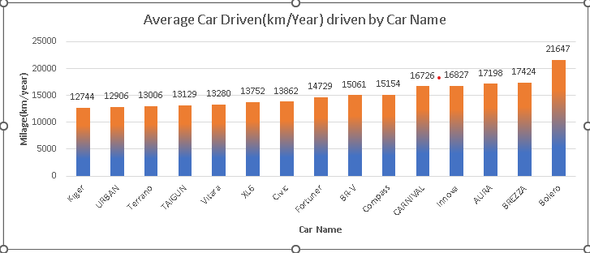
Least Driven Cars
We can see that lowest car driven is Kiger with 12744 km/year and then Urban with 12906 km/driven.
I.e least used car name are kiger ,urban etc for the travelling or long distance.

Slide 12
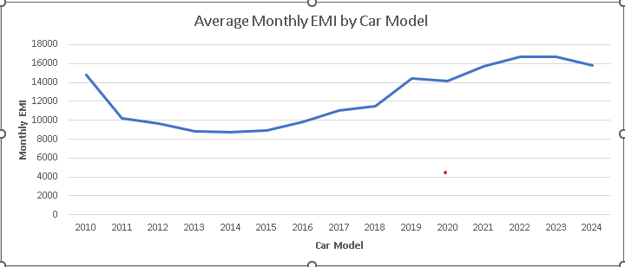
Monthly EMI Trends
Average monthly EMI is increasing from each year based on car model
Lowest monthly EMI is 2014 and the highest monthly EMI is 2023.

Slide 13
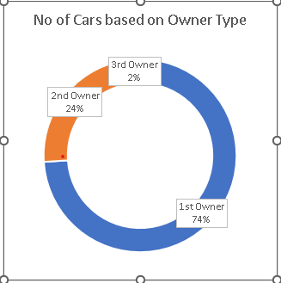
Distribution on Owner Types
We can see that most car are 1st Owner type with 74% and 2nd Owner type with 24% etc.

Slide 14
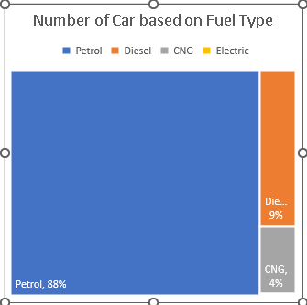
distribution on fuel type
We can see that most no of cars are uses Petrol as fuel type with 88% and least no of car uses electric as fuel type with >1%

Slide 15
Conclusion of the project
Based on our comprehensive analysis of the Cars24 dataset, several key insights have emerged:
Car Model vs. Kilometers Driven
Regional Price Differences
Least Driven Cars
Monthly EMI Trends
Distribution on Owner Types
Distribution on Fuel Types

Slide 16
Future scope of the project
Price Prediction Models and Usage Forecasting based on given cars24 project.
Live Data Updates and Mobile Access of the dashboard for up-to-date, on-the-go analysis.
Integrate external data such as economic indicators and vehicle history reports to provide more comprehensive insights.

