Slide 1

DEPARTMENT OF CSE(AI&ML) Major Project AGRINOVA APPLICATION USING AI&ML
PRESENTED BY:
U. Karthik Reddy(227R1A66K2)
R. Sai kiran (227R1A66J3)
K. Srinivas (227R1A66G0)
UNDER THE GUIDANCE OF:
N. Sandeep(Asst. Prof)

Slide 2
INTRODUCTION
Agriculture plays a vital role in economic growth, but farmers often face challenges such as unpredictable weather, crop diseases, and lack of timely expert guidance. To overcome these issues, our major project “AGRINOVA Application” provides a smart and integrated digital solution for modern farming. The application focuses on three core features: weather condition prediction, crop disease prediction, and an AI-powered chatbot. Weather prediction helps farmers plan sowing, irrigation, and harvesting efficiently. Disease prediction enables early identification of crop diseases, reducing losses and improving yield. The chatbot acts as a virtual assistant, offering instant guidance on crops, fertilizers, and farming practices. AGRINOVA aims to empower farmers with technology-driven insights, enhance productivity, and promote sustainable agriculture.

Slide 3
This project leverages Large Language Models (LLMs) to build an intelligent chatbot for Indian farmers, enabling natural language interaction to provide context-aware agricultural guidance. The system accepts user queries in multiple languages and responds with relevant information using a Groq-hosted LLM. Additionally, it includes a plant disease detection module powered by computer vision, allowing farmers to upload images of crops and receive instant diagnoses. By combining conversational AI with visual analysis, the platform aims to bridge the knowledge gap in rural farming communities, offering real-time, AI-driven support to enhance crop health and boost sustainable agricultural practices.
ABSTRACT

Slide 4
EXISTING SYSTEM
Traditional Agriculture Helplines
Web Portals or Mobile Apps
Manual Disease Diagnosis
Language and Literacy Barriers
Lack of Real-time Support

Slide 5
DISADVANTAGES
. Limited Availability
Not Scalable
No Visual Intelligence
Language Inaccessibility:
Low Personalization

Slide 6
PROPOSED SYSTEM
AI Chatbot (LLM-based)
Plant Disease Detection
Web-based Interface/API
Efficient and Fast Processing with Deep Learning Models
Weather-Integrated Advisory

Slide 7
ADVANTAGES
24/7 Real-Time Assistance
Multilingual Support
Image-Based Diagnosis
Cost-Effective and Scalable
Personalized, Context-Aware Responses
Bridges Knowledge Gap

Slide 8
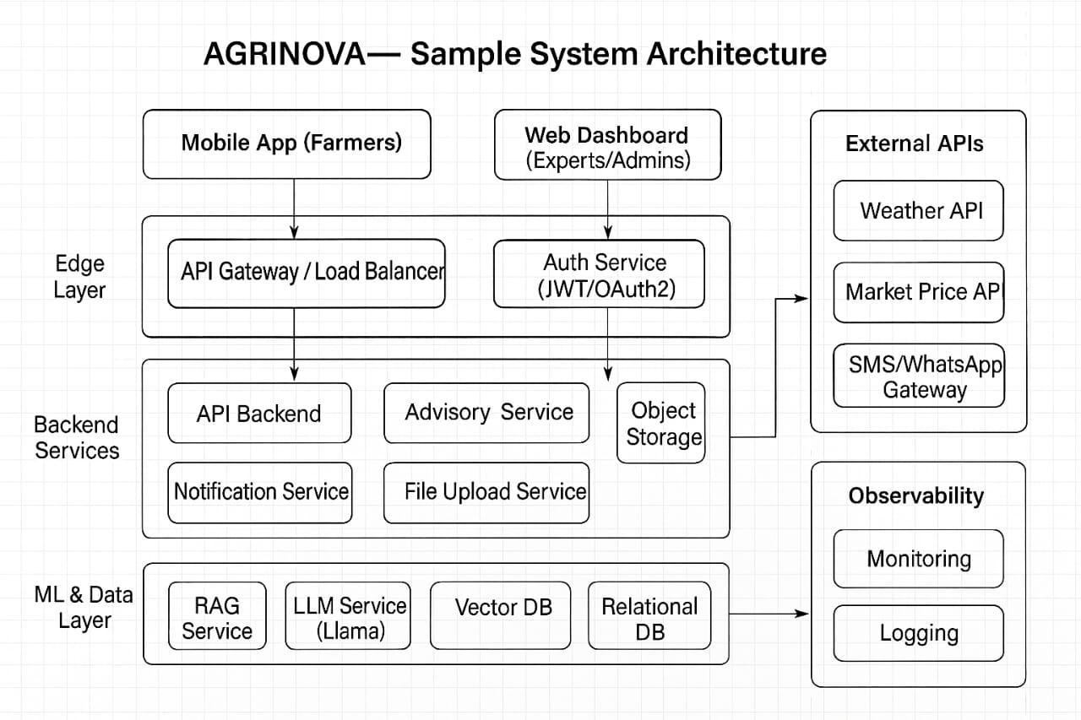
ARCHITECTURE

Slide 9
Software Requirements
1.Frontend (React + vite )
2. Backend (FastApi -Python , Noje.js - Express)
3. Databases & Storage
RDB: MySQL
VectorDB : Milvus
4. Machine Learning (LLM ,Llama /OpenAi API)

Slide 10
Hardware Requirements
RAM : 16GB
GPU : NVIDIA GPU with CUDA support
Storage : Minimun of 256 GB
Stable Internet Connection

Slide 11
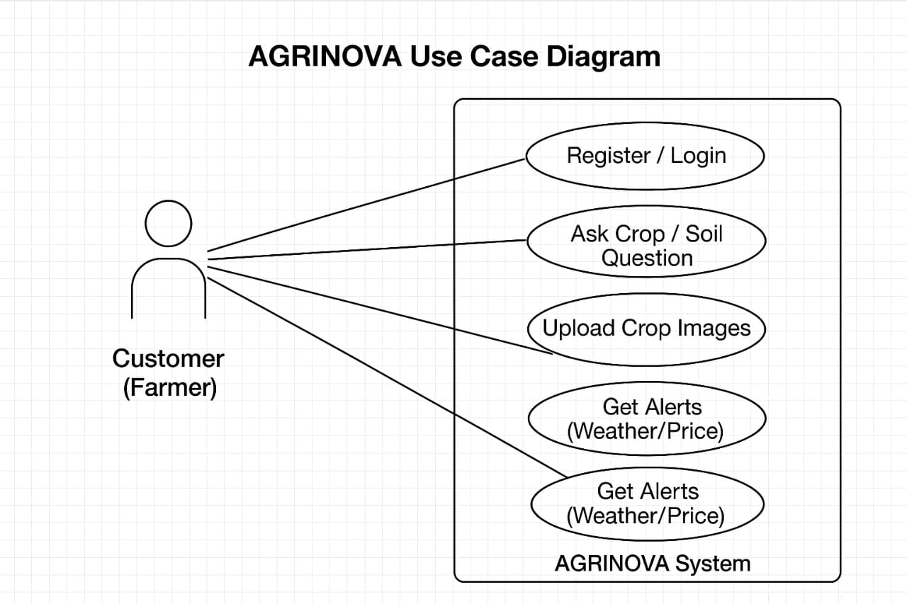
UseCase Diagram

Slide 12
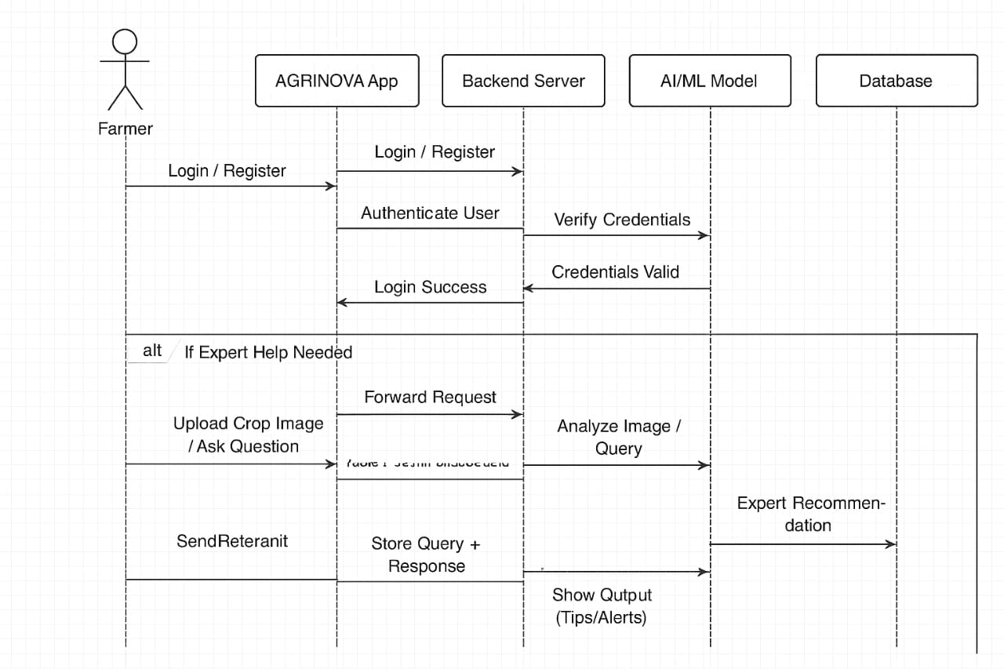
Sequence Diagram

Slide 13
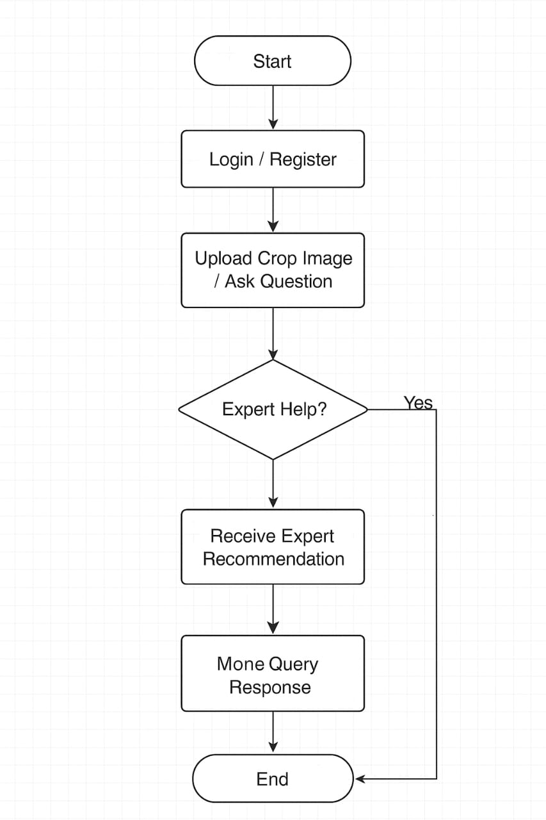
Activity Diagram

Slide 14
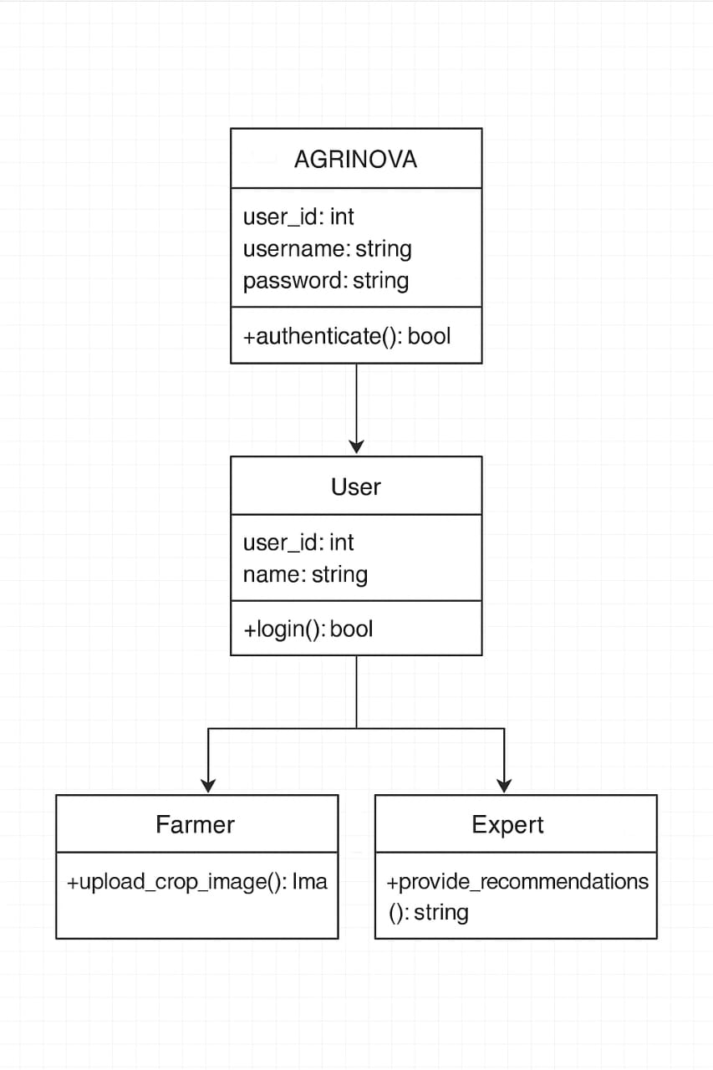
Class Diagram

Slide 15
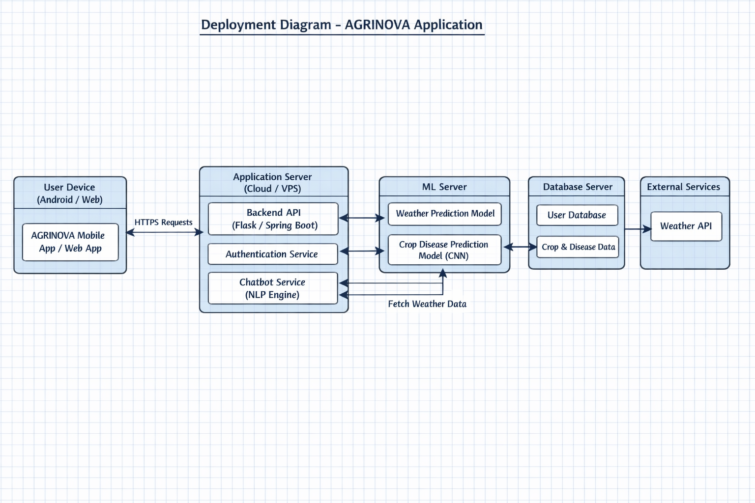
Deployment Diagram

Slide 16
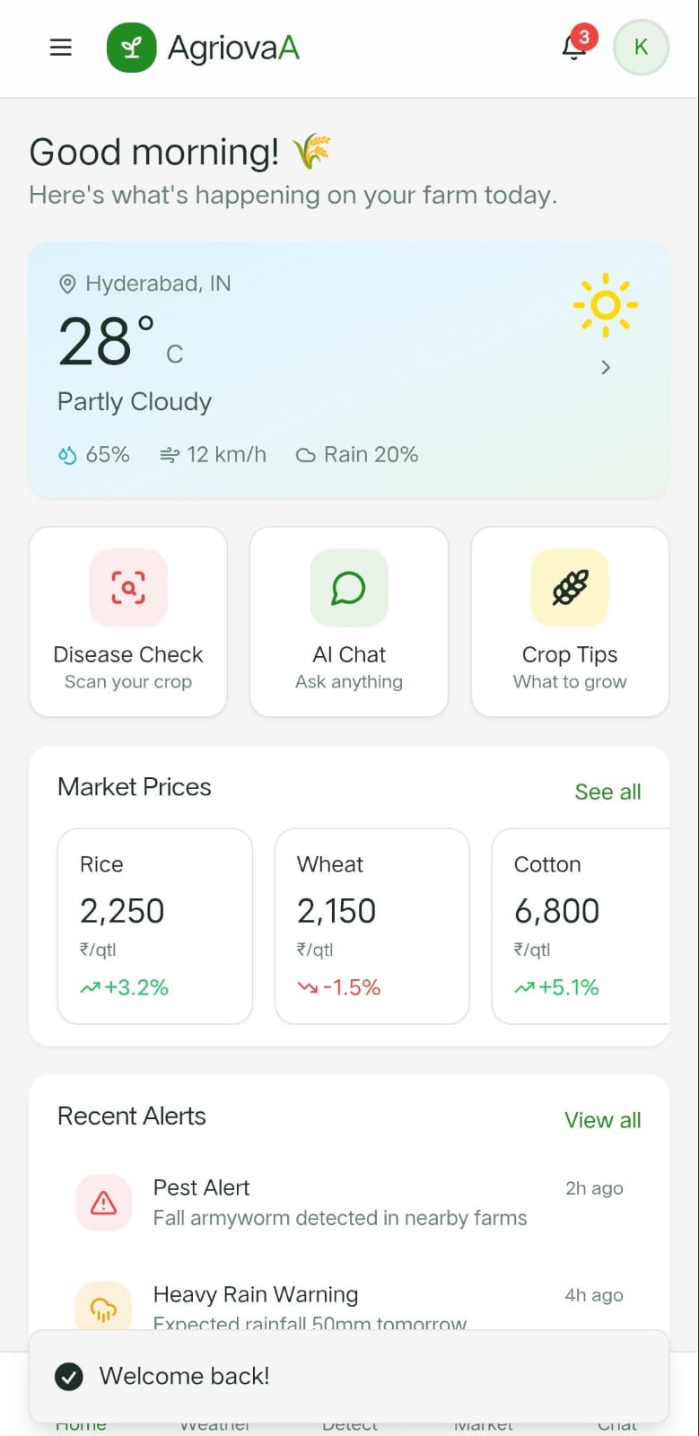
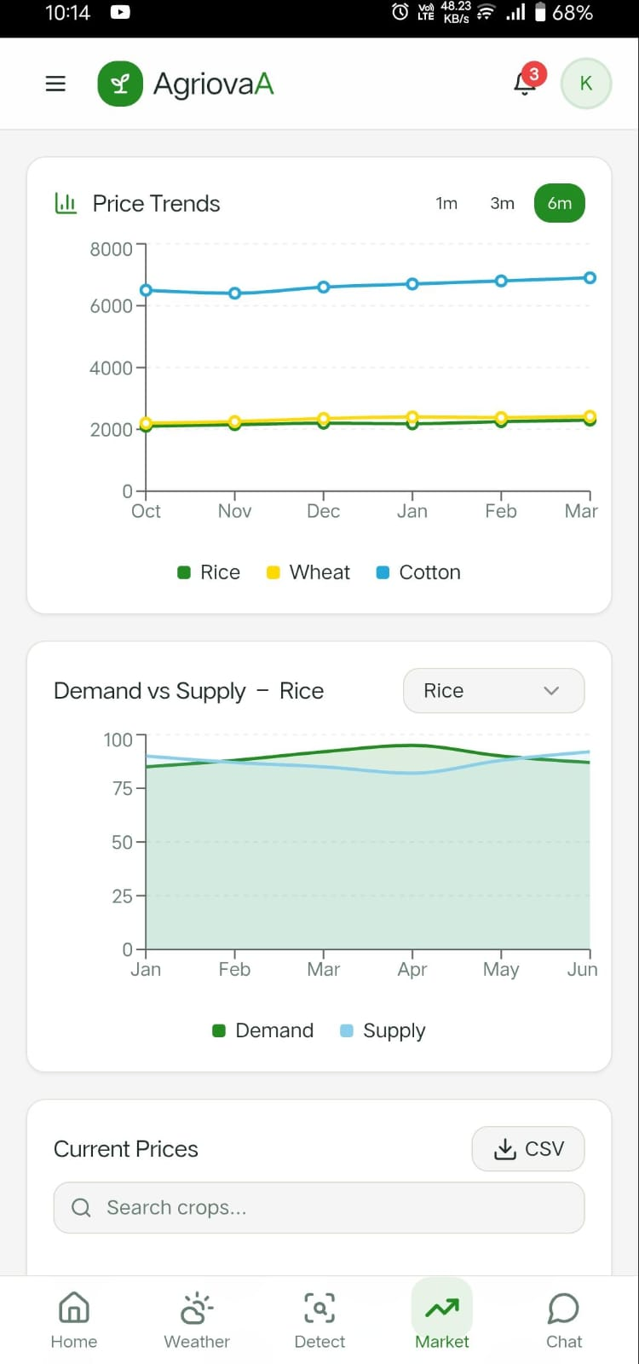
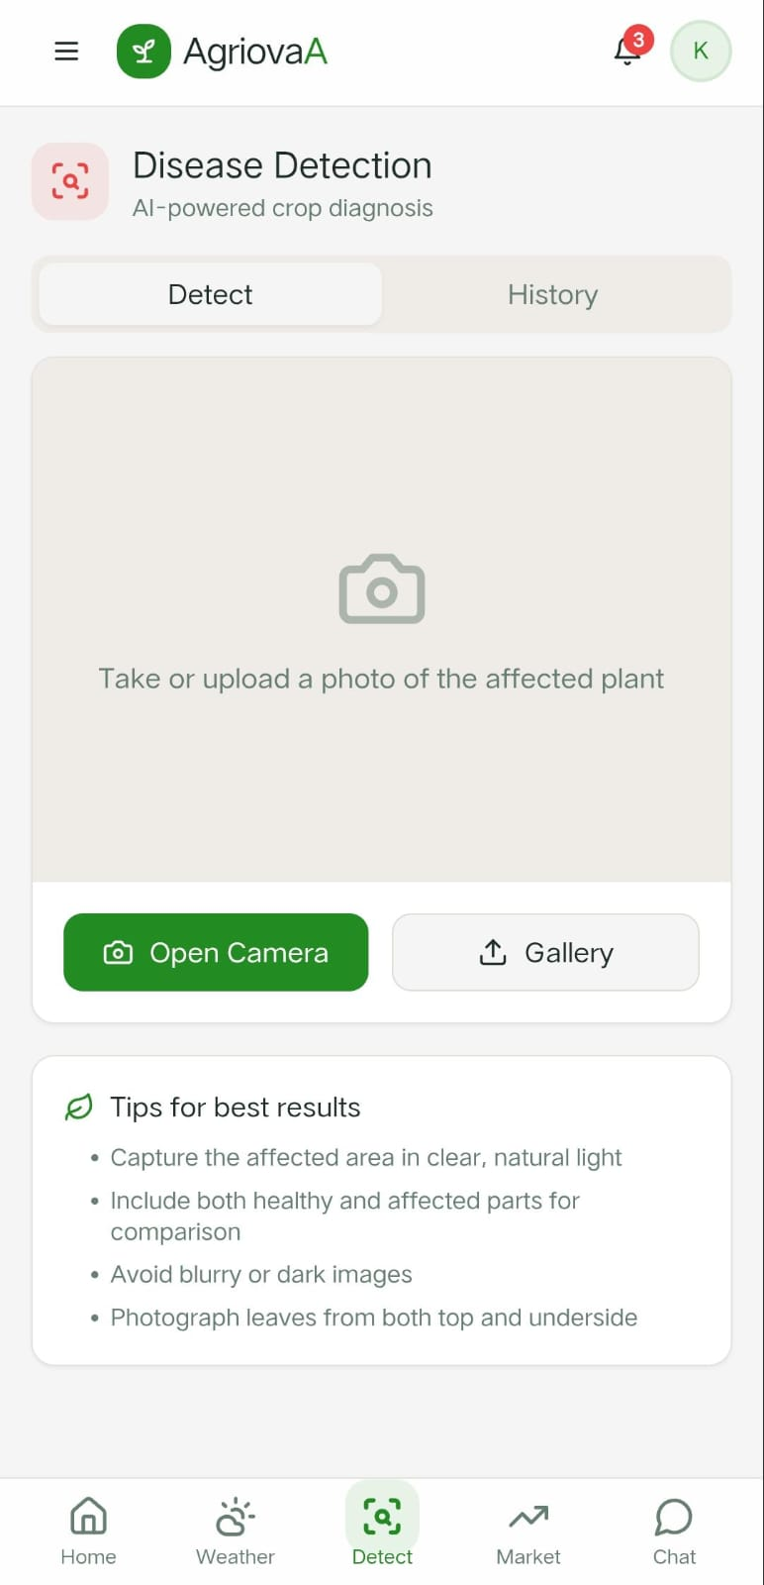
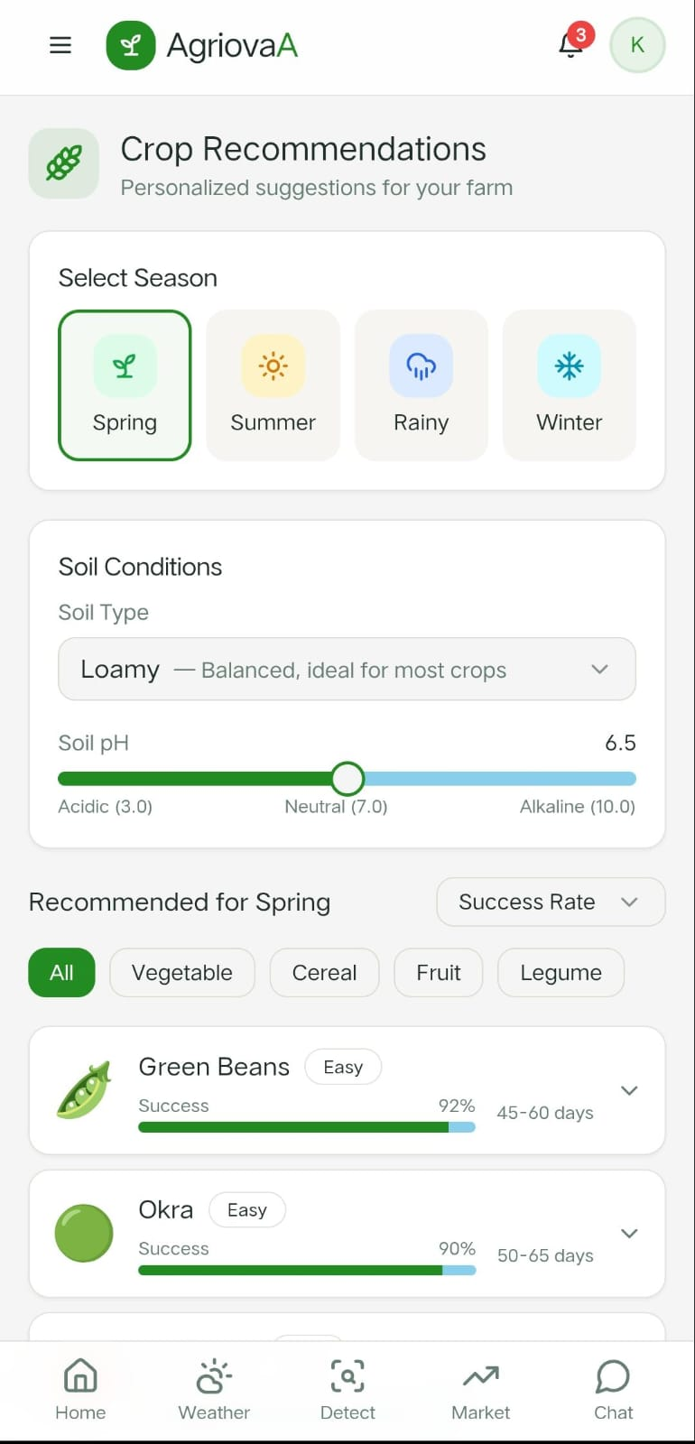
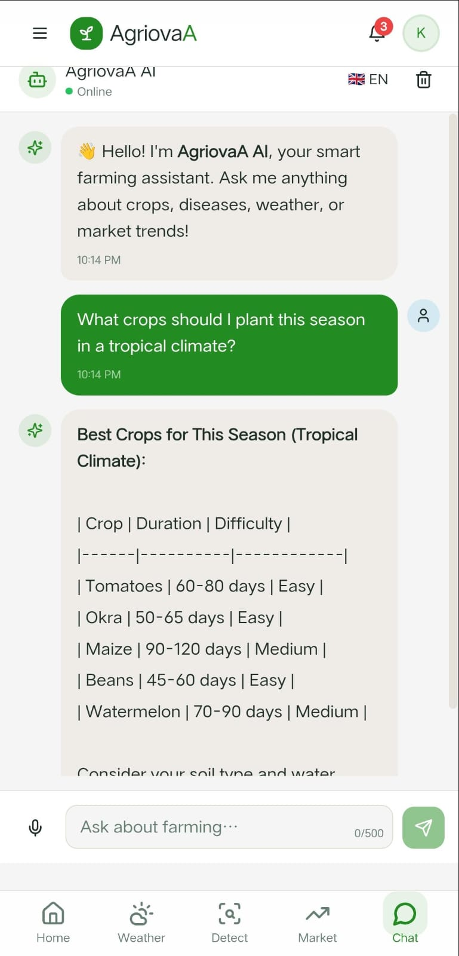
ScreenShots

Slide 17
Result Analysis
The AGRINOVA Application was successfully designed and implemented to assist farmers through intelligent, technology-driven solutions. The system effectively integrates weather prediction, crop disease prediction, and an AI-based chatbot within a single platform.
The weather prediction module provided accurate short-term forecasts, enabling better planning for irrigation, sowing, and harvesting activities. The crop disease prediction model demonstrated reliable performance in identifying common plant diseases at early stages, helping in timely preventive measures and reducing crop loss. The chatbot module efficiently handled user queries and delivered instant guidance related to farming practices, fertilizers, and disease management.
Overall, AGRINOVA improved decision-making efficiency, reduced dependency on manual expert consultation, and enhanced agricultural productivity.

Slide 18
CONCLUSION
The Agrinova application is a fusion of Natural Language Processing (NLP) and Computer Vision (CV) tailored for the agricultural domain. By leveraging cutting-edge AI, the project aims to:
Improve crop health
Increase yield
Support sustainable farming
Enable inclusive access to technology

Slide 19
REFERENCES
World Meteorological Organization, Weather Forecasting and Agricultural Applications, WMO Publications, 2022.
Mohanty, S. P., Hughes, D. P., & Salathé, M., “Using Deep Learning for Image-Based Plant Disease Detection,” Frontiers in Plant Science, 2016.
Food and Agriculture Organization (FAO), Digital Technologies in Agriculture, FAO Reports, 2021.
OpenWeatherMap API Documentation – Weather Data Services.

Slide 20
THANK YOU

