Slide 1

Give Me a Sign
Hack the North 2021

Slide 2
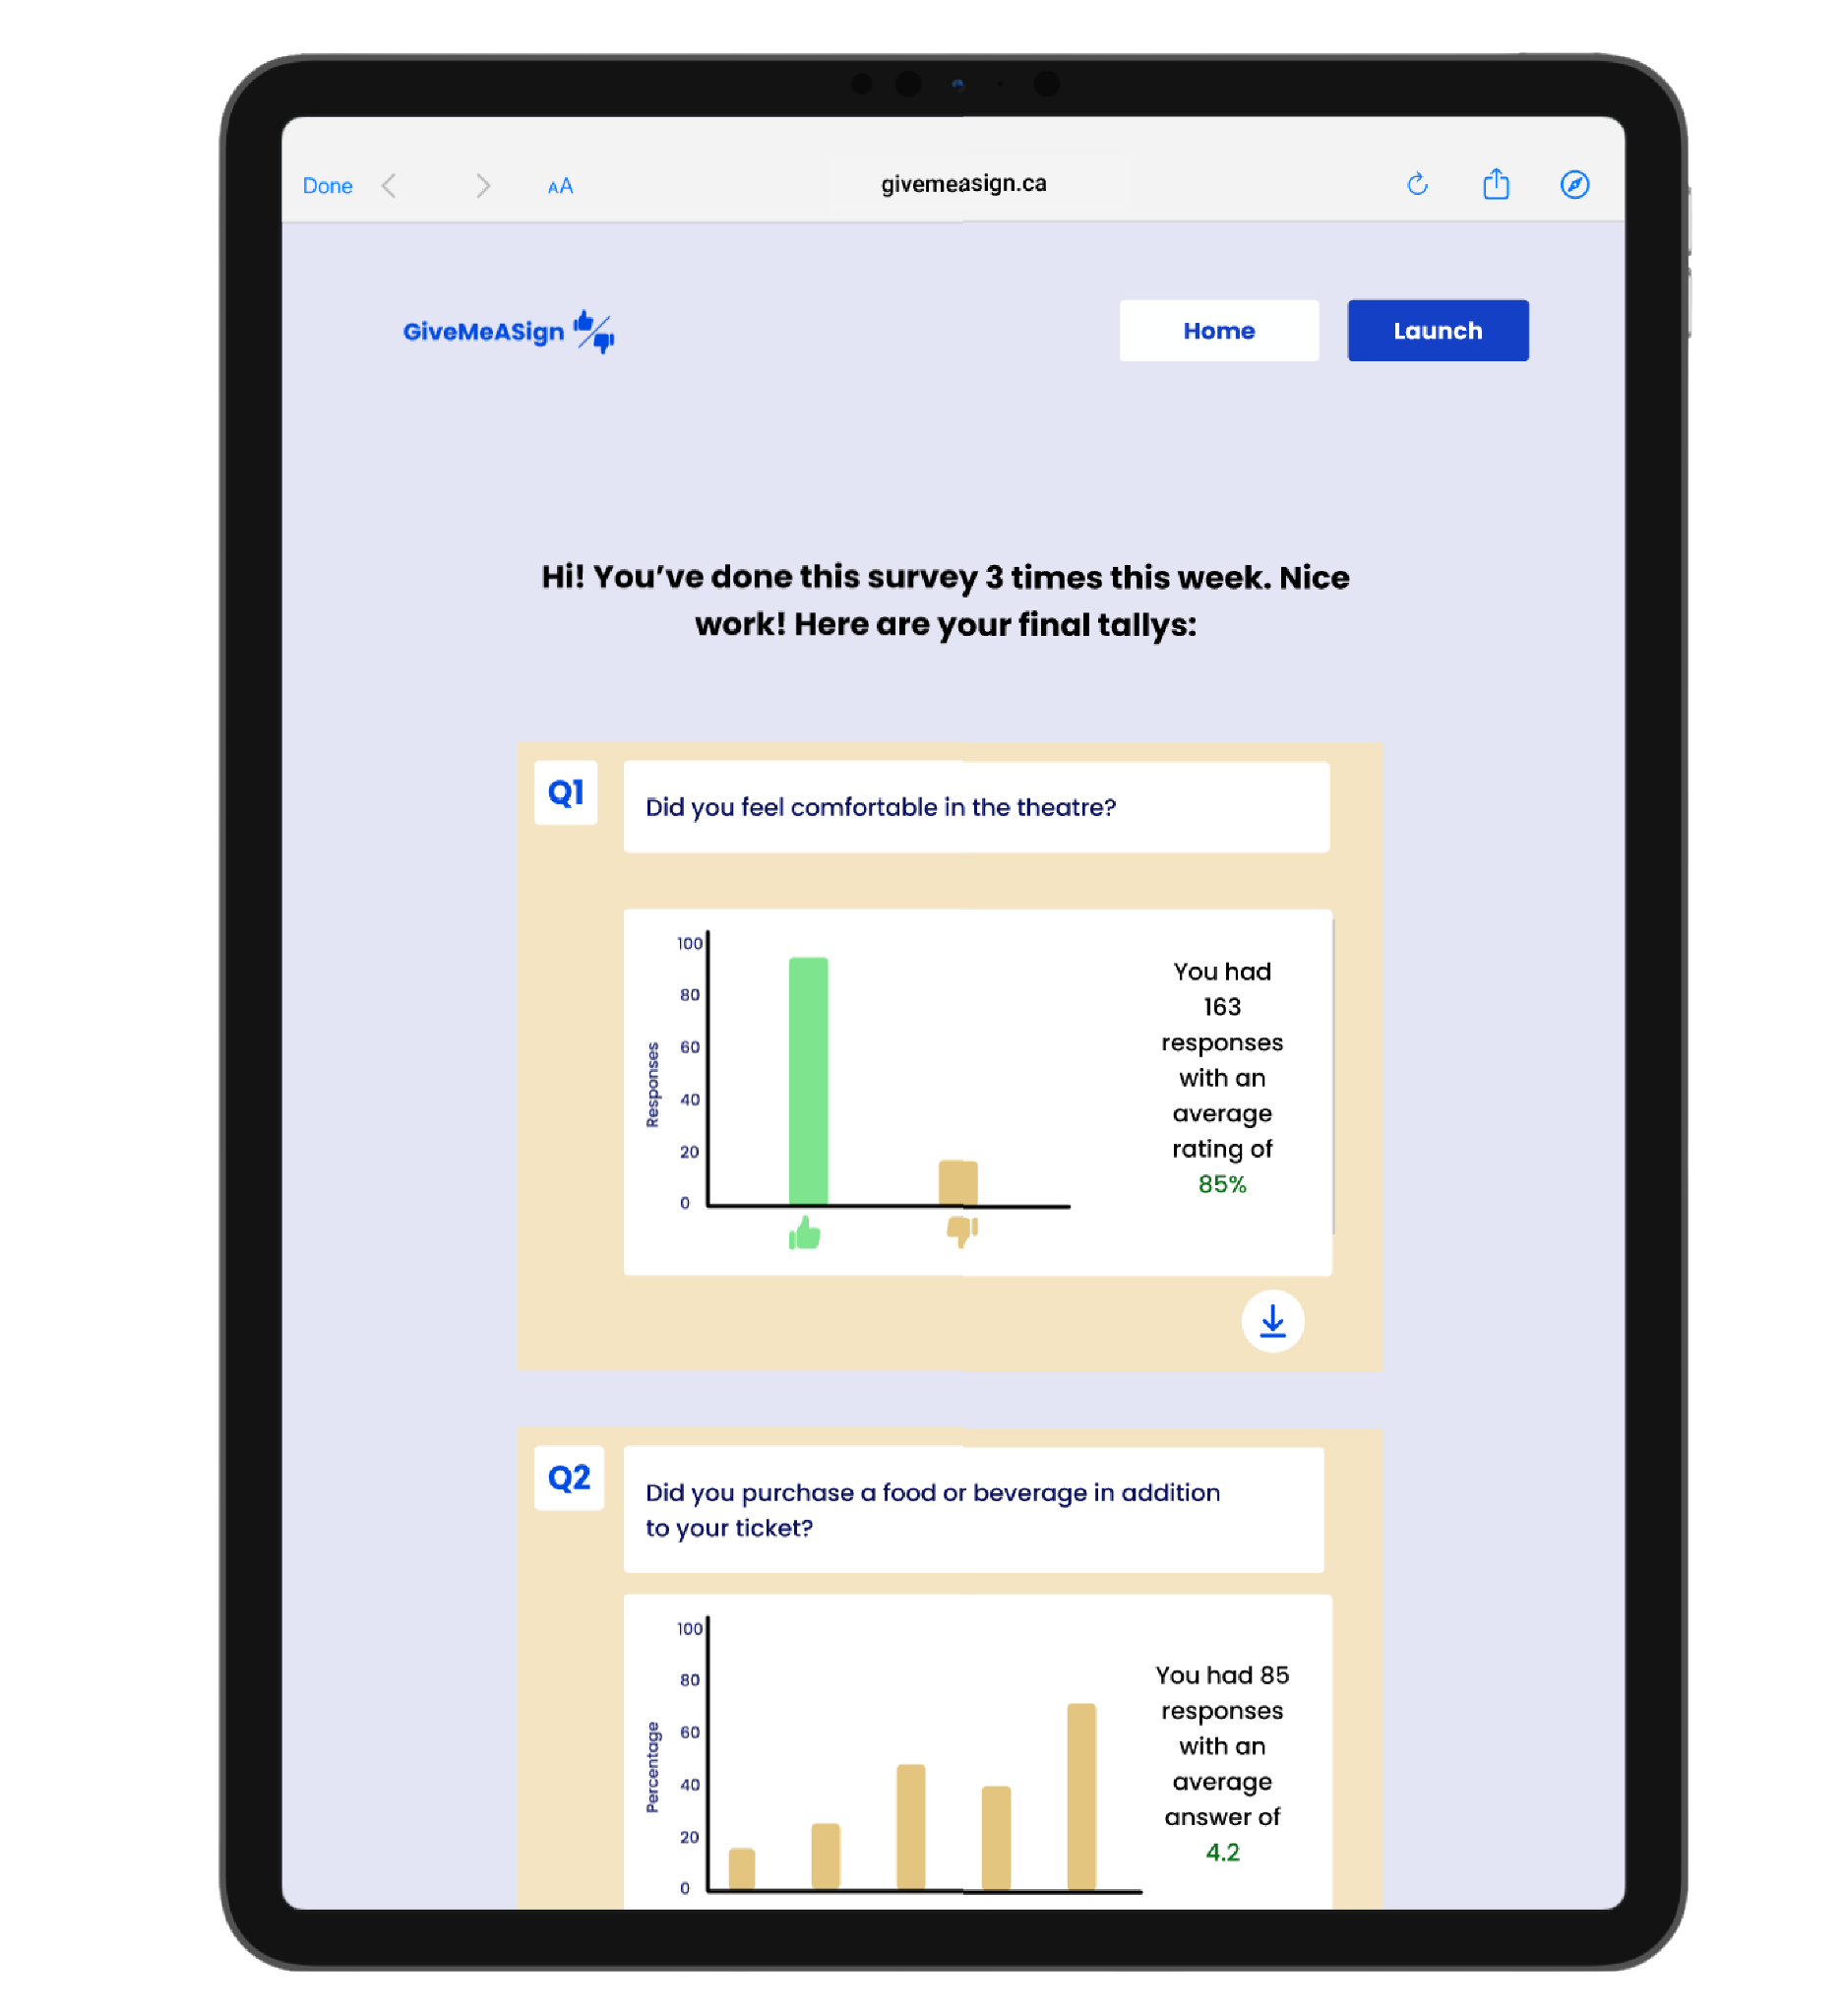
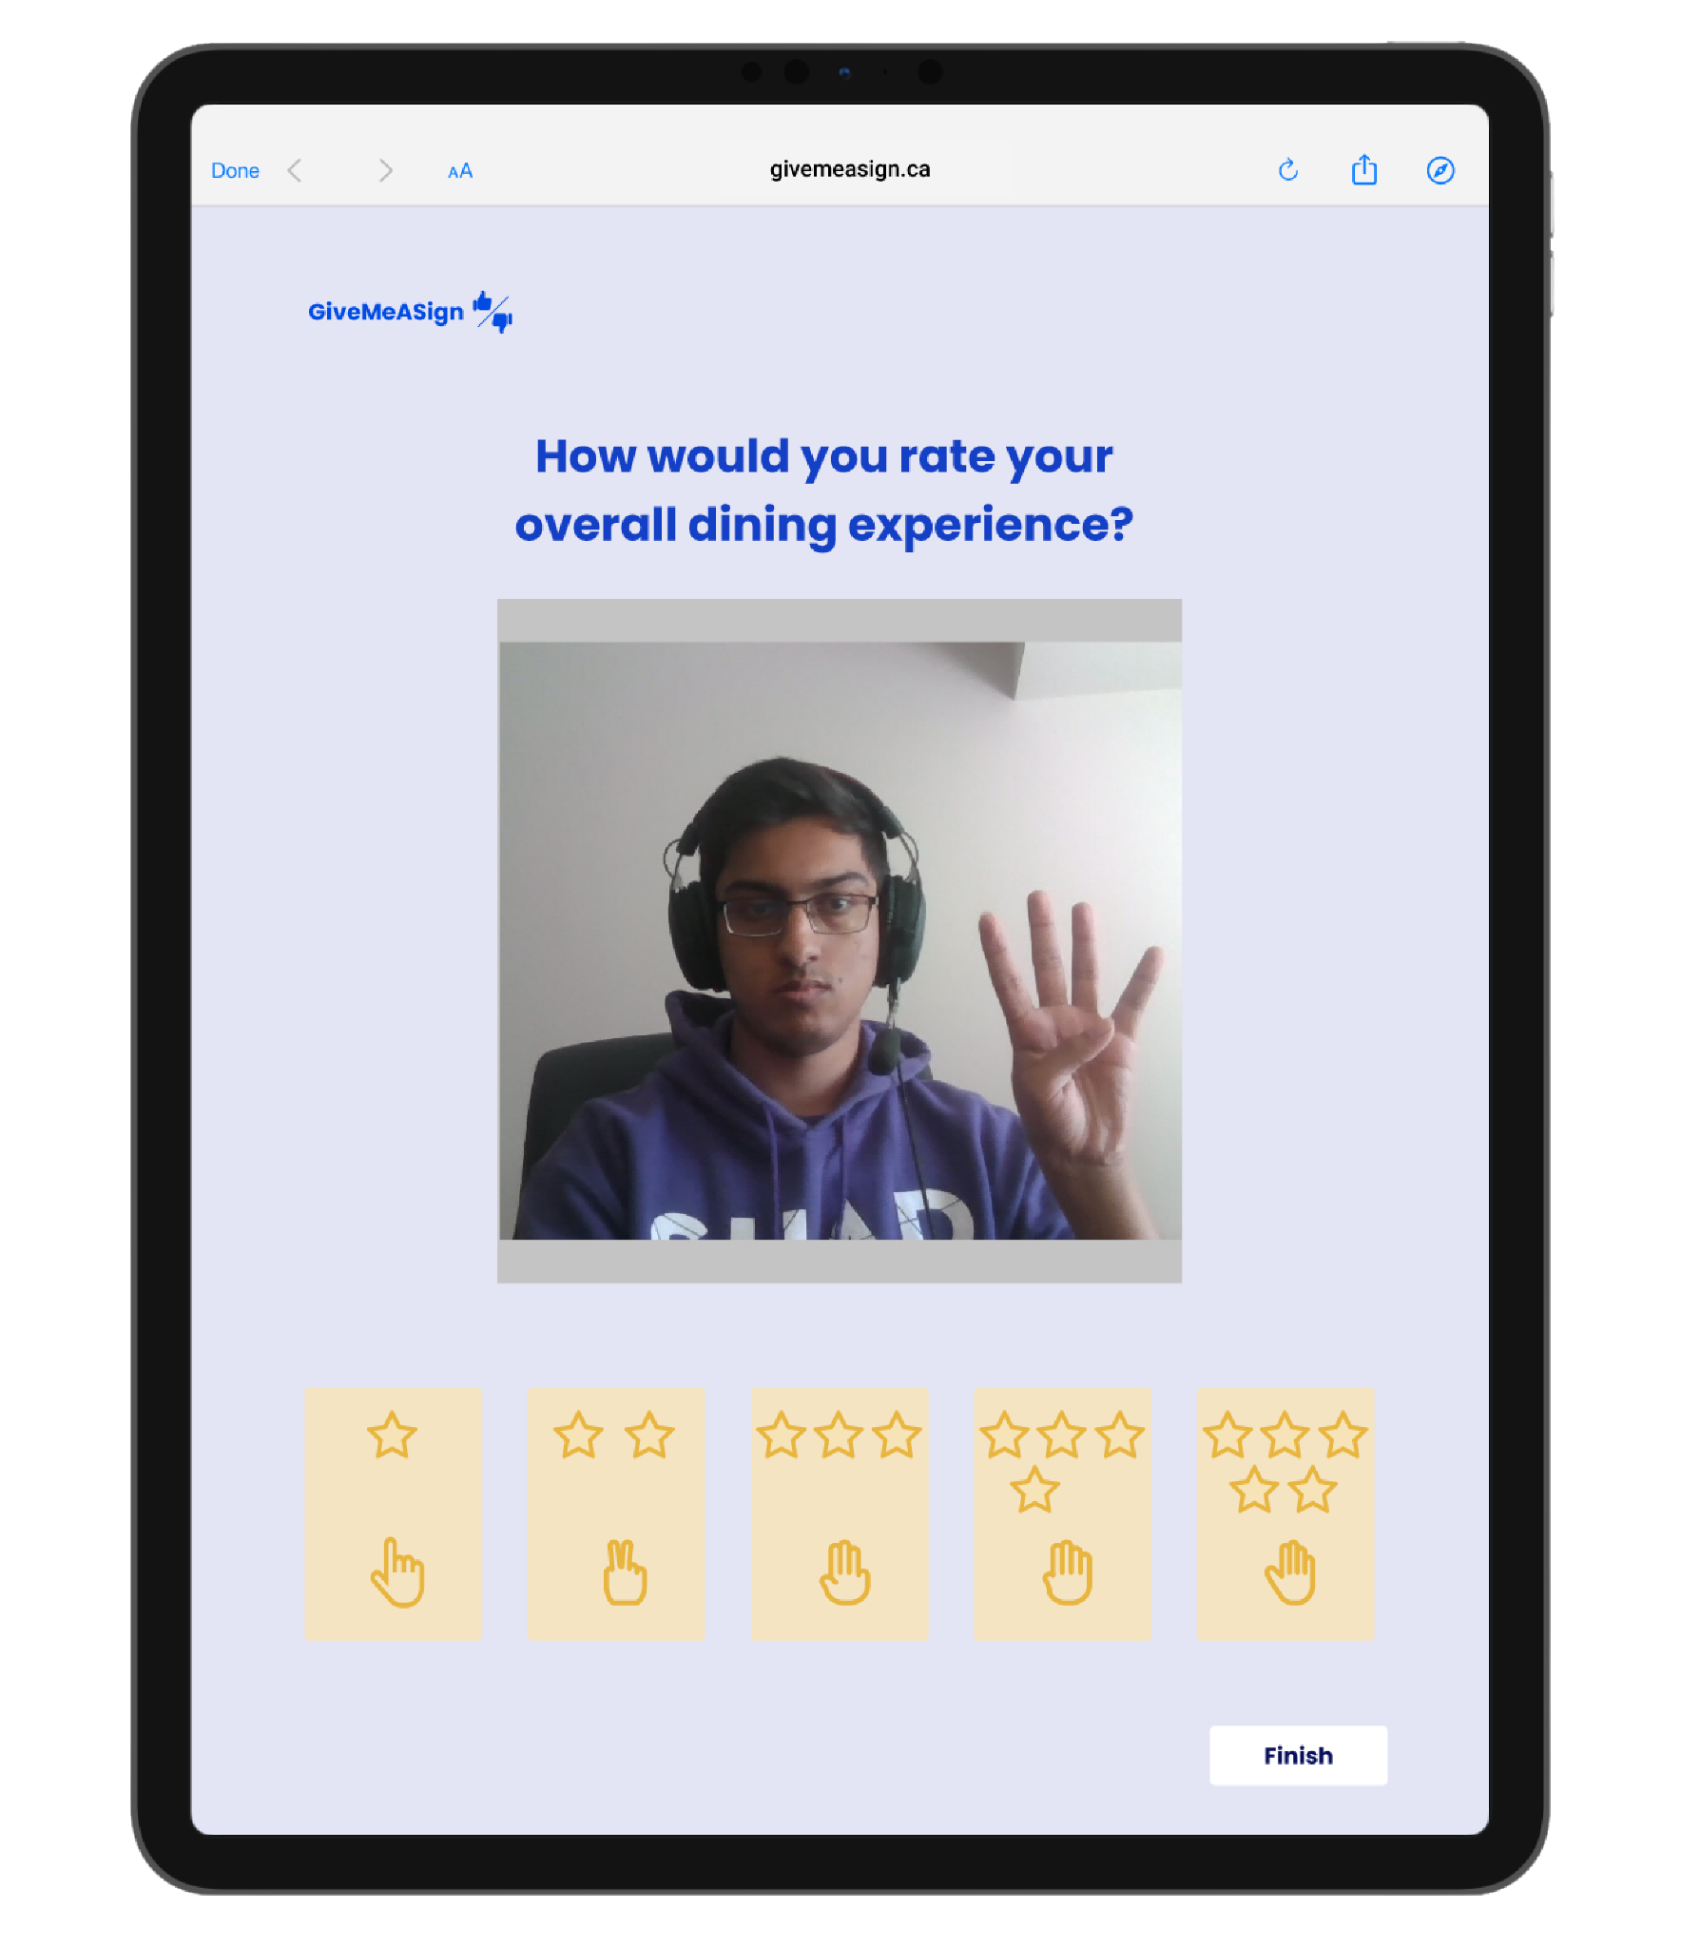
Overview
Our project provides a hands free survey service using computer vision to help people in the service industry provide the customer experience they aspire to

Slide 3
Feedback is crucial for growth.

Slide 4
Situation
The pandemic caused much of the service industry to close or radically change, and now as they are opening up there are many questions about how to provide a safe and enjoyable experience for everyone
Movie theatres, restaurants, and small businesses want to understand their customers so they can create a desirable experience

Slide 5
Problem
People want feedback on the experience they provide but they want it to feel smooth for customers and not detract from their impression of their service
Customers often do not want to go through extra steps to give feedback such as following links or scanning qr codes
The average survey response rate is 33%, with and in-person survey response rate of 57%, and an in-app survey rate of 13%
Source: SurveyAnyPlace
Notes:
Not enough resources for in person surveys

Slide 6
Goal:
Create a seamless feedback service for quick and easy use both by the survey maker and the user

Slide 7
The Solution
Provide a web application to allow organizers and owners to get quick feedback easily with simple hand gesture for any question they want to answer
Design use for both one-time events, and long term use with data analytics to help people better understand how they can improve
Hands-free services are one of the many ways we can prevent the spread of COVID-19

Slide 8

Technical Design
Backend
Frontend

Slide 9
The Solution
Users can add their own question, and track their progress through relaunching surveys to accumulate data over time within their account
With computer vision, anyone who walks by the survey can immediately give feedback
By using both the one to five metric and the yes/no, there are many possibilities open for survey design

Slide 10

Thank you for your time!
Karthik, Thomas, Manav, & Maria

