Slide 1
DATA 230-SEC27 Data Visualisation Term Project Gun Violence Trend ANALYSIS across USA
Professor: Dr. Andrew Bond
Karthik Nimmagadda
SID: 016996148

Slide 2
Data Set Overview
Acquired Data set from Kaggle.
Cleaned using Excel.
Performed around 8 visualisations.
Created 2 dashboards
One to analyse Victims
One to analyse Shooters

Slide 3
Overview
This project aims to provide a comprehensive data-driven analysis of gun violence in the United States.
Gun violence in the United States remains a significant public health and safety issue, affecting thousands of lives each year.
Each statistic we encounter is not just a number but a life cut short, a family shattered, a community left to pick up the pieces.
For instance, "In 2022, there were 68 reported incidents of gun violence, resulting in 74 fatalities and 110 injuries.

Slide 4
Motive
The main motive of this project is to help policymakers, social activists, researchers, and the general public interested in understanding and addressing the issue of gun violence in the USA.
Informing Policy: The findings from this project can be used to provide valuable insights to policymakers for crafting informed and effective gun control legislation and public safety measures.
Raising Awareness: Educating the public about the realities of gun violence, its patterns, and impacts, to foster a more informed and engaged citizenry.
Contribution to Research: Adding to the body of research on gun violence, offering a current and comprehensive analysis that can be a resource for further academic and social inquiry.

Slide 5
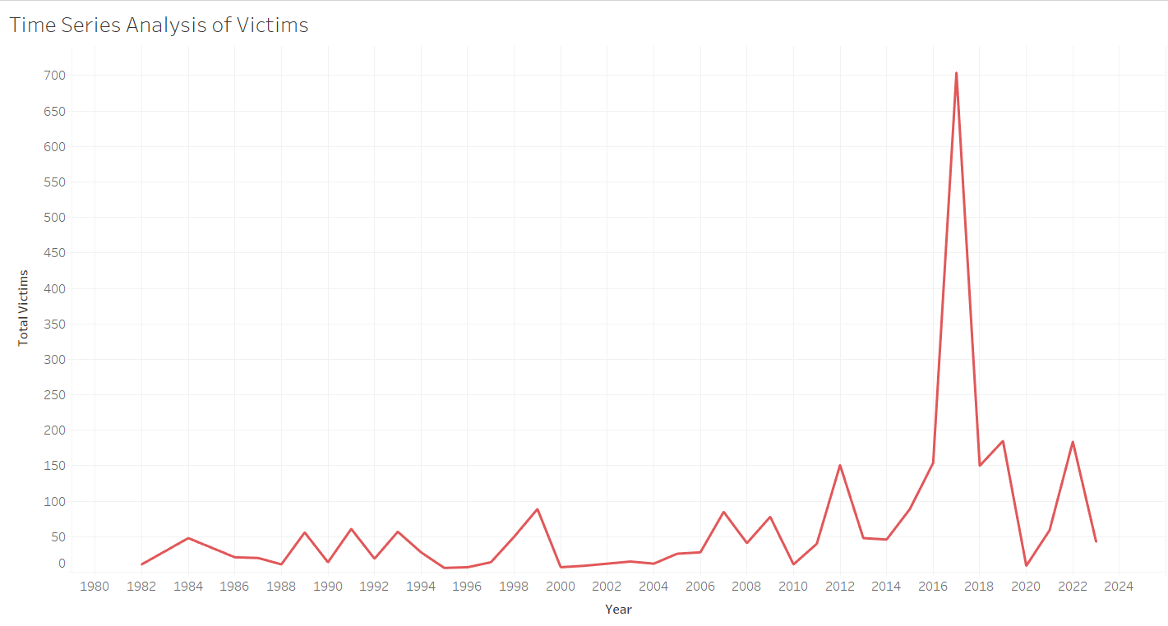
OVERVIEW OF VICTIMS 1. Time Series Analysis of Total Victims in USA
Data reveals a concerning upward trend in the total number of victims of gun violence over the past decade.
We can observe that the highest number of people are affected by gun violence in USA is in the year 2017 and the lowest is in the year 1982.
Around 704 victims are affected by gun violence crimes in 2017 and 11 are affected in 1982.

Slide 6
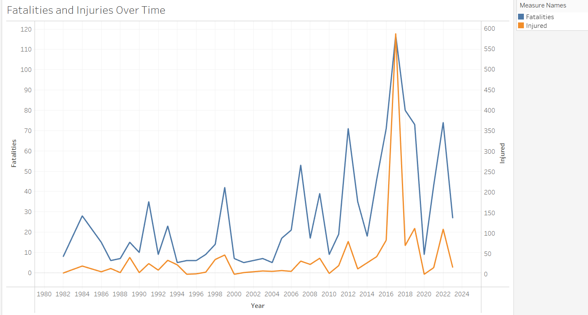
2. Fatalities and Injuries over a period of time.
We can see a rise in the total number of Injuries and Fatalities of gun violence over the past decade.
We can observe that the highest number injuries and fatalities due to gun violence in USA is in the year 2017 and lowest in the year 1982.
Around 587 injuries and 117 fatalities took place in the year 2017.
Around 8 injuries and 3 fatalities took place in 1982.

Slide 7
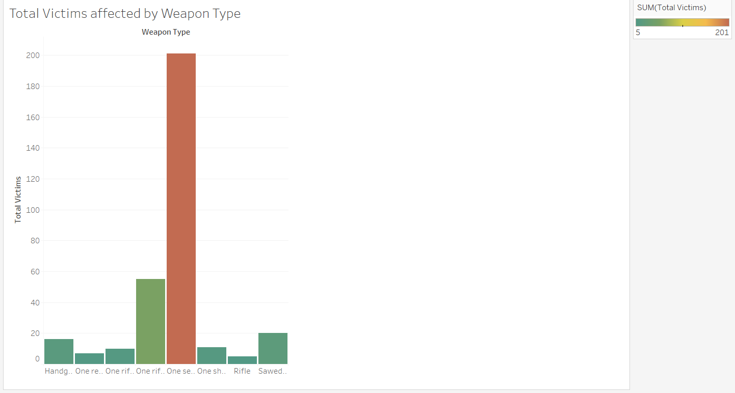
3. Total Victims affected by Weapon type.
Here we can observe that from the bar chart that most of the victims are affected by 8 weapons.
Around 5 members were victims of Rifle gun where 5 died and 0 injured.
Around 201 members were victims of Semiautomatic hand gun where 89 died and 112 injured.

Slide 8
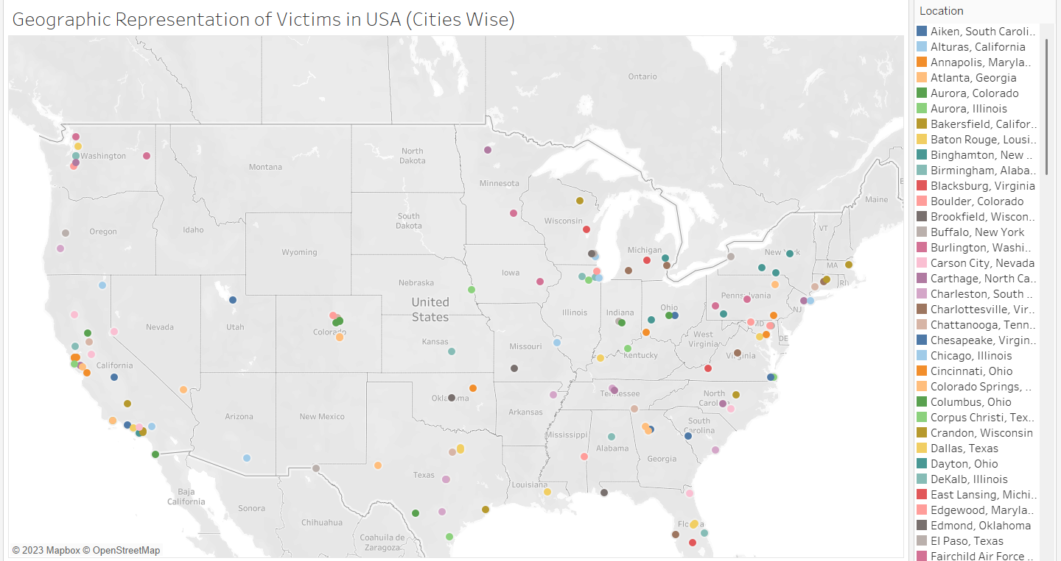
4. Geographical Representation of Victims(Cities Wise)
From the geographical map we can observe that gun violence has happened in 130 cities across USA.
Las Vegas stood first with 604 victims and Birmingham stood last with 3 victims.

Slide 9
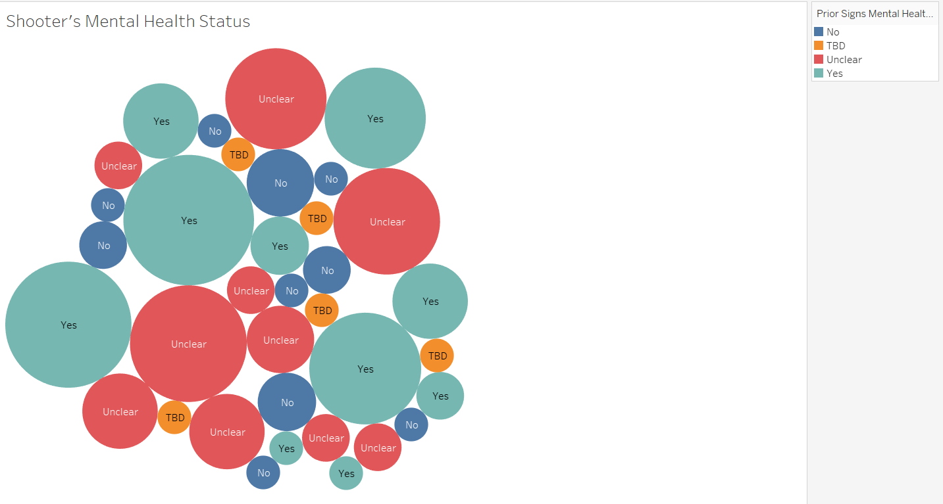
Overview of Shooters 1. Shooter’s Prior MENTAL HEALTH ISSUES
From the Circle chart it is evident that Most of the shooters are having Mental Health Issues.
Least number of shooters are not having any mental health issues.
Some were Unclear and remaining are To be Discussed.

Slide 10
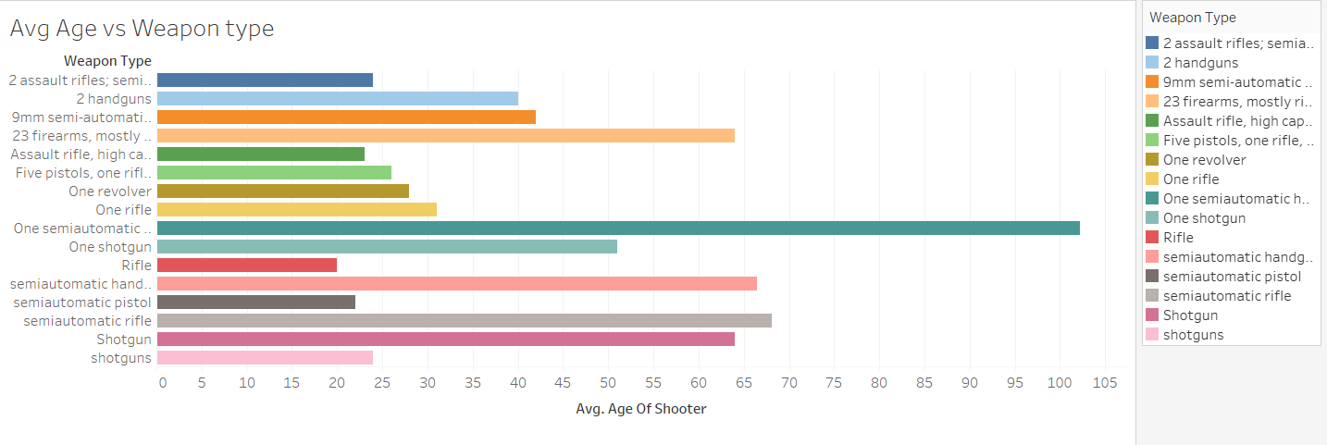
2. Average Age vs Weapon Type
We can observe that a bar chart is plotted between the average age of shooters and Weapon type they used.
Shooters of age 20 to 40 have used pistols, assault rifles and revolvers.
Shooters of age 40 to 60 have used shotguns.

Slide 11
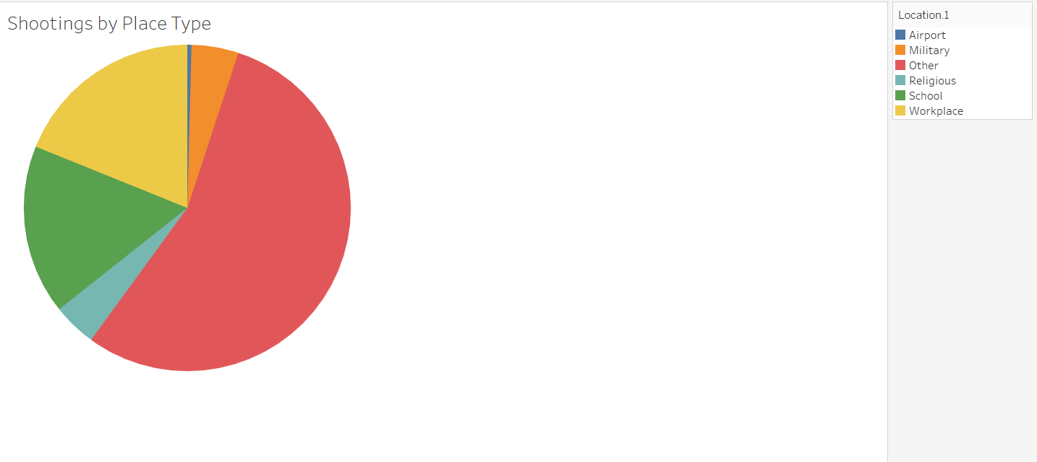
3. Shootings by Place type
From this Pie Chart we can observe that a analysis is drawn between Shootings happened and Place type.
Shootings took place at Airport, Military, Religious places, Schools, Work Places and Other.
Least Shooting Incidents happened at Airports and Most incidents occurred at Other Places.

Slide 12
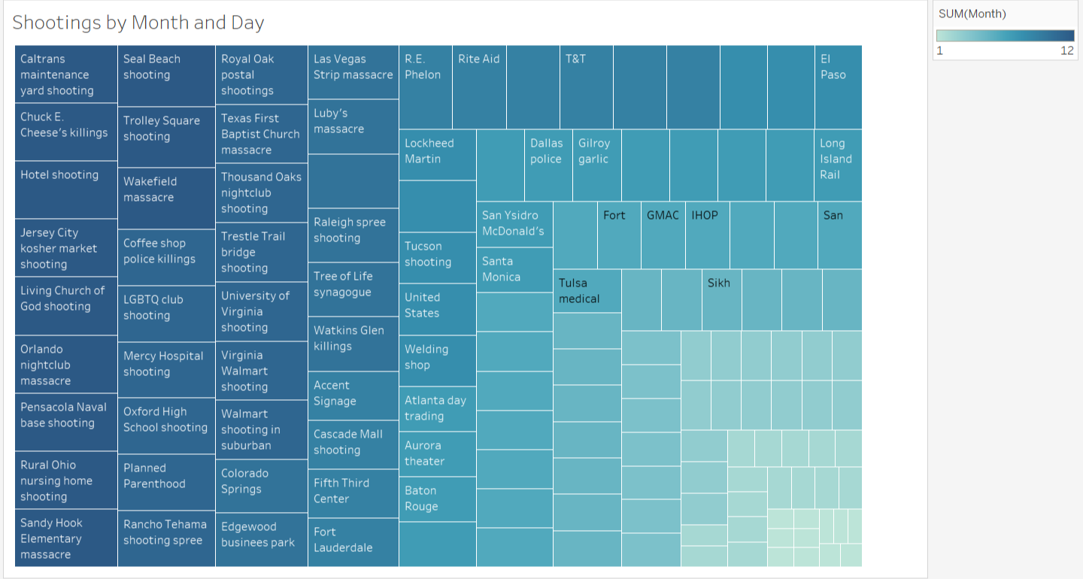
4. Shootings By Location and Month
From this tree map we can observe that most of the shootings happened in Second Half of the year.
Most of the shootings happened at other places like Public places like Markets, Churches, Schools, Clubs, Super stores.

Slide 13
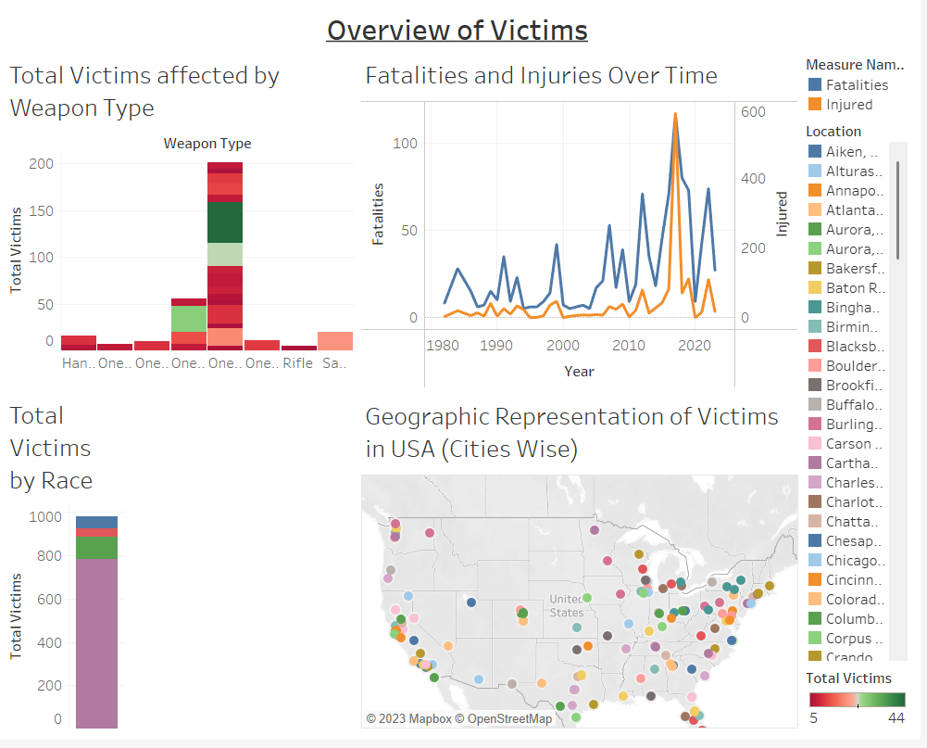
Overview of Victims Dashboard

Slide 14
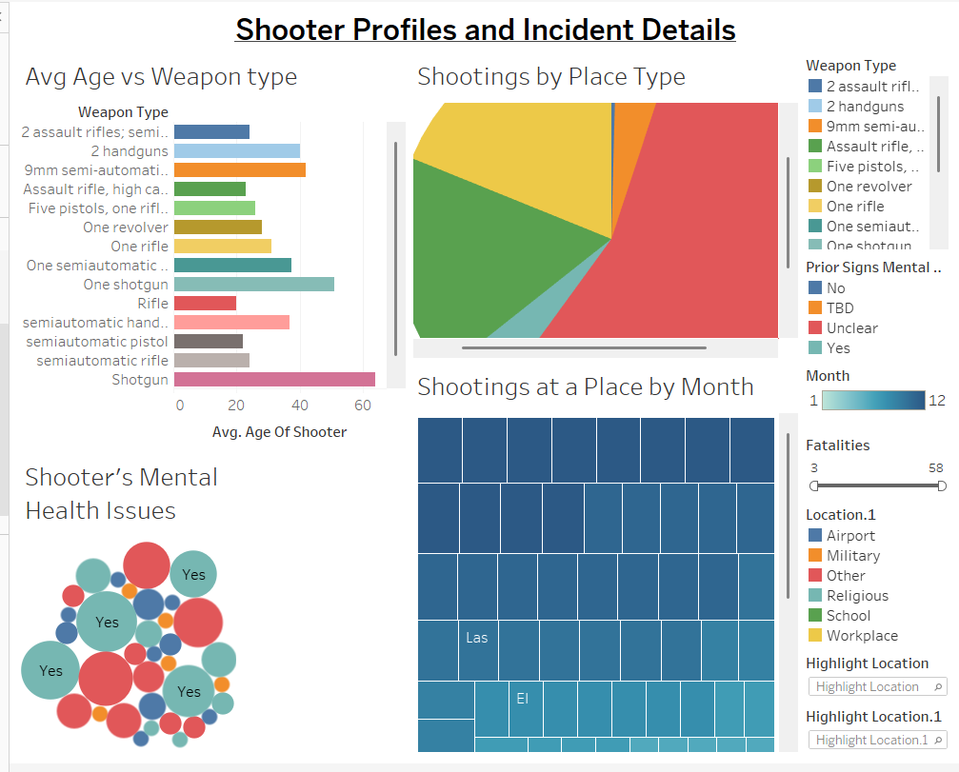
Overview of shooters dashboard

Slide 15
conclusion
My analysis has shed light on the multifaceted nature of gun violence in the USA. The data reveals troubling trends, including a rise in the number of incidents over the years and a significant number of victims affected by certain types of firearms, particularly rifles.
Geographical patterns indicate that gun violence is not evenly distributed across the country, with certain regions experiencing higher rates of incidents.
It is only through concerted efforts across policy, community engagement, and research that we can hope to see a decline in gun violence and its devastating effects on society.

Slide 16
THANK YOU
.

