Slide 1
INFOSYS SPRINGBOARD INTERNSHIP Data Vista: Sales Data Analysis And Visualization
BIG MART SALES DATA ANALYSIS
Name : N. Karthik
Email id : karthik0505n@gmail.com

Slide 2
TECHNOLOGIES LEARNED DURING THIS INTERNSHIP :
Data Operations – NUMPY
Learned how to perform Linear Regression, Logistic Regression, Euclidean distance, PCA, K-Means, Navie Bayes, SVM.
2. Data Processing – PANDAS
Used for manipulating, transforming and analysing the data.
3. Data Visualization – MATPLOTLIB
Used for visualizing the data for better understanding.
( line plot, scatter plot, bar plot, histogram, pie chart, combination of line and bar plot, line styles, logarithmic scale, plotting with annotations ).
4. Data Visualization – SEABORN
Used for creating visually appealing, statistically focused plots with minimal code.
5. Deep learning Image Processing – OPENCV
Digitizing and Executing images with the help of vision framework/libraries.
6. Deep Learning Video Processing – OPENCV
Digitizing and Executing videos with the help of vision framework/libraries.

Slide 3
Objective :
The project aims to analyze sales data from Big Mart to uncover key insights, extract meaningful information, and interpret findings to guide stakeholders in making data-driven decisions.
Problem Statement :
Big Mart is a chain of retail outlets aiming to maximize its sales and profitability. The management has collected detailed data from 2013 on 1,559 products sold across 10 different stores in various cities. The dataset includes attributes related to the products, the outlets, and their sales performance.
The key objectives of this project are:
To analyze sales trends and patterns across different products and stores.
To build a predictive model that estimates the outlet sales based on its characteristics and store attributes.
To Cluster the Outlet based on 'Weight', 'ProductVisibility', 'MRP'.
To identify key factors influencing sales performance to assist in strategic decision-making.

Slide 4
Challenges:
The dataset contains missing values, possibly due to technical glitches in some stores. Effective handling of these missing data points is crucial to ensure the reliability of insights and predictions.
Dataset Overview:
The dataset is divided into two files: Train and Test datasets.
Train Dataset: Contains sales data for 8,523 records, including both input features and the target variable (Item_Outlet_Sales).
Test Dataset: Contains 5,681 records for which sales (Item_Outlet_Sales) need to be predicted.

Slide 5
Data Dictionary:
Item_Identifier: Unique product ID
Item_Weight: Weight of the product
Item_Fat_Content: Indicates whether the product is low fat or not
Item_Visibility: % of the total display area of all products in a store allocated to this product
Item_Type: Category of the product
Item_MRP: Maximum Retail Price (list price) of the product
Outlet_Identifier: Unique store ID
Outlet_Establishment_Year: The year in which the store was established
Outlet_Size: Size of the store (e.g., Small, Medium, Large)
Outlet_Location_Type: Type of city where the store is located (e.g., Tier 1, Tier 2, Tier 3)
Outlet_Type: Indicates the type of store (e.g., Grocery Store, Supermarket Type 1/2/3)
Item_Outlet_Sales: Total sales of the product in a particular store (Target variable in the train dataset)

Slide 6
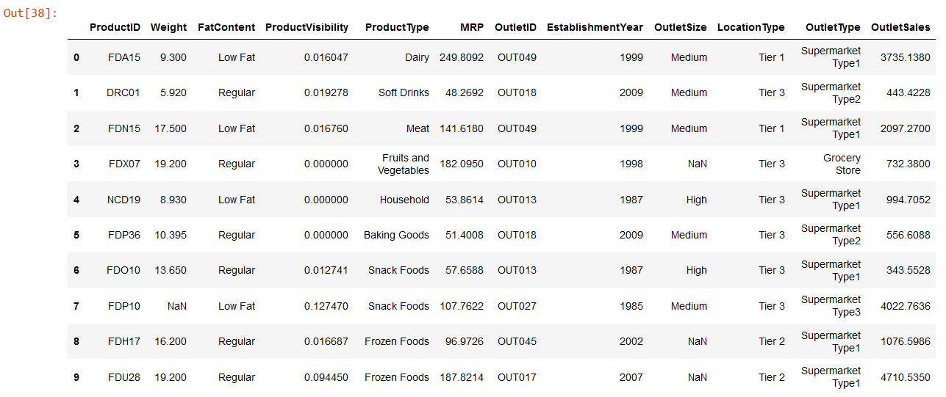
DATASET :

Slide 7
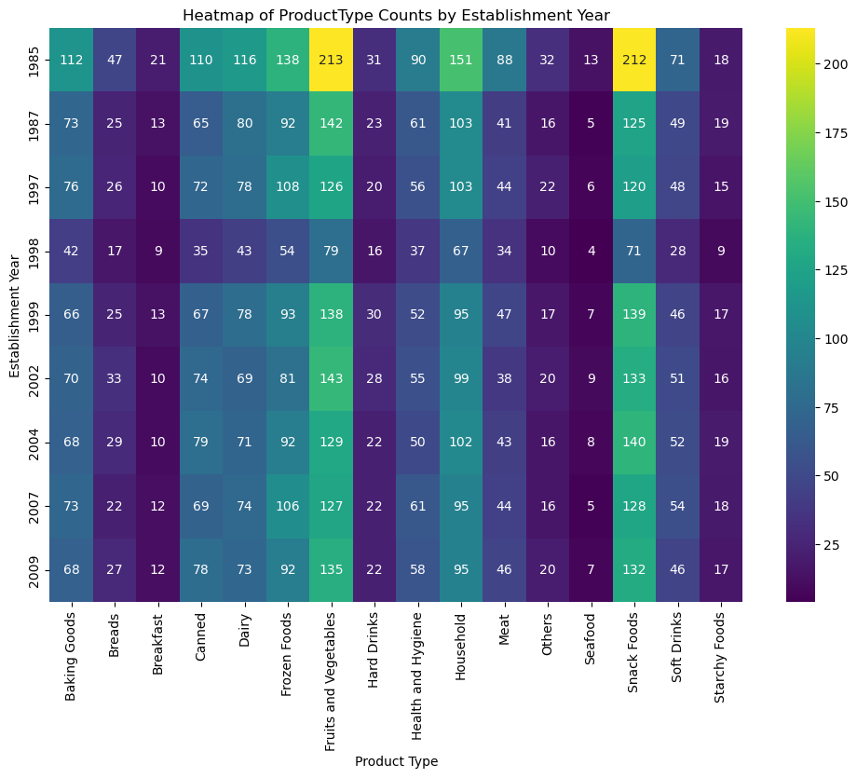
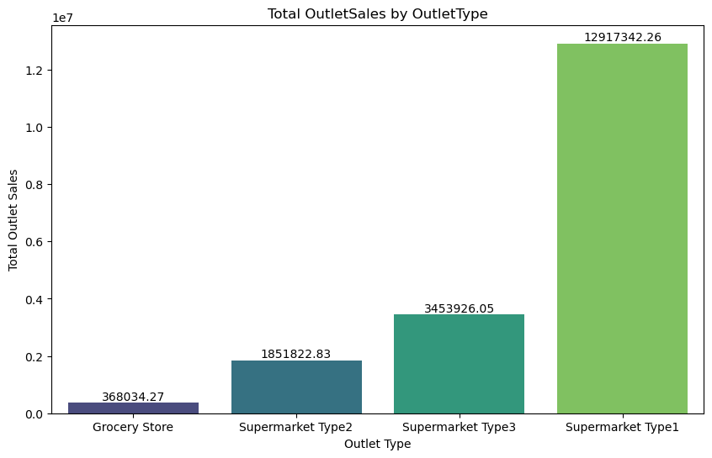
Exploratory Data Analysis :
This heatmap shows the count of each product type according to the establishment year. Where Fruits and Vegetables have highest count
This figure shows the Total OutletSales By each of the outletType, Where Supermarket Type1 has the Highest outlet sales.

Slide 8
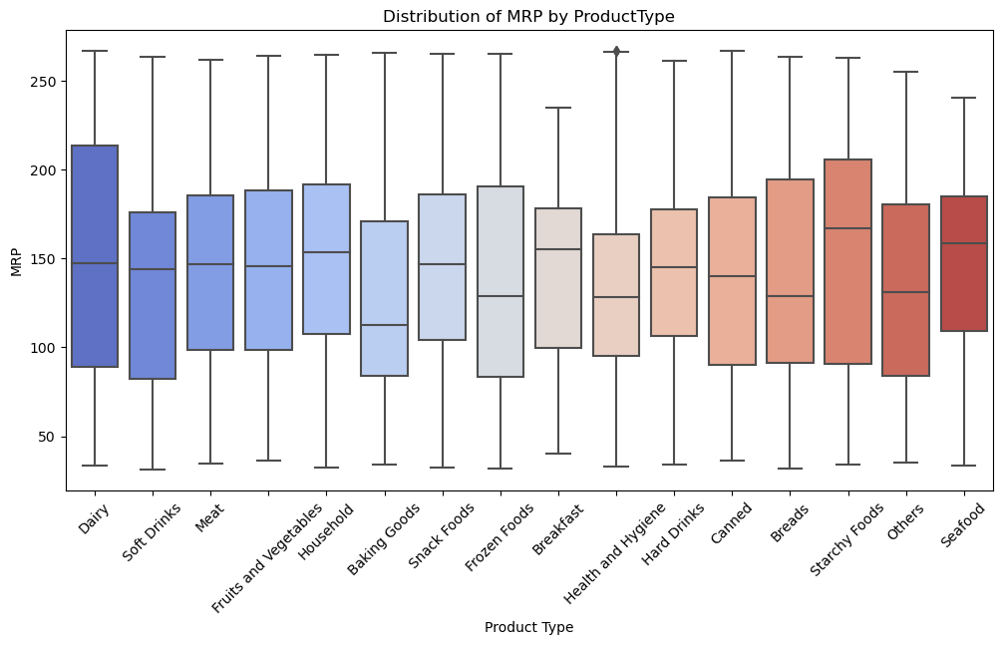
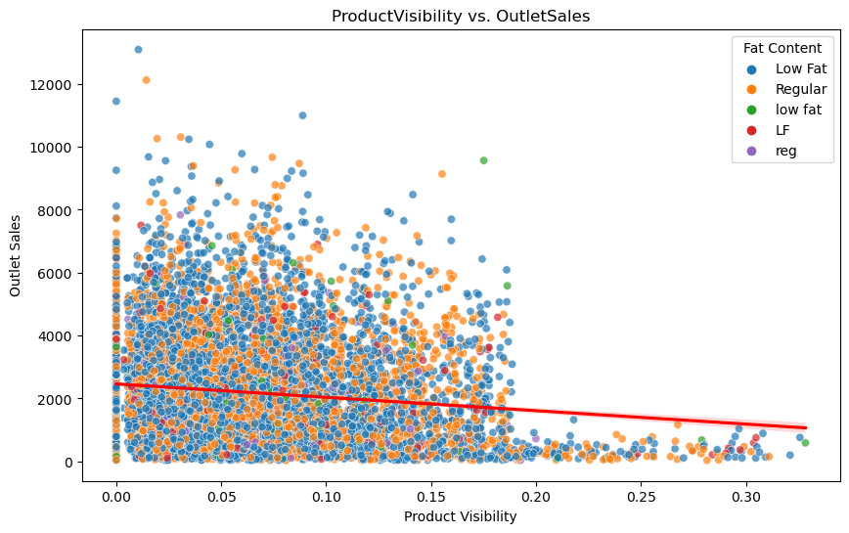
This ScatterPlot shows the Relationship between productVisibility and OutletSales. According to the dataset the lower product visibility has highest Sales.
This Box plot shows the Distribution of MRP by each productType.

Slide 9
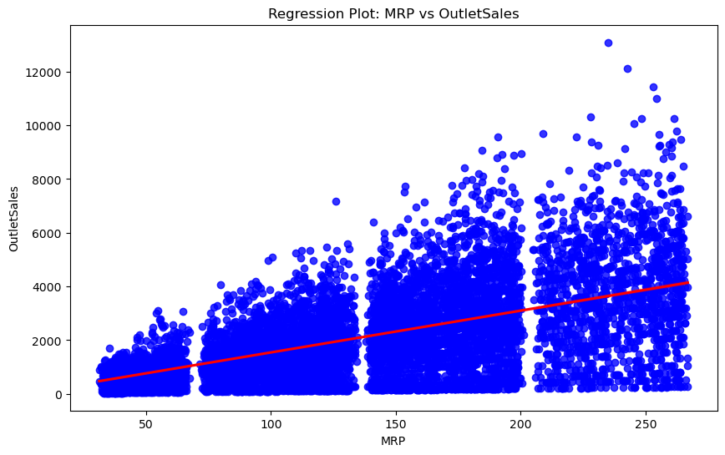
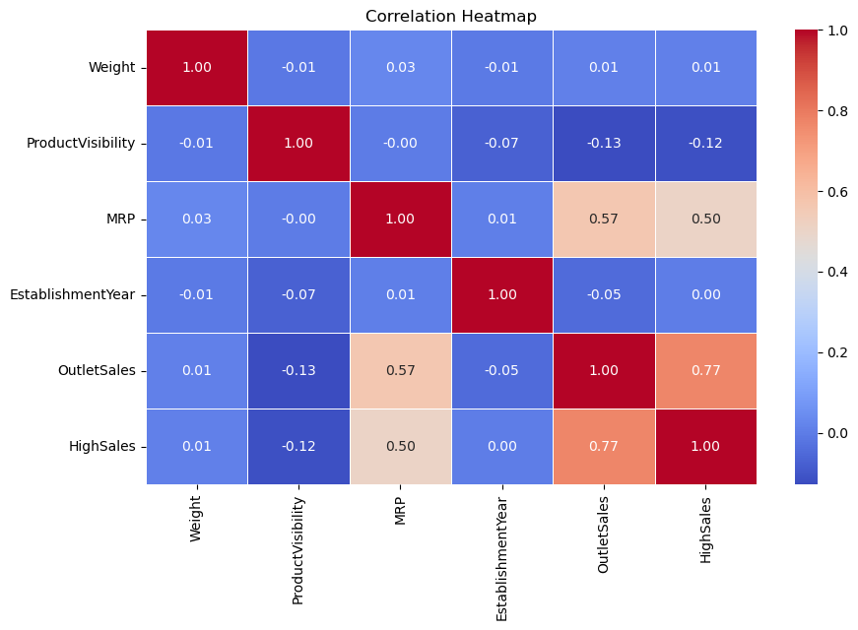
This Regression plot shows that if MRP increases then the OutletSales also increasing.
This Correlation Heatmap shows the correlation between the each variables. Where the MRP & OutletSales have (0.57), Which is the positive Correlation and MRP & HighSales have (0.50).

Slide 10
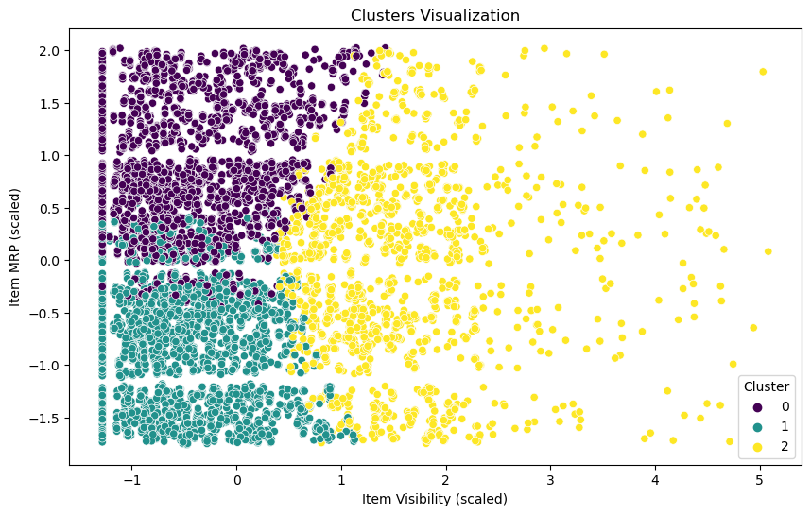
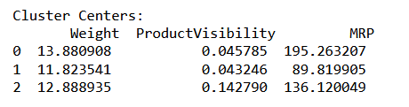
K Means Clustering :

Slide 11
Fitted Line Equation :
Conclusion :
Cluster 0: Represents products with an average weight of 13.88, a visibility percentage of 4.58%, and a higher MRP of 195.26. Likely premium or high-end products.
Cluster 1: Represents lighter products with a weight of 11.82, a visibility percentage of 4.32%, and the lowest MRP of 89.82. Likely basic or economical items.
Cluster 2: Represents moderately weighted products with a weight of 12.88, a higher visibility percentage of 14.28%, and a mid-range MRP of 136.12. Likely popular or moderately priced products.
These Clusters provide actionable insights for pricing, marketing, and store layout strategies.
The predictive model can help forecast sales and optimize inventory across stores.

