Slide 1
Data Vista: Sales Data Analysis And Visualization Topic : Big Mart Sales Data Analysis
INFOSYS SPRINGBOARD INTERNSHIP
Name : N. Karthik
Email id : karthik0505n@gmail.com

Slide 2
KEY LEARNINGS
WHAT IS DATA SCIENCE ?
Data Science is a interdisciplinary field that uses scientific methods, processes, algorithms and systems to extract knowledge and insights from structured and unstructured data.
WHAT IS AI ?
Artificial Intelligence is the creation of computer systems capable of performing tasks that typically require human intelligence.
AI stimulates human intelligence in machines for tasks like learning and problem solving.
WHAT IS MACHINE LEARNING ?
Machine Learning is teaching computers to learn patterns from data and make predictions or decisions without explicit programming. It works well with structured data and smaller datasets
WHAT IS DEEP LEARNING ?
Deep Learning is a more advanced type of ML that uses neural networks to process large amounts of raw data. It’s great for tasks like image recognition, natural language processing, and speech translation.

Slide 3
KEY LEARNINGS
WHAT IS RNN ? TYPES ? ISSUES IN IT.
A Recurrent Neural Network (RNN) is a type of neural network designed for sequential data, where the output from previous steps is fed back into the model to influence future steps
Types :
One-One, One- Many, Many-One, Many-Many
Issues :
Short Memory, While training loop more possibility of chances for data vanishing.
LSTM ( Long Short Term Memory ):
Built upon RNN, To solve all the issues with RNN. LSTM was built.
Memory Larger, Process and store large sequence data therefore model accuracy increases
LLM ( Large Language Model ):
Pretrained model on vast amount of data. GPT,BERT are the examples. It uses Encoder and Decoder architecture, Transformer Architecture, Self Attention mechanisim.

Slide 4



LIBRARIES LEARNED DURING THIS INTERNSHIP :
Data Operations – NUMPY
Learned how to perform Linear Regression, Logistic Regression, Euclidean distance, PCA, K-Means, Navie Bayes, SVM.
2. Data Processing – PANDAS
Used for manipulating, transforming and analysing the data.
3. Data Visualization – MATPLOTLIB
Used for visualizing the data for better understanding.
( line plot, scatter plot, bar plot, histogram, pie chart, combination of line and bar plot, line styles, logarithmic scale, plotting with annotations ).

Slide 5


LIBRARIES LEARNED DURING THIS INTERNSHIP :
4. Data Visualization – SEABORN
Used for creating visually appealing, statistically focused plots with minimal code.
5. Deep learning Image Processing – OPENCV
Digitizing and Executing images with the help of vision framework/libraries.
6. Deep Learning Video Processing – OPENCV
Digitizing and Executing videos with the help of vision framework/libraries.

Slide 6

GITHUB :
I have learned how to effectively use GitHub for pushing documents, editing files, and updating repositories. I also gained experience in creating and managing README files to provide essential project information. This knowledge has helped streamline collaborative development and version management.

Slide 7
PROJECT WORK : BIG MART SALES DATA ANALYSIS
The project aims to analyze sales data from Big Mart to uncover key insights, extract meaningful information, and interpret findings to guide stakeholders in making data-driven decisions.
Problem Statement :
Big Mart is a chain of retail outlets aiming to maximize its sales and profitability. The management has collected detailed data from 2013 on 1,559 products sold across 10 different stores in various cities. The dataset includes attributes related to the products, the outlets, and their sales performance.
The key objectives of this project are:
To analyze sales trends and patterns across different products and stores.
To build a predictive model that estimates the outlet sales based on its characteristics and store attributes.
To Cluster the Outlet based on 'Weight', 'ProductVisibility', 'MRP'.
To identify key factors influencing sales performance to assist in strategic decision-making.

Slide 8
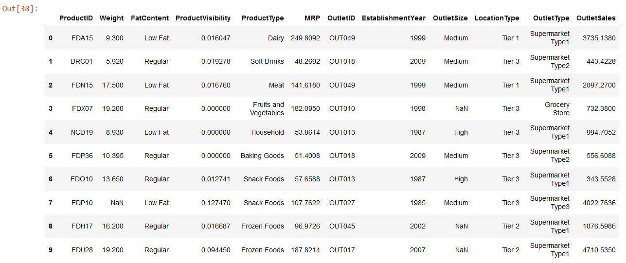
DATASET :

Slide 9
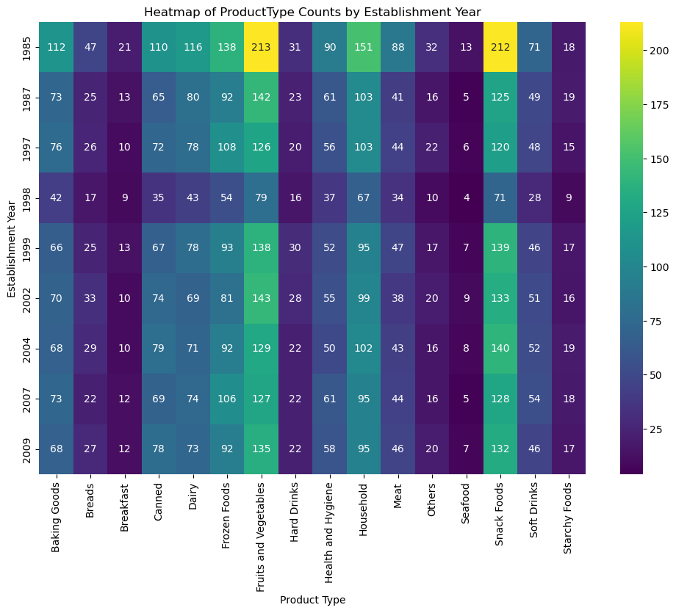
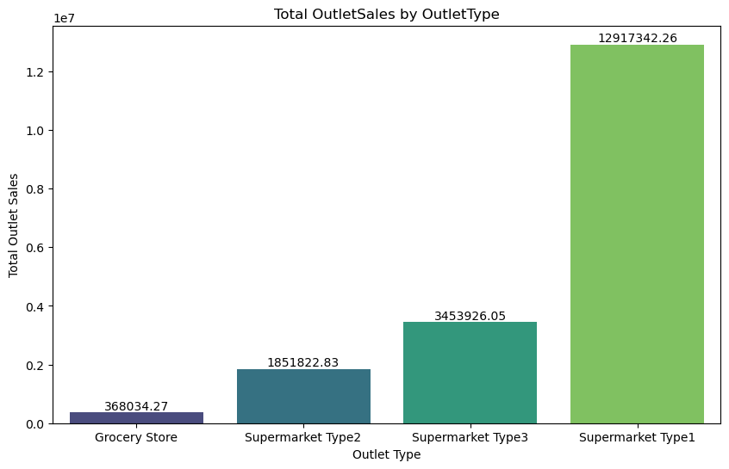
Exploratory Data Analysis :
This heatmap shows the count of each product type according to the establishment year. Where Fruits and Vegetables have highest count
This figure shows the Total OutletSales By each of the outletType, Where Supermarket Type1 has the Highest outlet sales.

Slide 10
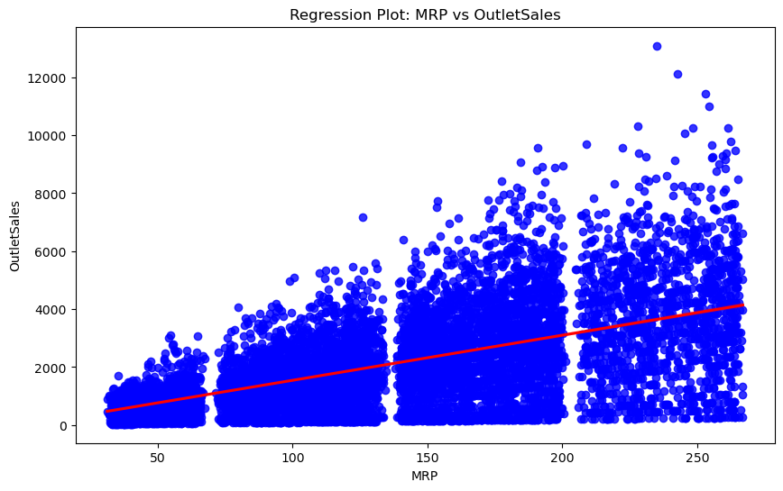
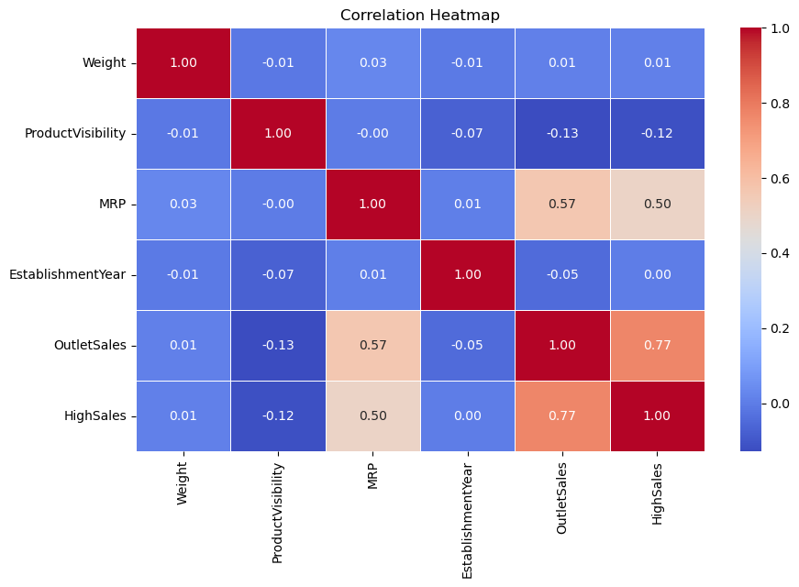
This Regression plot shows that if MRP increases then the OutletSales also increasing.
This Correlation Heatmap shows the correlation between the each variables. Where the MRP & OutletSales have (0.57), Which is the positive Correlation and MRP & HighSales have (0.50).

Slide 11
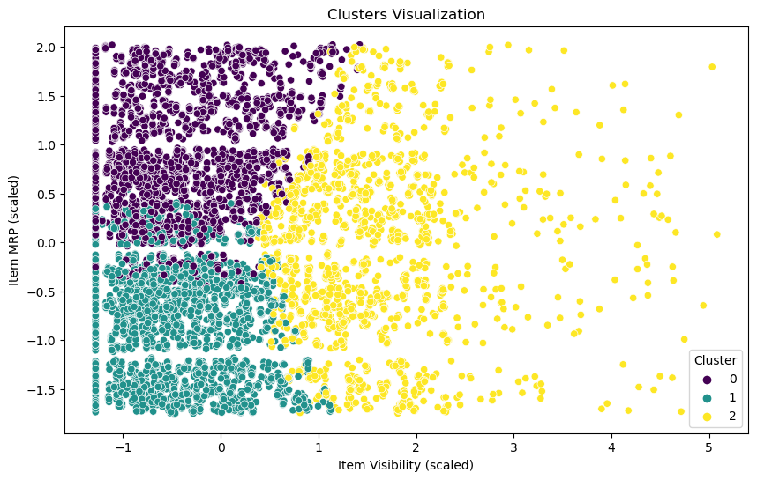
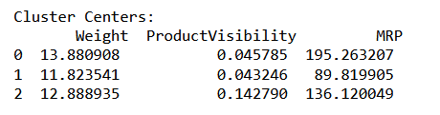
K Means Clustering :

Slide 12
Fitted Line Equation :
Conclusion :
Cluster 0: Represents products with an average weight of 13.88, a visibility percentage of 4.58%, and a higher MRP of 195.26. Likely premium or high-end products.
Cluster 1: Represents lighter products with a weight of 11.82, a visibility percentage of 4.32%, and the lowest MRP of 89.82. Likely basic or economical items.
Cluster 2: Represents moderately weighted products with a weight of 12.88, a higher visibility percentage of 14.28%, and a mid-range MRP of 136.12. Likely popular or moderately priced products.
These Clusters provide actionable insights for pricing, marketing, and store layout strategies.
The predictive model can help forecast sales and optimize inventory across stores.

Slide 13
GITHUB : GITHUB | LINK
THANK YOU…

