Slide 1
Human Action Recognition in Images Using Convolutional Neural Networks
Course : Deep Learning
Team : 28
Date : 6th July 2024

Slide 2
Project Description
The project addresses the challenge of accurately classifying human actions in images using deep learning techniques. The goal is to develop a model that can automatically identify and categorize various actions such as writing, applauding, fishing, and drinking from still images. Action recognition has a wide range of practical applications including surveillance systems, human-computer interaction, sports analytics, and healthcare monitoring. Accurate action recognition can enhance the functionality and safety of these systems.

Slide 3
Background
Convolutional Neural network: For image classification task we will use convolutional neural network as the primary model due to its strong performance. As it can effectively capture more complex patterns.
Architecture: Using architecture like VGGNet, GoogleNet, ResNet, DenseNet to leverage these model’s learned features and fine-tune them for action recognition task.

Slide 4
Dataset
Information
Dataset used: "Stanford 40 Action Dataset”
Type: Images
Actions in dataset: 40
Number of data: 9532 total images

Slide 5
Dataset
Preprocessing
Loading: Divided the raw dataset into 40 classes and images are loaded from the specified file paths using the ‘CustomImageDataset’ class.
Transformation: A series of transformation are applies to prepare the images for training.
Resizing: Image are resized to 224*224 pixels, which is a standard input size .
Normalization: Images are normalized using ([0.485, 0.456,0.406]) values for mean and ( [ [ 0.229,0.224.0.225]) for standard deviation.

Slide 6
Methods
VGG: The VGG that is Visual Geometry Group is a type of convolutional neural network which was developed by Visual Geometry Group at the University of Oxford. The VGG16 model is used for feature extraction by leveraging its pre-trained convolutional layers on the ImageNet dataset. The model is fine-tuned and trained using augmented data, employing the Adam optimizer and cross-entropy loss for multi-class classification.
ResNet: The Resnet model that is Residual network, learns residual function with reference to the layer inputs, instead of learning unreferenced functions. This model helps to solve the vanishing/exploding gradient.
DenseNet: Each dense block consists of multiple bottleneck layers, enhancing feature propagation. The model concludes with a global average pooling layer and a fully connected classifier.
GoogleNet: This model uses 1*1 convolution and global average pooling which enables deeper architecture. This model is based on inception architecture.

Slide 7
Methods
Deployment:
Data Preparation: Images of various human actions are loaded from specified directory which is labelled and pre-processed . This data is split into training, validation and test sets.
Model Used: ResNet model is used and trained using the training data and evaluated on validation data over epochs.
Visualization and Interaction: Streamlit is used for interactive web application which displays training progress which includes loss and accuracy epochs.This application will classify randomly selected images from the training set and display the predicted class.

Slide 8
Results
Model | Accuracy | Precision | Recall | F1 score
Vgg | 0.7725 | 0.7810 | 0.7725 | 0.7702
ResNet | 0.7568 | 0.7754 | 0.7568 | 0.7529
DenseNet | 0.3176 | 0.3217 | 0.3176 | 0.2976
GoogleNet | 0.1960 | 0.2204 | 0.1960 | 0.1597
Pretrained DenseNet | 0.7799 | 0.7934 | 0.7799 | 0.7790
Pretrained GoogleNet | 0.7652 | 0.7814 | 0.7652 | 0.7680

Slide 9
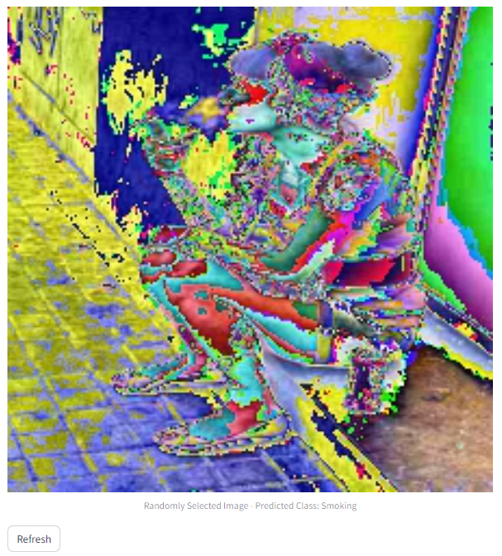
Results
The model gives prediction of the action that the person is smoking.

Slide 10
Real World Application
Surveillance and Security: It will help to identify unusual activities or behaviours in various places. This will detect actions like fights, thefts or suspicious behaviour to alert security personnel.
Healthcare: It will help to observe patient movement to detect falls or abnormal behaviour in hospitals or elderly care facilities.
Sports and Fitness: This will provide feedback on exercise routines and detect incorrect postures or movements.
Human-Computer Interaction: It will enable touchless interaction with devices and application through gesture recognition.
Robotics: This will allow robots to understand and respond to human actions in collaborative environment.
Smart Homes: Triggering smart home devices based on recognized actions, such as turning off lights when leaving a room. Also, it will detect unusual behavior to alert family members or emergency services.
Education: Observing student activities and engagement to provide feedback to teachers.

Slide 11
Summary
This Project is implemented using various deep learning model such as VGG, ResNet, DenseNet, GoogleNet which will classify human actions. For deployment we have used ResNet model. It will predict what action s performed by the human is given image. This can be used in real world application such as Surveillance and security, Healthcare, Sports and fitness, Robotics, Education and Smart Homes.

Slide 12
Contribution
Team Member | Project Part | Contribution(%)
Sriveera | Data processing and diving the raw dataset into 40 classes Implementing VGG and ResNet models with visualization results Deployment of the best model | 50%
Pbodke | Implementing Google Net and Dense Net from scratch models with Visualization results Implementing Pretrained Google Net and Dense Net models with visualization results | 50%

Slide 13
Contribution
Team Member | Project Part | Contribution(%)
Sriveera | Data processing and diving the raw dataset into 40 classes Implementing VGG and ResNet models with visualization results Deployment of the best model | 50%
Pbodke | Implementing Google Net and Dense Net from scratch models with Visualization results Implementing Pretrained Google Net and Dense Net models with visualization results | 50%

Slide 14
Thank you!

