Slide 1

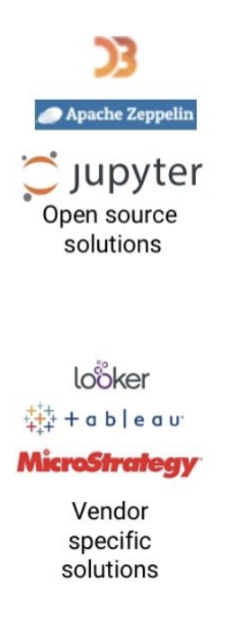











Solution with AWS
AWS Cloud
VPC
AWS Lambda
Dynamo DB
Amazon Athena
Enriched Data
Message Producer
Amazon Kinesis
Amazon EMR
Cluster
Amazon S3
AWS Glue
Amazon QuickSight
Http Request
Http Response
AWS Lambda
AWS Glue Crawler
AWS Glue Catalog

Slide 2

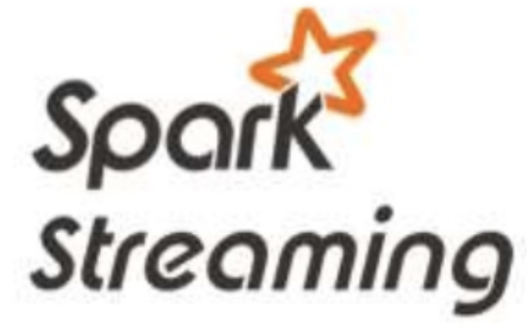

RT Streaming Architecture – On Premise
HBASE (NOSQL)
Message Producer
httpReq
httpRes
HDFS

