Slide 1
FORENSIC HANDWRITING EXAMINATION

Slide 2
INTRODUCTION
Handwriting is a personal biometric that has long been considered to be unique to a person.
For many centuries signature veriﬁcation has been used for authentication purposes.
Experts in forensic document analysis all around the world daily perform examination of handwritten documents to determine the authorship of a questioned document or detect evidence of forgery or disguise

Slide 3
METHODS
Character recognition
Manual Recognition (offline )
Online recognition

Slide 4
ways to achieve character recognition
Collection of characters
Extraction of features
Analysis of features
Optimization of future vector for better pattern recognition.
Training of a classifier.
Output.

Slide 5
Our approach
The purpose of the study is to determine whether it is possible to distinguish people by their handwriting using a subset of document examiner features.
the person may be able to determine which features should, and which should not, be used in a particular case.

Slide 6
Extraction of features
Micro features.
Eg: strokes,characters,graphemes.
Macro features.
Eg: words, lines.
We use micro features.

Slide 7
Choice of features
Based on some considerations characters “d”, “y”, “f”, and grapheme “th” were chosen for study.
Because they have more strokes and occur frequently.
The character images were extracted manually from 600 samples of the CEDAR letter representing 200 writers.

Slide 8
There were at most 10 samples of character “d”, eight samples of “y”, eight samples of “f”, and nine samples of “th” extracted from each of the 600 documents making total 30, 24, 24, and 27 samples of the corresponding character per writer

Slide 9
Feature extraction
Initial selection of the structural features to extract was motivated by studying the types of features described in books on forensic document examination.
Some of these elements, like height and width of a character, were strictly defined and thus were easy to extract from a character image.
Further experiments and analysis of extraction accuracy as well as feature usefulness via a ﬁlter approach allowed us to reconsider the feature set and eliminate some of the features and add others. The ﬁnal set comprised of 31 features (f1 ...f31).

Slide 10
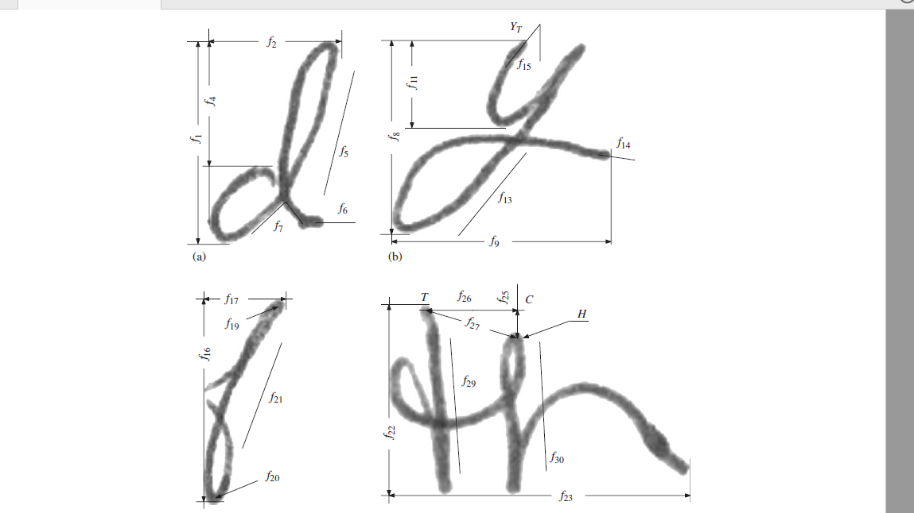
Feature extraction

Slide 11
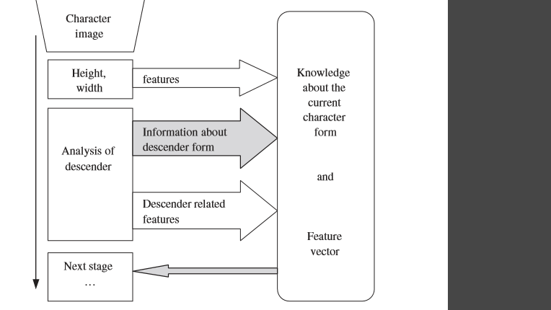
Feature extraction

Slide 12
Analysis of feature usefulness
First, all the features that may have discriminating power were extracted. Second, after extraction it was necessary to decide which features have discriminating power and which do not.

Slide 13
Feature selection
We use genetic algorithm for feature selection.
The genetic algorithm is a method for solving both constrained and unconstrained optimization problems that is based on natural selection, the process that drives biological evolution. The genetic algorithm repeatedly modifies a population of individual solutions.

Slide 14
Genetic algorithm
Start with a population of candidate solutions.
Variation: Introduce variation by applying two operators: crossover and mutation.
Survival of the fittest: Use a fitness criterion to bias the evolution towards desired features.

Slide 15
Classifier
In our study we used n-fold cross validation to evaluate a feature subset . The training data was divided into n approximately equal partitions and the induction algorithm was then run n times each time leaving one subset for test and using the other n − 1 parts for training. The classiﬁcation accuracy obtained from n tests was then averaged and associated with the corresponding feature subset.
DistAl, a constructive learning algorithm based on the multi-layer perceptron with spherical threshold units, was chosen as a classiﬁcation system . There were several reasons for this choice over other possibilities:
DistAl does not require any a priori assumptions about network topology. Network topology is determined dynamically in the learning process.

Slide 16
DistAl is based on a distance metric between patterns which means it can easily be adapted to handle patterns with missing feature values.
Experiments conducted on both artiﬁcial and real data demonstrated results of classiﬁcation comparable to those obtained by other commonly used learning algorithms.

Slide 17
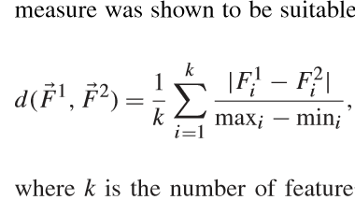
All feature values were treated as real numbers. Having performed several experiments we chose the normalised Manhattan distance as a distance measure for DistAl because this measure was shown to be suitable for the problem at hand
where k is the number of features, mini and maxi are the minimum and maximum values of the ith feature in the data set, respectively

Slide 18
Results
Experiments were conducted to evaluate writer classiﬁcation accuracy achieved using the DistAl neural network when only one character and a set of four characters were used.
Feature vectors for four-character combinations were formed by merging feature vectors for separate characters together. Each character gave its feature vector for one and only one combination

Slide 19
Conclusions
Although we did not achieve identiﬁcation accuracy close to 100%, a number of important issues were revealed from the study.
It was demonstrated that not only characters are different in their discriminating power but also there exist a noticeable difference between characters and graphemes.
The most important (indispensable) features as well as irrelevant features were identiﬁed under the assumption that the data is all genuine unconstrained handwriting.

Slide 20
MACHINE LEARNING
Machine learning is an application of artificial intelligence (AI) that provides systems the ability to automatically learn and improve from experience without being explicitly programmed. Machine learning focuses on the development of computer programs that can access data and use it learn for themselves.

