Slide 1
Sales Performance Analysis
Data Analysis Capstone Project
Karthik CG | 3rd BCA | Sri JCBM College, Sringeri

Slide 2
Problem Statement
Sales are growing, but profit margin is only 12.5%
Which categories, regions and discounts drive or hurt profit?
Goal: data-backed actions to improve profitability
2

Slide 3
Dataset
Superstore dataset (Kaggle): 9,994 order lines, 21 columns
Orders from 2014 to 2017 across 4 regions, 3 categories, 17 sub-categories
5,009 orders from 793 customers
Total Sales 2,297,201 | Total Profit 286,397
3

Slide 4
Data Cleaning
Inspected shape, data types and head of the data
Missing values: 0 found. Duplicates: 0 found
Converted Order Date and Ship Date to datetime
Checked for invalid values (Sales, Quantity, dates)
Added Year, Month and Profit Margin % columns
4

Slide 5
Exploratory Data Analysis
Average order line: Sales 229.86, Profit 28.66, Discount 16%
Sales and Profit correlation 0.48; Discount and Profit -0.22
1,881 profit outliers (18.8%) found with the IQR method
Largest single loss: -6,600; largest profit: 8,400
5

Slide 6
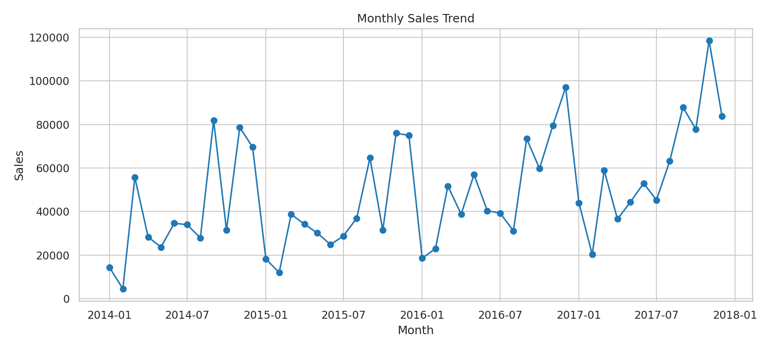
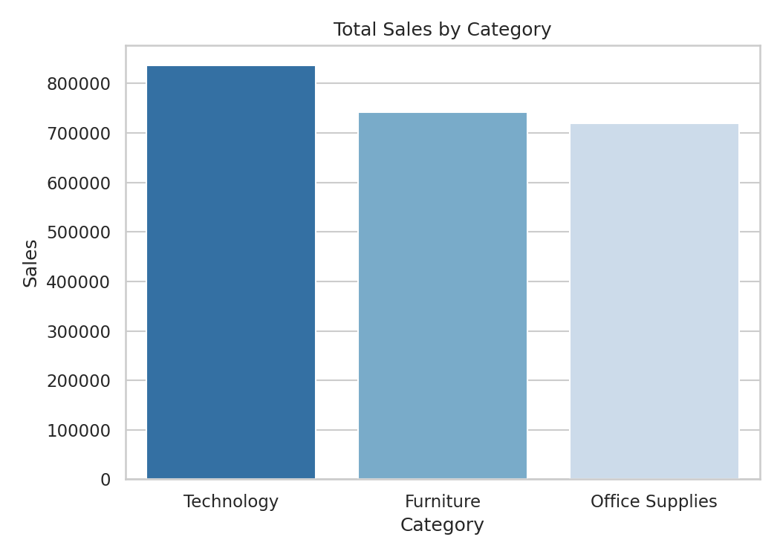
Visualizations: Sales
Sales peak every Nov-Dec; Technology leads sales.
6

Slide 7
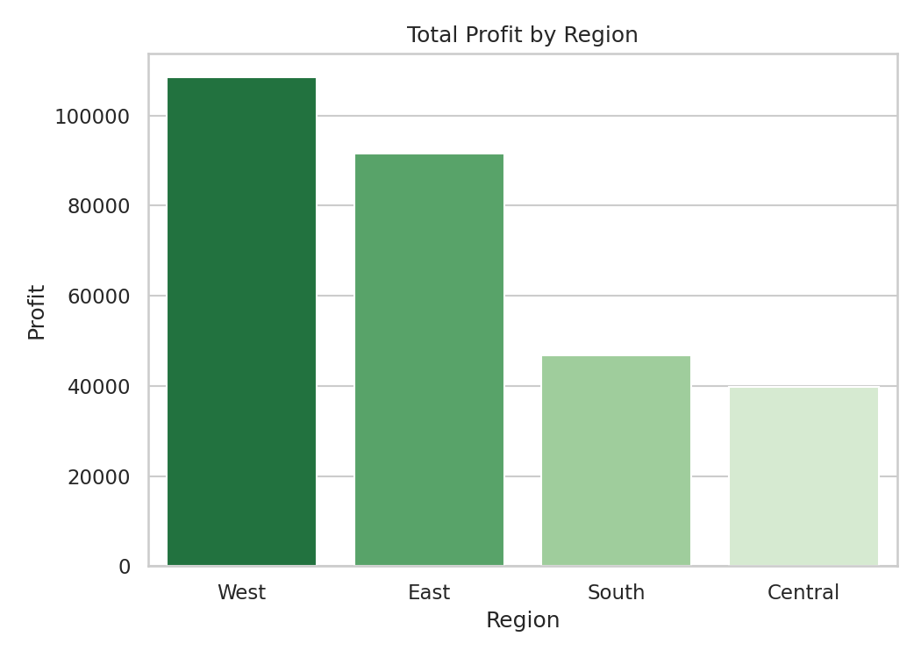
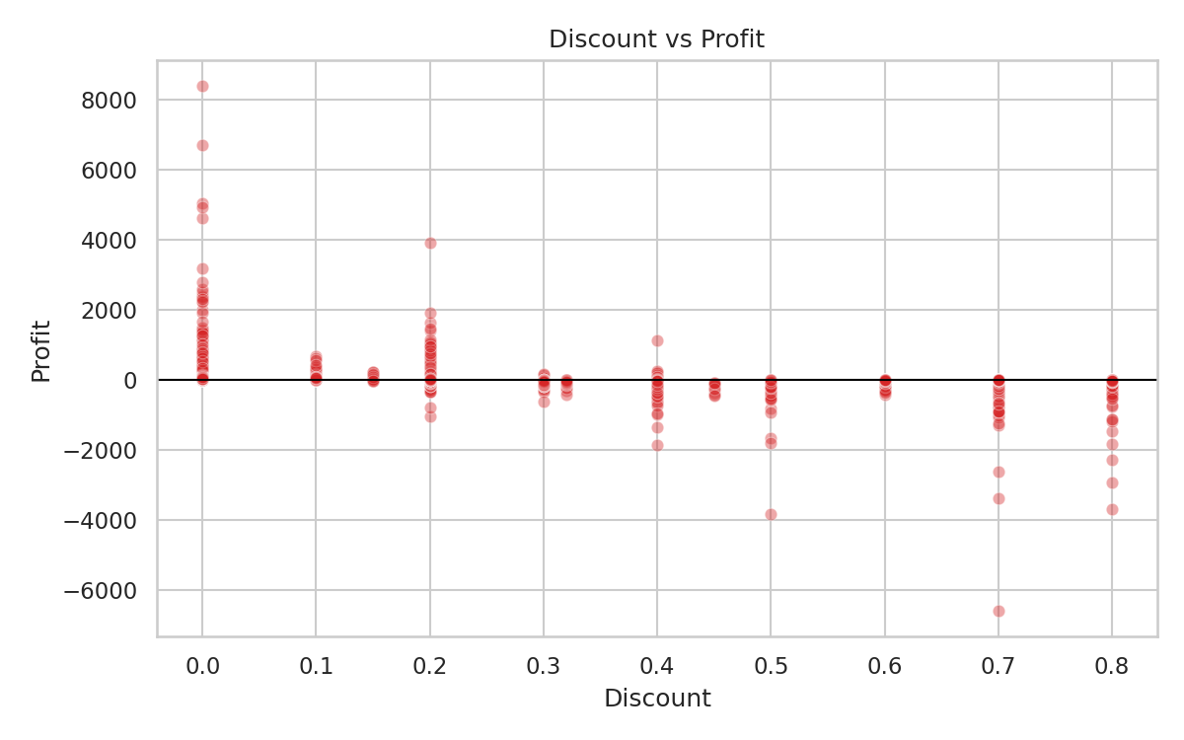
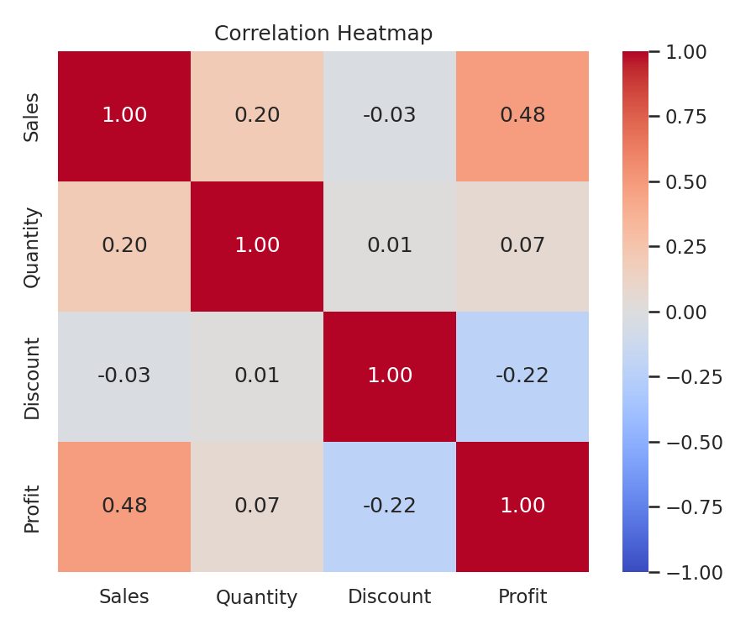
Visualizations: Profit
West earns the most profit; high discounts push orders into losses.
7

Slide 8
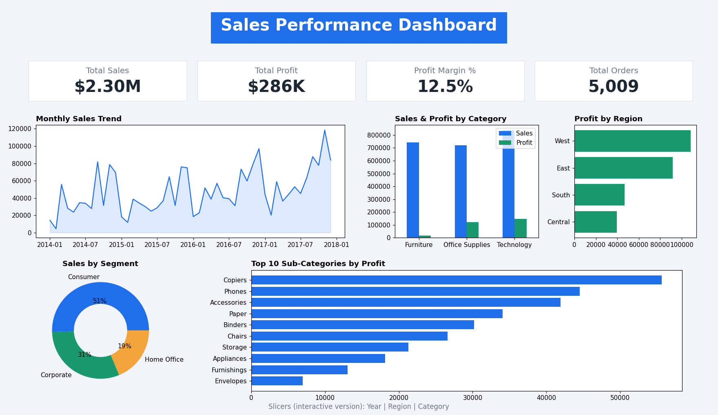
Power BI Style Dashboard
8

Slide 9
Key Insights
Sales peak in Nov (352K) and Dec (325K); lowest in Feb (60K)
Technology: 145K profit. Furniture: only 18K profit on 742K sales
Tables, Bookcases and Supplies lose money
30%+ discount orders lose money 96.8% of the time (-135K)
Central is weakest region (39.7K); top 20% of customers give 48% of sales
9

Slide 10
Recommendations
Cap discounts at about 20%; approval needed above 30%
Reprice or drop Tables, Bookcases and Supplies
Run festive campaigns early; stock up before November
Improve Central region; loyalty programme for top customers
10

Slide 11
Conclusion
Profit depends on discount discipline and product mix, not volume alone
Sales grew 51% from 2014 to 2017, with profit nearly doubling
Next step: forecasting and customer segmentation
11

