Slide 1
Credit Risk Default Prediction
By - Karthikeya, Ritwick, Sohail

Slide 2
Executive Summary
The Goal:
To improve our profitability and mitigate credit risk through the power of predictive systems.
The Tool:
A machine learning model to calculate the probability of default for our potential loan customers.
The Strategy:
Two sets of strategies for aggressive and conservative outlooks. We will set guideline thresholds for probability of default at which customers will be rejected.
The Advantage:
Higher revenue, lower default rates and the flexibility to change our strategy by adjusting the rejection threshold.
Strategy | Train Sample |  |  | Test 1 Sample |  |  | Test 2 Sample |  |  | Overall
 | #Total Loans | Default Rate | Revenue | #Total Loans | Default Rate | Revenue | #Total Loans | Default Rate | Revenue | #Total Loans | Default Rate | Revenue
Conservative | 530681 | 0.819% | $ 500.18 | 113897 | 1.654% | $ 107.23 | 123296 | 0.693% | $ 109.33 | 767874 | 0.922% | $ 716.75
Aggressive | 738623 | 7.461% | $ 1,146.13 | 160882 | 9.384% | $ 241.12 | 168584 | 5.419% | $ 255.92 | 1068089 | 7.428% | $ 1,643.17

Slide 3
Why do we care about this?
Americans total credit card balance is $986 billion in Q4 of 2022
Average American has $2948 credit card debt
The delinquency rate for Q4 2022 is 2.25%
So it’s a whopping $22.17 billion in a single quarter!!

Slide 4

The Speed Hero
The “Boost Master”
XGBoost is a powerful jet engine for your machine learning model. It gives you a boost of speed and
accuracy, so you can reach new heights in your predictions.
Like a superhero that never gives up, it keeps iterating and improving your model until it's the best.

Slide 5
What makes Boost Master the best?
40X
Our XGBOOST model runs
faster than normal models
The aggregate feature strategy generates
>37%
than random feature strategy

Slide 6
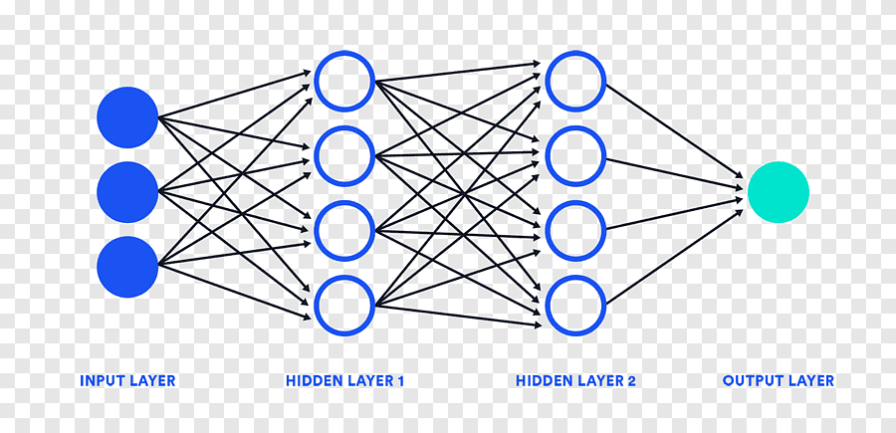
The Brain Hero
The “Neural Ninja”
Neural Networks are like the ultimate multitaskers. They can analyze text, images, and sounds all at once,
making accurate predictions.
Neural Networks are like the brains of your model. They can learn from experience and adjust their weights to make
better predictions, just like how our brains learn from past experiences.

Slide 7

The Mission
To predict whether the borrower will default or not

Slide 8
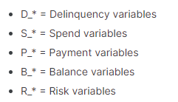
The Food
Data is the food required for the characters to accomplish this mission
It has 458k unique customer records and a total of 190 features
The timeline of the data is from 2017-03-31 - 2018-03-31 (1 year)
The features in the given data is categorized into:

Slide 9
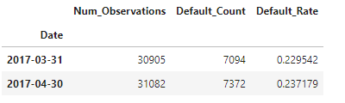
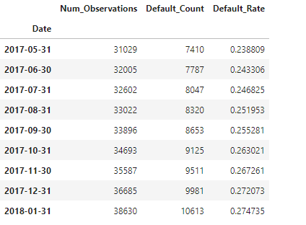
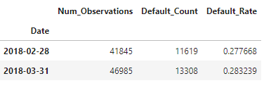
Data
Test1
Train
Test2

Slide 10
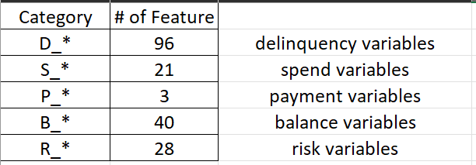
Feature Categories

Slide 11
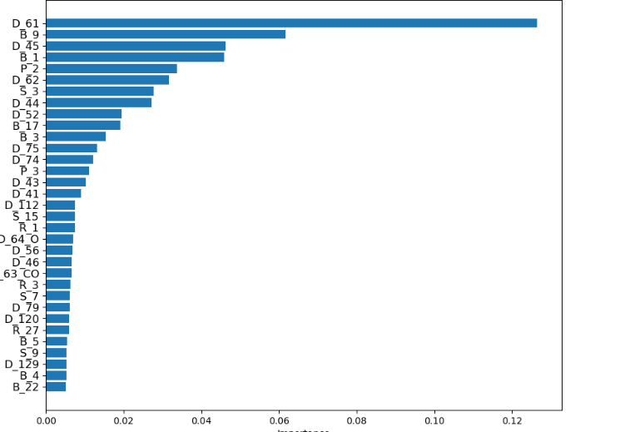
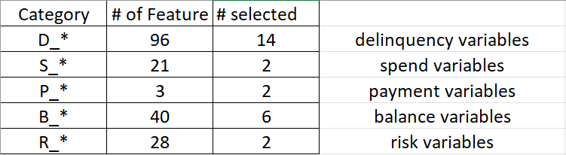
Feature Selection based on Importance

Slide 12
Run Time of XgBoost grid search
~40x Faster
Guess how?

Slide 13
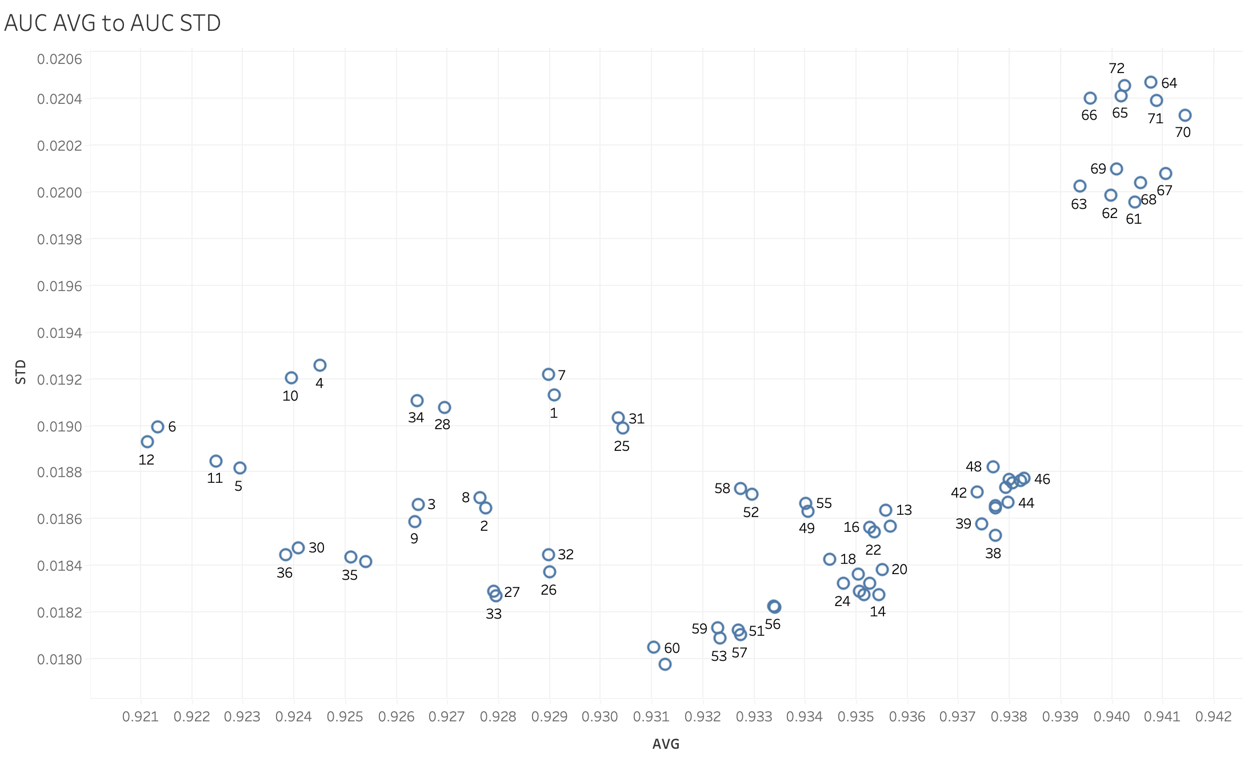
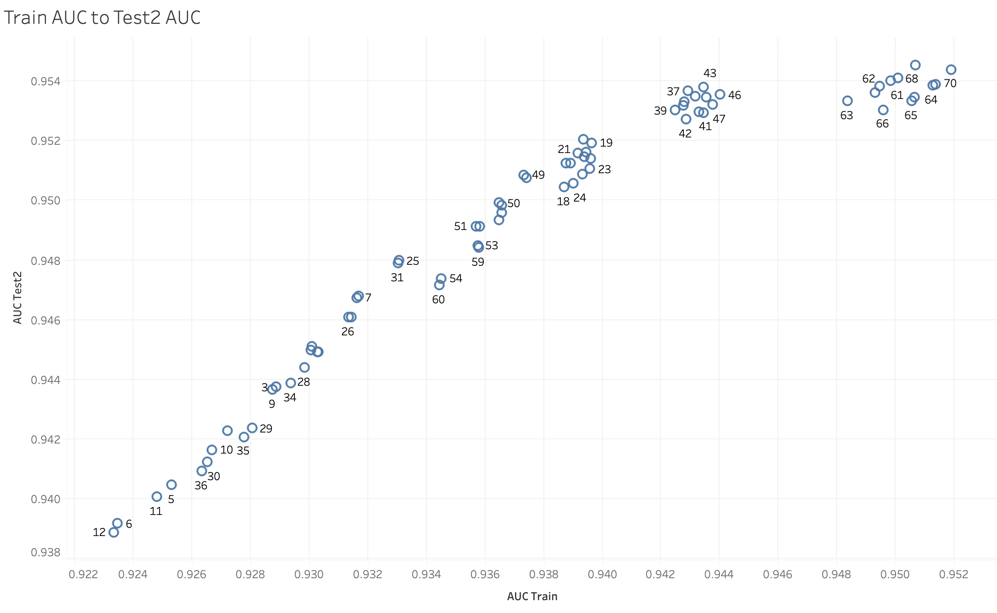

Slide 14
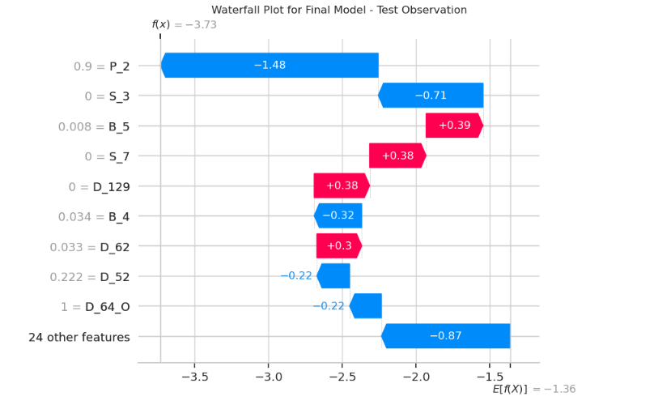
XGBoost Shap - Waterfall

Slide 15
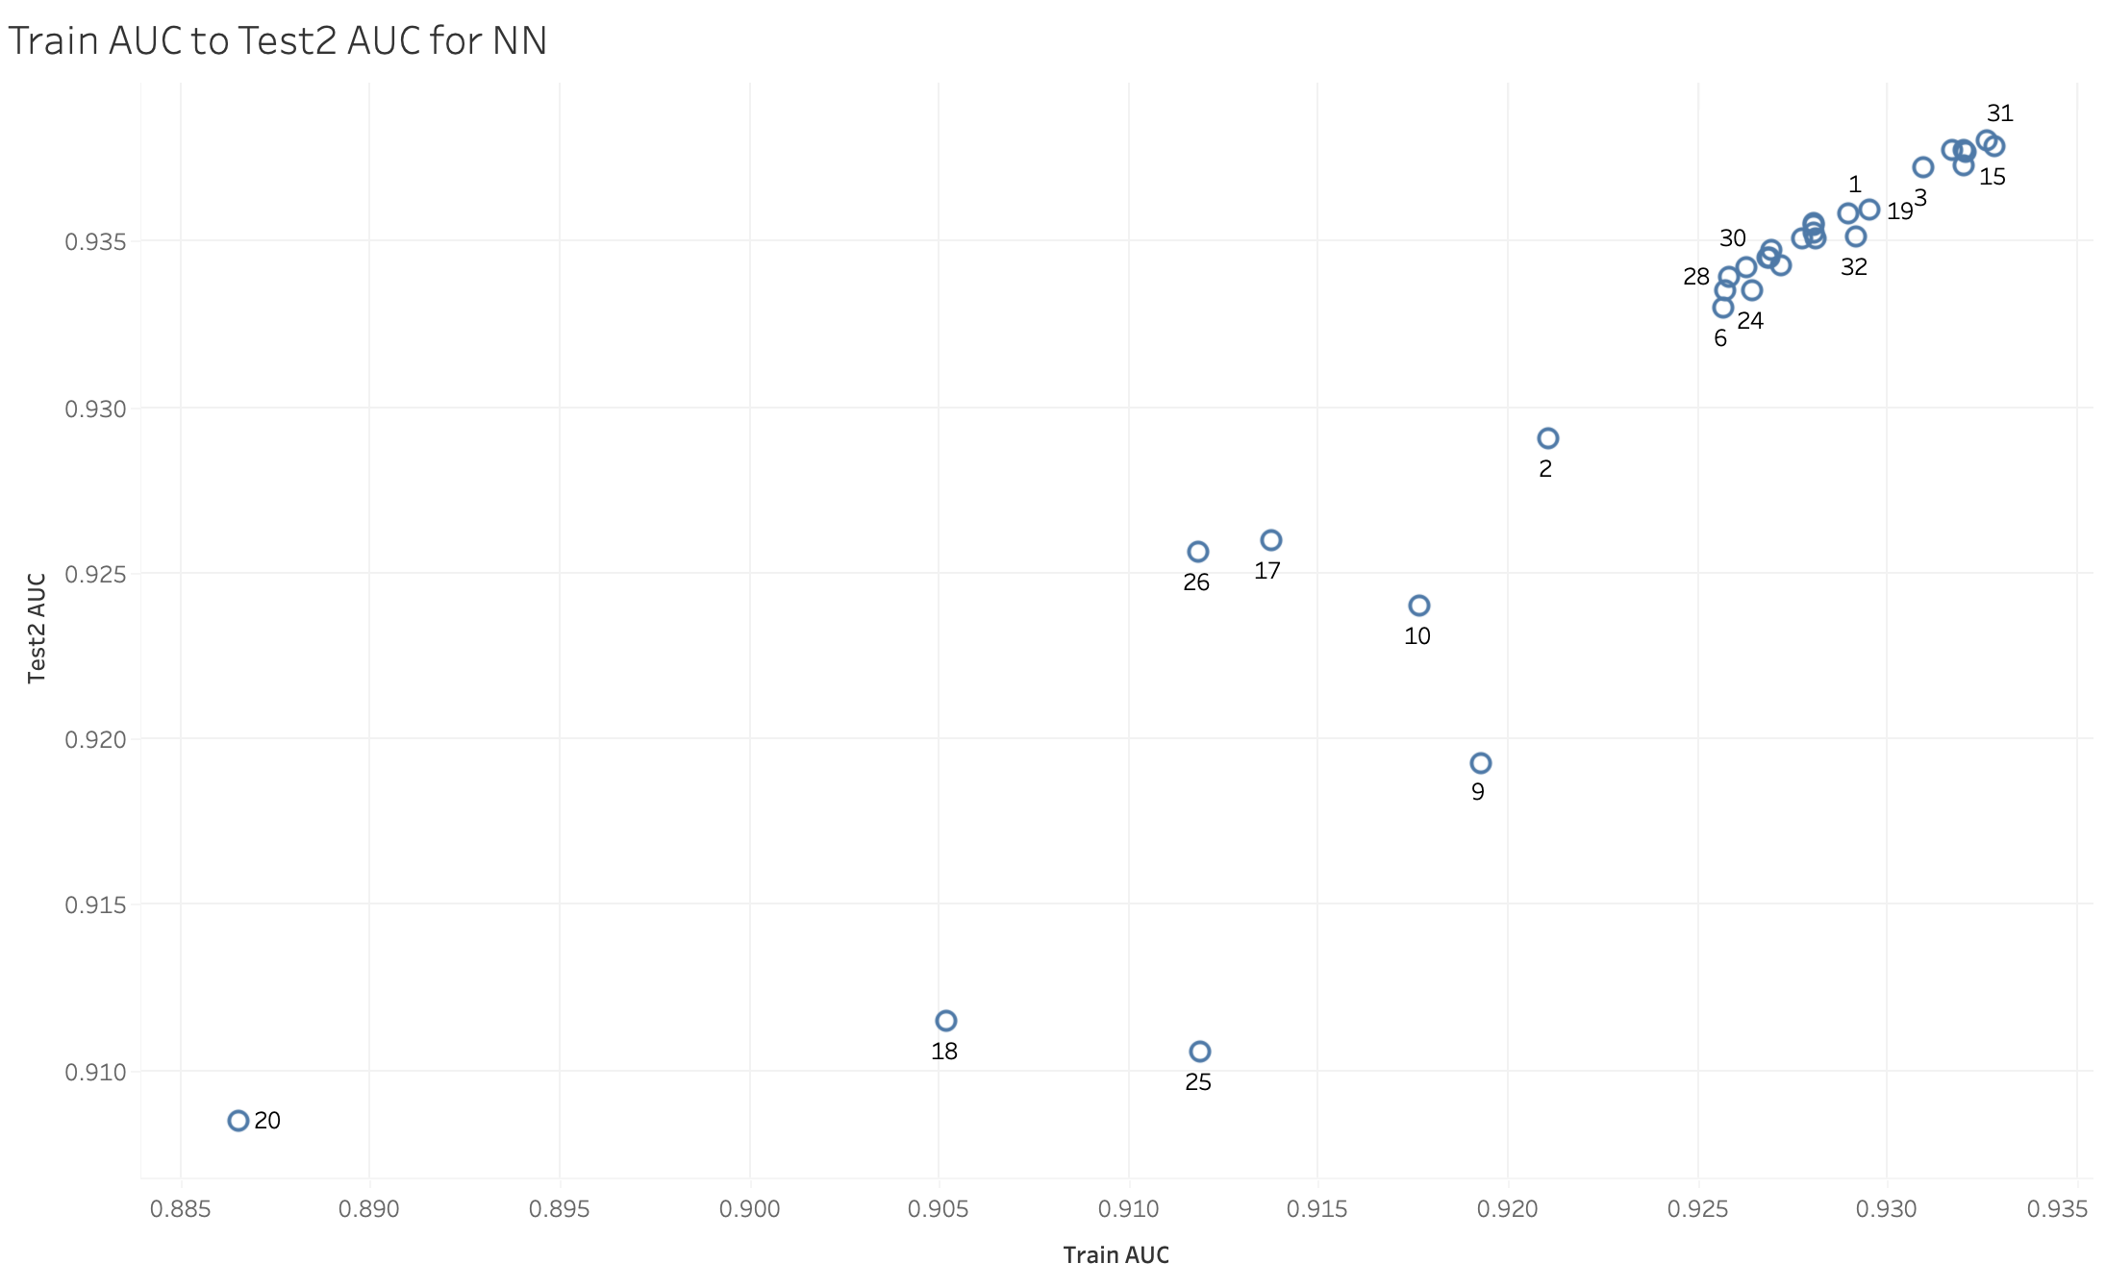
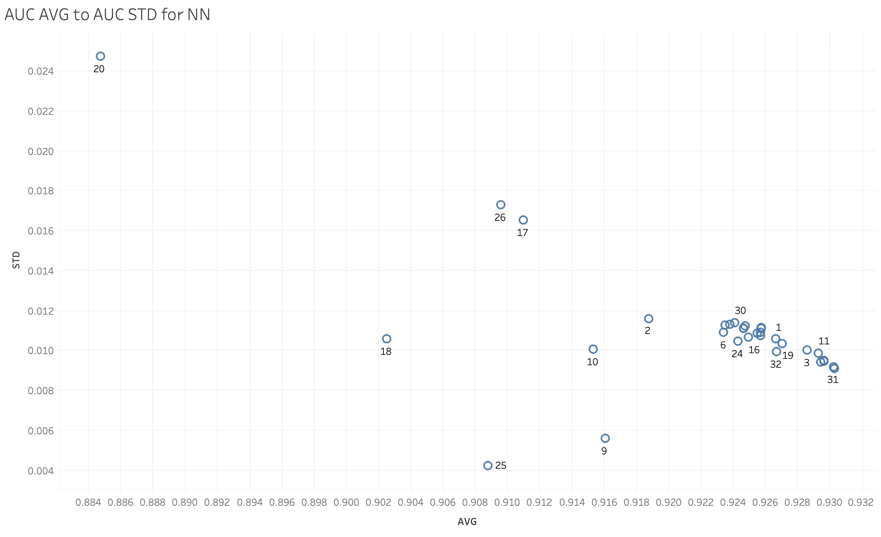
Neural Network Grid Search

Slide 16
Final Model
The roc_auc metric is slightly better for xgboost
We use xgboost because the training time with our parameters
is significantly less.(8 mins vs 3hrs)
Tested for 72 combinations for xgboost’s grid search compared
to 32 in neural network

