Slide 1
REAL-TIME-LANGUAGE-TRANSLATOR

Slide 2

PRESENTED BY
P.KARTHIK - 21JQ1A0526
T.SRI LALITHA - 21JQ1A0537
N.TULASI - 21JQ1A0522
UNDER THE GUIDANCE OF :
Mr. A. Sandeep
Assistant Professor of CSE
Department of Computer Science and Engineering
Kakinada Institute of Technology and Science, Divili , Peddapuram -533437

Slide 3
CONTENTS
ABSTRACT
INTRODUCTION
EXISTING SYSTEM
PROPSED SYSTEM
SCOPE & PURPOSE
REQUIRMENTS SPECIFICATION
ALGORITHMS
ARCHITECTURE
UML DIAGRAMS
TEST CASES
SAMPLE CODE
OUTPUT SCREENS
CONCLUSION AND FUTURE SCOPE

Slide 4
ABSTRACT
The Real-Time Language Translator is a voice translation tool that provides instant translations to bridge language gaps. It uses Python, GTTS for text-to-speech, Speech Recognition for capturing spoken input, Streamlit for the user interface, Pygame for audio playback, and Google trans for translation. Users can speak naturally, and the tool listens and translates seamlessly. It is useful for travelers, professionals, and anyone needing quick translations. With an easy setup and smooth functionality, this tool demonstrates how AI can enhance communication and break language barriers.

Slide 5
INTRODUCTION
Instant, accurate voice-based translation.
Powered by Python, GTTS, SpeechRecognition, Streamlit, Pygame, and Googletrans.
User-friendly for all technical levels.
Natural, human-like translations for enhanced communication.
Ideal for travel, business, and cross-cultural communication
Breaks language barriers, fosters global collaboration.

Slide 6
EXISTING SYSTEM
Focus on text-based translation (e.g., Google Translate, Microsoft Translator).
Use AI, machine learning, and NLP for accuracy and context-awareness.
Can translate text from images using OCR.
Works well for popular languages (e.g., English, Spanish).
Poor support for regional or less common languages.

Slide 7
PROPOSED SYSTEM
Real-time voice-based translation with a focus on Indian regional languages.
Acts as a virtual interpreter for seamless multilingual communication.
Listens to spoken words and converts them into the target language.
Built using Python, GTTS, SpeechRecognition, Streamlit UI, Pygame, and Googletrans.
Enhances accessibility for regional language speakers.
Handles real-time speech processing for fluid communication.
Bridges language gaps, making communication easier and more inclusive.

Slide 8
SCOPE & PURPOSE
SCOPE :
Provides real-time translation for seamless communication.
Ensures accurate and fast translations using advanced technology.
Simple and intuitive user interface for easy access.
PURPOSE :
Break language barriers for effective communication.
Enhance conversations between people speaking different languages.
Support travelers in navigating foreign places.

Slide 9
REQUIRMENTS SPECIFICATION
MODULES :
os: File and directory operations.
time: Delays and timing.
pygame: Audio playback.
streamlit: Web UI creation.
speech_recognition: Speech-to-text conversion.
gtts: Text-to-speech conversion.
googletrans: Language translation.
tempfile: Temporary file handling.

Slide 10
SOFTWARE REQUIRMENTS :
Python 3.8.5+
GTTS (Text-to-Speech)
SpeechRecognition (Speech-to-Text)
Googletrans (Translation)
Streamlit (User Interface)
HARDWARE REQUIRMENTS :
CPU: Dual-core or better
RAM: 4GB+
Storage: 2GB+ free space
Microphone & Speakers
Internet Connection

Slide 11
ALGORITHMS
Deep Neural Networks (DNNs) :
Speech to Text: The tool listens to your voice and turns it into text. This is done using Google’s speech recognition, which uses DNNs to understand what you’re saying.
Translation: The tool translates the text from one language to another. Google Translate, which the tool uses, relies on DNNs to make translations accurate and smooth.

Slide 12
3. Text to Speech: The tool reads out the translated text in the new language. Google’s text-to-speech (gTTS) uses DNNs to make the voice sound natural.
4. Noise Handling: The app tries to ignore background noise when listening to your voice. While not directly using DNNs, advanced noise filtering often uses DNNs to work better.

Slide 13
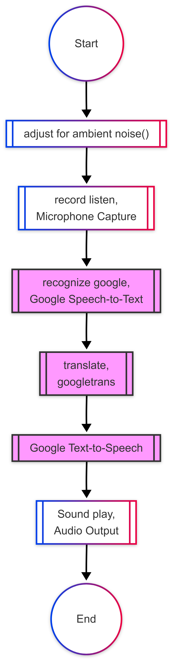
ARCHITECTURE

Slide 14
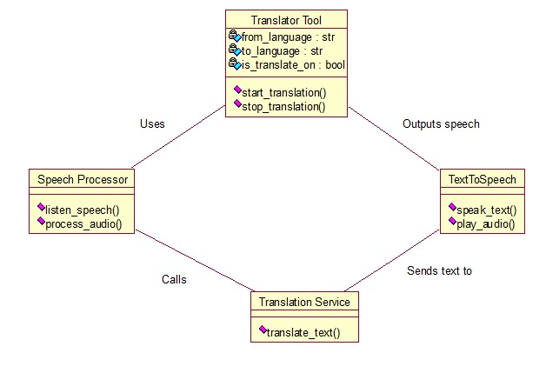
UML DIAGRAMS
CLASS DIAGRAM :
CLASS DIAGRAMS CONSISTS OF THE CLASSES AND THE OBJECTS AND THE INTERACTION BETWEEN THEM. IT MAINLY DEALS WITH INTERACTION BETWEEN CLASSES IN SYSTEM , THEIR BEHAVIOUR AND PROPERTIES OF THE SYSTEM.

Slide 15
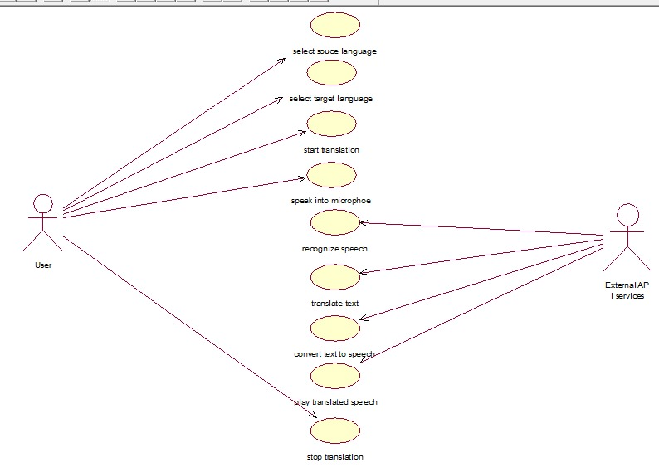
USE CASE DIAGRAM :
A USE CASE DIAGRAM IS USED TO REPRESENT THE DYNAMIC BEHAVIOUR OF A SYSTEM. IT ENCAPSULATES THE SYSTEM’S FUNCTIONALITY BY INCORPORATING USE CASES, ACTORS AND THEIR RELATIONSHIPS.

Slide 16
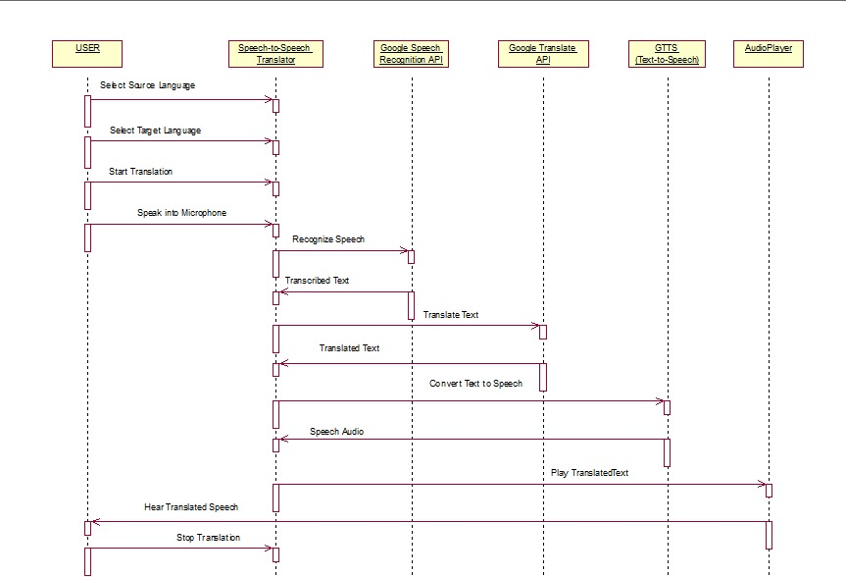
SEQUENCE DIAGRAM :
THE PURPOSE OF SEQUENCE DIAGRAM IS TO SHOW THE FLOW OF FUNCTIONALITY THROUGH A USE CASE. IN OTHER, WE CALL IT A MAPPING PROCESS IN TERMS OF DATA TRANSFER FROM THE ACTOR THROUGH THE CORRESPONDING.

Slide 17
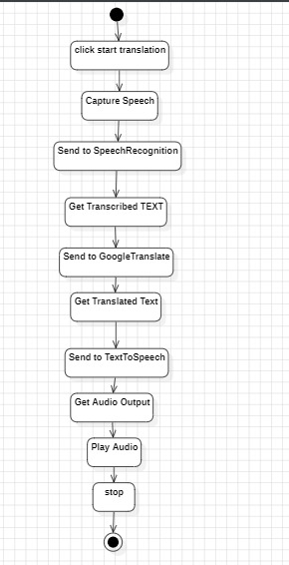
ACTIVITY DIAGRAM :
ACTIVITY DIAGRAMS ARE GRAPHICAL REPRESENTATION OF WORKFLOW OFF STEPWISE ACTIVITIES AND ACTIONS WITH SUPPORT OF CHOICE, ITERATION AND CONCURRENCY.

Slide 18
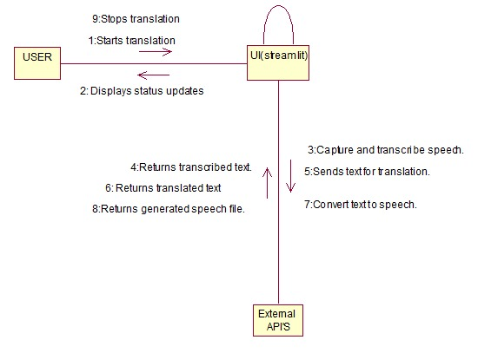
COLLABORATION DIAGRAM :
IT CONSISTING OF A SET OF OBJECTS AND THEIR RELATIONSHIP. IT EMPHASIZES THE STRUCTURAL ORGANIZATION OF THE OBJECTS THAT SEND AND RECEIVE MESSAGES.

Slide 19
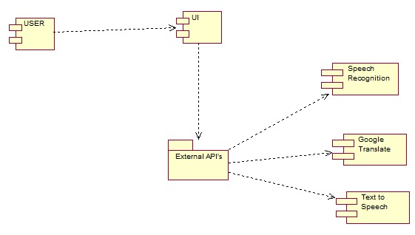
COMPONENT DIAGRAM :
IN THE OBJECT-ORIENTED ANALYSIS, A COMPONENT DIAGRAM DEPICTS HOW COMPONENTS ARE WIRED TOGETHER TO FORM LARGER COMPONENTS AND OR SOFTWARE SYSTEMS.

Slide 20
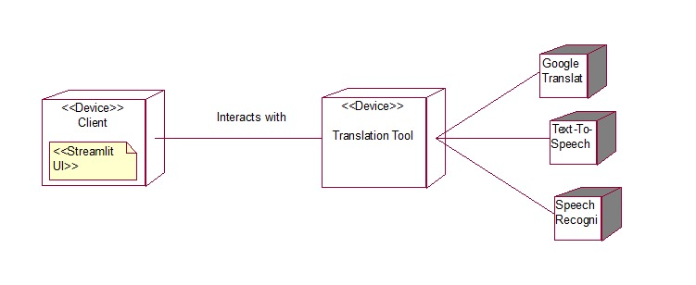
DEPLOYMENT DIAGRAM :
A DEPLOYMENT DIAGRAMS IN THE UNIFIED MODELLING LANGUAGE MODULES THE PHYSICAL DEPLOYMENT OF ARTIFACTS ON NODES.

Slide 21
TEST CASES
S.NO | TEST CASE NAME | TEST PROCEDURE | EXPECTED RESULT | TEST RESULT
1 | UI Dropdown selection | Select different languages from dropdown list | Working all languages | Success
2 | Same source and target language | Speak a sentence with both languages set the same | Translate successfully | Success
3 | Translate source to target language | Speak clear sentence with selected source and target language | Translate successfully | Success
4 | Silent input | Stay silent while system is listening | Speech could not understand | Success
5 | Long speech input | Speak for 30sec (Long sentence) to test processing | Taking Long speeches | Success

Slide 22
S. No | TEST CASE NAME | TEST PROCEDURE | EXPECTED RESULT | TEST RESULT
6 | Internet disconnection | Disable the internet while translation stopped | Translation stopped | Success
7 | Background noise handling | Test speech recognition in a noise environment | Noise reduction | Success
8 | Moderate fast input | Speak moderate fast to see if recognition captures the words | Capture words | Success
9 | Special characters and handling | Speak numbers and Punctuation | Maintain its originality | Success
10 | Multiple language switching | Switch between multiple languages between the session | Switching successfully | Success
11 | Audio quality variation | Test with High and low-quality microphone | Recognize speech | Success

Slide 23
SAMPLE CODE
import speech_recognition as sr
from googletrans import Translator
from gtts import gTTS
import os
import pygame
# Initialize
translator = Translator()
pygame.mixer.init()
def recognize_speech():
r = sr.Recognizer()
with sr.Microphone() as source:
print("Speak now...")
audio = r.listen(source)
return r.recognize_google(audio, language="en")

Slide 24
def translate_text(text, target_lang="es"):
return translator.translate(text, dest=target_lang).text
def text_to_speech(text, lang="es"):
tts = gTTS(text, lang=lang)
tts.save("speech.mp3")
pygame.mixer.music.load("speech.mp3")
pygame.mixer.music.play()
if __name__ == "__main__":
text = recognize_speech()
translated = translate_text(text)
print(f"Translated: {translated}")
text_to_speech(translated)

Slide 25
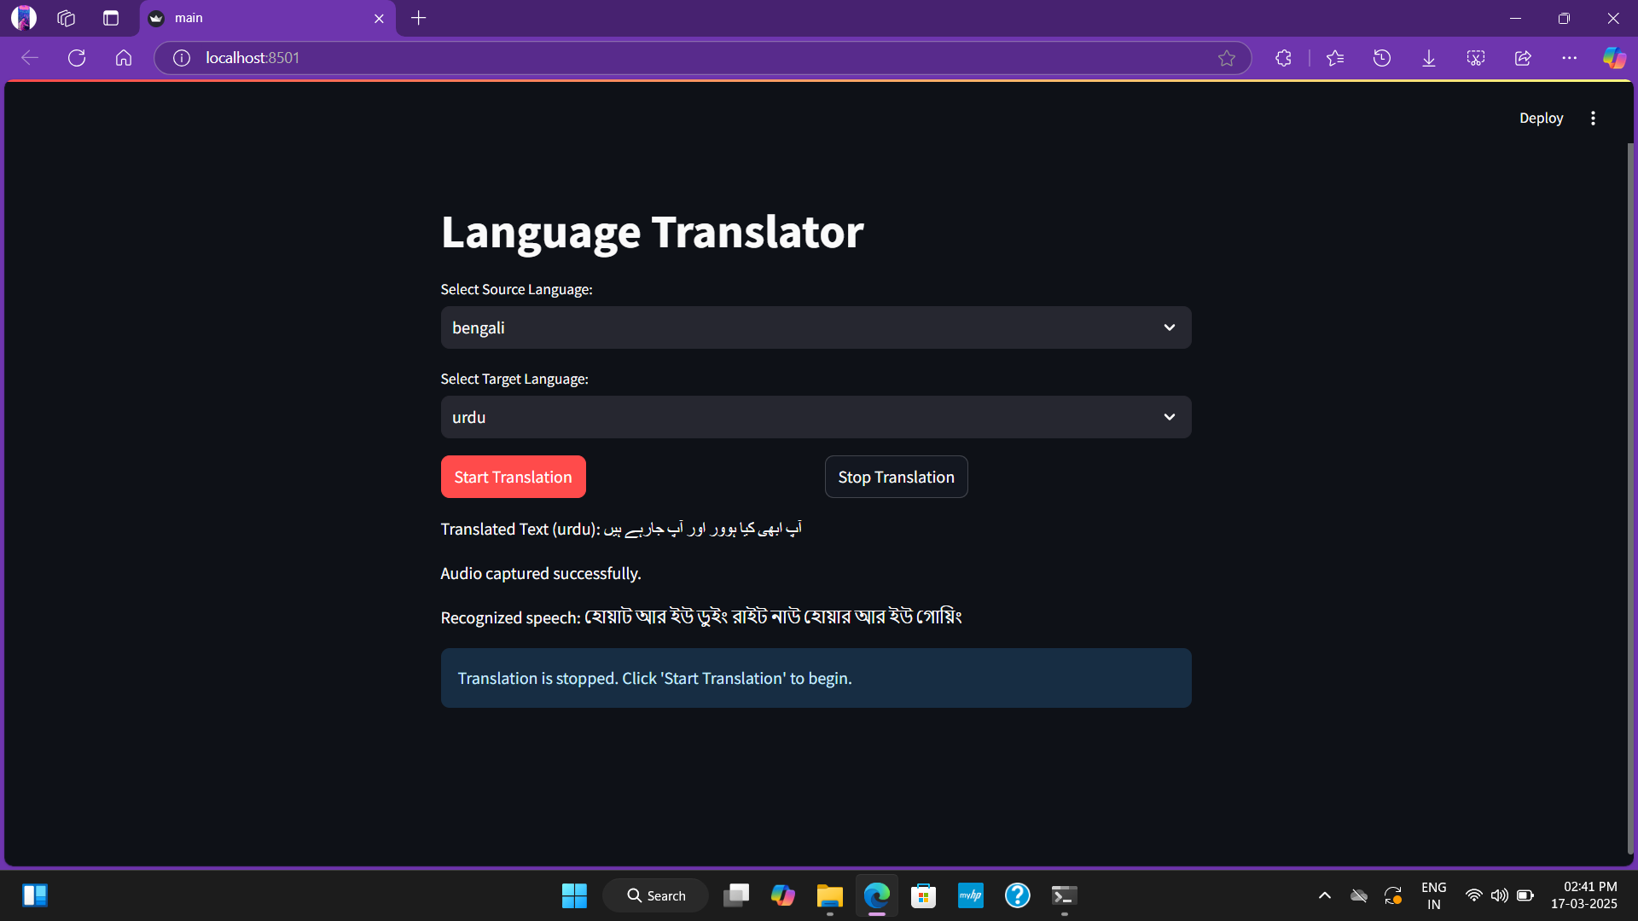
OUTPUT SCREENS
UI Dropdown languages

Slide 26

Same source and target language

Slide 27

Source to target Language

Slide 28
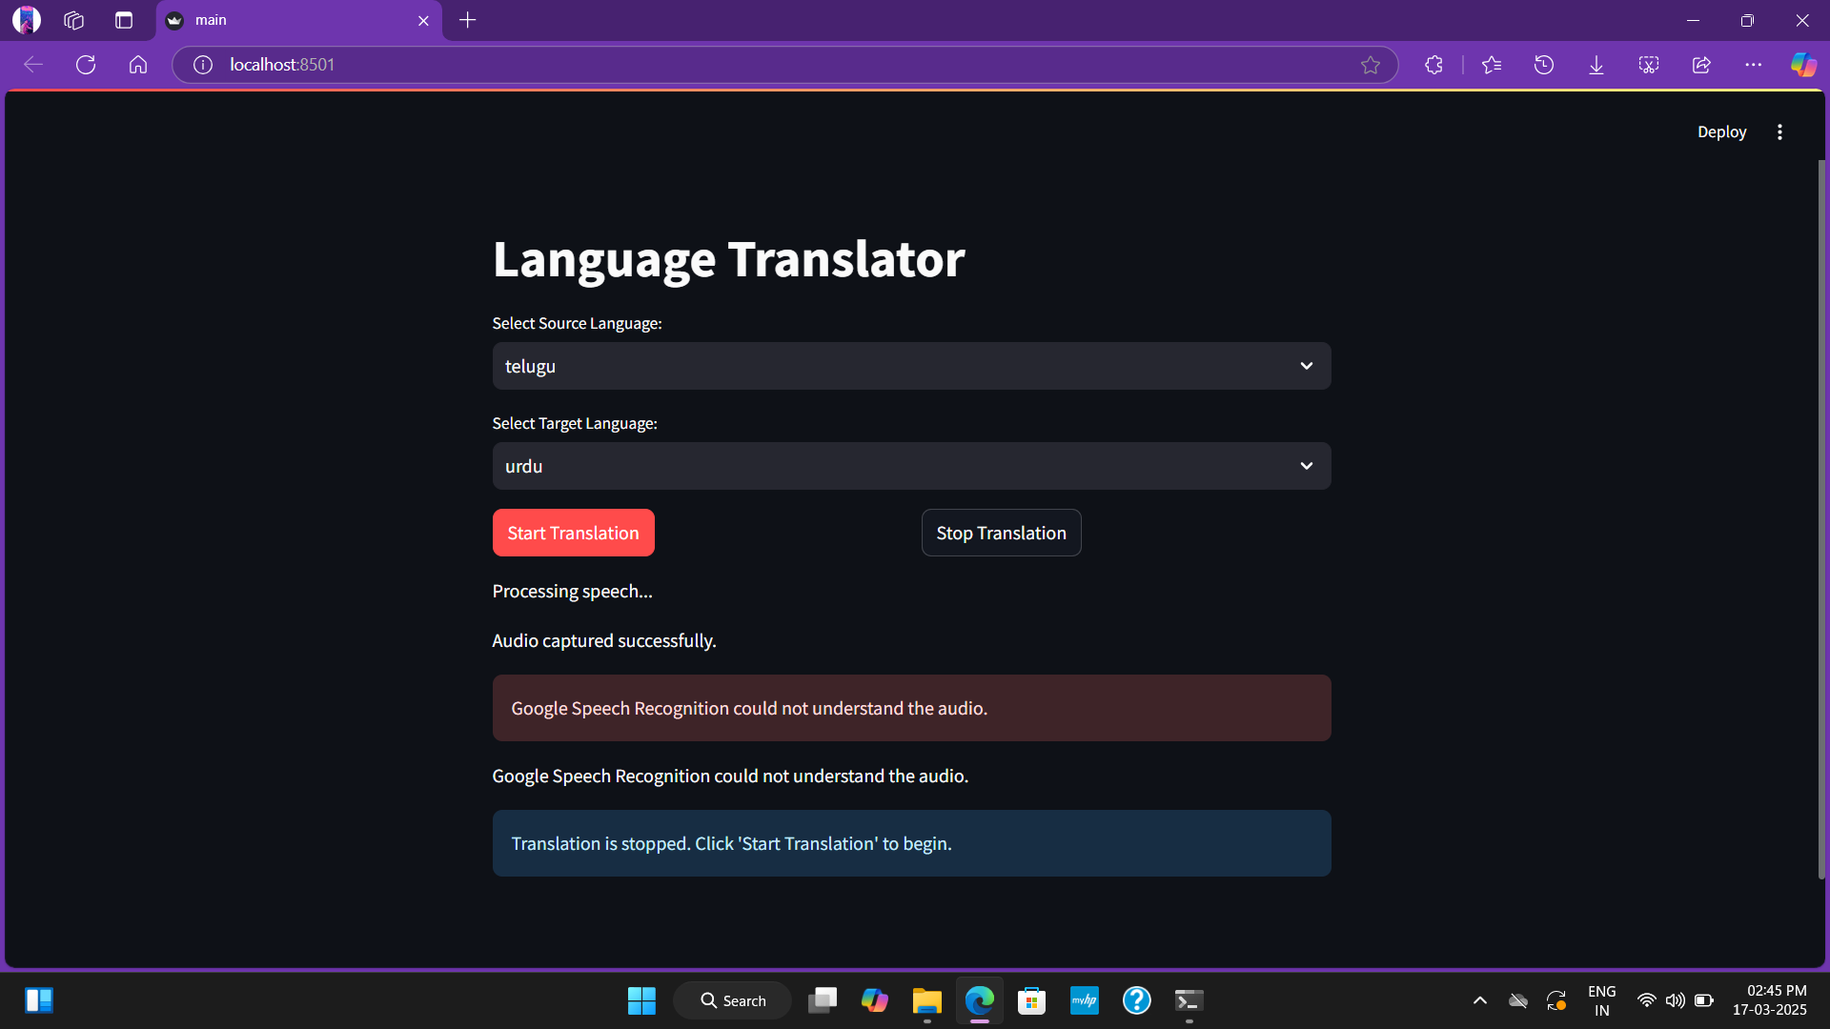
Silent input

Slide 29
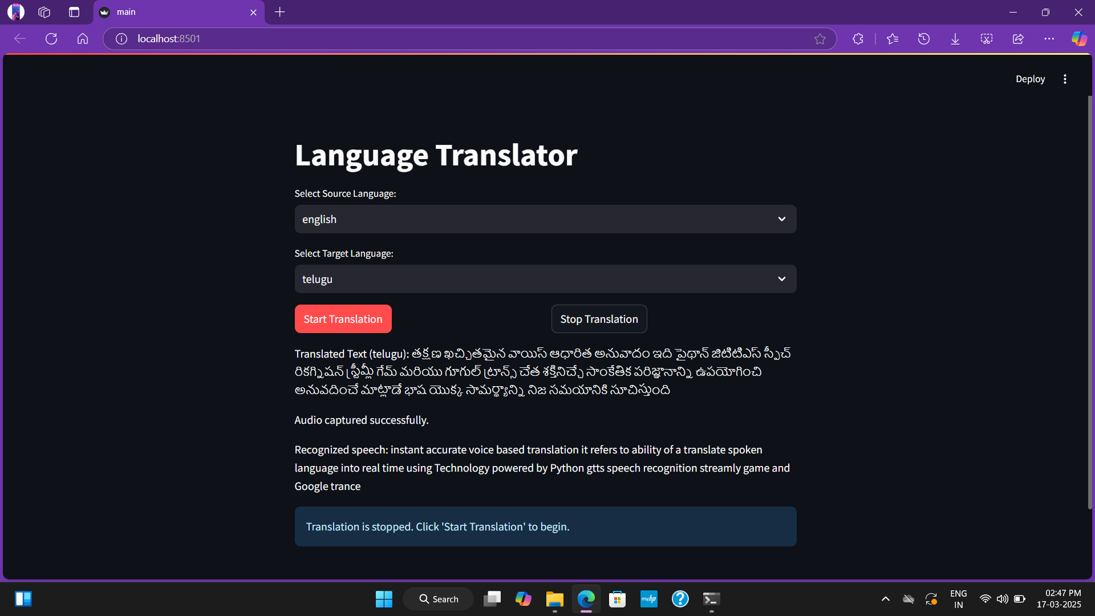
Long speech

Slide 30
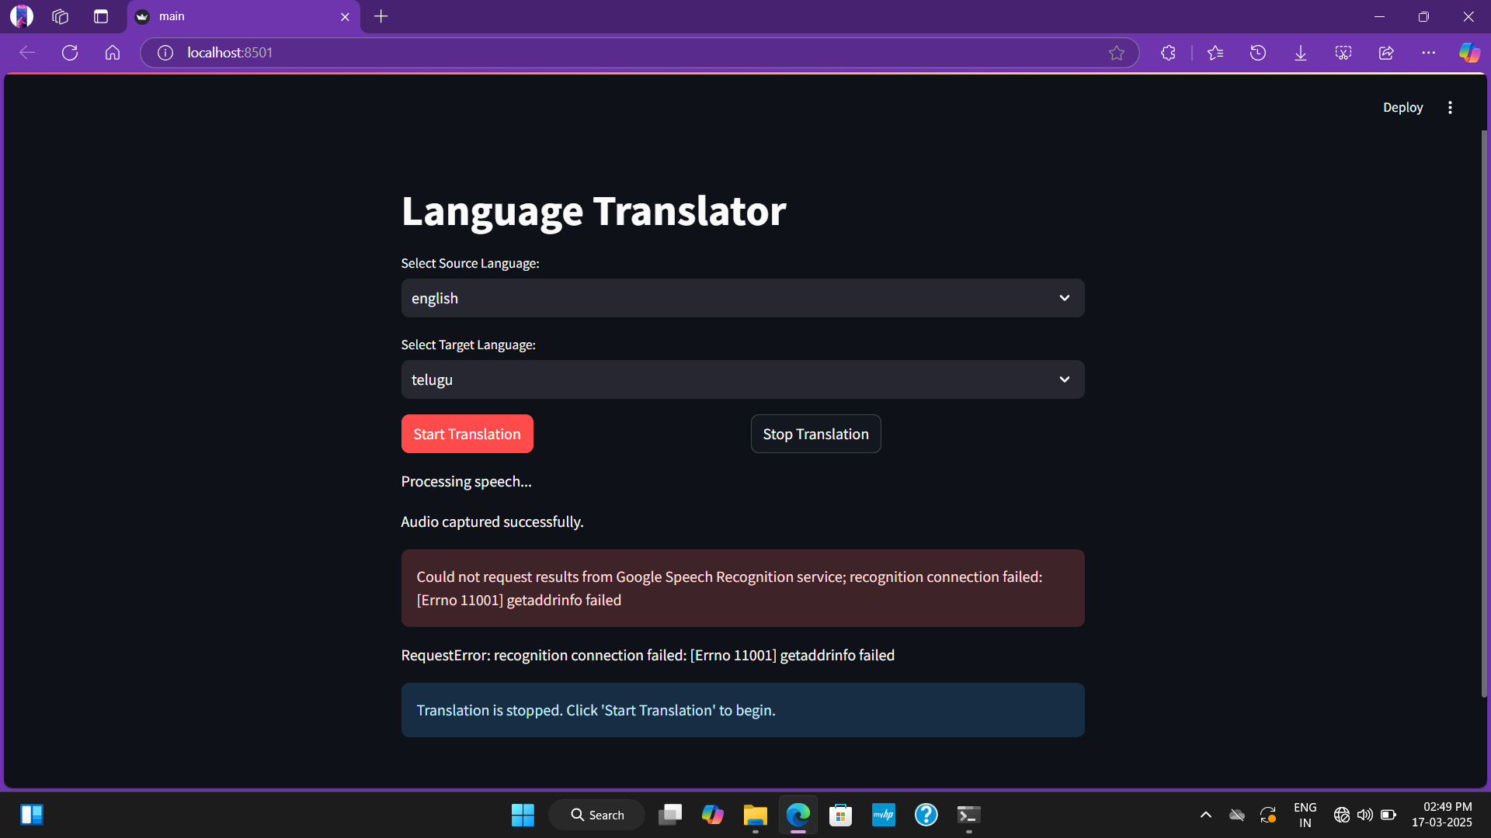
Internet disconnect

Slide 31

Background noise handling

Slide 32
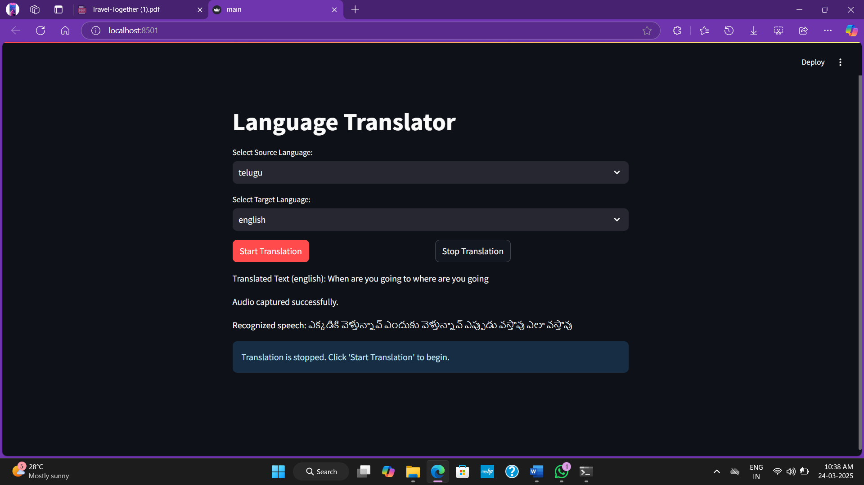
Moderate fast input

Slide 33

Special characters handling

Slide 34
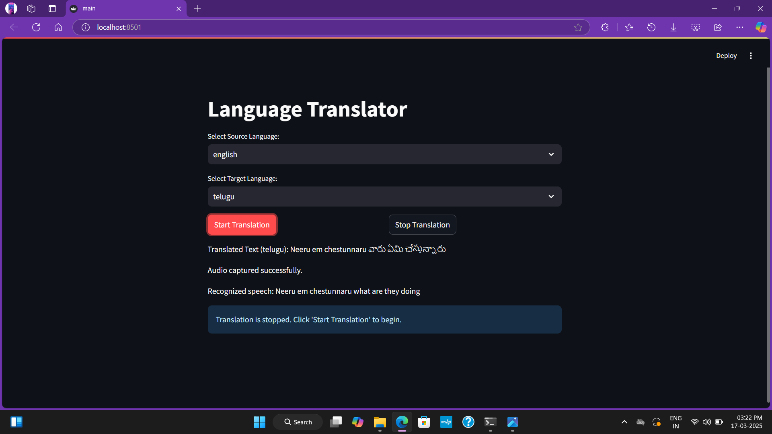
Multiple language switching

Slide 35
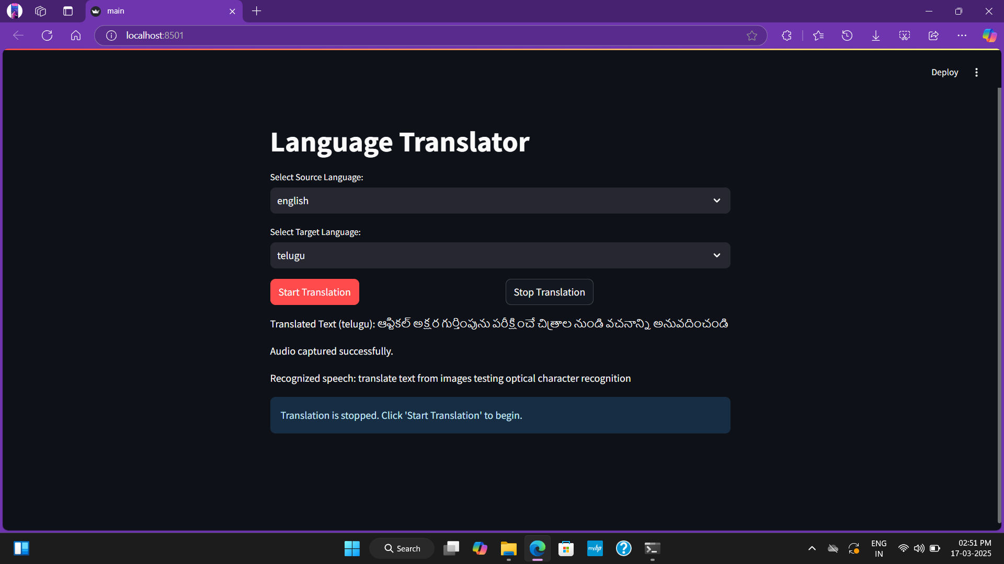
Audio Quality variation

Slide 36
CONCLUSION & FUTURE SCOPE
CONCLUSION :
What it does: This translator app lets people speak and instantly hear translations in over 30 languages, helping travelers, students, and businesses communicate easily.
How it works: It listens to your voice, converts it to text, translates it, then speaks it back in the chosen language - all through a simple website.
Why it matters: In our connected world, tools like this help break down language barriers and bring people closer together.

Slide 37
FUTURE SCOPE :
Expanded Language Support & Offline Mode – Increase the number of supported languages and add offline translation using open-source tools like Mozilla DeepSpeech or OpenNMT.
Enhanced Usability & Accessibility – Implement noise cancellation, customizable voices, and accessibility features like voice feedback and screen reader compatibility.
Integration & Specialized Translation – Connect with platforms like Zoom or WhatsApp and train AI models for accurate translations in fields like medicine, law, and technology.

Slide 38
THANK YOU….

