Slide 1


Slide 2
  ABSTRACT
Delhi House Price Prediction System
  The Delhi House Price Prediction System is a machine learning-based project designed to estimate residential property prices based on various features such as locality, area (sqft), number of bedrooms, bathrooms, parking availability, property status, and region.
  The system uses historical housing data from Delhi-NCR to train regression models that identify patterns and relationships between property features and prices.
  After preprocessing and feature engineering, multiple regression algorithms are applied and evaluated to select the best performing model.
  The final system provides accurate price predictions to help buyers, sellers, and real estate investors make data-driven decisions.

Slide 3
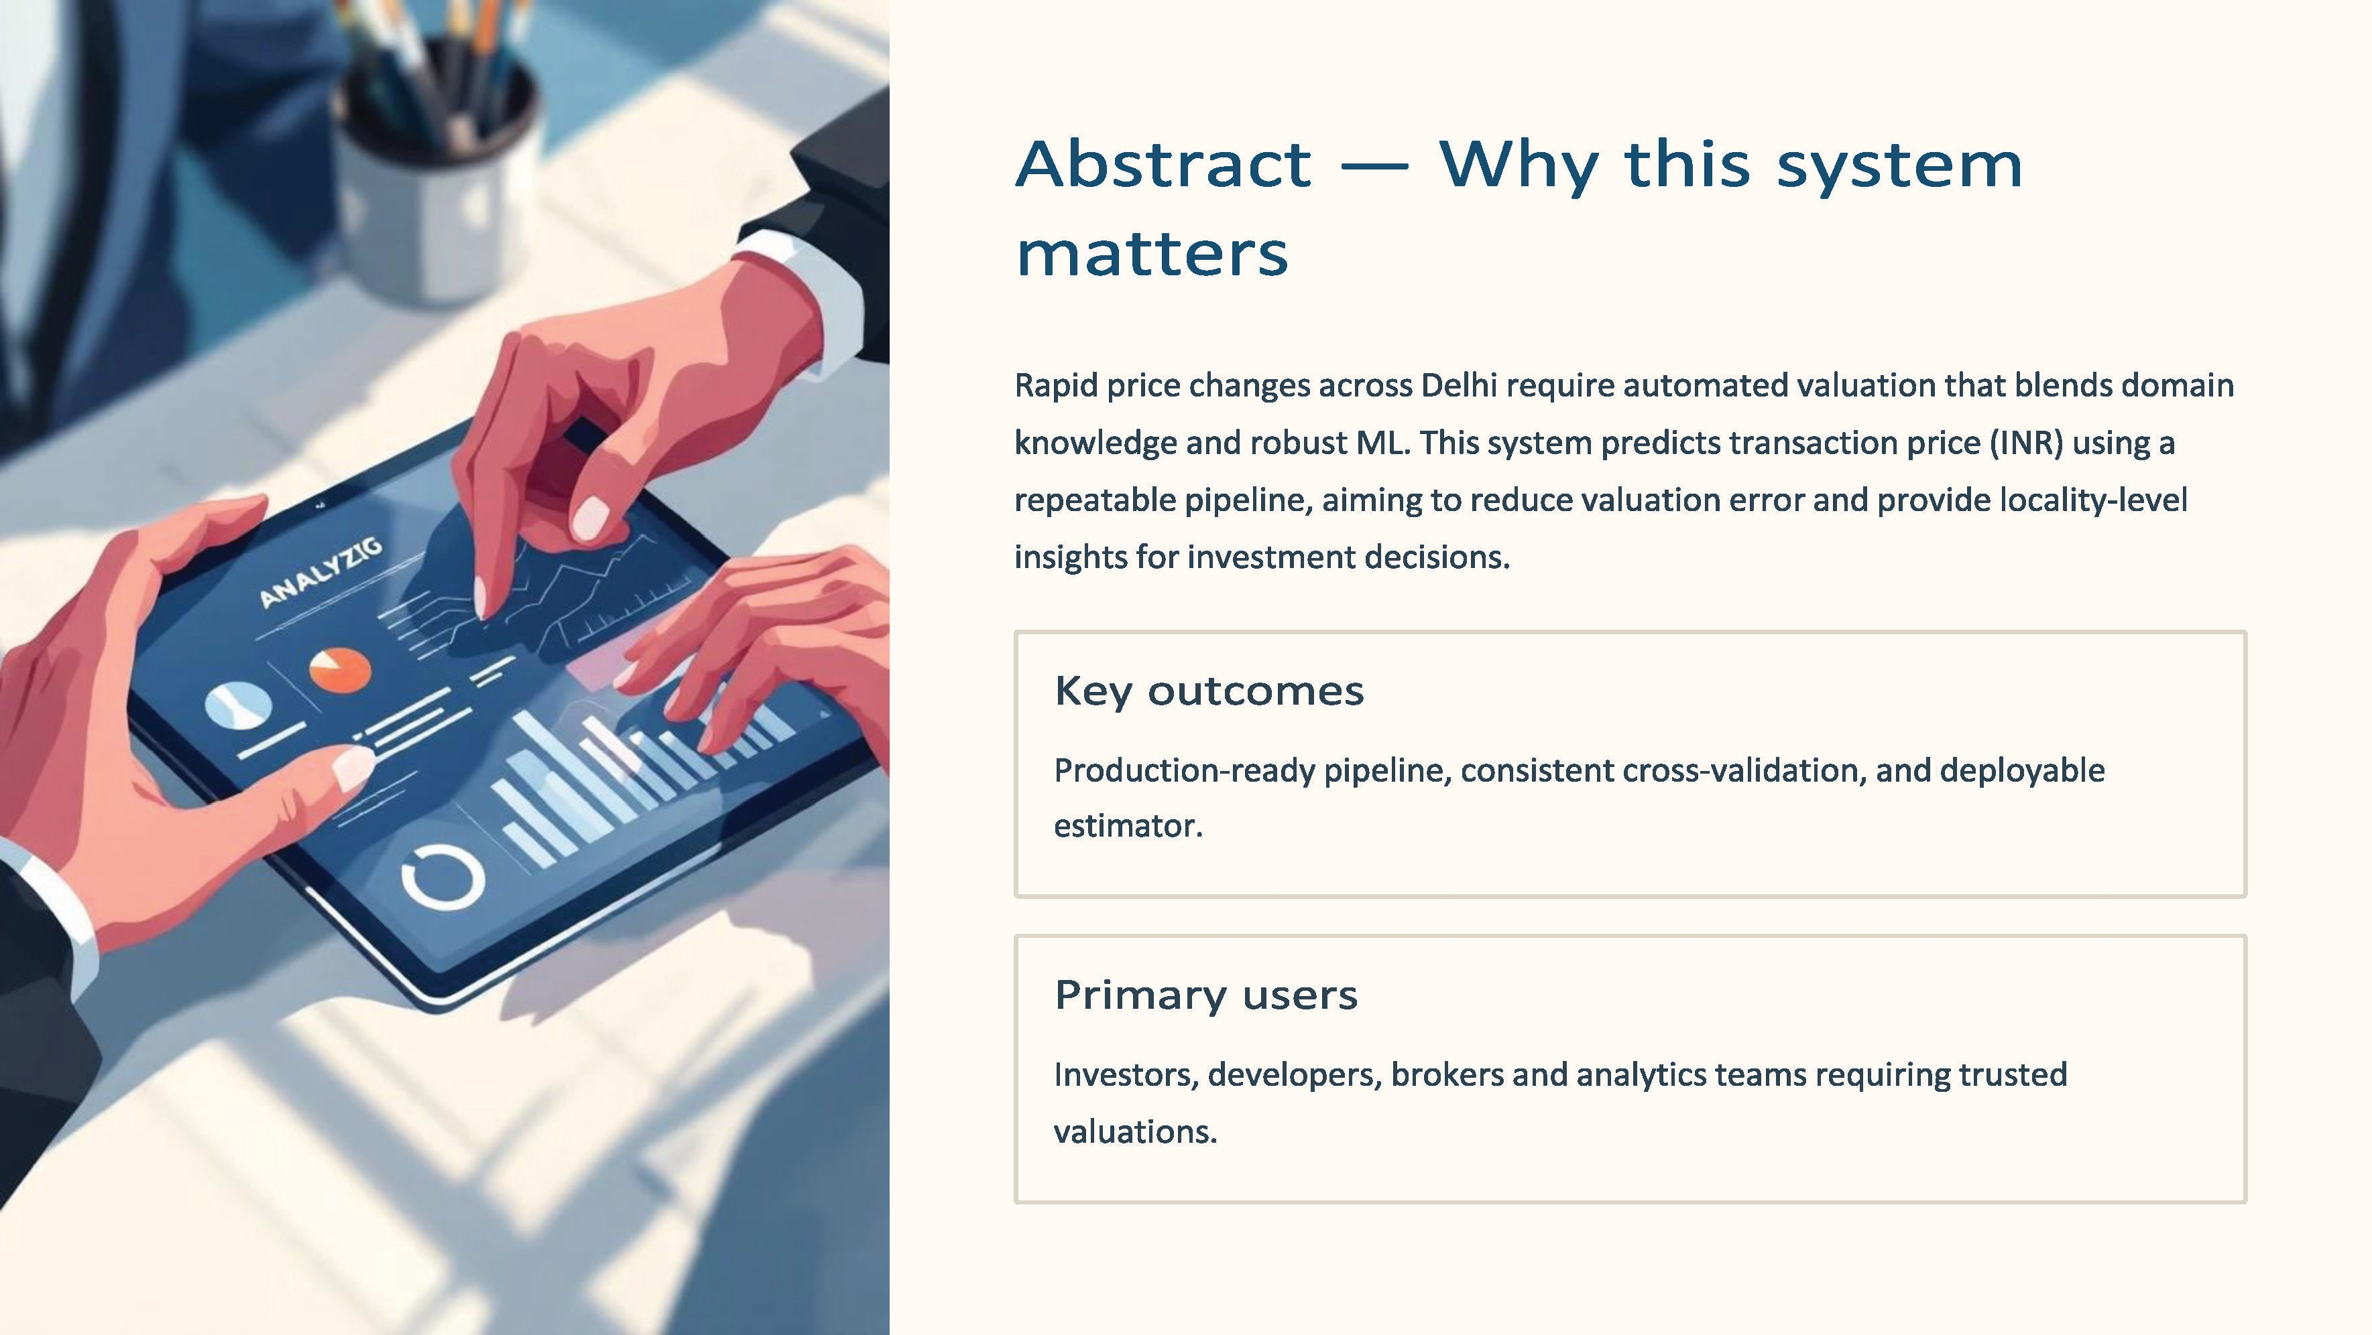

Slide 4
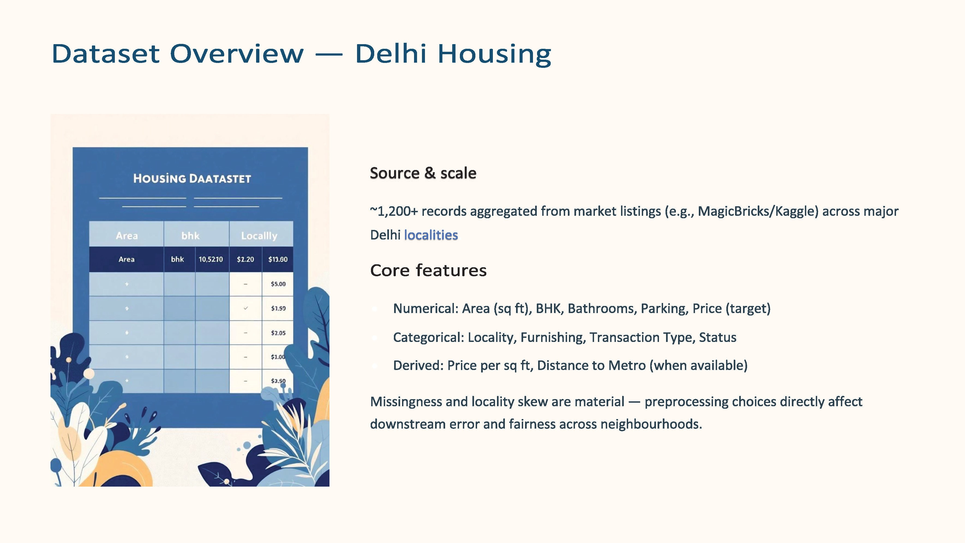

Slide 5
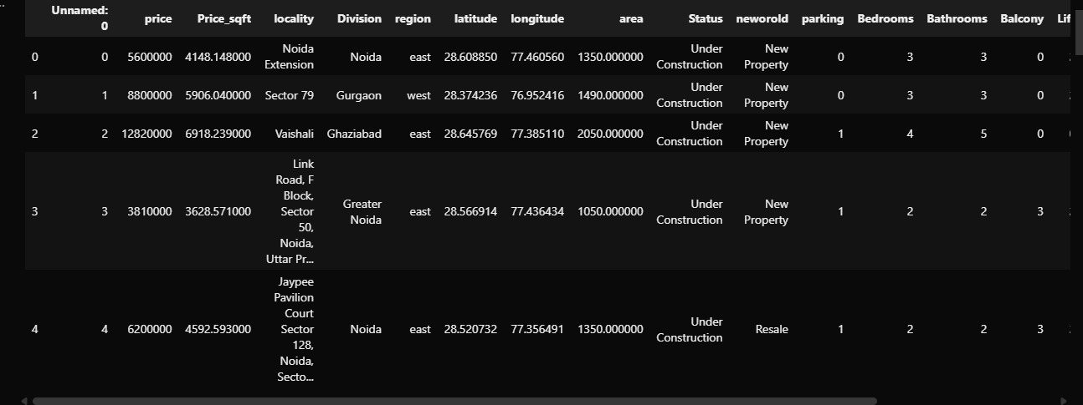
DATASET OVERVIEW

Slide 6
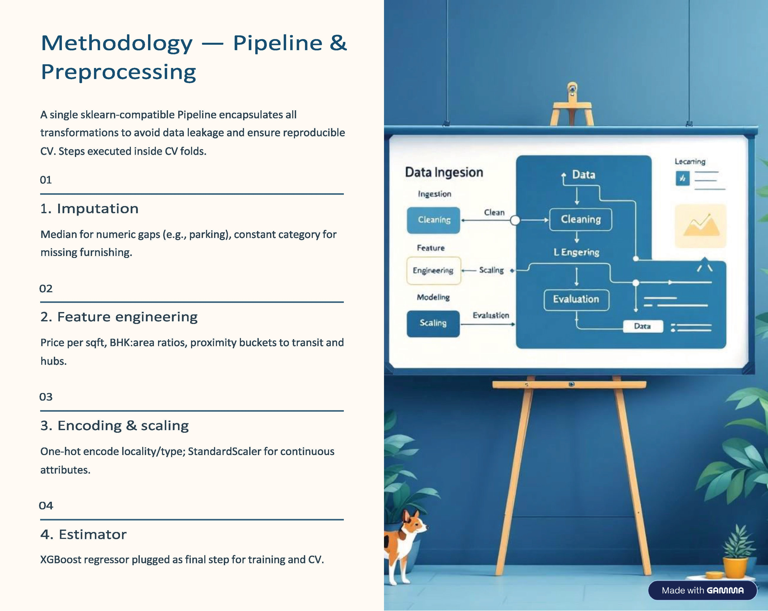

Slide 7
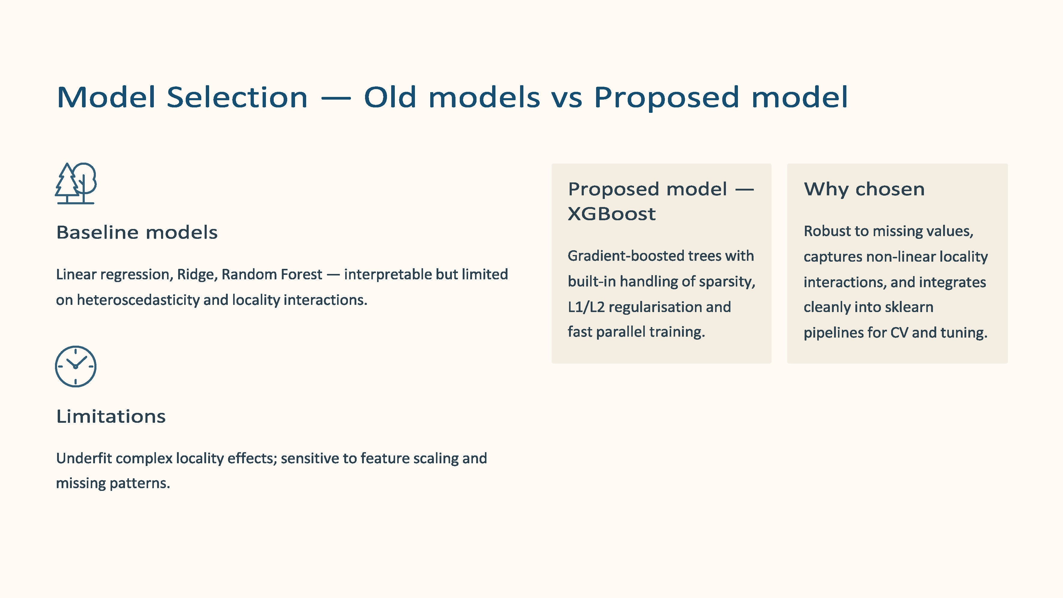

Slide 8
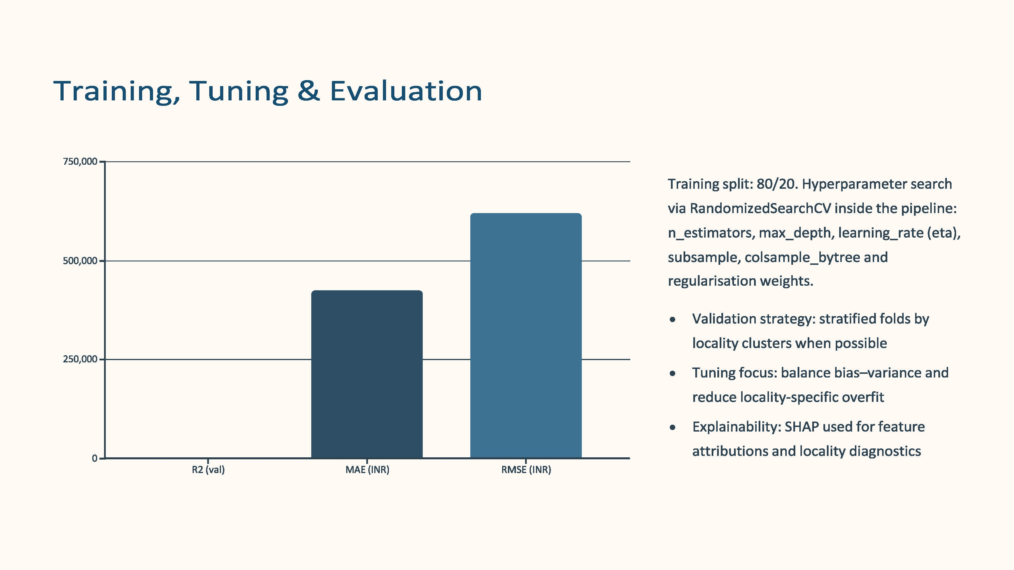

Slide 9
