Slide 1
SOCIAL & SUSTAINABILITY PROJECT
Recovery Agent
Digital Loan App
Harassment in India
Today, 10:42 pm
3
Pay ₹6,200 in 2 hours or your photo goes to all your contacts.
FIR ready. Police will arrest you tomorrow.
Framing the crisis through the UN SDGs,
and our solution: LoanShield.
Your family will know you are a fraud.
1
8
10
16
Four SDGs, one problem
Karthik J
K Annu Prasath
Pasunuru Sai Vivek
Srinidhi Vishal Chejarla
23BRS1191
24BCE5409
24BCE1239
24BCE1493
Notes:
Introduce the team and the problem: illegal loan apps harass borrowers with threats like these. Part 1 frames it through four SDGs; Part 2 presents our solution, LoanShield.

Slide 2
THE CRISIS
Illegal digital lending traps borrowers
1
Quick loans attract the vulnerable
2
Hidden fees deepen debt
3
Aggressive recovery tactics
Instant approval, no paperwork, aimed at people banks turn away.
→
Large cuts before the money arrives, then short deadlines and penalties.
→
Threats, blackmail and shaming when the borrower cannot pay.
The harm spreads: families, workplaces and whole communities lose trust in digital finance.
LoanShield · Social & Sustainability
02

Slide 3
WHY IT MATTERS
Harassment tactics & real-world harm
Threatening calls & messages
Contact-list blackmail
Abusive language and fake legal notices create constant fear.
Personal data is weaponised to shame and pressure borrowers.
Fear, stress & family conflict
Privacy violations
Repeated harassment causes psychological harm and tears families apart.
Data misuse exposes victims and destroys trust in digital systems.
ACCESS WITHOUT PROTECTION
NO INSTITUTIONAL ACCOUNTABILITY
UNSUSTAINABLE DIGITAL FINANCE
LoanShield · Social & Sustainability
03

Slide 4
1
SDG 1
No Poverty
Predatory lending creates a poverty trap
1
High charges
2
Debt cycles
3
Essential cuts
4
Financial ruin
Push vulnerable households deeper into debt.
Forced to re-borrow just to survive.
Less spending on food, health and education.
Poverty becomes impossible to escape.
SDG 1: predatory lending does not just cause debt. It makes poverty structurally harder to escape.
LoanShield · Social & Sustainability
04

Slide 5
Unsafe lending undermines fair economic participation
8
SDG 8
Decent Work & Economic Growth
10
SDG 10
Reduced Inequalities
Livelihoods at risk
Inequality widens
Harassment calls at work disrupt employment. Constant stress reduces productivity. Predatory debt makes decent work meaningless.
Vulnerable and marginalised groups face the highest risk of exploitation. Without safe credit, existing inequalities only grow.
LoanShield · Social & Sustainability
05

Slide 6
16
SDG 16
Peace, Justice & Strong Institutions
Threats, data abuse & eroding trust
Threats & fake legal notices
Privacy violations
No accessible justice
Create constant fear and insecurity, undermining personal safety and dignity.
Misuse of personal data weakens trust in digital institutions and financial systems.
Victims lack clear pathways for accountability, leaving exploiters unchallenged.
Without strong institutions to regulate lending and protect data, digital finance becomes a tool of coercion.
LoanShield · Social & Sustainability
06
Notes:
Connect SDG 1,8,10 to 16.
Explain the scenario of a victim.
Explain how they get threatened
Explain why the scammers escape
Explain why people lose trust in the institutions.

Slide 7
ONE PROBLEM, FOUR SDGs
Digital finance must
empower, not exploit.
1
8
10
16
Deepens poverty & debt traps
Disrupts livelihoods & work
Widens existing inequalities
Erodes trust & justice
Loan-app harassment is not just a fintech issue. It is a sustainable development crisis. Safe, fair and accountable digital finance is essential for inclusive growth in India.
LoanShield · Social & Sustainability
07

Slide 8
PROBLEM RECAP
Where the problem leaves victims
1
Easy loan, hidden cost
2
Threats & blackmail
3
Silence & rebrand
₹5,000 promised, ₹3,500 paid, full repayment in 7 days.
→
Contact lists, morphed photos and fake police notices.
→
The victim pays and stays quiet. The app returns under a new name.
What is missing: a way for victims to fight back, together, with proof.
1
8
10
16
Our solution answers each stage of it.
LoanShield · Social & Sustainability
08
Notes:
Bridge from Part 1. One line per box: how people get trapped, how they are threatened, why the operators escape. Then: what is missing is a way for victims to fight back with proof.

Slide 9
OBJECTIVES
What our solution sets out to do
1
Calm the victim
2
Build evidence
3
Protect the contacts
Answer every threat with the facts and the law it breaks.
Seal each message as tamper-proof proof.
Warn family and friends before the scammers reach them.
4
Unmask the operator
5
Offer a fair alternative
6
Reach everyone
Link rebranded apps by UPI ID, phone number and wording.
Small, fair loans through SHGs and microfinance groups.
Tamil, Hindi and English; help for people who can’t use phones.
LoanShield · Social & Sustainability
09
Notes:
Six objectives. The first four are what the website does; five and six are delivered through community partners.

Slide 10
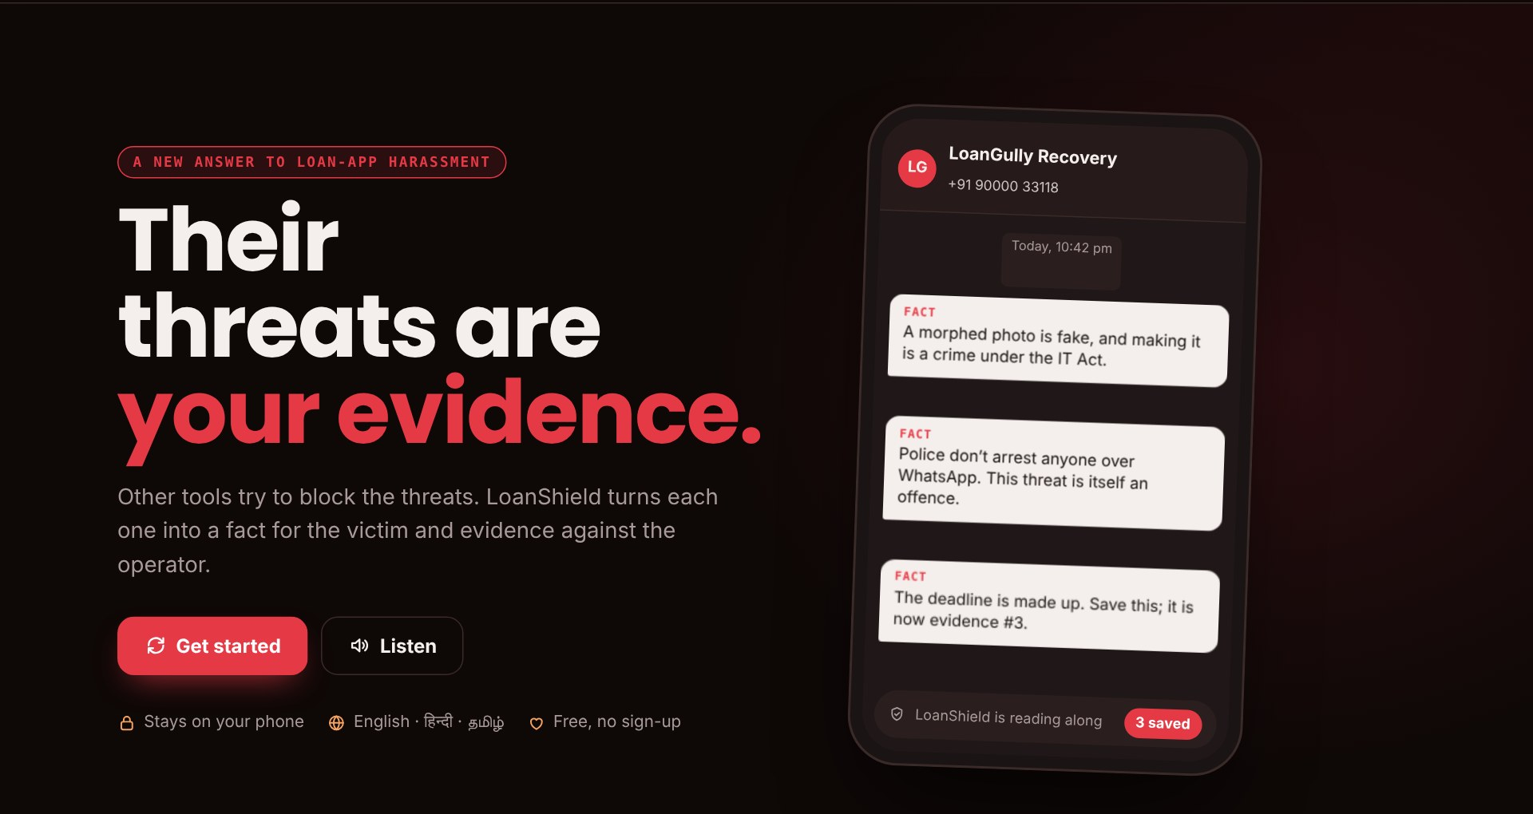
OUR SOLUTION
LoanShield
Their threats become evidence.
A community system with a website at its centre. Other tools try to block the threats. LoanShield turns each one into a fact for the victim and evidence against the operator.
Flip
Every threat is answered with what is actually true.
Live https://karthik705.github.io/loanshield/
Seal
Every message becomes tamper-proof evidence.
Link
Every UPI ID leads back to one operator.
LoanShield · Social & Sustainability
10
Notes:
The one-line idea: their threats become evidence. Three verbs: flip, seal, link. Show the live website if time allows.

Slide 11
HOW IT WORKS
Five stages, one loop
1
Prevent
2
Detect
3
Protect
4
Respond
5
Reform
COMMUNITY
WEBSITE
WEBSITE + NGO
COMMUNITY
COMMUNITY
• Real-cost camps at SHGs and colleges
• Fair small loans via SHGs
→
• Links reports by UPI ID and number
• Public only after 3 people report
→
• Flips each threat into fact and law
• Warns contacts in 3 languages
→
• Legal-aid clinics help file
• Leaked-photo takedowns by NGOs
→
• Public dashboard of operators
• Reports to app stores
↺ Loop: hotspots found in Reform decide where the next Prevent camps run.
● Carried by the website ● Carried by people and partners
LoanShield · Social & Sustainability
11
Notes:
Walk left to right. The website handles Detect and Protect. Prevent, Respond and Reform are run by SHGs, NGO counsellors, legal-aid clinics and student volunteers.

Slide 12
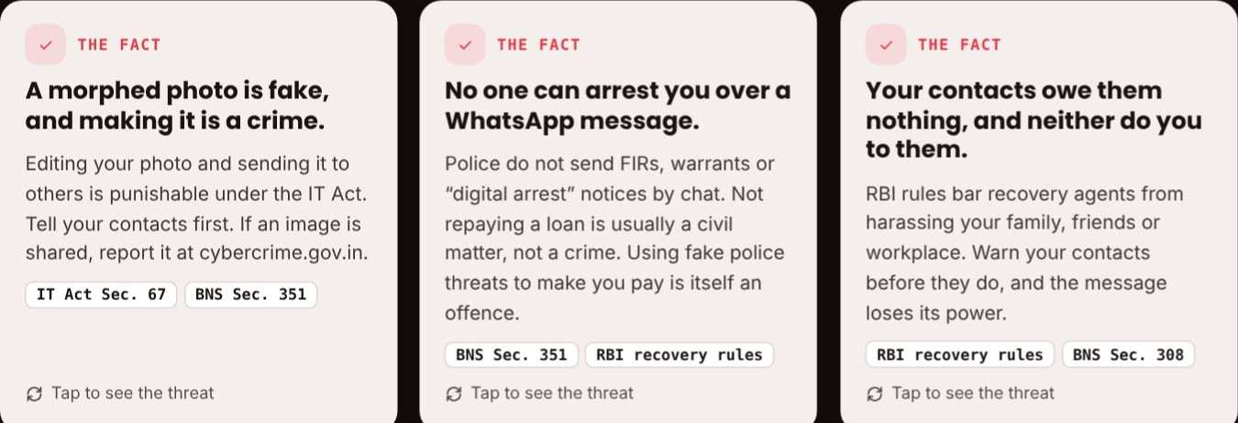
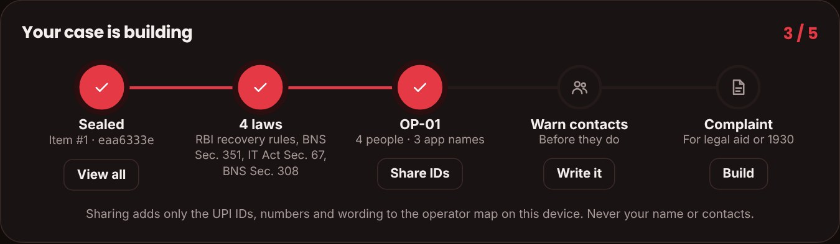
THE WEBSITE: ONE PART OF THE SYSTEM
Paste a threat. Watch it flip.
Speak, paste or screenshot
Say what happened; the key details are pulled out.
Fear → Fact
Each threat card turns over to show the truth and the law.
Protect me in one tap
Seals it, links the operator, writes the warning and complaint.
Case tracker
Evidence, laws, operator, warning and complaint in one view.
LoanShield · Social & Sustainability
12
Notes:
Demo: paste the example message, show the cards flipping, then the case tracker filling up. Everything is checked on the phone; nothing is uploaded unless the victim shares it.

Slide 13
TECH STACK
Simple tools, chosen to reach everyone
Website
Reading threats
Voice
Opens in any phone browser. No app to install.
Spots threat words in English, Hindi and Tamil.
Speak instead of typing; hear the facts read out.
HTML · CSS · JavaScript
Keyword detection + AI for screenshots
Phone’s built-in speech tools
Evidence seal
Linking operators
Privacy & hosting
A digital fingerprint shows if anything changed.
Matches UPI IDs and numbers across reports.
Checked on the phone; shared only by choice.
SHA-256 hashing
Pattern matching
Free hosting on GitHub Pages
LoanShield · Social & Sustainability
13
Notes:
Keep it light: everything runs in a normal phone browser, needs no app and costs almost nothing to run. The point is reach, not complexity.

Slide 14
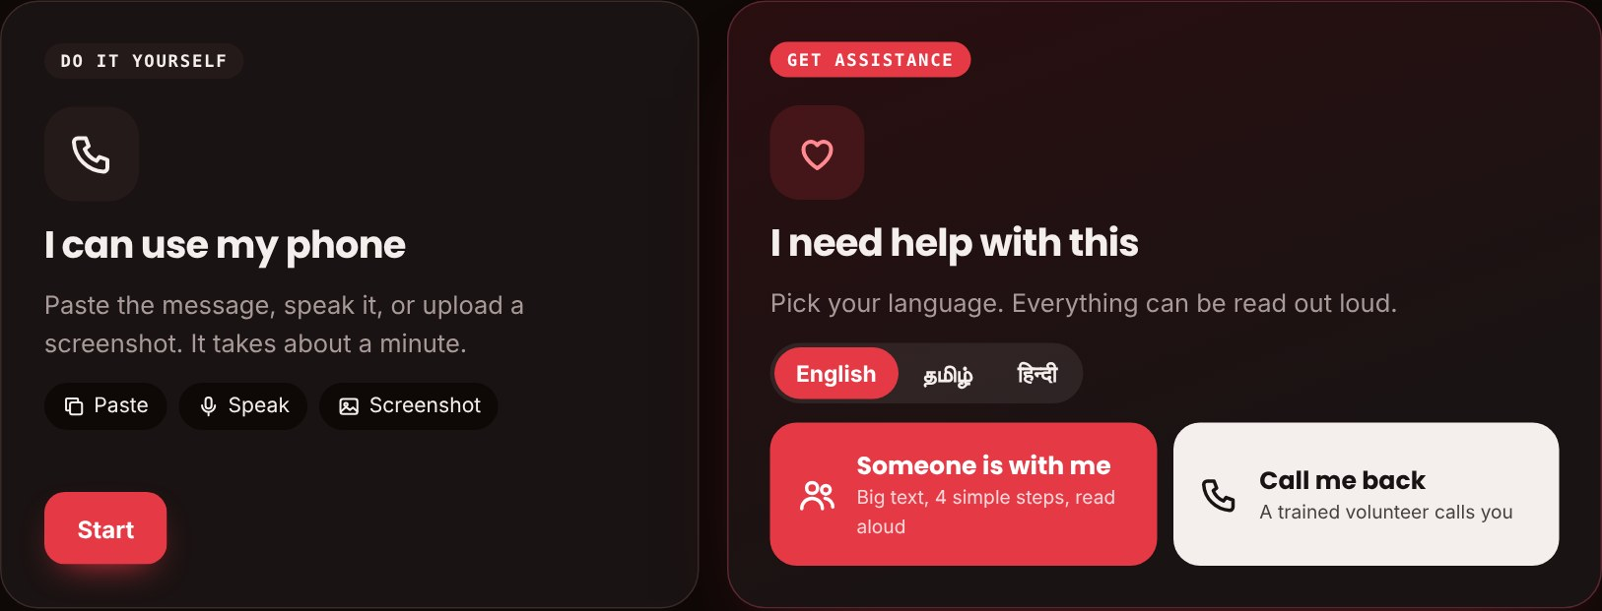
FOR PEOPLE WHO STRUGGLE WITH TECH
Two ways in: do it yourself, or get assistance
Do it yourself
Someone is with me
Paste, speak or upload a screenshot. About a minute.
Helper mode: big text, 4 simple steps, read aloud.
Call me back
Their language, out loud
A trained NGO volunteer calls in their language.
Tamil, Hindi or English; facts are spoken.
No smartphone at all? Student volunteers run weekly help desks at SHG meetings and do every step for them.
LoanShield · Social & Sustainability
14
Notes:
The first people trapped are those least used to smartphones. The website asks first: do it yourself or get assistance. Help desks at SHG meetings reach people with no smartphone at all.

Slide 15
WHEN A MORPHED PHOTO LEAKS
Evidence is not enough. Dignity comes first.
Before it spreads
Within hours
For the person
• Contact Shield warns family first: “any photo of me is fake”
• The photo arrives already discredited
• Ready takedown request for each platform
• Platforms must act within 2 hours of a complaint (IT Rules, 2026)
• StopNCII blocks re-uploads; the image never leaves the phone
• An NGO counsellor does the takedowns
• A woman volunteer on request
• They never have to see it again
On the website: “This photo is fake. Making it is the crime, not being in it.” One button opens the whole checklist.
LoanShield · Social & Sustainability
15
Notes:
Answer to "isn’t the leaked photo still humiliating?": yes, so the response is takedown plus support, not just evidence. Warn contacts first, take it down within hours, block re-uploads, and let a counsellor do it so the victim never sees it again. WhatsApp copies cannot be deleted from other phones, which is why the early warning matters most.

Slide 16
NOVELTY
What is new in our approach
USUAL APPROACH
LOANSHIELD
Spam blockers hide the message. The victim is still scared.
→
Flips fear into facts
Each threat is answered with the truth and the law it breaks.
More threats mean more fear. Each victim complains alone.
→
Every threat builds the case
Messages are sealed as evidence; contacts are warned first.
One app is reported. It returns next week with a new name.
→
Follows the money
Reports sharing a UPI ID or number join into one operator.
Other tools defend one phone. LoanShield turns every victim’s report into one case against the operator.
LoanShield · Social & Sustainability
16
Notes:
If asked "isn’t this a spam checker?": spam checkers block a number. We answer the fear, build evidence and link victims together by the money trail.

Slide 17
SDG IMPACT
How the solution serves the SDGs
16
MAJOR SDG
Peace, Justice & Strong Institutions
1
SDG 1 · No Poverty
Fair SHG loans and real-cost checks break the debt trap.
• Access to justice: sealed evidence and legal-aid help
• Less fear: threats answered with facts
• Accountability: operators named, not just apps
• Privacy: checked on the phone, shared by consent
SDG 8 · Decent Work
8
Contact warnings keep threats away from employers.
10
SDG 10 · Reduced Inequalities
Local languages and assisted help reach low-literacy users.
LoanShield · Social & Sustainability
17
Notes:
Lead with SDG 16: the core harm is intimidation and no access to justice, and that is what LoanShield attacks directly. SDGs 1, 8 and 10 are supported.

Slide 18
FUNDING & PARTNERS
Run with cyber-safety NGOs
CyberPeace Foundation
Responsible Netism
Cyber Society of India
Cyber-safety NGO. Pilot funding, counsellor network and victim helpdesk.
Online-safety NGO. Awareness workshops in colleges and communities.
Chennai-based cyber awareness body. Volunteer training for our pilot.
CSR grants: from responsible fintech companies and banks
Law-college clinics: pro-bono legal help for filing
SHGs & microfinance groups: the fair-loan alternative
Student volunteers: NSS and social clubs run camps
Partners we plan to approach for the pilot. Running cost is low: the website is free to host.
LoanShield · Social & Sustainability
18
Notes:
Funding and people come from cyber-safety NGOs and CSR, not from government programmes. These are organisations we plan to approach; none has committed yet.

Slide 19
CHALLENGES & LIMITATIONS
What makes it hard, and what it can’t do yet
CHALLENGES → HOW WE HANDLE THEM
LIMITATIONS
Apps rebrand in weeks
→ link by UPI ID and number, not app name
Keyword scanner can miss new wording
Tested on 50 team-written messages, not field data
Shame stops reporting
→ private by default, NGO counsellors
Evidence is stored only on the victim’s own device
False or spiteful reports
→ public only after 3 different people
Legal mapping is a guide, not legal advice
Low digital literacy
→ assisted help, voice and local languages
People-side stages depend on NGO partners
LoanShield · Social & Sustainability
19
Notes:
Be upfront about limits. Scanner results on our test set: 100% recall, 86% precision, but on team-written messages.

Slide 20
FUTURE SCOPE
Where LoanShield goes next
1
Android app
2
Smarter reading
3
WhatsApp bot
Share any message straight in; log late-night calls automatically.
A trained model for Tamil, Telugu and Bengali threats.
Forward a threat to one number; get the facts back as a voice note.
4
Voice notes
5
90-day pilot
6
Open data for NGOs
Turn threatening voice messages into text evidence.
One SHG federation and one cyber-safety NGO in Chennai.
Share operator links with partners to speed up takedowns.
LoanShield · Social & Sustainability
20
Notes:
The pilot is the most important next step: it gives real data to replace our test set.

Slide 21
THANK YOU
Safer loans.
Stronger people.
→
Try LoanShield
https://karthik705.github.io/loanshield/
Karthik J
K Annu Prasath
23BRS1191
24BCE5409
Pasunuru Sai Vivek
Srinidhi Vishal Chejarla
24BCE1239
24BCE1493
LoanShield · Social & Sustainability
21
Notes:
Close and invite questions.

