Slide 1
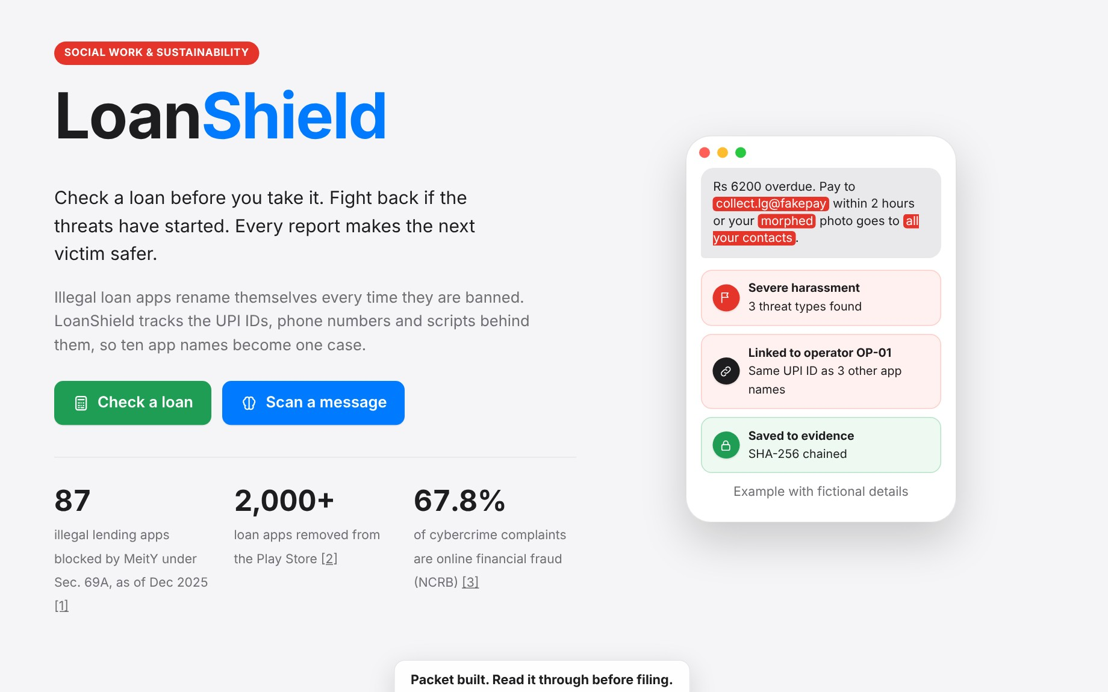
SOCIAL WORK & SUSTAINABILITY
LoanShield
LoanShield
Fighting illegal loan app harassment by following the money, not the app name.
A five-stage system: community programmes, a shared scam graph, a victim toolkit, legal-aid support and a public dashboard.
Live toolkit https://claude.ai/artifact/RvuocA8TjtWS3NRL1imJfX
[Team names] · [Course code] · [Institution]
Notes:
LoanShield is a socio-technical system. The website is one part of it; the rest is community and institutional work.

Slide 2
The problem
Illegal instant-loan apps trap first-time, low-income borrowers, then blackmail them
Contact blackmail
Morphed photos
Fake legal threats
Hidden cost
Family and employers get threats
Edited images sent to contacts
"FIR", "digital arrest"
₹5,000 promised, ₹3,500 paid, 7 days
87
2,000+
67.8%
illegal apps blocked by MeitY (Dec 2025)
loan apps removed from Play Store
of cybercrime complaints are financial fraud
Sustainable Development Goals affected
SDG 1 · No Poverty
SDG 8 · Decent Work
SDG 10 · Equality
SDG 16 · Justice
Debt spirals over 2,000%/yr
Threats reach the workplace
Least literate targeted most
Victims stay silent
Sources: PIB Dec 2025; Rajya Sabha Q.263, Feb 2024; NCRB via Business Standard.
Notes:
Four harms, three verified numbers, four SDGs. Telangana police linked 6–8 suicides to loan app harassment in two years.

Slide 3
Objectives
What LoanShield sets out to do
1
2
3
Prevent borrowing from scam apps
Unmask the operator
Protect victims and their contacts
Show the real cost of a loan and offer a fair alternative through SHGs and microfinance.
Link rebranded apps through shared UPI IDs, phone numbers and scripts.
Flag threats and warn contacts first, without reading private messages.
4
5
6
Make evidence and complaints count
Hold systems to account
Leave no one out
Tamper-evident evidence, the law each threat breaks, and bundled complaints.
A public dashboard of operators and time-to-action for regulators.
Indian languages, basic phones (WhatsApp/IVR) and human volunteers.
Notes:
Objectives 1 and 5 are delivered mostly by people and partners; the website delivers parts of 2, 3 and 4.

Slide 4
There are many scam apps. Why another?
Each existing tool protects one phone or one complaint. None connects victims to the operator.
Comparison
Existing tool | What it does | What it misses
Truecaller, Google spam filters | Block known spam numbers on one phone | Agents rotate SIMs; contacts still get blackmailed
Bank fraud alerts, MuleHunter.AI | Flag suspicious accounts inside banks | Never see the victim’s threats or evidence
RBI DLA list, MeitY Sec. 69A bans | List legal apps; block named apps | One name at a time; operators rebrand in weeks
1930, cybercrime.gov.in, Chakshu | Take complaints | Each complaint stands alone, with weak evidence
LoanShield | Links victims’ reports by money trail; protects contacts; organises community help | Gives all of the above one operator-level, verified case
Notes:
This is our positioning: we do not compete with Truecaller or bank systems. We sit between victims and these institutions.

Slide 5
The LoanShield pipeline
Five stages. The website covers parts of three; people and partners carry the rest.
1 Prevent
2 Detect
3 Protect
4 Respond
5 Reform
Community
Tech
Tech + people
Community
Tech
Truth Check camps at SHGs
Fair micro-loans via MFIs
WhatsApp / IVR lender check
Shared scam graph
Link by UPI, phone, script
Public only at 3 reporters
Threat scanner
Contact Shield warning
Counsellor callback
Hash-chained evidence
Legal-aid filing help
Bundled case per operator
Public dashboard
Quarterly brief to RBI, MeitY
Hotspots guide Prevent
›
›
›
›
In the website
In the website
In the website
Reform’s hotspots decide where the next Prevent camps run
Community-led
Tech-led
Notes:
Walk left to right. Emphasise that Prevent and Reform are mostly people and policy work, not software.

Slide 6
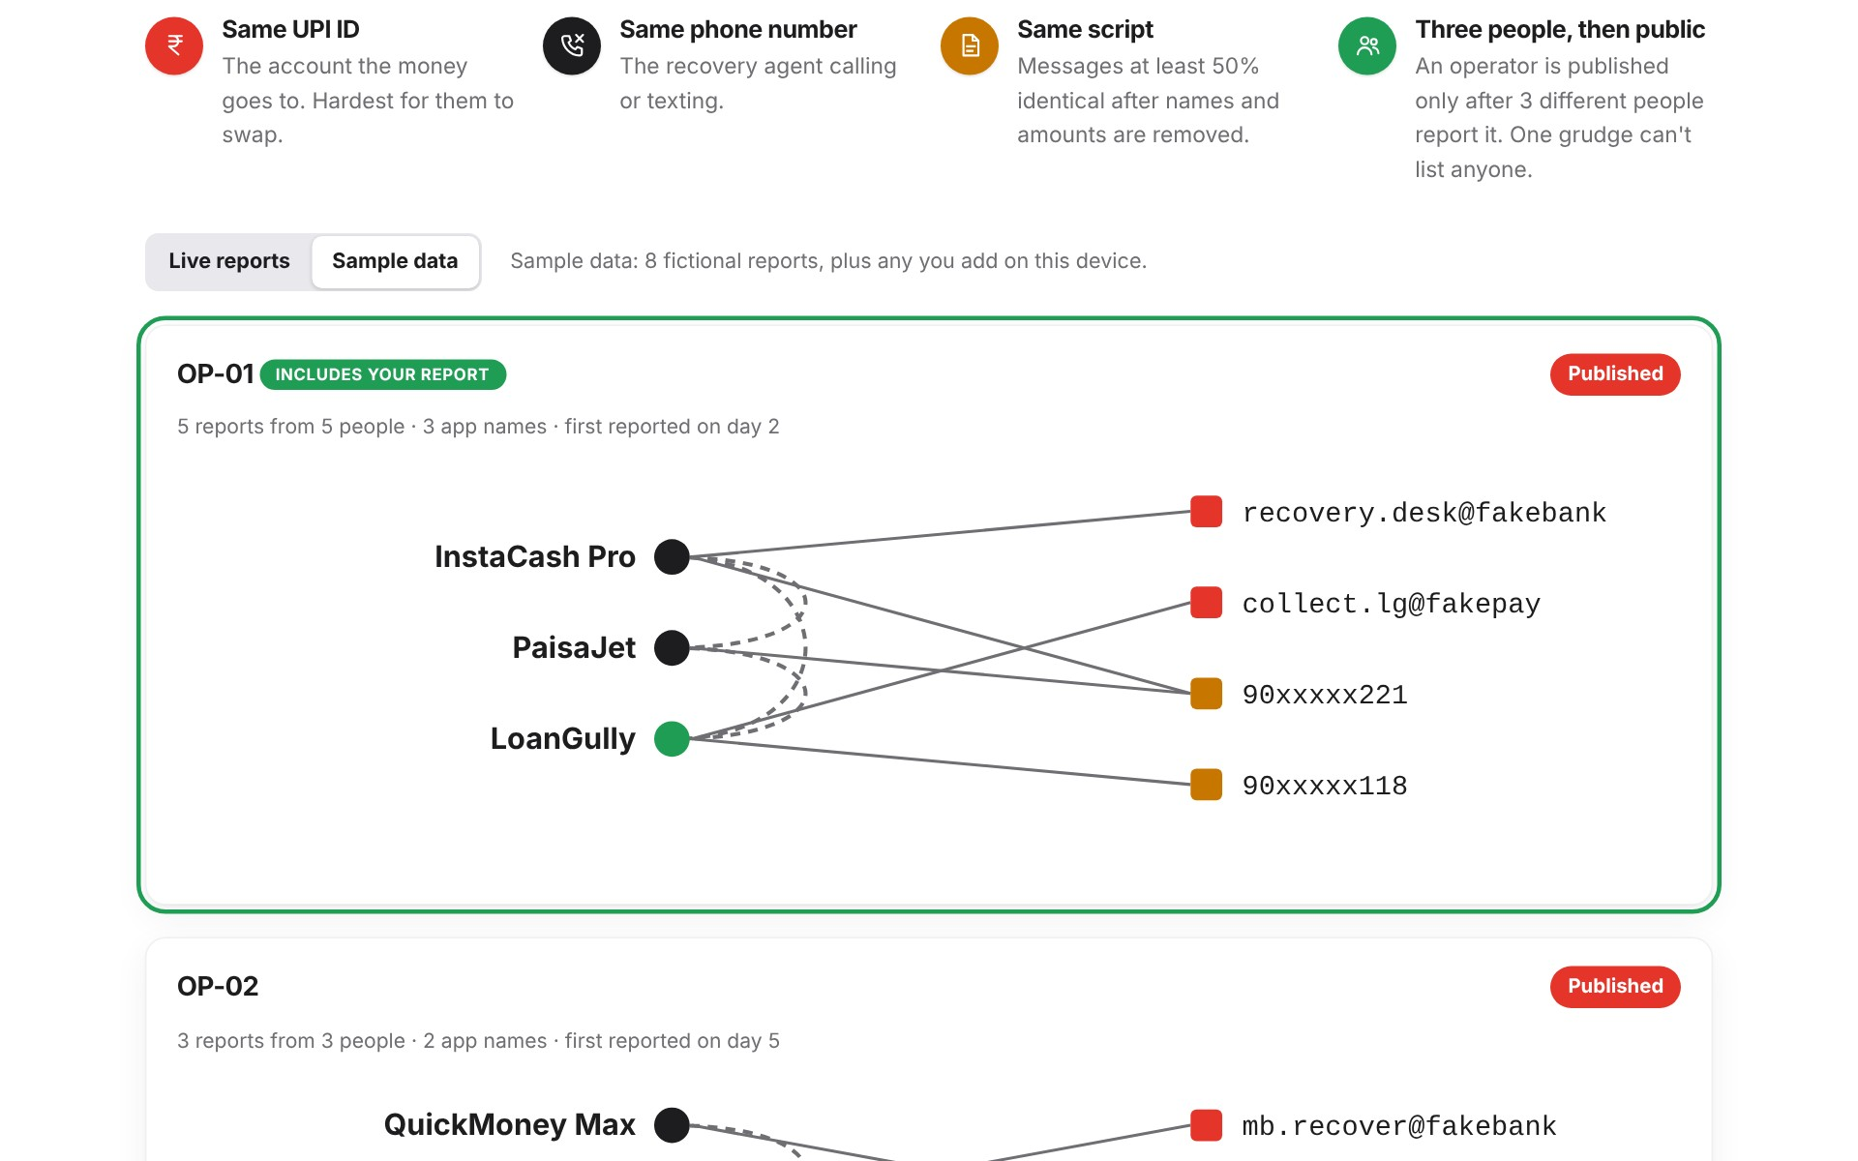
Stages 1–2: Prevent and Detect
Prevent · community-led
Detect · tech-led
Remove the reason people borrow from scam apps.
Find the operator, not just the app name.
Truth Check camps at SHG meetings, colleges and ration shops: turn "₹5,000 loan" into its real yearly cost (2,235% in our example)
Fair-credit partners: SHG federations and microfinance institutions give a small, fast, legal loan instead
WhatsApp / IVR line checks a lender against RBI’s DLA directory, for basic phones
Student volunteers translate and run sessions in Tamil and Hindi
Reports that share a UPI ID, number or ≥50% of a script join one operator
Published only after 3 different people report it
Operators go to MeitY, Google Play and telecoms as one case
SDG 1.4
SDG 1.5
SDG 8.10
Notes:
Prevent is entirely a community programme. Detect is the scam graph, which is live in the website and shared by everyone with the link.

Slide 7
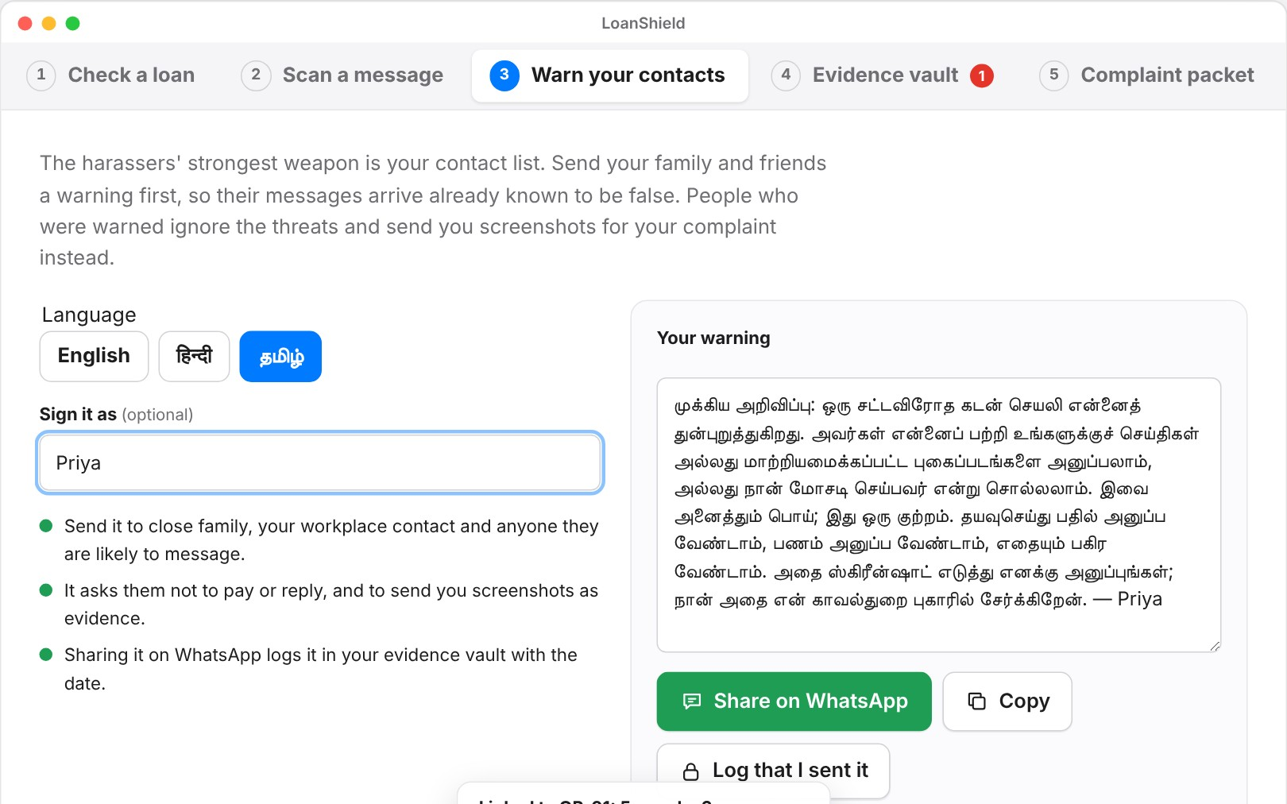
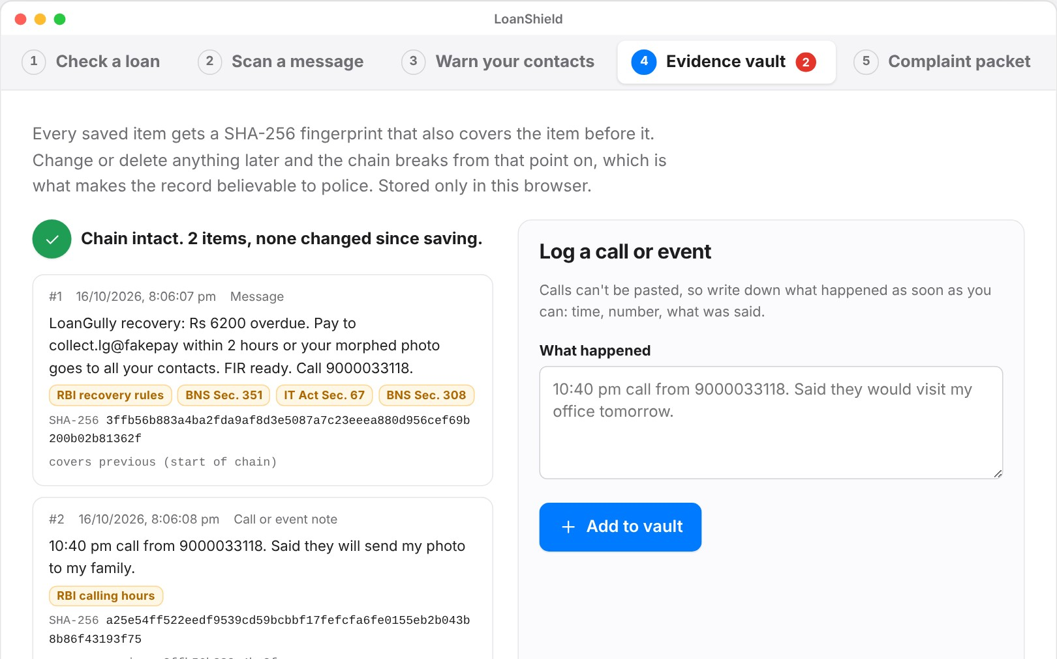
Stages 3–4: Protect and Respond
Protect · tech + people
Respond · community-led
Threat scanner names the threat and pulls out UPI IDs and numbers, from shared text only
Contact Shield: warn contacts first, in English, Hindi or Tamil, so blackmail loses its power
Severe threats show 1930 and Tele-MANAS 14416; NGO counsellors call back
Evidence vault: SHA-256 hash chain proves nothing was edited (for a Sec. 63 BSA certificate)
Rights map: names the RBI rule, BNS or IT Act section each threat may break
Law-college legal-aid clinics help file; one bundled case per operator goes to the cyber cell
Notes:
Protect and Respond are where the website does most work, but the counsellors and legal-aid clinics are what make victims actually report.

Slide 8
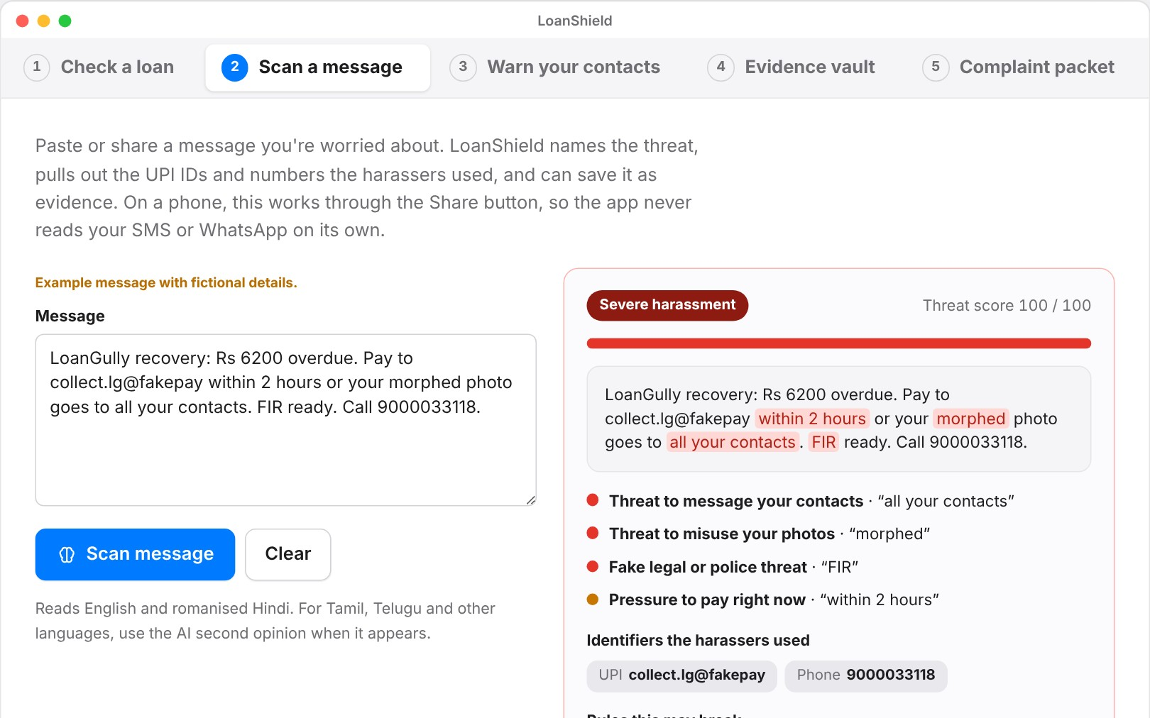
Stage 5: Reform, and where the website fits
Reform · tech-led
Website (one part)
Tech stack
Public dashboard: operators, app names per operator, days from first report to action
Students publish a quarterly brief to RBI, MeitY and Google Play
Regional hotspots feed back into Prevent
Web app
HTML, CSS, JS
Graph
Union-find + Jaccard
Evidence
SHA-256 Web Crypto
Shared data
Five working tools: loan check, threat scanner, Contact Shield, evidence vault, complaint packet, plus the live scam graph.
Artifact database
Android (next)
Kotlin, TF Lite, ML Kit
Open: claude.ai/artifact/RvuocA8TjtWS3NRL1imJfX
Basic phones
WhatsApp / IVR bot
SDG 16.4
SDG 16.6
Notes:
Make clear the website is the digital front door. Reform depends on students and partners publishing and lobbying.

Slide 9
How we stand out
Our novelty, and the evidence it works
Follows the money trail
Three-person rule
Scanner test
Links ten app names to one operator by UPI ID, number and script.
Nothing goes public until 3 people report it, so no one can frame a rival.
100%
threats caught (recall)
86%
Disarms the contact list
Names the law broken
Contact Shield warns family first. No spam app does this.
Each threat mapped to RBI, BNS or IT Act; late-night calls flagged.
flags correct (precision)
0.93
F1 score
Court-ready evidence
Community, not just code
50 test messages written by the team; real accuracy measured in the pilot.
A hash chain shows nothing was edited after saving.
SHG credit, legal aid and a public dashboard close the loop.
Notes:
If asked "Truecaller already exists": Truecaller blocks a number on one phone. We link every victim’s report to the operator and protect the people the scammers actually target, the contacts.

Slide 10
Challenges, limitations and future scope
Challenges
Limitations
Future scope
Apps rebrand in weeks → link by money trail
Android blocks SMS reading → share-in design
False reports → 3-person rule, masked numbers
Shame stops reporting → volunteers, Contact Shield
Keyword scanner misses new wording
Test set not from the field yet
Evidence stored only in the browser
Legal mapping is indicative, not advice
Android app with call screening and OCR
Trained model in Tamil, Telugu, Bengali
WhatsApp / IVR line for basic phones
Graph API for cyber cells and banks; 90-day district pilot
Safer loans. Stronger people. Help: 1930 · cybercrime.gov.in · Tele-MANAS 14416
Notes:
Close with the pilot: one SHG federation, one legal-aid clinic and the district cyber cell, for 90 days.

