Slide 1
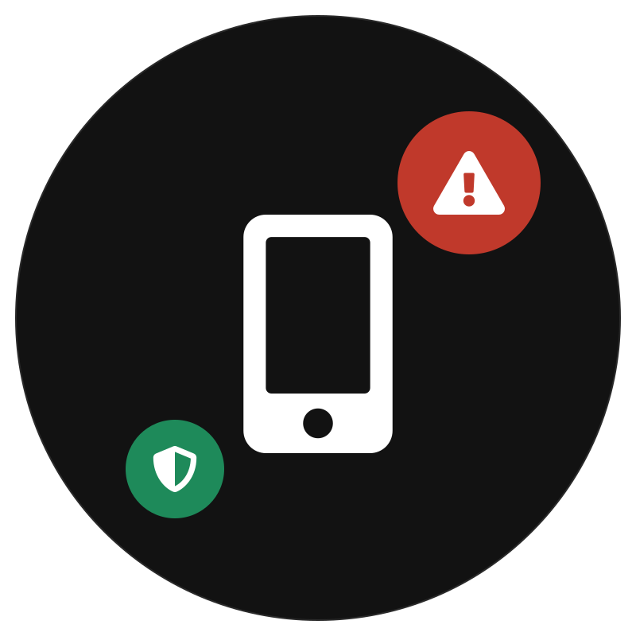
A SOCIAL WORK PROJECT
Digital Loan App
Harassment
When a small loan turns into a nightmare
Illegal apps are blackmailing people who just needed quick cash.
Tied to 4 UN Sustainable Development Goals:
1
No Poverty
8
Decent Work
10
Reduced
Inequalities
16
Peace &
Justice
(the solution comes in part two)

Slide 2
The Boom — and Its Dark Side
Everyone wants fast cash. Not everyone checks who’s lending it.
Instant cash, zero questions
Minutes to approve. No real checks.
87
apps blocked by MeitY (Sec. 69A), as of Dec 2025
A permissions grab
Contacts, photos, SMS — all handed over.
2,000+
apps pulled from the Play Store
Whack-a-mole apps
Banned today, reborn tomorrow under a new name.
₹19.4 cr
seized by ED in one Hyderabad case, 2024
RBI keeps a list of verified lenders — illegal apps just ignore it.
Digital Loan App Harassment
2

Slide 3



Problem Statement
Illegal loan apps prey on desperate borrowers — then blackmail them into paying up.
Who is harmed
What goes wrong
Why it persists
First-time, low-income borrowers.
Threats spread to your entire contact list.
Apps rebrand faster than the law can catch up.
Digital Loan App Harassment
3

Slide 4






Anatomy of the Trap
One missed payment. A well-rehearsed nightmare.
1
2
3
4
5
Install & over-permit
Instant, costly credit
Payment falls due
Recovery turns abusive
Blackmail escalates
Grabs your contacts + photos.
Tiny loan, huge interest.
7–15 days. That’s it.
Calls. Threats. Repeat.
Fake “arrest.” Real fear.
Digital Loan App Harassment
4

Slide 5




The Tactics of Harassment
Recovery “agents” turn your own data into a weapon.
Contact-list blackmail
Morphed images
Fake legal notices
Your contacts get the ugly texts.
Photos twisted into threats.
“Police” call about your “arrest.”
Abusive calls
Public shaming
Hidden charges
Odd hours. Ugly language.
Your face, branded “defaulter.”
Fees stack until it’s unpayable.
Digital Loan App Harassment
5

Slide 6
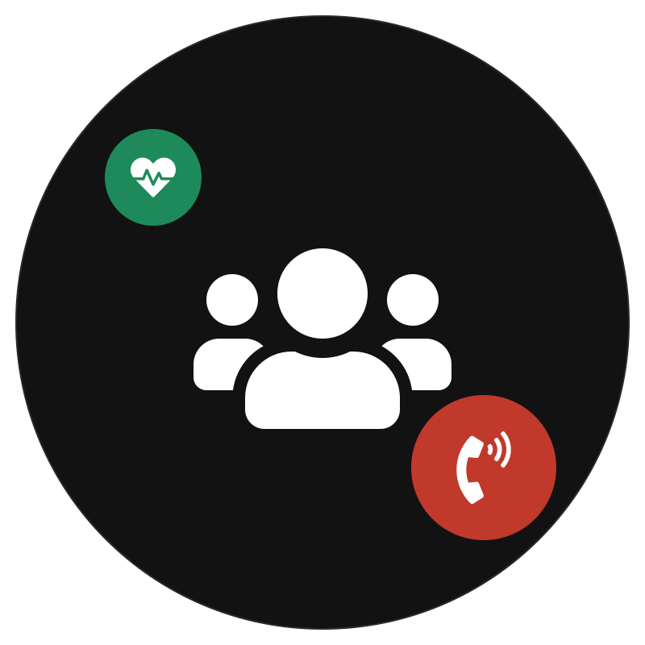


The Human Cost
This isn’t about money. It’s about safety.
Rising crisis
Jobs at risk
Families hurt
Telangana police alone linked 6–8 suicides to loan-app harassment in two years.
Agents call employers directly — over debts as small as ₹2,000.
Shame spreads to everyone the borrower loves.
Source: MeitY/Google Parliament replies, 2024; state police reports, 2021–24.
Digital Loan App Harassment
6

Slide 7



Why the System Can’t Keep Up
The rules exist. The scammers just move faster.
Apps rebrand fast
New name, same scam — in weeks.
No paper trail
Rented SIMs make agents nearly untraceable.
Nobody knows help exists
Most victims don’t know it’s illegal — or that help (1930) is free.
Digital Loan App Harassment
7

Slide 8
SDG Spotlight
Four UN goals, all hit by the same scam
1
8
10
16
No Poverty
Decent Work
Reduced Inequalities
Peace & Justice
Traps the poor deeper in debt.
Puts jobs — and trust — at risk.
Hits those least able to fight back.
Justice moves slower than the scam.
Critical
High
Critical
High
Digital Loan App Harassment
8

Slide 9
Why It’s Personal
One scam, four goals undone
1
One bad month shouldn’t mean a lifetime of debt.
8
A missed EMI shouldn’t cost you your job.
10
The most vulnerable are the easiest targets.
16
Justice is slow. The scam isn’t.
Digital Loan App Harassment
9

Slide 10
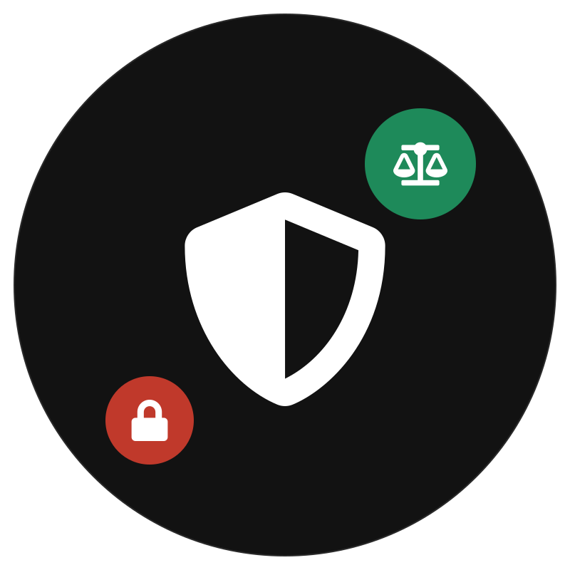
Why This Matters
A problem hiding in plain sight
Bans don’t stick — apps just rebrand.
Victims are exactly who inclusion should protect.
Reporting is slow. The harm isn’t.
We need a fix as fast as the scam.
Up next: an AI-based fix — detection, call blocking, evidence storage, auto-complaints.
Digital Loan App Harassment
10

