Slide 1
Secure Data Hiding in Images Using Steganography
CAPSTONE PROJECT
Presented By: KARTHIK GANESH
Student Name : KARTHIK GANESH
College Name & Department : PSG COLLEGE OF TECHNOLOGY, AMCS DEPARTMENT

Slide 2
OUTLINE
Problem Statement
Technology used
Wow factor
End users
Result
Conclusion
Git-hub Link
Future scope

Slide 3
Problem Statement
Core Issue: The increasing need for secure and discreet communication in a digital world where data breaches and surveillance are prevalent.
Specific Challenge: How to transmit sensitive information without drawing attention to the existence of the message itself. Traditional encryption, while secure, often signals that something is being hidden.
Solution: To develop a user-friendly and effective steganography tool that allows users to seamlessly embed and extract data within images, providing a layer of covert communication.

Slide 4
Technology used
Tech Used: Python , Flask , HTML, CSS , JS
Python: The foundation for the steganography logic and server operations.
Flask: Builds the web interface (web framework) for user interaction and data handling.
HTML / CSS / JS: For frontend user interface
Libraries Used:
OpenCV – Processes and manipulates images for data hiding and extraction
Base64 – For encoding and decoding the password before and after its embedded into the image
flask - Builds the web interface for user interaction and data handling

Slide 5
Wow factors
Simplicity and Accessibility: The tool is designed to be user-friendly, allowing individuals without technical expertise to easily hide and retrieve information.
Imperceptible Data Hiding: The use of LSB (Least Significant Bit) modification ensures that the hidden data is virtually undetectable to the human eye.
Password-Based Security: The integration of password protection adds a layer of security, ensuring that only authorized users can access the hidden information.
Practical Application: The project demonstrates a real-world application of steganography, showcasing its potential for secure communication and data protection.
No Message Length Requirement: The implementation uses a delimiter, thereby eliminating the need for the user to specify the message length during decoding.

Slide 6
End users
Individuals: Anyone who values privacy and wants to protect their personal communications.
Businesses: Companies looking to protect confidential data or intellectual property.
Security Professionals: For research, testing, and developing secure communication methods.

Slide 7
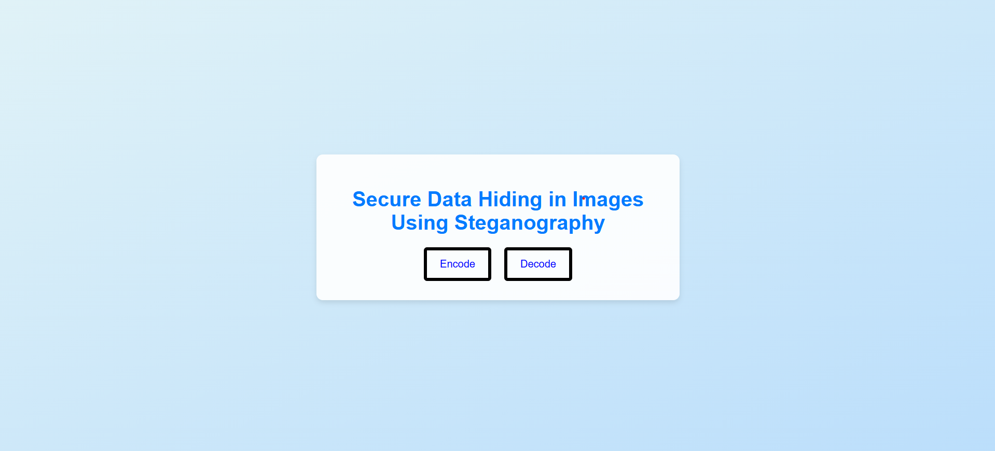
Results
HOME PAGE

Slide 8
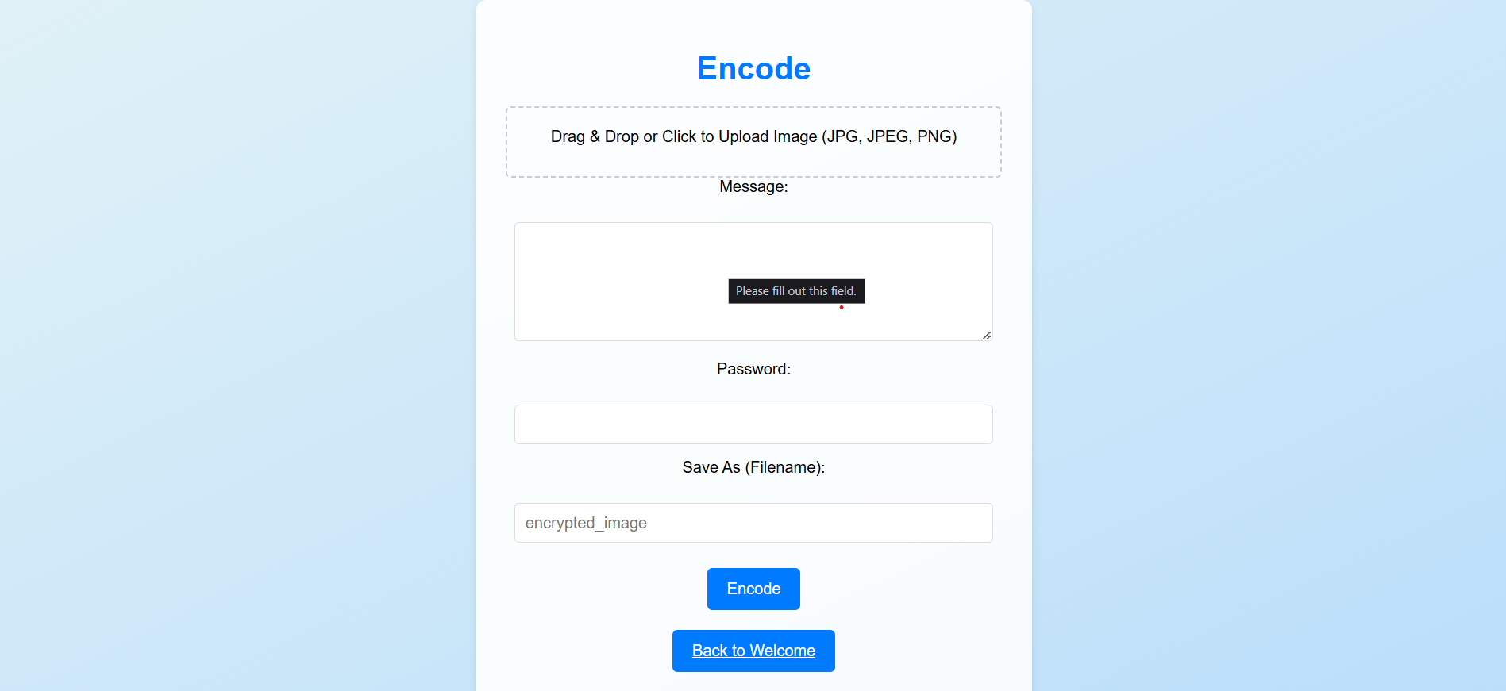
Results
ENCODING PAGE

Slide 9
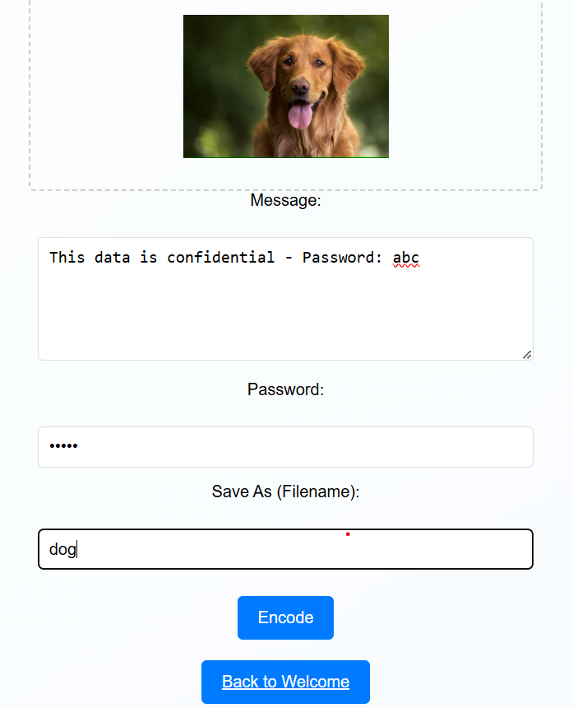
Results
ENCODING PAGE
The Message is hidden inside the photo
Password: abcde for hiding the data inside the photo

Slide 10
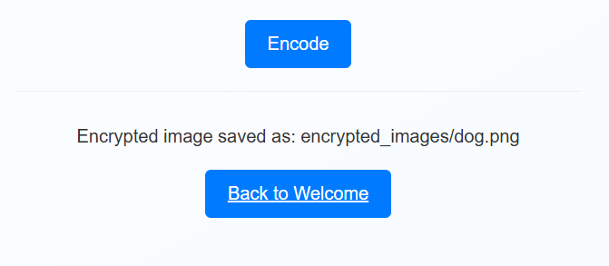
Results
ENCODING PAGE
The Message is hidden inside the photo
Password: abcde for hiding the data inside the photo

Slide 11
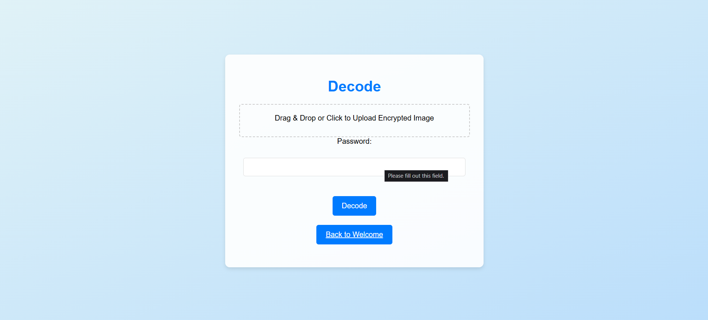
Results
DECODING PAGE

Slide 12
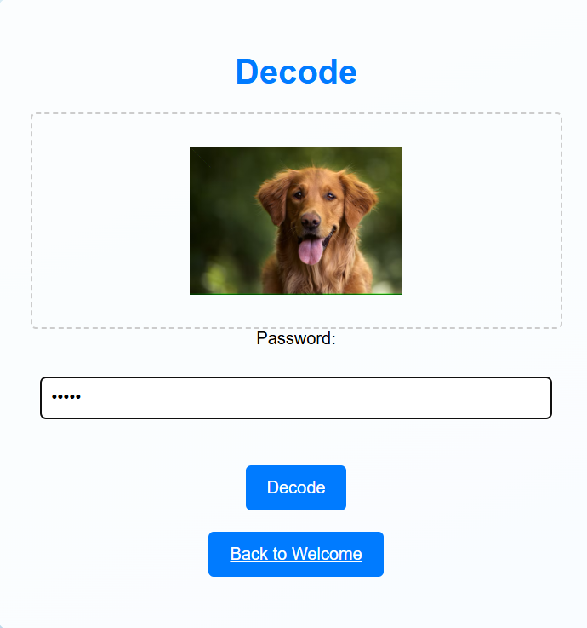
Results
DECODING PAGE
We upload the encrypted image
Provide the password for the image
In this example, password is ‘abcde’

Slide 13
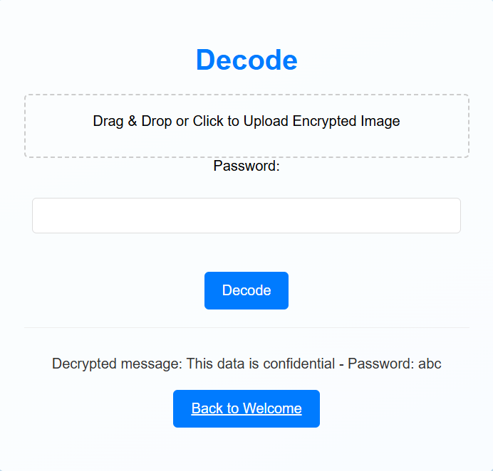
Results
DECODING PAGE

Slide 14
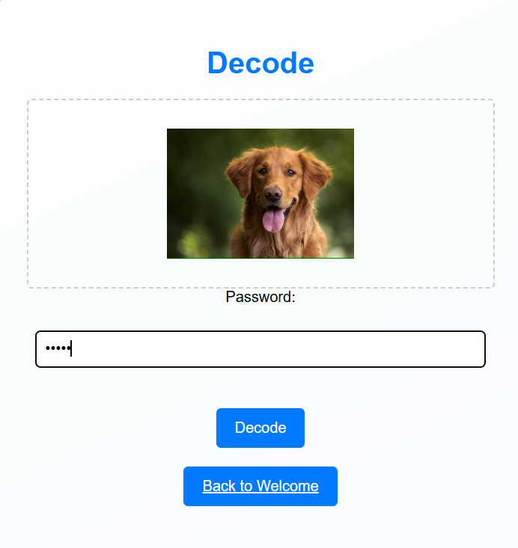
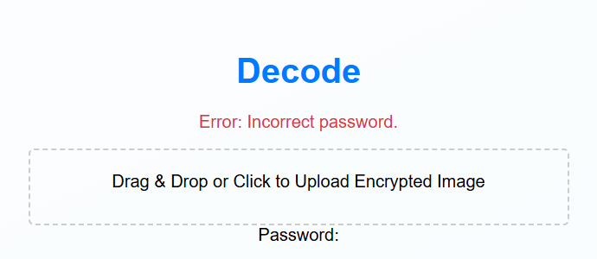
Results
DECODING PAGE – WRONG PASSWORD FOR THE IMAGE
Here, I put the password as ‘PL123’. It doesn’t work since
it is a incorrect password

Slide 15
Conclusion
Successful Implementation: The project successfully demonstrates the feasibility and effectiveness of image steganography using LSB modification and password protection.
Enhanced Privacy: The tool offers a practical solution for enhancing digital privacy and secure communication.

Slide 16
GitHub Link
GITHUB LINK: https://github.com/Karthik7375/Steganography.git

Slide 17
Future scope
Advanced Algorithms: Implementing more robust steganography algorithms to increase capacity and security.
Support for Other Media: Extending the tool to support other file types, such as audio and video.
Add steganalysis resistance techniques

Slide 18
THANK YOU

