Slide 1


FFBANK
Online App
100% trust worthy bank
Best service
Lones at low interest rate
Online Website avalible

Slide 2
Table of context
Overview
Pages of our website
Code of the website
Advantages of our Online webpage
Possible future developments
Software's used to develop
Project progression
Conclusion

Slide 3

Overview
Contains a wide range of features such as user authentication, loan management, Interfaces for User and Admin with a same website
It also provides the important information such as transaction details , loan details, User details and Balance in the account with a single click
Implementing a cheque based transfer of money is one of the feature that we added in this website by just having a picture of the cheque we can carry a transaction And admin will have the details of the cheque Conformation will be manual

Slide 4

Webpage of
Our Bank

Slide 5
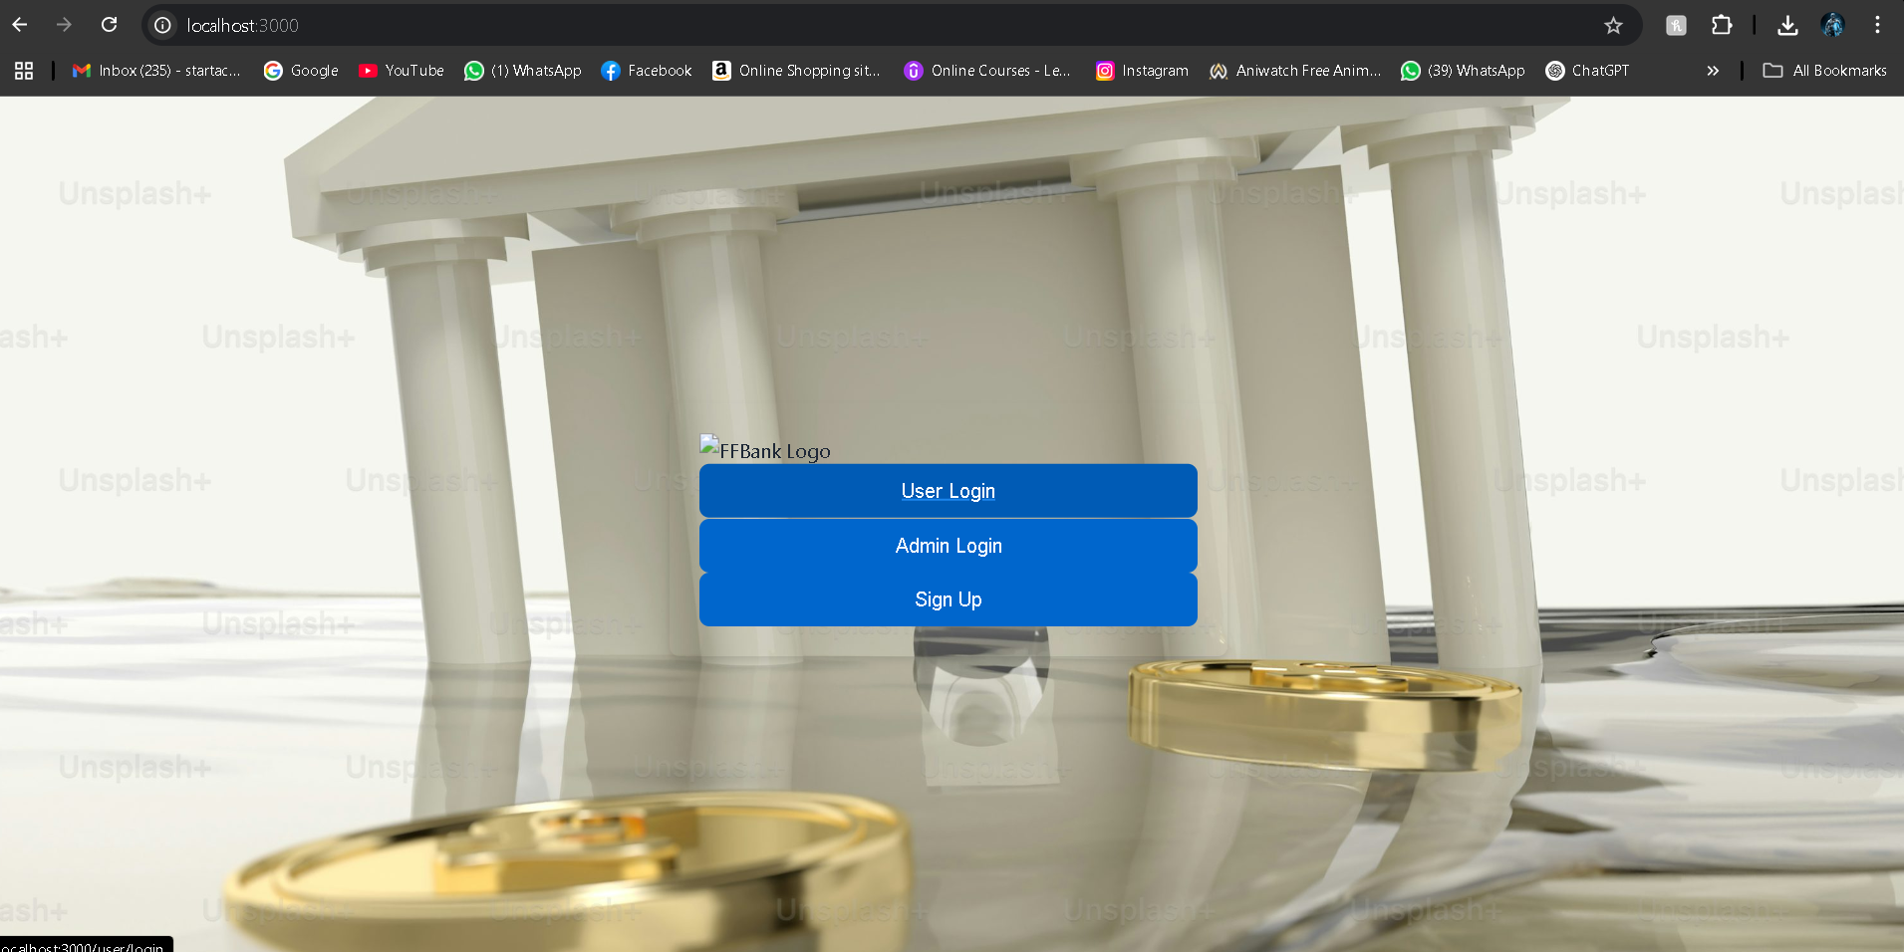

Slide 6
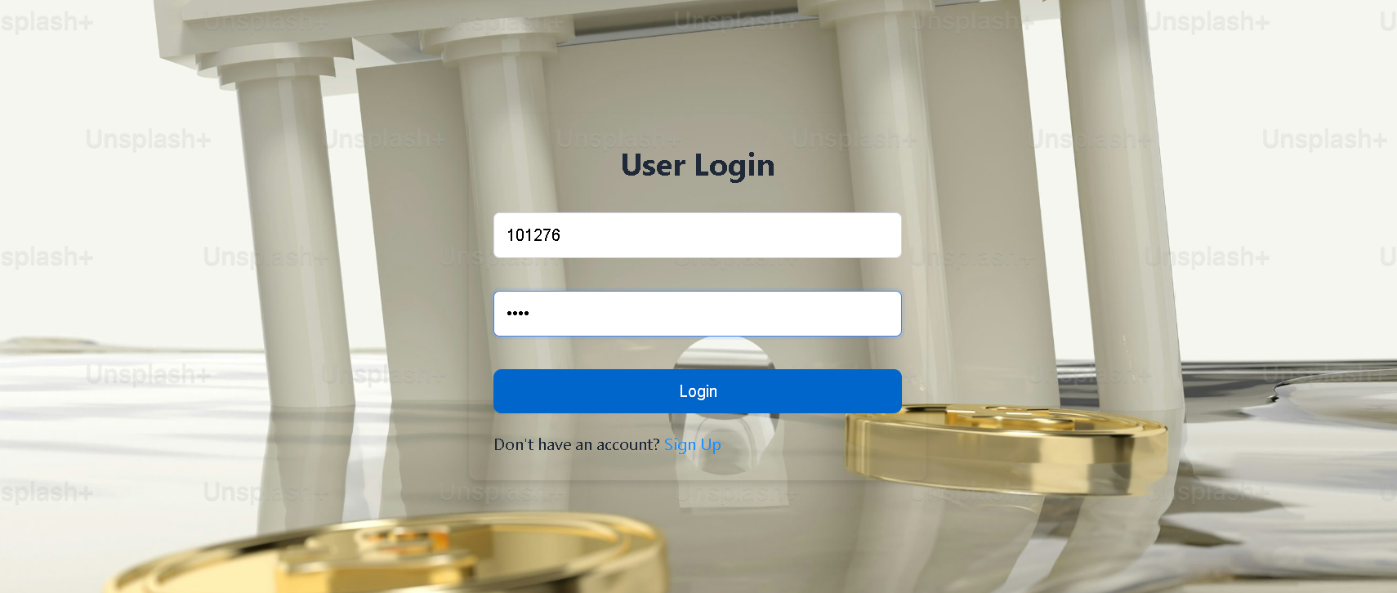
User login page(i.e. if account already registered)

Slide 7
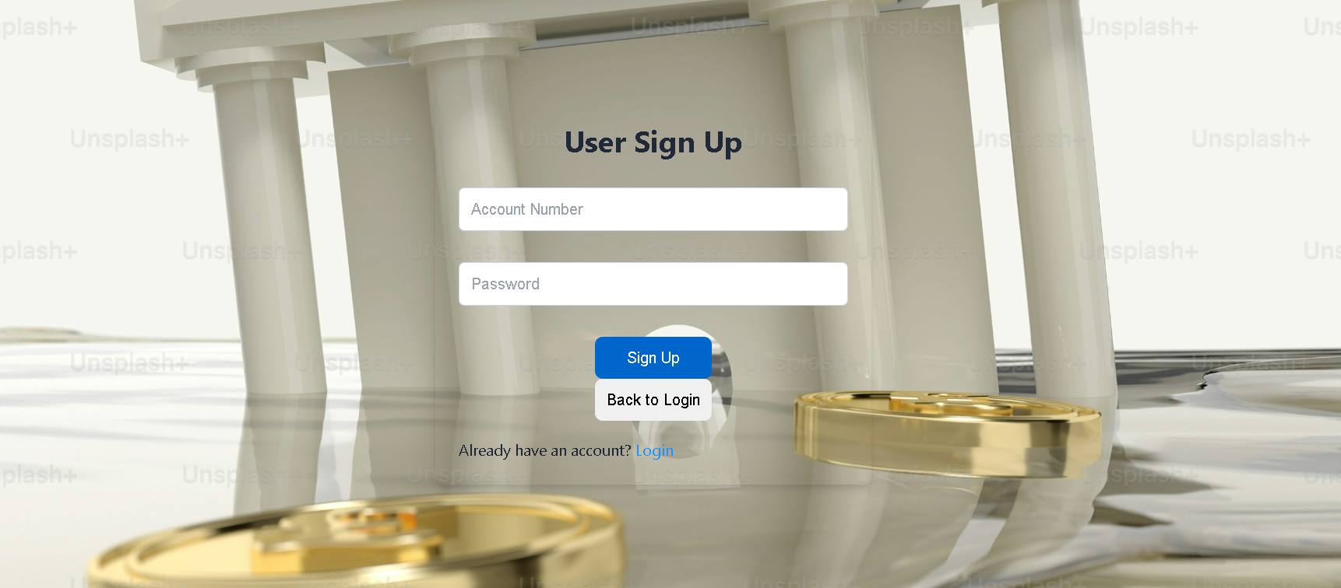
To Add credentials for the account number

Slide 8
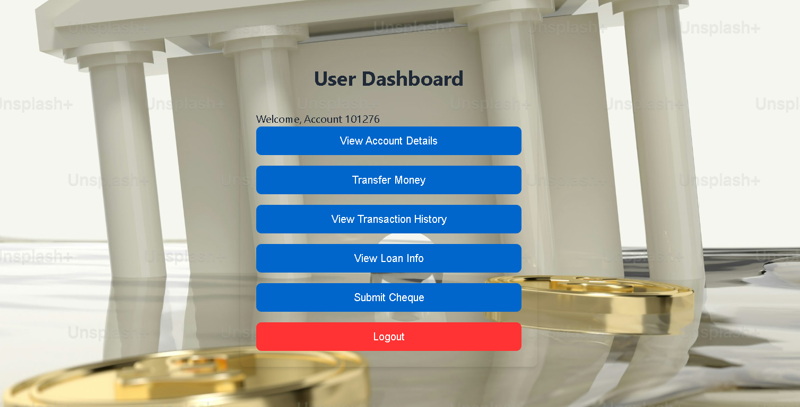
Dashboard

Slide 9



Slide 10
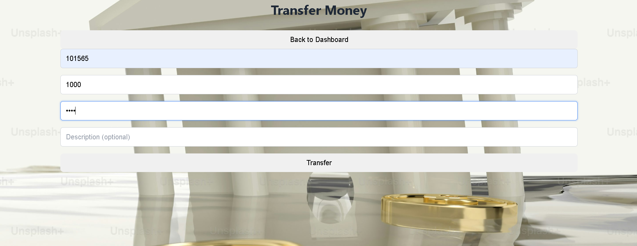
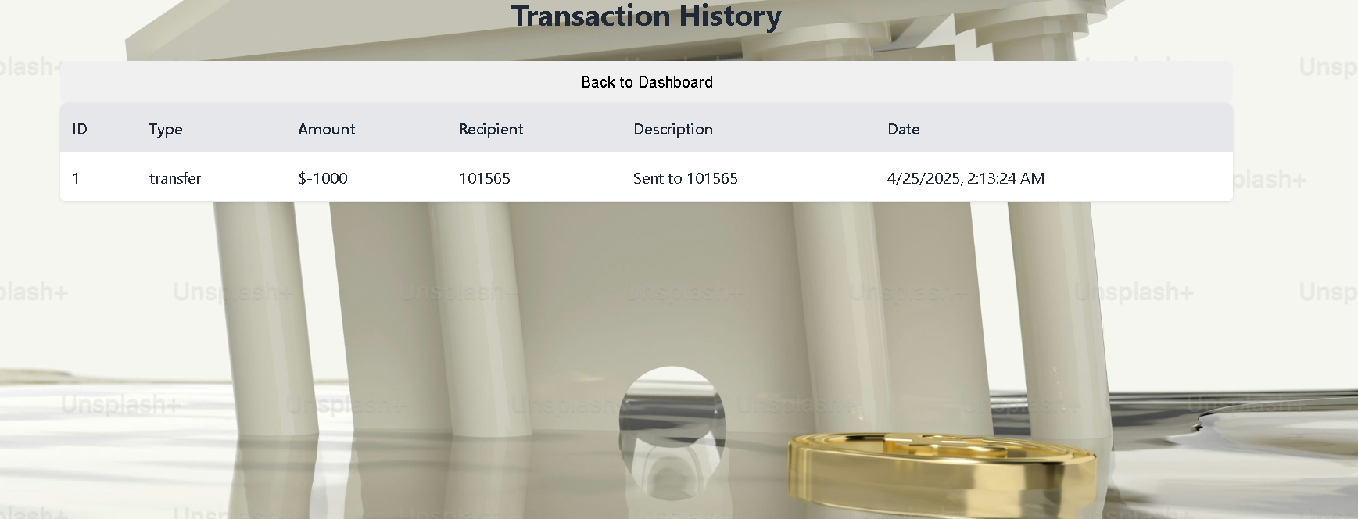

Slide 11
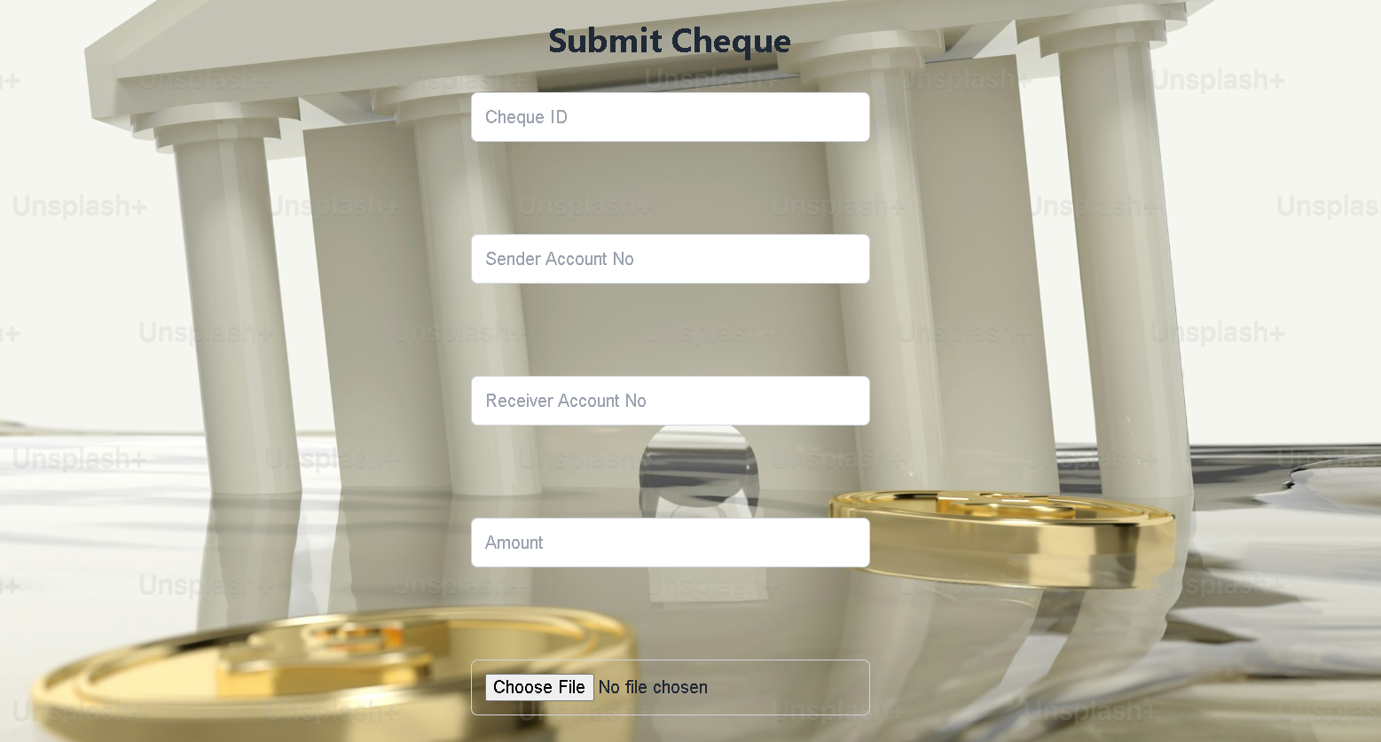
Cheque details submission

Slide 12
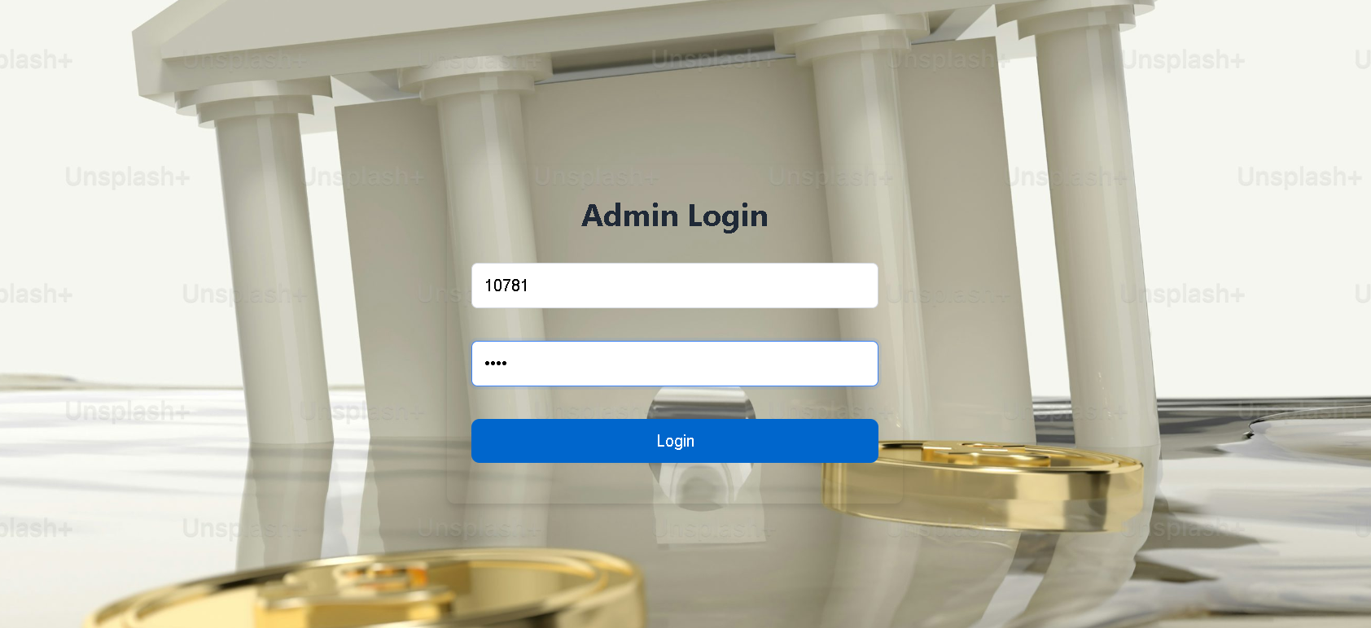
Admin login for the staff of the bank

Slide 13
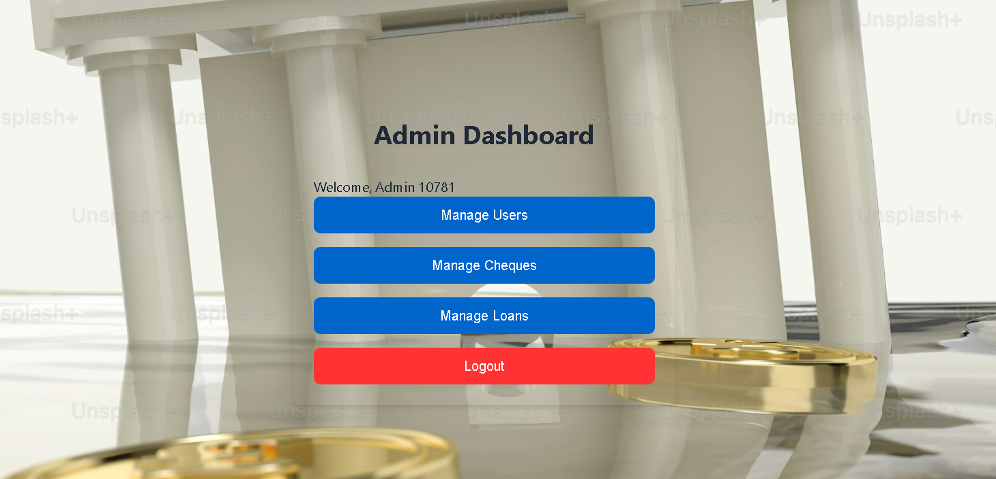

Slide 14
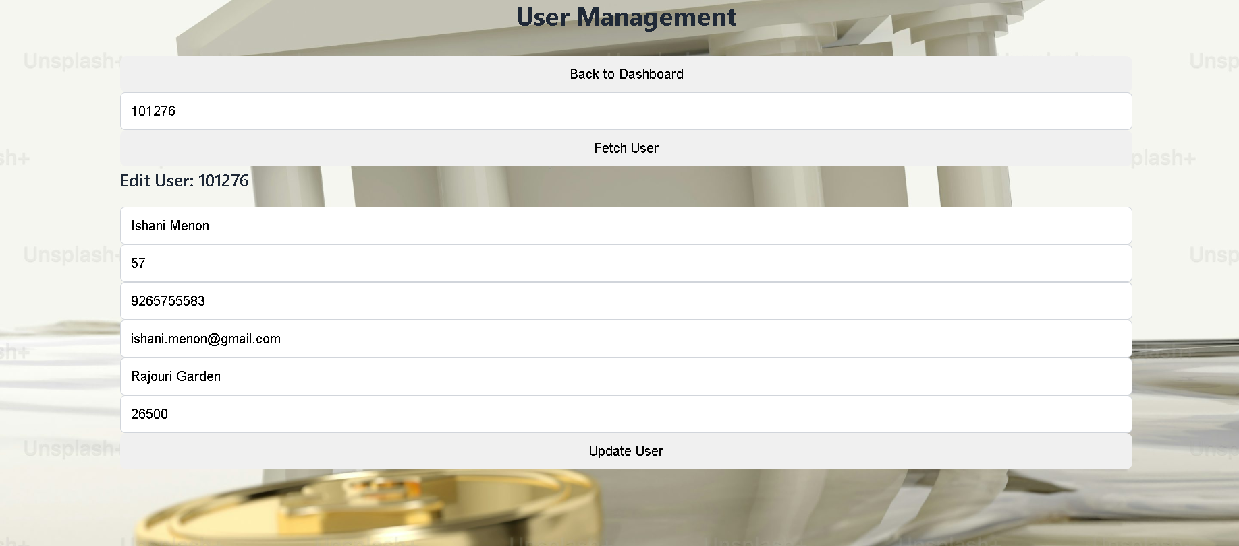
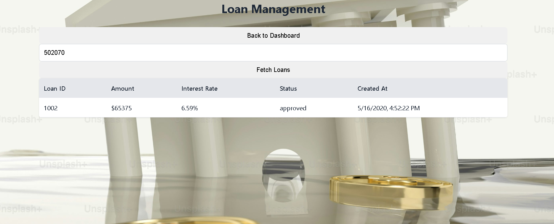

Slide 15
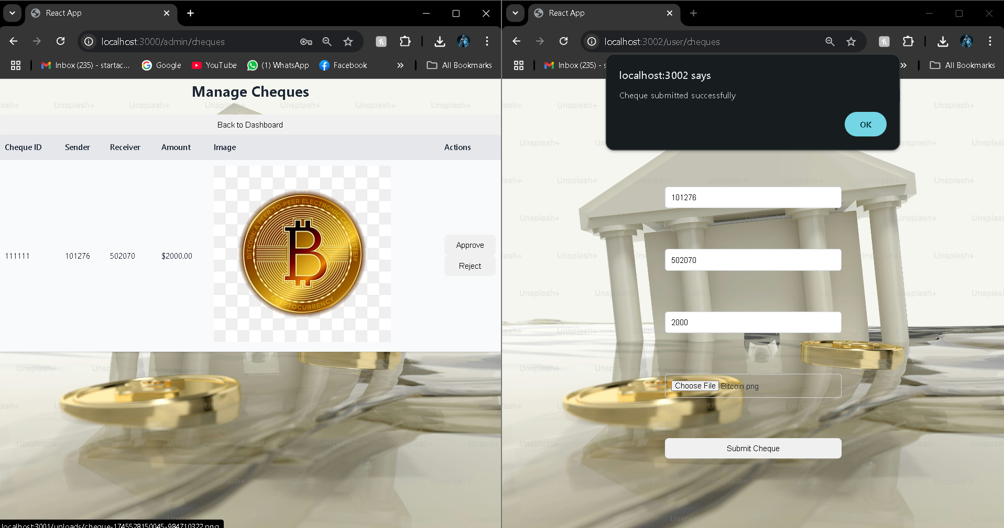

Slide 16
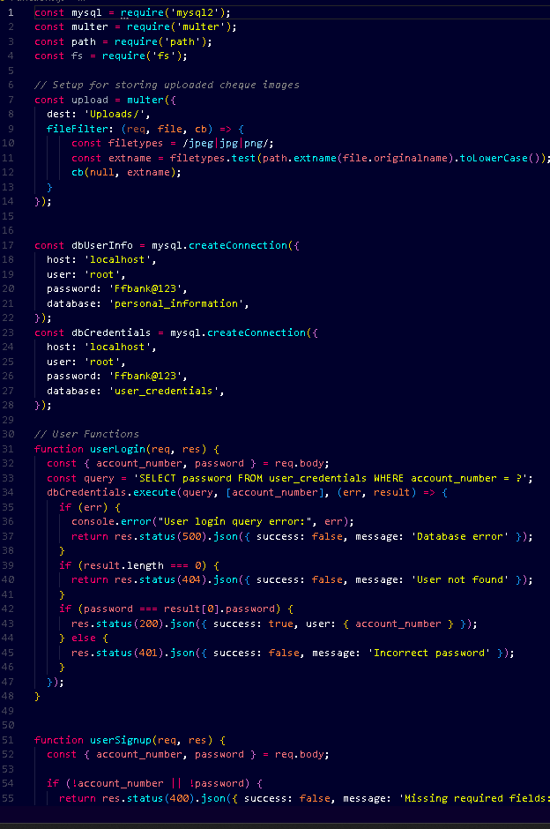
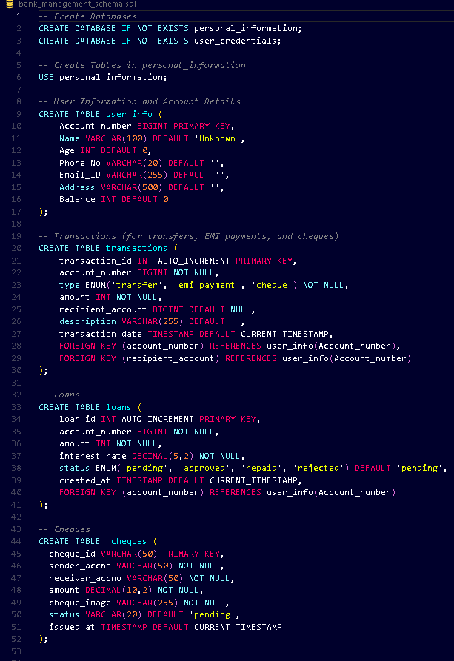
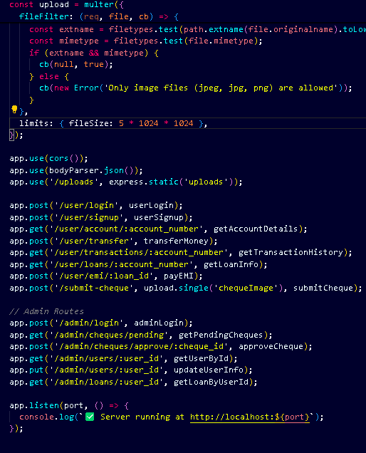
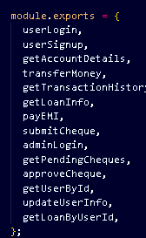
Coding Parts of the website
Functions
All functions used
Database
Server

Slide 17
Advantages over the
Existing Websites
New feature ! cheques
Multipurpose
Our Website has a wide range of features that can be accessed with a click of a button, Same page for both admins and users.
Cheques image can be used as a proof and transfer money.

Slide 18
Possible upgrades that can be done to the existing website
Increasing Security concern for pin storage
Add a phone number or message at user credentials are applying.
Request sending via classes and not through functions
After transaction notifying the user via message
Paying loans through the app as an EMI option
Adding Service time Notifications of the bank employs
i.e Noting the rush of the bank in the app

Slide 19




Software used in this project
Frontend of the website
For connection of database with frontend
For database

Slide 20

Project Progression
Testing
18-04-25
Date of proposal
1-03-25
Requirement Gathering 27-04-25
Feasibility Study
25-03-25
Completion date
24-04-25
Coding
4-04-25

Slide 21


Conclusion
In conclusion, our Banking Platform provides a secure, reliable, and user-friendly solution for managing financial needs with ease. With a wide range of features such as online account management, transaction tracking, fund transfers, and customer support, the platform ensures a smooth and convenient banking experience. Evolve our services with new features, we are committed to introducing innovative features and expanding capabilities to meet the growing needs of our users.

