Slide 1

Property Dispute Judgment Interpretation System Using Feature-Based Grammar, Probabilistic Context-Free Grammar and Word Sense Disambiguation
DSA0316-Natural Language Processing
Supervised By:
Kumaragurubaran T
SAVEETHA SCHOOL OF ENGINEERING
Presented By :
ABBURI ANIL(192425344)
N. Tharun Sai (192472382)
S.N.V.S Karthik(192424186)
V Yogeswar (192425175)

Slide 2


Abstract
The system is designed to analyze and interpret court judgments related to property disputes using Natural Language Processing.
Feature-Based Grammar (FBG) is used to represent grammatical features and analyze the syntactic structure of legal sentences.
Probabilistic Context-Free Grammar (PCFG) is used to generate and rank possible sentence structures based on their probabilities.
Word Sense Disambiguation (WSD) identifies the appropriate meaning of ambiguous legal terms using their context.

Slide 3
INTRODUCTION
Property dispute judgments contain complex sentences, legal terminology, and context-dependent meanings.
Understanding these judgments manually can be time-consuming, especially when sentences contain multiple clauses and legal terms.
NLP can help convert legal text into structured linguistic information for easier analysis.
This project combines FBG, PCFG, and WSD to analyze sentence structure and identify the appropriate meaning of legal terms.

Slide 4
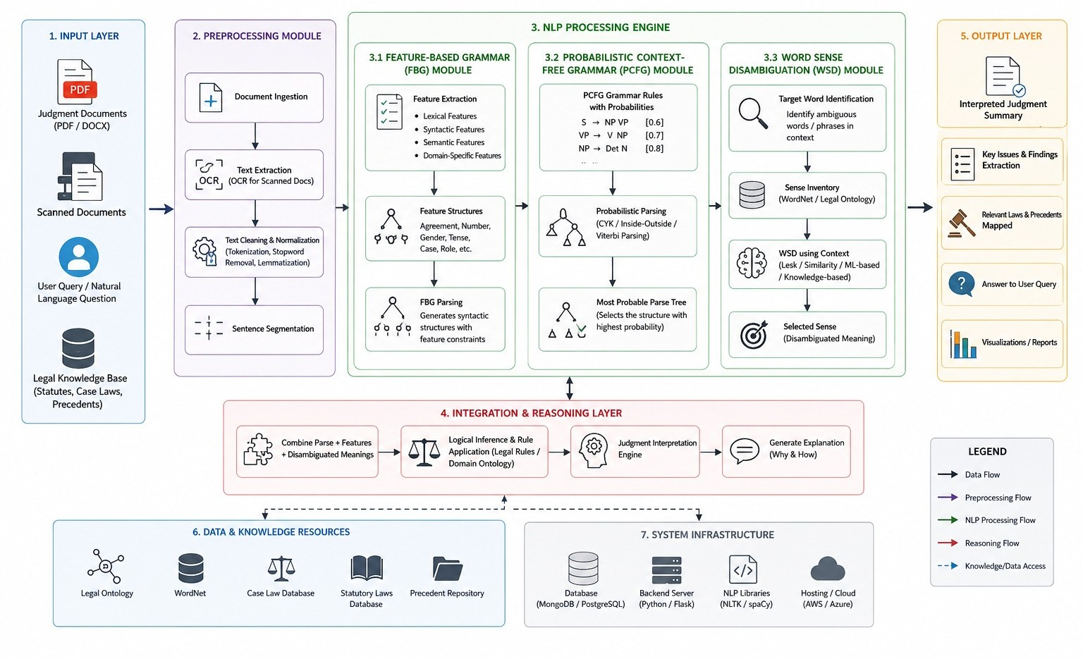
SYSTEM ARCHITECTURE

Slide 5
EXISTING SYSTEM
Conventional legal text analysis often focuses on basic text processing or document classification rather than detailed sentence interpretation.
Manual identification of legal terms, clauses, and relationships can require significant time and effort.
Simple rule-based or shallow parsing methods may have difficulty handling complex sentence structures and ambiguous legal terms.
Existing approaches may not combine syntactic parsing, probabilistic analysis, and word sense disambiguation in a single property-dispute interpretation workflow.

Slide 6
LITERATURE SURVEY
Year | Paper | Authors | Scope / Objective | Key Highlights | Relevance to Your Topic
2025 | Advances in Word Sense Disambiguation for Natural Language Processing | J. Smith, A. Kumar | To improve contextual understanding of ambiguous words in NLP systems | Introduces deep learning and knowledge-based WSD techniques for accurate meaning identification | Helps identify correct legal meanings of terms like possession, ownership, and claim in property judgments
2024 | Probabilistic Context-Free Grammar for Syntactic Parsing | M. Johnson, D. Klein | To apply PCFG models for resolving syntactic ambiguities in natural language | Uses statistical probabilities to select the most likely parse tree for complex sentences | Supports parsing of long and complex legal sentences in property dispute documents
2023 | Feature-Based Grammar in Computational Linguistics | R. Kaplan, J. Bresnan | To represent syntactic and semantic constraints using feature structures | Demonstrates agreement constraints, grammatical relations, and structured linguistic representations | Enables structured analysis of legal statements in court judgments
2023 | Legal Text Mining Using Natural Language Processing | S. Bhattacharya, P. Gupta | To automatically analyze legal documents using NLP techniques | Extracts entities, relationships, and key legal arguments from judgments | Helps automate interpretation of property dispute cases
i
l

Slide 7


PROBLEM STATEMENT
Property dispute judgments contain complex sentence structures and specialized legal terminology.
Long sentences and multiple clauses can make syntactic analysis difficult.
Legal terms such as claim, title, possession, and ownership can have different meanings depending on context.
Therefore, there is a need for an NLP system that can analyze sentence structure, resolve ambiguity, and interpret legal terms in context.

Slide 8
MODULE 1 – Legal Text Preprocessing and Linguistic Analysis
Collect property dispute judgments and legal documents as input data.
Perform text preprocessing such as tokenization and sentence segmentation.
Apply Part-of-Speech (POS) tagging to identify the grammatical category of each word.
Convert the raw legal text into structured linguistic information for further analysis.
Example:-
“Karthik claimed ownership."
→ Karthik = Proper Noun → claimed = Verb → ownership = Noun

Slide 9

MODULE 2 – Feature-Based Grammar Parsing and Syntactic Analysis
Represent legal sentences using Feature-Based Grammar (FBG).
Identify grammatical features such as tense, number, and person.
Analyze relationships between subject, verb, and object in legal sentences.
Generate a structured syntactic representation of the sentence.
Example:
“Karthik claimed ownership."
→ Subject: Karthik → Verb: claimed → Object: ownership

Slide 10
MODULE 3 – Probabilistic Context-Free Grammar Parsing and Ambiguity Resolution
Define Context-Free Grammar (CFG) rules for legal sentence structures.
Assign probabilities to different grammar rules.
Generate possible parse structures for complex or ambiguous sentences.
Select the most probable parse based on the assigned probabilities.
Example:-
If two possible interpretations are found:
Parse 1 → 0.75 probability Parse 2 → 0.25 probability
→ The system selects Parse 1 as the more probable structure.

Slide 11
MODULE 4 – Word Sense Disambiguation and Property Judgment Interpretation
Identify ambiguous legal terms such as claim, title, possession, and ownership.
Apply Word Sense Disambiguation (WSD) to determine the correct meaning from context.
Combine grammatical structure and word meaning to understand the property dispute.
Generate a clear and structured interpretation of the judgment.
Example:-
“Karthik claimed ownership of the property."
→ Person: Karthik → Legal action: Claimed → Issue: Ownership → Property: Disputed property

Slide 12
CONCLUSION
The proposed system combines Feature-Based Grammar, PCFG, and Word Sense Disambiguation for property dispute judgment analysis.
The system first preprocesses legal text, then analyzes its grammatical structure and possible sentence interpretations.
WSD helps identify the appropriate meaning of ambiguous legal terms based on their context.
Overall, the integrated approach provides a structured interpretation of property dispute judgments and demonstrates the use of NLP for legal text analysis.

Slide 13
REFERENCES
A survey and explanation of Word Sense Disambiguation — a core component of your system — was published on GeeksforGeeks in August 2025, summarizing modern WSD techniques and their importance in Natural Language Processing (NLP).
Probabilistic Context-Free Grammars are a well-established statistical grammar formalism widely used to resolve syntactic ambiguity by assigning probabilities to parse rules. The Wikipedia entry provides an overview of PCFG principles and applications (relevant foundational background)
Research from SemEval 2023 Task 6: LegalEval demonstrated active academic work in automated legal text understanding, including structuring and explaining legal documents

Slide 14
THANK YOU

