Slide 1
Micron
An Open-Source LabVIEW Based Microservice Architecture/Template
https://github.com/KarthikAbiram/Micron
Karthik Abiram
LabVIEW Champion, CLA, CTA
Soliton Technologies
LinkedIn: https://www.linkedin.com/in/karthikabiram/

Slide 2
Micron’s Vision
Enable easy exchange and swapping of microservices built with different programming languages easily.
Create a docker compose type system for service executables, instead of containers.
Provide tooling, libraries and batteries missing in default gRPC, like a client starting and stopping services.
Reduce the barrier of entry in creating microservices in different programming languages.
Source: Micron’s Vision
Possible Similar Project: https://github.com/dapr/dapr
Network: my-application-1
Network: my-application-2
Service-1
(LabVIEW)
Service-2
(Python)
Service-1
Service-2
Service-3
Service-3
(Go)

Slide 3
Every Design is a Trade Off
My personal take on microservices:
Top Advantage:
Leverage multiple programming languages easily.
Hard separation with clear responsibility.
Top Trade Off:
Some aspects are more complex than a monolith.
No sharing of references/instrument handles.

Slide 4
Install Micron
Download and install below VIPM packages:
LabVIEW gRPC Packages v1.5.1.1
Micron v0.2.2.20
Available in Tools -> Micron -> Create New Microservice
APIs available in Functions Palette -> Data Communication -> Micron

Slide 5
Micron Components
MicronCLI – A command line registry for registering microservices.
LabVIEW Starter
Server – A minimalistic wrapper on top of gRPC server
Client – A minimalistic wrapper on top of gRPC client

Slide 6
MicronCLI
MicronCLI – A command line registry for registering & querying microservice connection strings.
micronCLI register --network mynetwork --service-id myservice --connection localhost:50051
micronCLI register mynetwork myservice localhost:50051
micronCLI query --network mynetwork --service-id myservice
micronCLI query mynetwork myservice //Returns Connection String
micronCLI unregister --network mynetwork --service-id myservice
micronCLI unregister mynetwork myservice
micronCLI clear --network mynetwork
micronCLI clear mynetwork

Slide 7
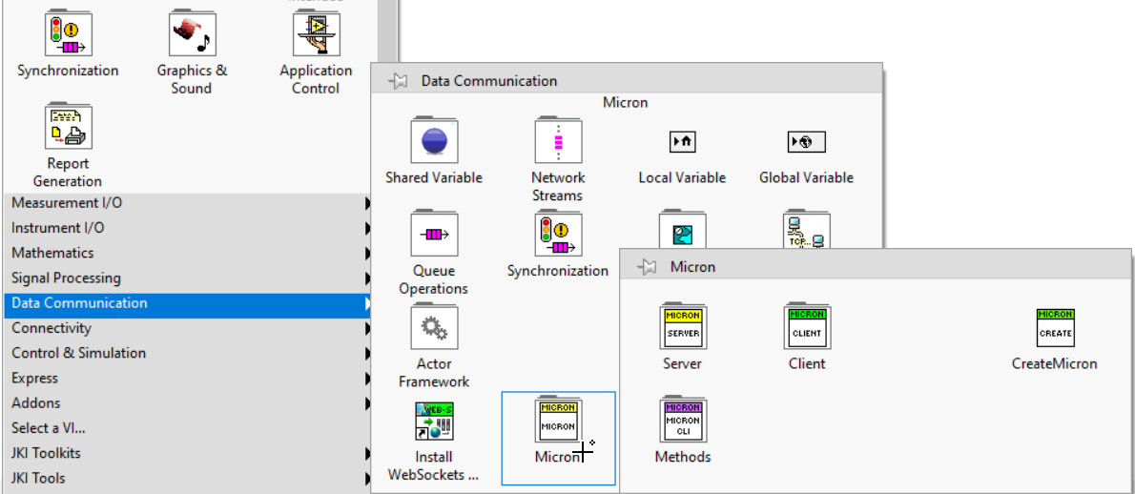
Micron APIs in Functions Palette

Slide 8
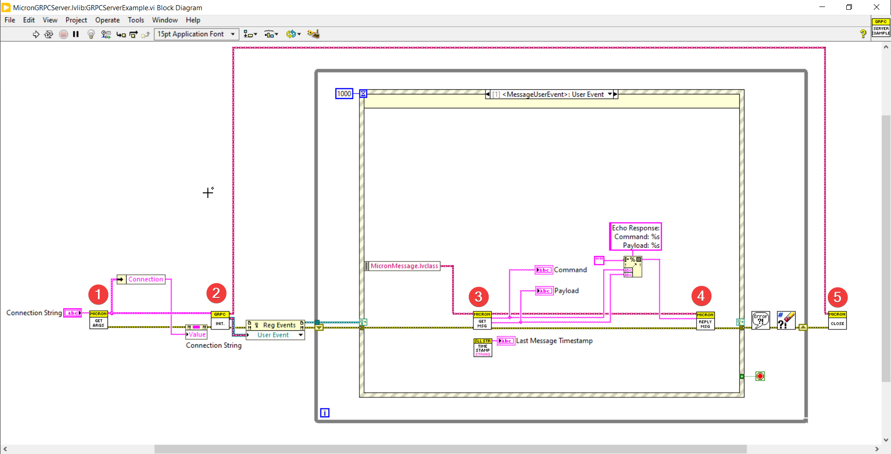
Micron Server Flow
5 Step Process:
Get Args
Initialize
Get Message
Reply
Close

Slide 9
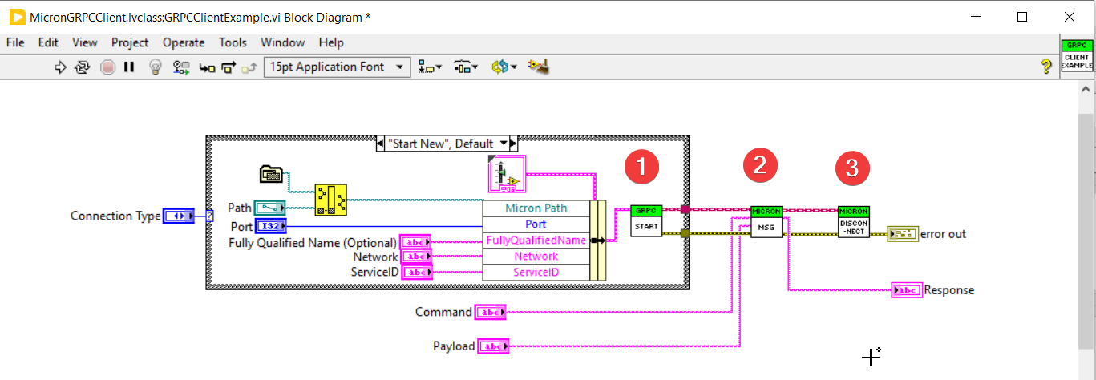
Micron Client Flow
3 Step Process:
Start/Connect
Message
Disconnect

Slide 10
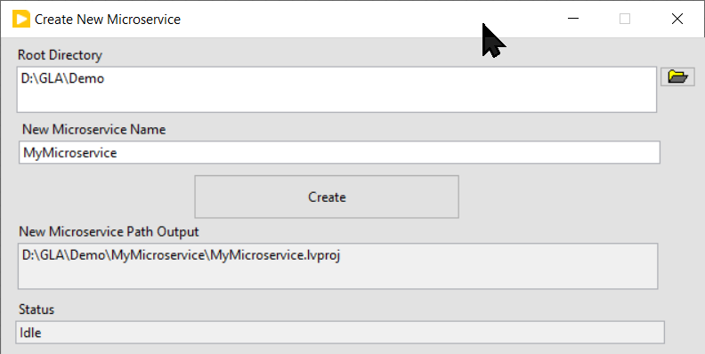
Create New Microservice
Tools -> Micron -> Create New Microservice

Slide 11
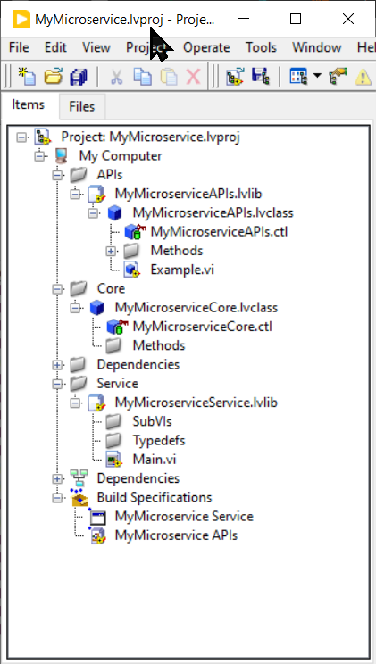
Micron Microservice – Ready to Run ☺
Client APIs for others to talk to your Service
Core Business Logic
Service

Slide 12
Demo

