Slide 1
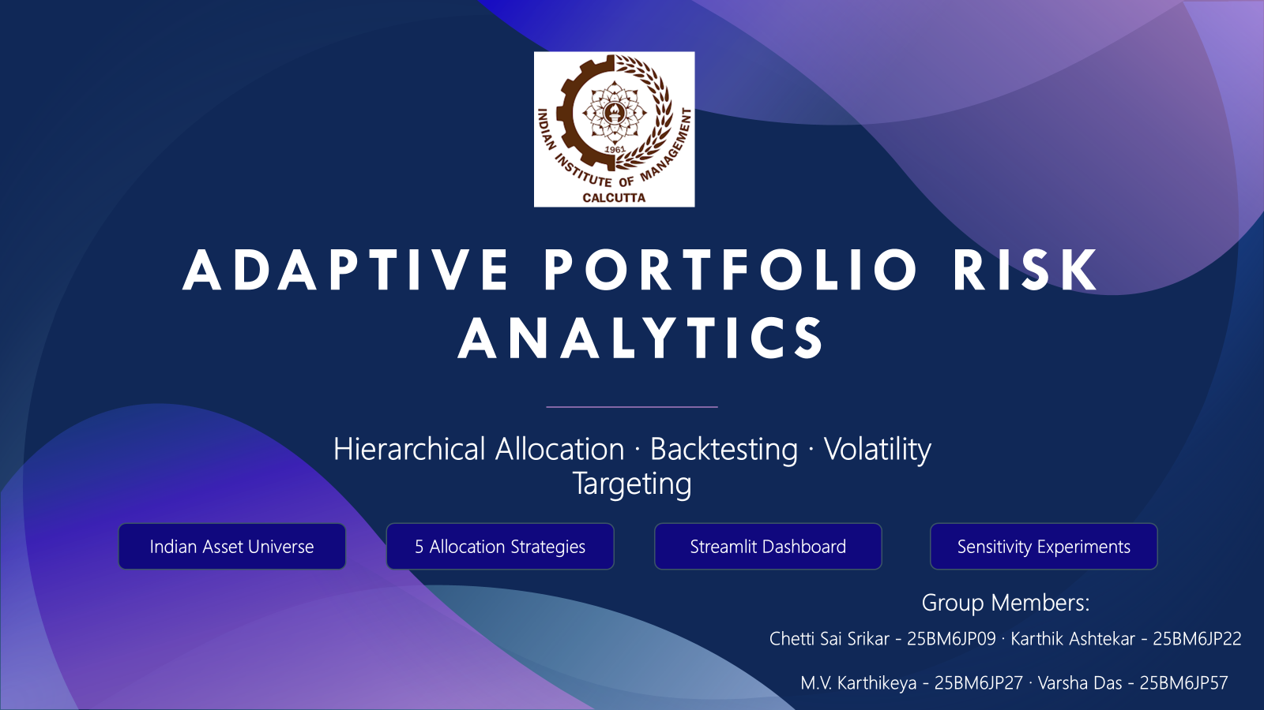

Slide 2
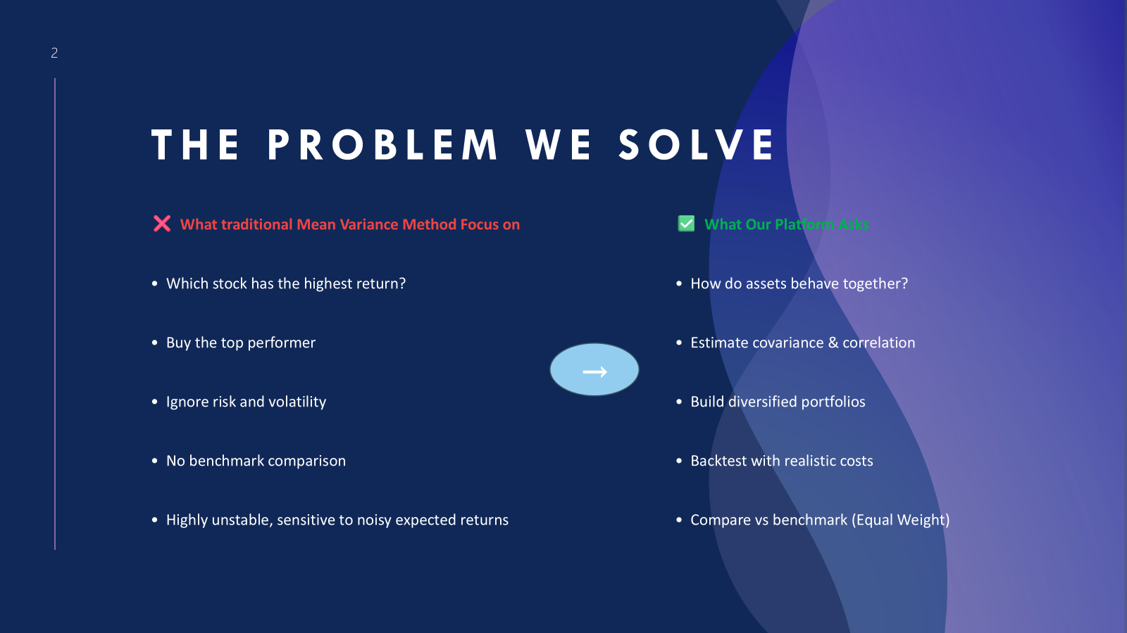

Slide 3
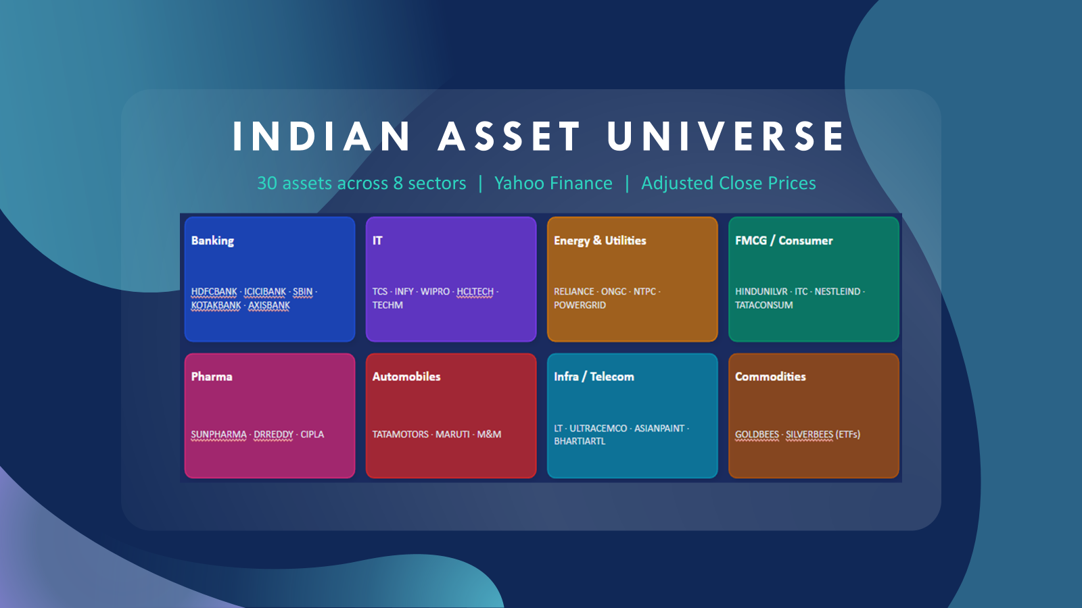

Slide 4
End-to-End Project Pipeline
Data
Acquisition
Cleaning &
Returns
Risk &
Covariance
Clustering
→
↓
Dashboard &
Sensitivity
Analytics &
Metrics
Backtesting
Portfolio
Construction
→
Each stage depends on the previous. Errors propagate — clean data is foundational.
Notes:
Walk through the pipeline from left to right, top to bottom. Each stage feeds the next.

Slide 5


Data Acquisition & Preprocessing
📡 Yahoo Finance
🔢 Simple & Log Returns
Adjusted close prices (accounts for dividends, splits, bonuses). Date range: 2020–2025.
🧹 Data Cleaning
📐 Annualized Volatility
Drop assets > 5% missing · Anomaly detection (|log return| > 0.50)
Forward-fill · Winsorize returns [−20%, +20%]
Notes:
Adjusted close is crucial. Without it, corporate actions cause artificial return spikes. Winsorization prevents outliers from distorting covariance.

Slide 6



Risk Measurement: Covariance, Correlation & Distance
Covariance Σij
Correlation ρij
Distance dij
Measures co-movement of two asset returns in return units. Positive = move together.
Standardized between –1 and +1. Banking stocks: ρ ≈ 0.80. Gold vs equity: ρ ≈ 0.10.
Converts correlation to a metric for hierarchical clustering. Low ρ → high distance.
💡 Key Insight: Portfolio risk ≠ weighted average of individual risks. Covariance between assets drives overall portfolio risk.
Notes:
Correlation standardizes covariance. Distance converts correlation for hierarchical clustering. Low correlation assets add genuine diversification.

Slide 7
Covariance Estimation Engine
Sample Covariance
Ledoit-Wolf Shrinkage
✅ Simple, easy to understand
✅ Pulls noisy estimates toward stable target (δ)
⚠ Noisy in small samples; sensitive to crises
⚠ Fixed shrinkage; no recency weighting
EWMA
EWMA + Ledoit-Wolf
✅ Recent observations weighted more (span=252)
✅ Combines recency with regularization — BEST OF BOTH
⚠ No regularization; can be noisy
⚠ Slightly more complex
Notes:
The covariance factory is a key design feature. Sensitivity experiments test all four estimators, demonstrating how model risk affects allocation outcomes.

Slide 8
5 Portfolio Construction Strategies
1
Equal Weight
Default benchmark · No estimation needed · Hard to overfit
wi = 1/N
2
Inverse Volatility
Lower-volatility assets get more weight · Risk-aware without covariance
wi = (1/σi) / Σ(1/σj)
3
Mean-Variance / Max-Sharpe
Theoretically powerful but sensitive to return estimates
max wᵀμ / √(wᵀΣw)
4
HRP
Uses hierarchical clustering · Stable · No return forecasting needed
Recursive by cluster variance
5
HERC
Equalizes risk contribution across tree branches · More direct risk budgeting
Recursive by branch risk
Notes:
EW is the benchmark. HRP and HERC are the main novel strategies. HRP uses quasi-diagonalization; HERC traverses the explicit tree.

Slide 9


HRP vs HERC — Hierarchical Allocation Deep Dive
HRP — Hierarchical Risk Parity
HERC — Hierarchical ERC
1. Estimate covariance matrix
1. Same covariance & clustering steps
2. Convert to correlation & distance
2. Traverse explicit linkage tree
3. Build hierarchical cluster tree
3. At each node: compute branch risk
4. Quasi-diagonalize asset order
5. Recursively bisect clusters
4. Equalize risk contribution between sibling branches
6. Allocate inversely by cluster variance
Notes:
Key difference: HRP uses quasi-diagonal ordering then recursive bisection by cluster variance. HERC traverses the explicit tree and equalizes sibling branch risk.

Slide 10
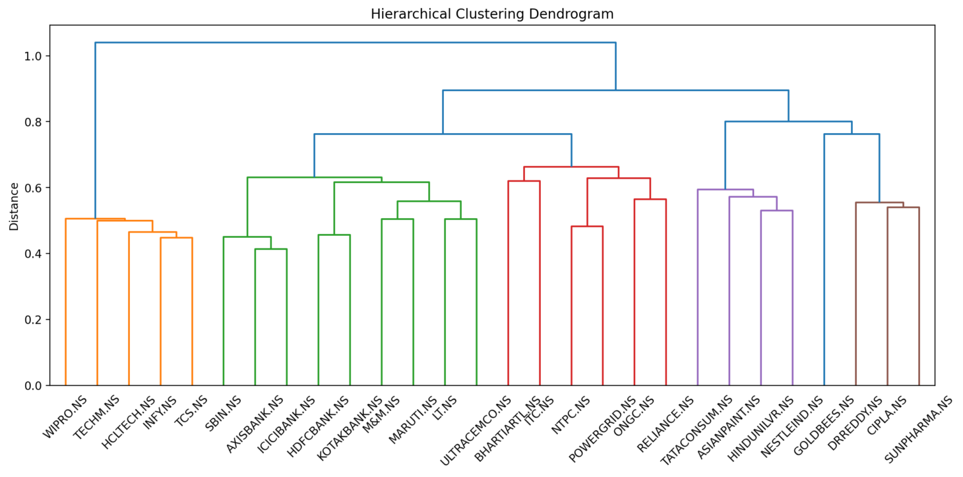

Slide 11
Walk-Forward Backtesting
Training Window
(252 days)
Test Period
→ apply weights
Slide Forward →
Repeat
🔒 No Look-Ahead Bias
Only past data used to make decisions. Exposure at day t uses information up to day t−1.
Portfolio return is previous weights dot current returns — decision always precedes outcome.
🔄 3 Rebalance Modes
💰 Gross vs Net Value
Calendar · Threshold (drift ≥ 3/5/10/20%) · Calendar-or-Threshold — tested in experiments.
Transaction costs (15 bps default = 10 base + 5 slippage) deducted on net portfolio value.
Notes:
Walk-forward testing is the gold standard for avoiding look-ahead bias. The model walks through history, updating weights using only past information.

Slide 12
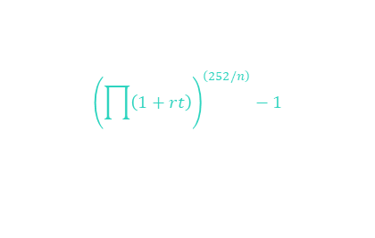



Performance & Risk Metrics
CAGR
Sharpe Ratio
Sortino Ratio
Excess return / Downside deviation
Annualized compound growth rate
Return per unit of total risk (higher = better)
Penalizes only downside volatility
Calmar Ratio
Max Drawdown
VaR / CVaR
5th pctile / E[r | r ≤ VaR]
Growth vs worst peak-to-trough loss (default ranking metric)
Worst peak-to-trough portfolio decline
Tail risk: threshold and expected shortfall
Notes:
Calmar is the default ranking metric because it balances growth and worst loss. Risk-adjusted metrics tell a more complete story than raw CAGR.

Slide 13
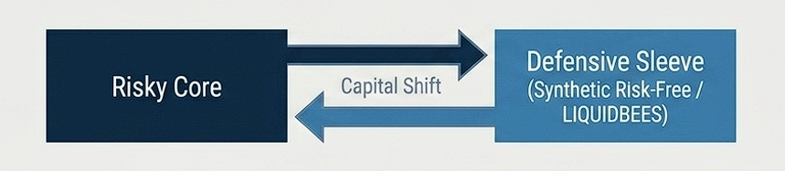

Volatility Targeting Overlay
What it does
Adjusts how much of the portfolio goes into the risky strategy vs a defensive sleeve (LIQUIDBEES / Synthetic Risk-Free).
Adaptive Regime Targets
Regime
Percentile
Target Vol
Exposure Formula
Calm
≤ 40th pct
12%
Normal
40–80th pct
10%
Stress
80–95th pct
6%
No Look-Ahead
Realized volatility is lagged by 1 day. Exposure at day t uses only information through t−1.
Crisis
> 95th pct
3%
Rule-based regimes using lagged realised volatility percentile — not full Markov-switching (planned future work)
Notes:
Volatility targeting is a key risk management layer. It separates WHAT to hold (HRP/HERC) from HOW MUCH to hold. During crises, it cuts risky exposure to 3% target vol.

Slide 14
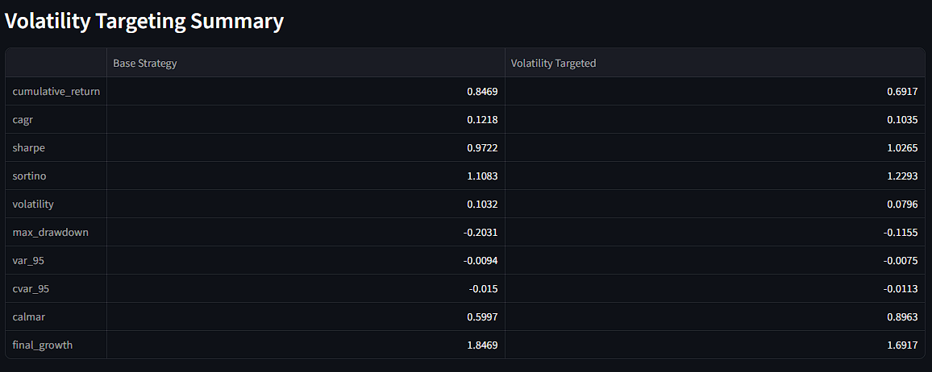
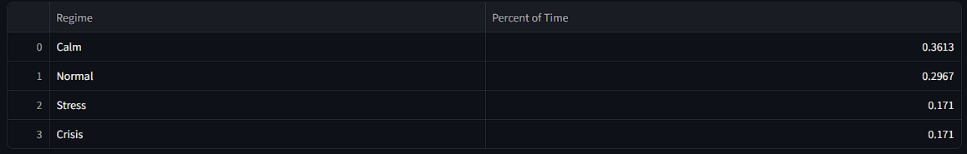

Slide 15
Sensitivity Experiment Results
Ranked by Calmar Ratio | All experiments: Vol Targeting ON | 10 bps base + 5 bps slippage
Rank
Strategy
Cov Method
Rebalance
CAGR
Sharpe
Calmar
Max DD
#1
HERC
ewma_ledoit_wolf
threshold 20%
12.5%
1.187
0.848
-12.5%
#2
HRP
sample
threshold 20%
10.4%
1.018
0.833
-13.4%
#3
HRP
ewma
threshold 20%
11.1%
1.094
0.826
-14.7%
#4
HRP
ledoit_wolf
threshold 5%
10.5%
1.019
0.825
-12.7%
#5
HRP
ledoit_wolf
threshold 10%
10.2%
0.994
0.817
-12.5%
📊 Average by Strategy: HERC → CAGR 11.9% | Sharpe 1.135 | Calmar 0.810 | HRP → CAGR 10.3% | Sharpe 1.005 | Calmar 0.802
Notes:
HERC with EWMA+Ledoit-Wolf covariance and 20% threshold rebalancing is the top configuration. All experiments have volatility targeting enabled.

Slide 16


Risk Contribution Analytics
💡 Capital weight ≠ Risk weight | An asset with 5% capital can drive 25% of portfolio risk if it is volatile and highly correlated with the rest.
Marginal Risk
Contribution (MRC)
Total Risk
Contribution (TRC)
Percentage Risk
Contribution (PRC)
TRCi = wi × MRCi
How much portfolio risk changes if one asset's weight increases slightly.
The actual amount of risk each asset contributes to the portfolio.
Each asset's share of total portfolio risk — enables true diversification audit.
Notes:
Risk contribution is the explanation layer. It answers not just 'which strategy performs better' but WHY a strategy's risk behaves differently from its capital allocation.

Slide 17
Key FRM Learnings
What this project taught us as Financial Risk Management students
📈 Risk-Adjusted Return > Raw Return
🔗 Diversification = Correlation, Not Count
📊 Portfolio Risk ≠ Weighted Average
Highest CAGR is not the best strategy. Sharpe, Sortino, Calmar tell the real story.
5 banking stocks are NOT 5 uncorrelated bets. True diversification depends on covariance.
The same assets can produce very different portfolio risk depending on how they are combined.
💰 Capital ≠ Risk Allocation
🔮 Expected Returns Are Noisy
💸 Transaction Costs Change Rankings
A 5% weight asset can drive 25% of portfolio risk. Always ask: where is the risk coming from?
Return forecasting error can dominate optimization. HRP/HERC rely on risk structure instead.
A strategy that rebalances too often may lose its edge after friction. Turnover matters.
Notes:
These learnings connect financial theory to practical implementation. Portfolio management is about understanding, measuring, and controlling risk — not just maximizing return.

Slide 18
Streamlit Dashboard & Outputs
⚙ Dashboard Controls
📊 Dashboard Outputs
▸ Select asset universe & override tickers
▸ Growth & drawdown curves
▸ Choose date range (2020–2026)
▸ Performance metric tables
▸ Select strategy & covariance method
▸ Portfolio weights over time
▸ Configure rebalance rules & thresholds
▸ Correlation heatmap & dendrogram
▸ Enable/disable volatility targeting
▸ Turnover & transaction cost summary
▸ Run rolling walk-forward backtest
▸ Benchmark comparison & sensitivity table
Code structure: src/data/ · src/risk/ · src/portfolio/ · src/backtesting/ · src/analytics/ · src/experiments/ · src/dashboard/app.py
Notes:
The Streamlit dashboard ties everything together. Users can run experiments interactively and see ranked results.

Slide 19
Built vs Future Work
✅ Implemented
🔭 Future Work
• Yahoo Finance data acquisition
◦ Full Markov-switching regime detection
• Data cleaning & return computation
◦ NLP sentiment (RBI text, earnings calls)
• Covariance estimator factory (4 types)
• Hierarchical clustering & dendrogram
◦ Dynamic allocation by macro/sentiment signals
• EW, IV, MV/Max-Sharpe, HRP, HERC
◦ Combinatorial Purged Cross-Validation (CPCV)
• Rolling walk-forward backtesting
• Calendar / threshold rebalancing
◦ Production data governance & catalog
• Turnover & transaction cost tracking
◦ Liquidity / market impact / tax modeling
• Performance & risk metrics
◦ Alpha Vantage integration (placeholder only)
• Risk contribution analytics
• Volatility targeting overlay
◦ Full deployment + monitoring + auth
• Experiment sensitivity framework
• Streamlit dashboard
Notes:
Correct framing: 'We have built the core portfolio construction, analytics, backtesting, and volatility-targeting platform. Regime detection and NLP are planned extensions.'

Slide 20
Adaptive Portfolio Risk Analytics
A risk-aware portfolio research platform comparing hierarchical and baseline
allocation strategies using robust covariance estimation, rolling backtesting,
transaction-cost diagnostics, risk attribution, and volatility targeting.
Top Result: HERC + EWMA-LedoitWolf + threshold rebalancing
CAGR 12.5% · Sharpe 1.187 · Calmar 0.848 · Max DD −14.7%
End-to-End
Realistic
Extensible
Data → Metrics
→ Dashboard
Costs · Lookback
· Benchmarks
NLP & Regimes
are next steps
Notes:
Closing slide. Key message: strong research infrastructure, defensible framing, clear future path.

