Slide 1
Do Safety Constraints Tax Humor?
Quantifying the Alignment Tax via Distributional Analysis
Karthik Bhattaram · 2026

Slide 2
The Core Question
Hypothesis: RLHF safety training compresses LLM outputs toward
safe, predictable text — reducing the statistical properties
that make jokes funny.
Three metrics expected to fall under alignment:
• Punchline surprisal — unexpected endings
• Pre-punchline entropy — model uncertainty before punchline
• Embedding distance — semantic leap from setup to punchline
Three models tested:
Base → Instruct (RLHF) → Safety-finetuned (ours)

Slide 3
Datasets
Joke corpora:
r/Jokes
194,553 Reddit jokes
One-liners
3,200 short jokes
1,000 per source used
for metric extraction
Safety fine-tuning data:
AdvBench
520 harmful prompts
HarmBench
400 harmful prompts
920 total (prompt, refusal)
7 varied refusal templates

Slide 4
Models
Base Llama 3.2-1B Pre-training only
1.2B params
Instruct Llama 3.2-1B-Instruct + RLHF / instruction tuning
1.2B params
Safety Llama 3.2-1B-Instruct + LoRA refusal fine-tune
(ours) 1.2B params AdvBench + HarmBench
Safety fine-tuning: LoRA r=16, 3 epochs, lr=2e-4,
response-only loss. Training loss: 3.72 → 0.34, accuracy: ~90%

Slide 5
Three Distributional Metrics
1. Punchline Surprisal
Mean −log P(punchline tokens given setup).
High = model didn't predict the punchline.
2. Pre-punchline Entropy
Shannon entropy of next-token distribution at setup end.
High = model uncertain about what comes next.
3. Setup–Punchline Embedding Distance
Cosine distance between sentence embeddings.
High = punchline is conceptually far from setup (semantic leap).
Inverted-U hypothesis: humor quality peaks at MODERATE values of all three.

Slide 6
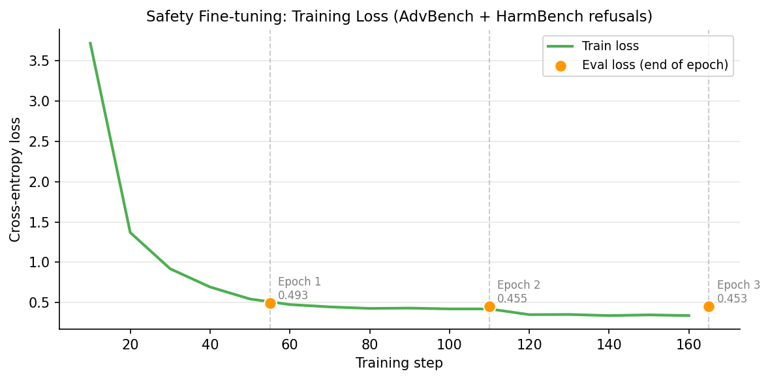
Safety Fine-tuning: Training Curve
Loss converges 3.72 → 0.34 over 3 epochs (165 steps). Token accuracy ~90%.

Slide 7
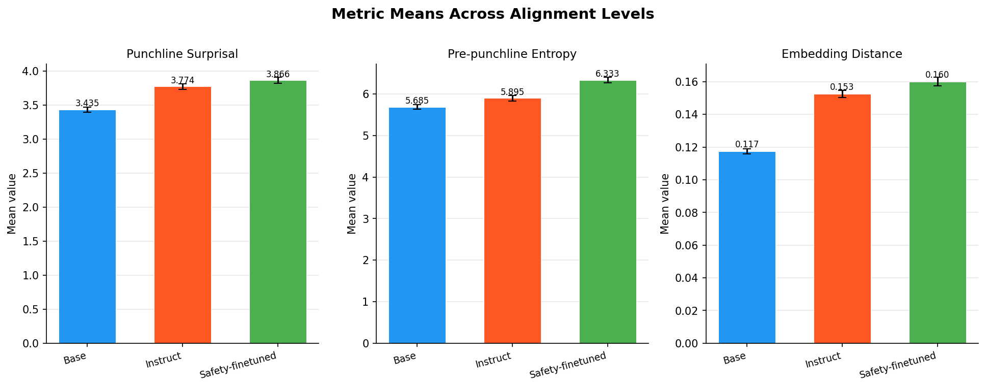
Results: Metric Means

Slide 8
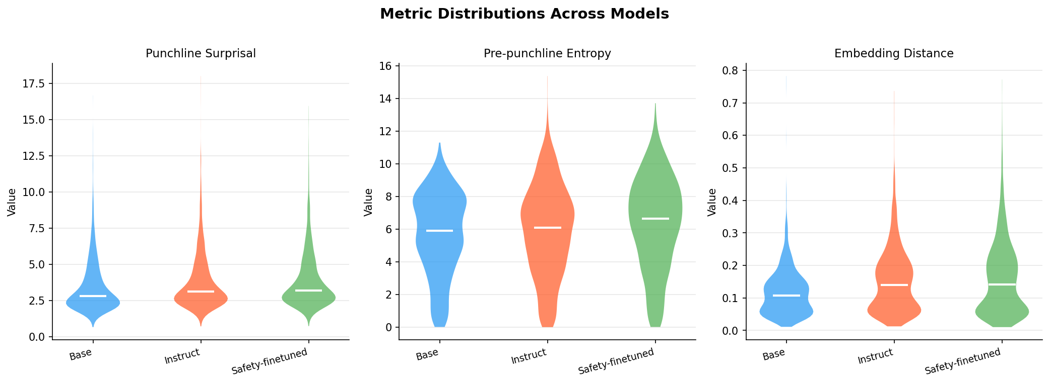
Results: Full Distributions

Slide 9
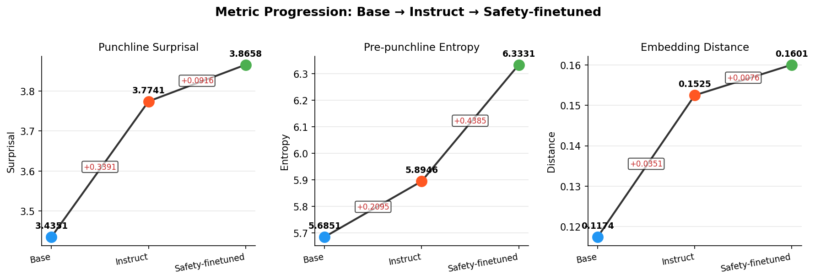
Results: Metric Progression

Slide 10
Results: Statistical Comparison
Base → Instruct:
Surprisal +0.339 Cohen d=0.18 p = 2e-15 ***
Entropy +0.210 Cohen d=0.08 p = 0.071
Distance +0.035 Cohen d=0.41 p = 2e-27 ***
Instruct → Safety:
Surprisal +0.092 Cohen d=0.05 p = 0.016 *
Entropy +0.439 Cohen d=0.16 p = 1e-7 ***
Distance +0.008 Cohen d=0.07 p = 0.56 n.s.
Base → Safety (cumulative):
Surprisal +0.431 Cohen d=0.23 p = 3e-24 ***
Entropy +0.648 Cohen d=0.24 p = 5e-14 ***
Distance +0.043 Cohen d=0.45 p = 4e-25 ***

Slide 11
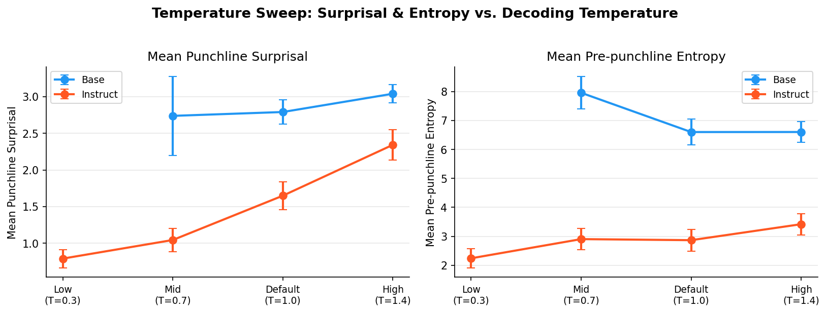
Temperature Sweep
Higher temperature raises both metrics. Instruct stays above Base at all temps.

Slide 12
Humor Quality: LLM-as-Judge
Distributional metrics measure form — but do the jokes actually land?
Scored every joke (corpus + generated) with a single consistent judge
(Gemini), 1-10 on unexpectedness, cleverness, amusement, overall.
Why not the local 1B judge?
It returned valid scores for only ~18% of generated jokes
(parse failures concentrate on the noisiest outputs).
Gemini judge: 2,851 / 2,859 = 99.7% valid.
One judge over corpus AND generated removes the two-judge confound.

Slide 13
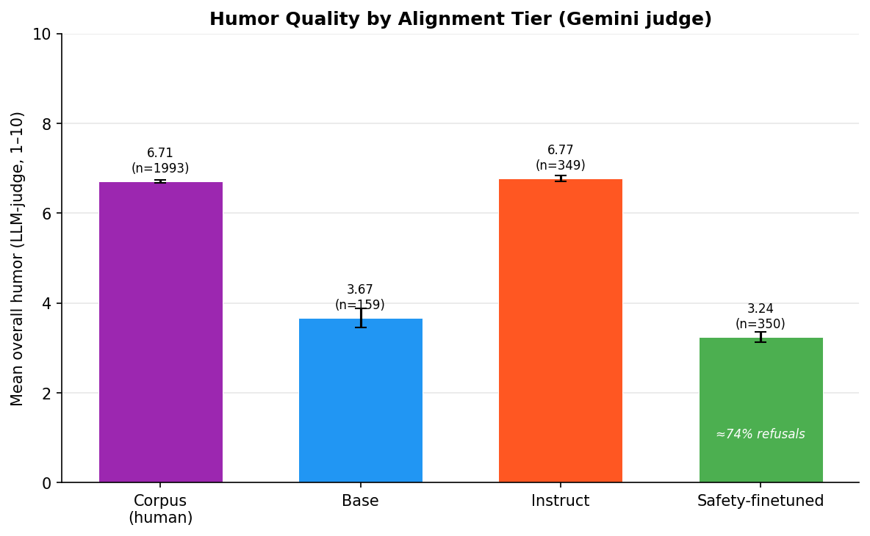
Humor by Alignment Tier
Non-monotonic: RLHF (Instruct) matches the human corpus; safety fine-tuning collapses humor — ~74% of its outputs are refusals to benign joke prompts.

Slide 14
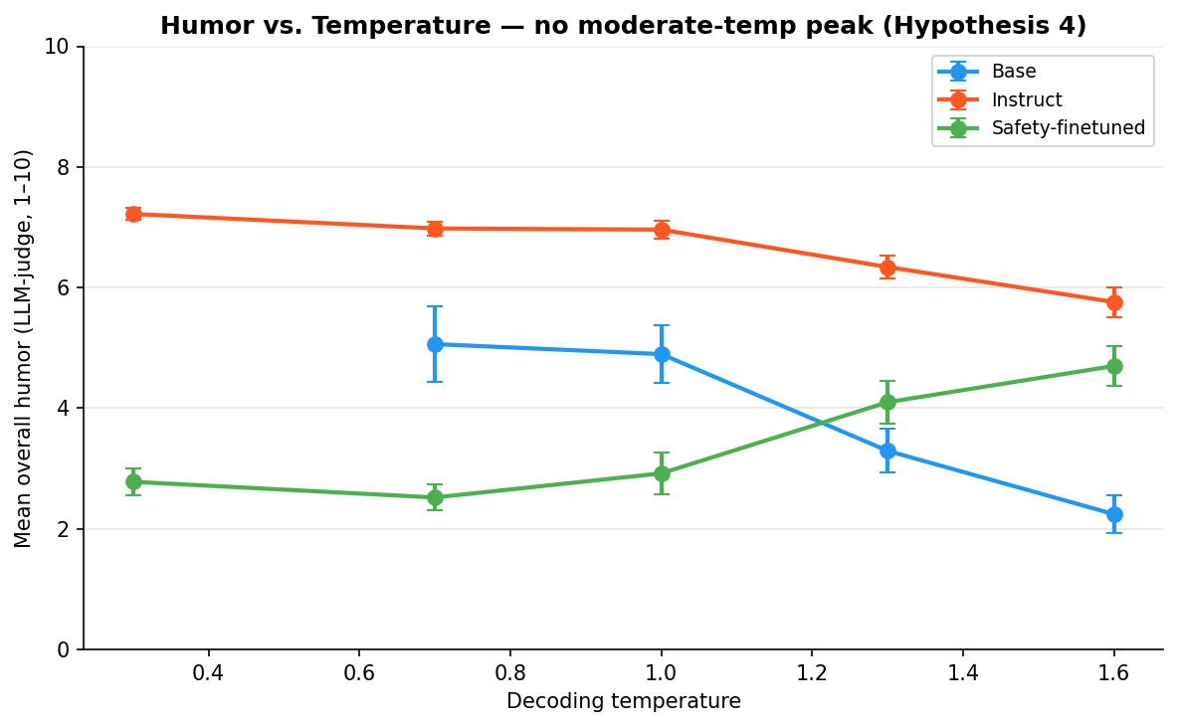
Humor vs. Temperature (Hypothesis 4)
No moderate-temperature peak: instruct humor declines monotonically (7.2 -> 5.8) as surprisal/entropy rise. Funniest at low temperature / narrow nucleus.

Slide 15
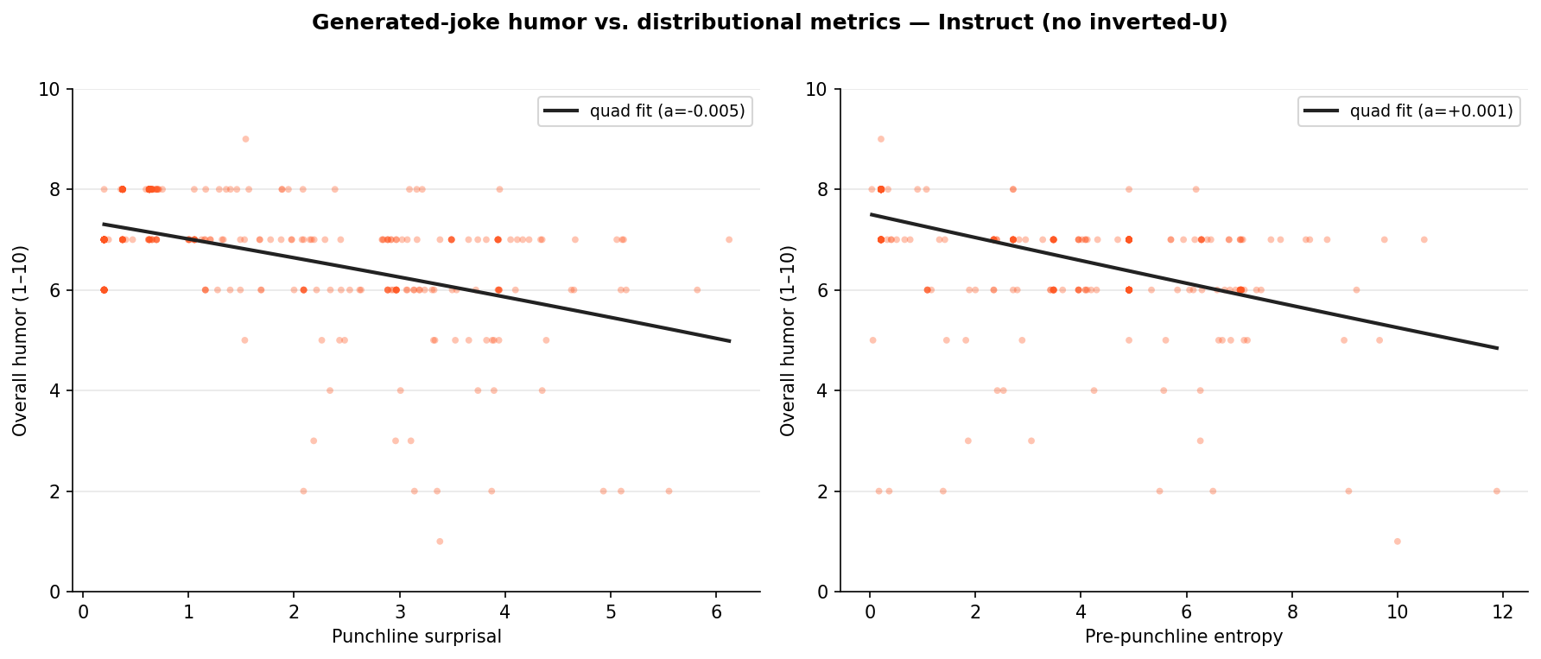
Inverted-U on Generated Jokes? No.
Humor vs. metrics (instruct), with quadratic fits. No significant peak; metrics relate to humor (R^2 up to 0.32) but monotonically, not as a sweet spot.

Slide 16
Key Finding: Disruption, Not Compression
All three metrics INCREASE at every alignment step.
Safety training does NOT compress outputs toward predictable text.
Two distinct mechanisms:
Base → Instruct (driven by surprisal & distance):
RLHF sensitises the model to harmful content.
Offensive punchlines become more surprising.
Clean classic jokes are better predicted (RLHF familiarity effect).
Instruct → Safety (driven by entropy):
Refusal fine-tuning disrupts next-token confidence across all text.
Collateral damage from a narrow 920-example training distribution.
Distance barely moves — semantic leap unchanged.

Slide 17
Example Jokes: Largest Divergences
Instruct >> Base surprisal:
(offensive jokes)
"What do you call a guy
who gets lots of blowjobs?"
→ Successful
Base: 14.2 Inst: 18.0 Δ=+3.84
"What can you make with
epileptic lettuce?"
→ A seizure salad
Base: 7.2 Inst: 10.7 Δ=+3.58
Base >> Instruct surprisal:
(classic clean jokes)
"Why did the hungry baby
calf cross the road?"
→ To get to the udder side.
Base: 7.1 Inst: 5.7 Δ=−1.43
"For Sale: French WWII Rifle"
→ Never fired. Only dropped once.
Base: 7.7 Inst: 6.5 Δ=−1.19

Slide 18
Conclusion & Future Work
Findings:
Inverted-U not confirmed (1B, noisy)
Alignment shift confirmed —
direction is UPWARD
Two distinct mechanisms:
RLHF content-sensitisation
Safety entropy disruption
Humor (LLM-judge): RLHF keeps
humor; safety FT -> 74% refusals
Limitations:
1B model is weak
Offensive jokes confound results
Only 920 refusal examples
Future work:
Filter to clean-only jokes
and re-test compression hypothesis
Scale to Llama 3.1-8B
Probe the safety model's
humor representations (Chumor)
Probe whether elevated entropy
improves joke generation quality

