Slide 1
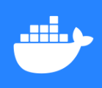
Docker
a simplicity of container technology
By Karthik Kumar BA

Slide 2
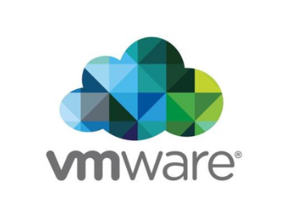
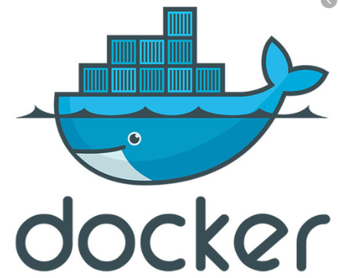
More to know before docker
VS
By Karthik Kumar BA

Slide 3
What is a virtual Machine:
In basic terms, a virtual machine is an emulation of a specific computer system type. They operate based
on the architecture and functions of that real computer system type and
its implementation can involve specialized hardware, software or both.
when you think of a virtual machine , you probably think of VMware, citrix and or virtual box.
Virtualization software allows you to
setup one operating system with another. Although they both share the same physical hardware,
the virtual machine is isolated from
that hardware and has to communicate with it through something called a Hypervisor.
An aws instance is one type of virtual Machine !
What is a container:
A container is exactly what you might except it to be based on the general definition of the word.
It is an entirely isolated set of
packages, libraries and/or applications that are completely independent from its surroundings.
In the simplest example, you place your leftovers in a plastic container and then set it on the table. Although the table lends the platform on which the leftover are resting upon, they are independent of the table itself. What you do to one does not necessarily affect the other(although in certain instances it can)
By Karthik Kumar BA

Slide 4
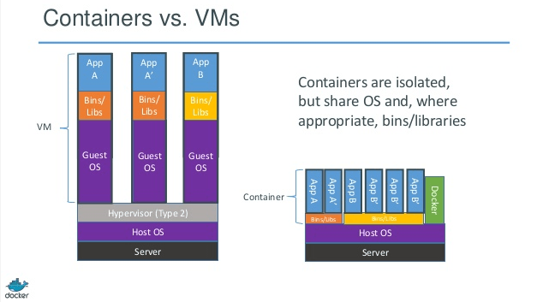
Container vs VMs
By Karthik Kumar BA

Slide 5
What is the difference::
As in most things in life, the importance is in perspective. From the perspective of getting the most performance out of hardware purchased, virtualization was invented to allow us to share but segregate server instances from each other. This way, we could protect one operating system
from another with out letting space CPU cycles, memory or disk space go to waste.
Now, virtualization is becoming more granular. We have virtual servers, but they are based on emulating virtual hardware through a hypervisor.
This means that they are heavy in terms of system requirements. Containers however, use shared operating systems and more efficient in system resource terms.
By Karthik Kumar BA

Slide 6
Why Docker ?
What is Docker
Use case of Docker

Slide 7
What is Docker
Docker is an open-source platform for developing,
Docker is an application that makes it simple and easy to run application processes in a container, which are like virtual machines, only more portable, more resource-friendly, and more dependent on the host operating system.
By Karthik Kumar BA

Slide 8
Why Docker ?
Keep it Simple
Docker’s friendly, CLI-based workflow makes building, sharing, and running containerized applications accessible to developers of all skill levels.
Move Fast
Install from a single package to get up and running in minutes. Code and test locally while ensuring consistency between development and production.
Collaborate
Use Certified and community-provided images in your project. Push to a cloud-based application registry and collaborate with team members.
By Karthik Kumar BA

Slide 9
Use case of Docker
It works on my machine!
It works different machines and platforms.
Docker allows you to run containers locally.
There is no need to install software packages locally. Everything you need for your development environment can simply run on the Docker engine as containers. Regardless of the language or the tool, you can easily containerize your environment locally. With Docker Desktop and Docker Hub, it’s the ultimate answer to your portability concerns as containers can easily move across machines.
We are adopting a microservices architecture.
enable faster app deployments and updates. Docker allows you containerize your microservices and simplify the delivery and management of those microservices. Containerization provides individual microservices with their own isolated workload environments, making them independently deployable and scalable.
I need to move my legacy apps to containers.
Using Docker to containerize your legacy apps come with a number of benefits. Development and test is more efficient, deployment and disaster recovery is greatly simplified, and you're able to run multiple instances of the app without conflicting with other apps.
By Karthik Kumar BA

Slide 10
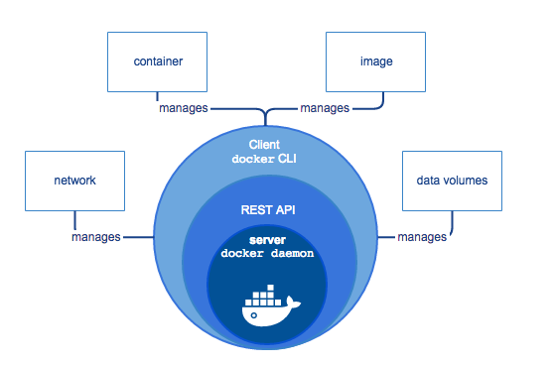
Docker Engine
By Karthik Kumar BA

Slide 11
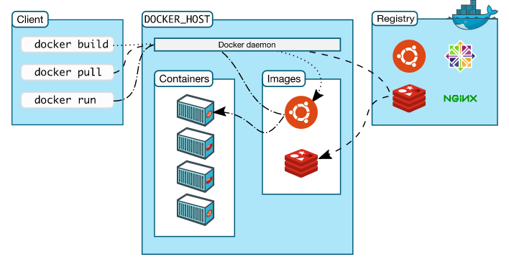
Docker Architecture:
By Karthik Kumar BA

Slide 12
Thank You
By Karthik Kumar BA

