Slide 1
Book Bridge: Enhancing Learning Through Intergenerational Book Trading

Slide 2

INTRODUCTION
Welcome to Sustainable Knowledge Exchange: Enhancing Learning Through Intergenerational Book Trading. This presentation explores the benefits of
and its impact on sustainable knowledge exchange.

Slide 3

Fostering
crucial for preserving knowledge. Connecting older and younger generations through book trading
IMPORTANCE OF INTERGENERATIONAL EXCHANGE
is
promotes a rich exchange of experiences and ideas, contributing to a sustainable learning environment.

Slide 4



BENEFITS OF BOOK TRADING
Book trading promotes by reducing waste and promoting reuse. It also encourages and fosters a sense of community.
Additionally, it provides access to a diverse range of knowledge and perspectives.

Slide 5
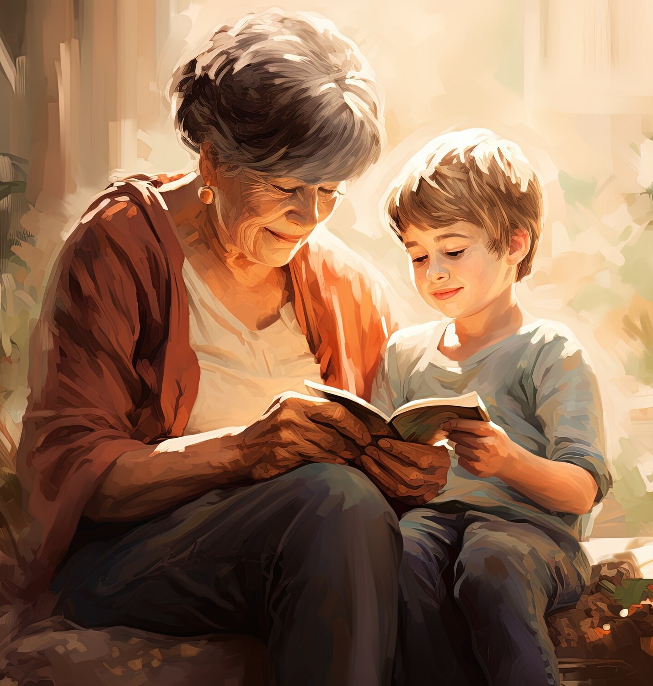
PROMOTING LITERACY AND LEARNING
Intergenerational book trading enhances and encourages a passion for reading across
generations. It also facilitates the transfer of
cultural wisdom, enriching the learning experience.
and

Slide 6



CHALLENGES AND SOLUTIONS
While intergenerational book trading oﬀers numerous benefits, it also presents challenges such as access and logistics. Solutions include establishing
and leveraging digital platforms for wider reach and accessibility.

Slide 7

PLATFORM FEATURES
The Book Bridge Website will oﬀer a user-friendly interface for seniors and juniors to connect, share book recommendations, and engage in meaningful discussions. It will also provide curated reading lists and virtual book clubs for diverse age groups.

Slide 8




ENGAGING THE COMMUNITY
Involving the community in book trading initiatives fosters a sense of
and
. By organizing and workshops,
communities can actively participate in sustainable knowledge exchange.

Slide 9





MEASURING IMPACT
Measuring the impact of intergenerational book trading involves assessing factors such as ,
, and the
. These metrics help evaluate the success of sustainable knowledge exchange.

Slide 10

CONCLUSION
In conclusion, Sustainable Knowledge Exchange through intergenerational book trading oﬀers a unique opportunity to enhance learning and promote . By fostering connections and sharing knowledge across generations, we can create a more enriched and inclusive learning environment.

Slide 11
Thanks!

