Slide 1
CLASH OF THE CLAWS | TECH MANAGEMENT, SRI-B
FinClaw AI
AI that stops you from spending before it's too late
Karthik Maiya | Ruthwik Bhargav | Vishal B | Dhanaraj

Slide 2
IDEA
Problem Statement
Theme Selected
The Problem
GenAI Research & Productivity (on-device intervention)
Digital spending is too effortless, leading to impulse buying. Tracking expenses post-purchase is a tedious, manual chore.
Target Persona
Why It's Important
Gen-Z and Millennials who frequently use Quick Commerce apps, struggle with financial discipline, and abandon traditional budgeting apps due to manual entry fatigue.
The modern purchase experience is intentionally optimized against the consumer, and maintaining financial awareness requires too much friction.
FinClaw AI 🦞 — OpenClaw Hackathon 2025

Slide 3
IDEA
Current Solution & Gaps
Existing Solutions
What's Missing / Broken
The Opportunity
Traditional expense trackers, banking apps, and manual spreadsheets.
They are entirely reactive and require manual data entry. They cannot detect intent before a purchase, nor can they automatically parse natural language or physical receipts effortlessly.
A unified AI ecosystem that provides proactive intervention at checkout AND effortless automated tracking post-purchase.
FinClaw AI 🦞 | OpenClaw Hackathon 2025

Slide 4
IDEA
Our Solutions
The FinClaw Ecosystem—a two-pronged autonomous financial guardian powered by OpenClaw
Solution 1: Proactive
An Android Accessibility service that watches checkout screens, reads product and amount data, and intervenes before impulsive spending happens.
Solution 2: Reactive/Analytical
A personalized Telegram Bot linked to Actual Budget that logs expenses via natural language, performs Receipt OCR, and answers budget queries dynamically.
Key Features:
Real-time checkout detection
Emotional AI warnings
Tesseract-powered Receipt OCR
Conversational financial insights
FinClaw AI 🦞 | OpenClaw Hackathon 2025

Slide 5

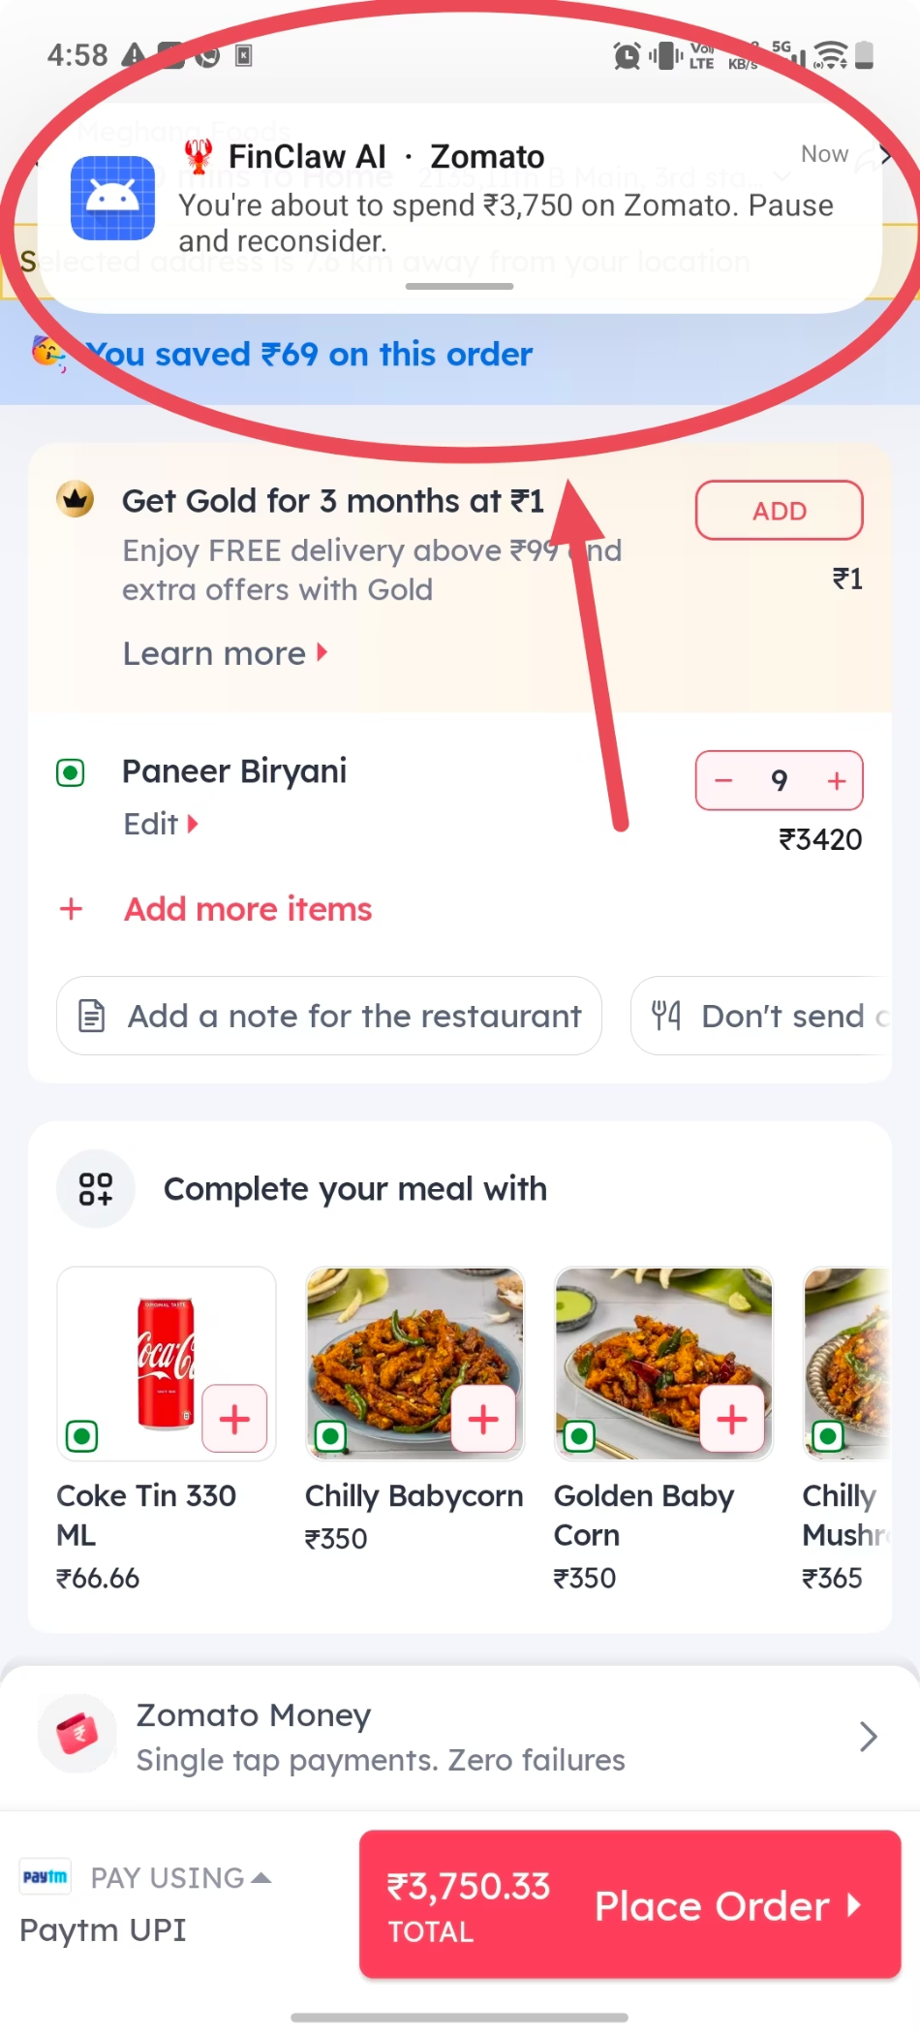
IDEA
Demo/Product Walkthrough
Screen/Flow: User opens Swiggy → reaches checkout → AccessibilityService detects payment UI → Flask backend receives product + amount → OpenClaw reasons via Groq → Android shows warning notification or fullscreen overlay
How User Interacts: Mid-checkout, app reads screen, extracts "BK Veg Pizza Puff — ₹407", sends to AI. Returns tailored warning: "You've spent ₹1,200 on food this week. Skip this?"
Key Moments: Notification shown for ₹407 food order (normal). Fullscreen impulse overlay triggered for ₹16,990 iPhone purchase. Dashboard pie chart auto-updates with new transaction category.

Slide 6
IDEA
Tech & Architecture
Frontend / Intervention Layer
Bot & Tracking Layer
AI & Backend
Node.js, Telegram Bot API, Actual Budget API, Tesseract.js (for OCR)
Python, Flask, Groq API (fast LLM inference)
Kotlin, Jetpack Compose, Android AccessibilityService
Orchestration
OpenClaw workspace manages agent behavior, budget metadata skills, and intelligent categorization fallbacks
FinClaw AI 🦞 | OpenClaw Hackathon 2025

Slide 7
IDEA
Impact & Use cases
Real-Life Scenarios:
College student on Zomato at midnight — app flags ₹407 Peri Peri Fries as 4th food order this week
Professional on Flipkart during flash sale — fullscreen overlay for ₹16,990 iPhone 15 Pro Max
Amazon one-click purchase — detects ₹4,500 shoes and categorizes as Shopping with warning
Quick-commerce impulse buy — Blinkit ₹1,200 detergent + snacks flagged as over daily utility budget
Scale Potential: Works on any Android app with checkout UI. Extensible to any quick-commerce, food delivery, or e-commerce platform. Can serve millions of users who make daily impulse purchases.
FinClaw AI 🦞 | OpenClaw Hackathon 2025

Slide 8
IDEA
Differentiation
Why FinClaw Stands Out
MOAT 1 — Screen-Level AI Awareness
MOAT 2 — Emotionally Intelligent LLM Intervention
Every existing finance app is reactive — it records history. FinClaw is proactive — it observes intent in real-time and acts before money is spent. This is the fundamental behavioral shift.
Uses Android AccessibilityService to read live checkout UI — no API integrations, no bank access needed. Works on any app that renders checkout text.
OpenClaw + Groq generate context-aware, emotionally resonant warnings — not generic alerts. The AI understands what you are buying, when, and why it might be impulsive.
In business, a moat is a sustainable competitive advantage that protects a company from competitors and helps maintain long-term profitability.

Slide 9
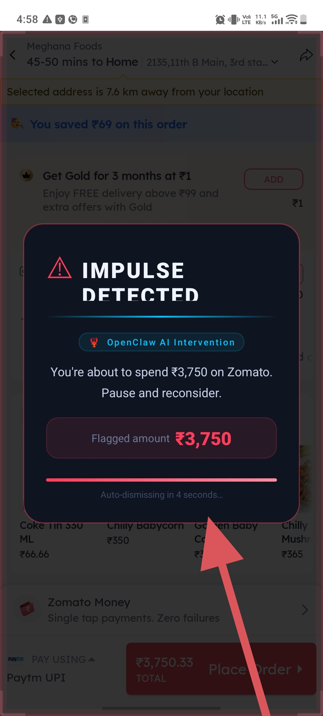
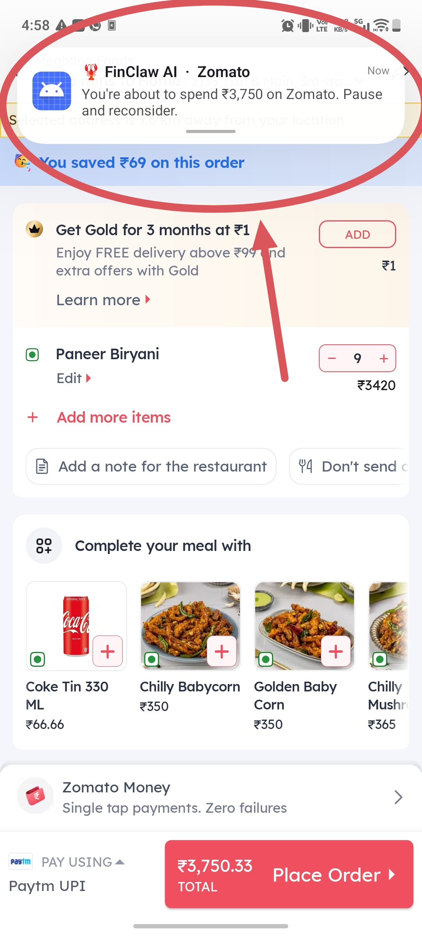
IDEA
Demo Link
GitHub Repo: github.com/KarthikMaiya/FinClaw
Demo Flow:
1. Open dashboard → 2. Open Swiggy/Amazon → 3. Reach checkout → 4. Show detected amount + product → 5. OpenClaw reasoning in backend → 6. Android notification → 7. Fullscreen overlay → 8. Dashboard update
Document Submitted: README + Architecture + Demo Screenshots included in submission.

Slide 10

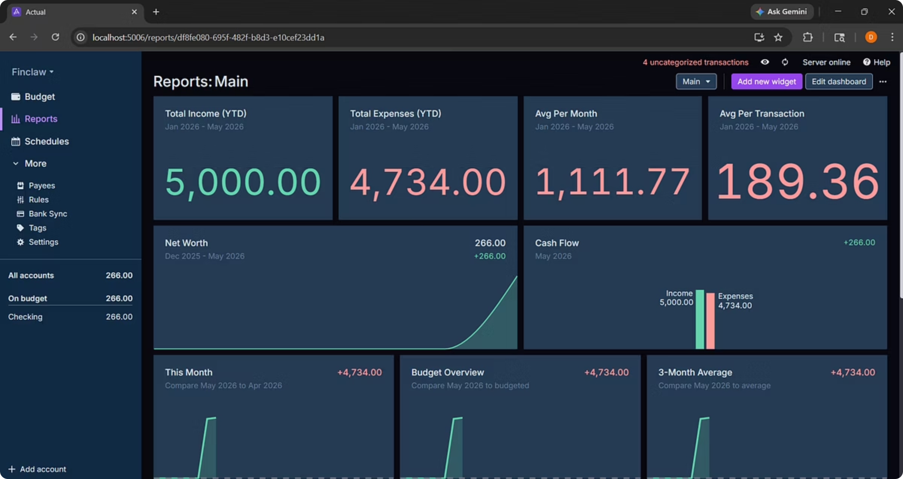
Visualization
Dashboard pie charts
Spending analytics
Category breakdowns

Slide 11
IDEA
Future Roadmap & Extensibility
📱 User-defined budget input screen with monthly spending limits per category
🧠 Emotional spending history analysis — AI detects patterns like late-night food orders or sale-triggered electronics sprees
📊 Live dashboard with pie charts, weekly summaries, category-wise spending reports
🗣️ Voice-based AI intervention — spoken warning before purchase is confirmed
☁️ Cloud sync + multi-device support for households tracking shared budgets

