Slide 1
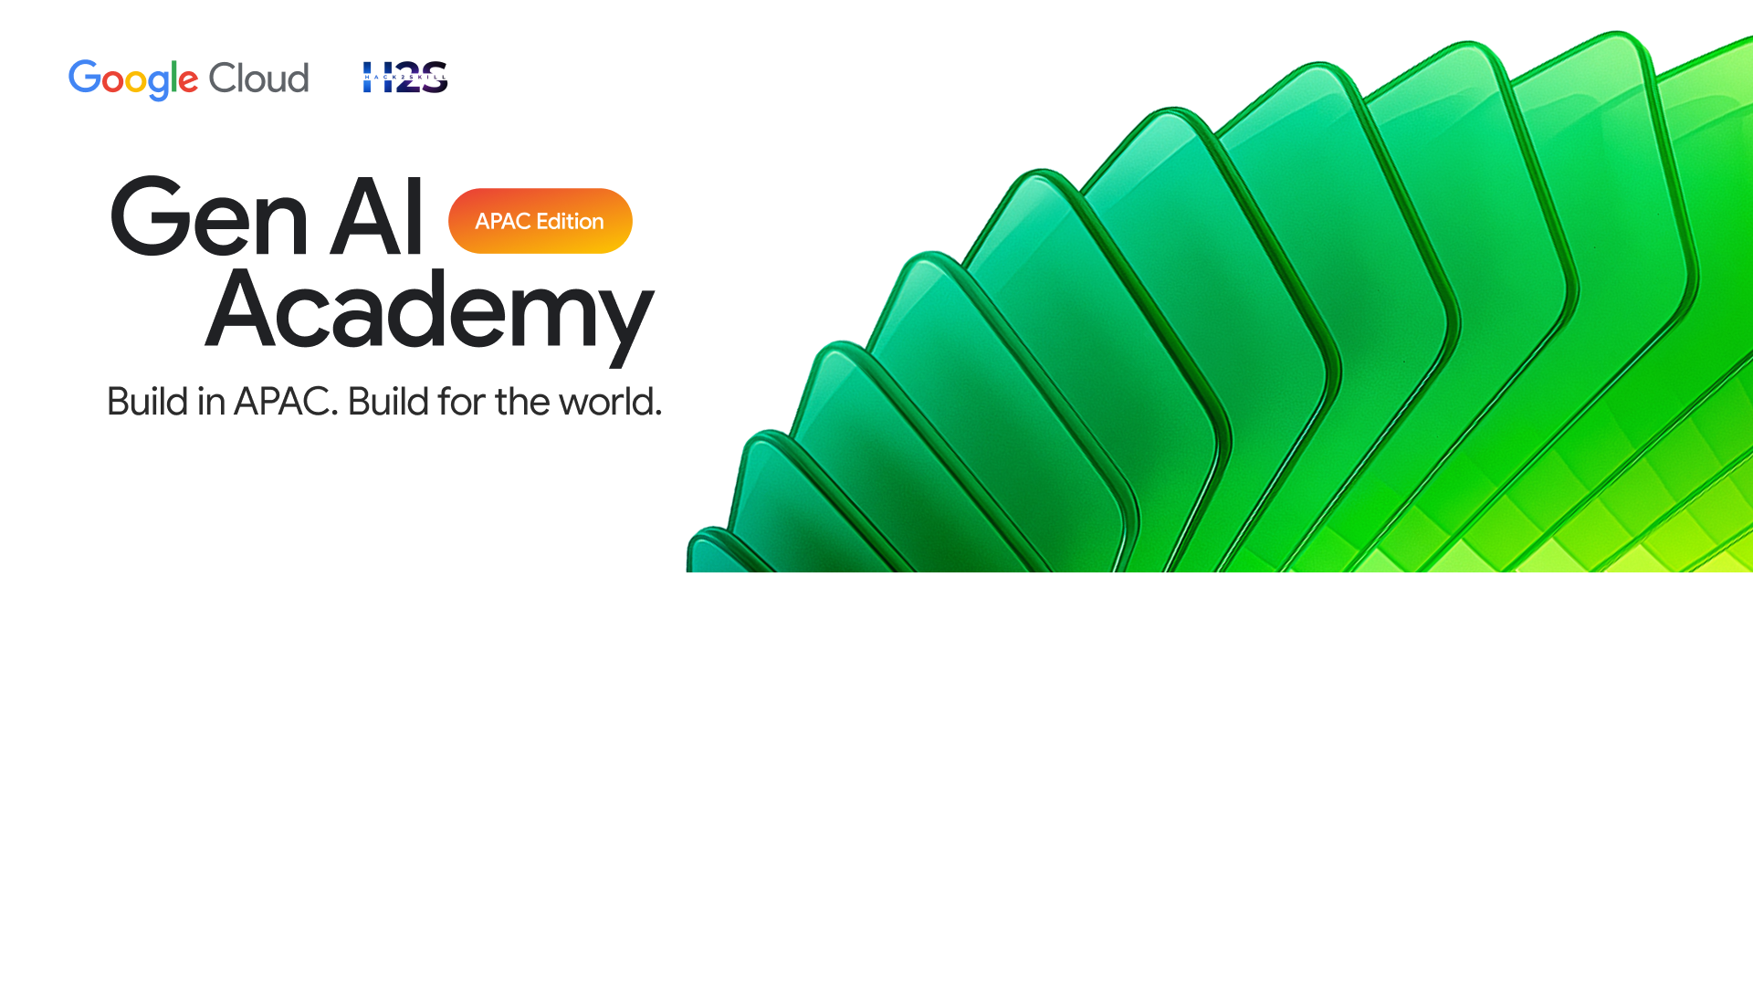
Participant Details
The Problem
Name: Karthik Mothiki
Knowledge workers switch tools 300+ times per day — toggling between Calendar, Notion, email, and chat while coordination cost compounds silently. Most AI tools only watch one app at a time, solving a slice while the rest of the workday fractures. Sūtradhāra reclaims the whole day.
Role: Senior Robotics Engineer — AI & Embedded Systems
Submission: Sūtradhāra — AI Productivity OS
Track: Gen AI Academy APAC Challenge
Cross-tool · Reversible · Learning

Slide 2
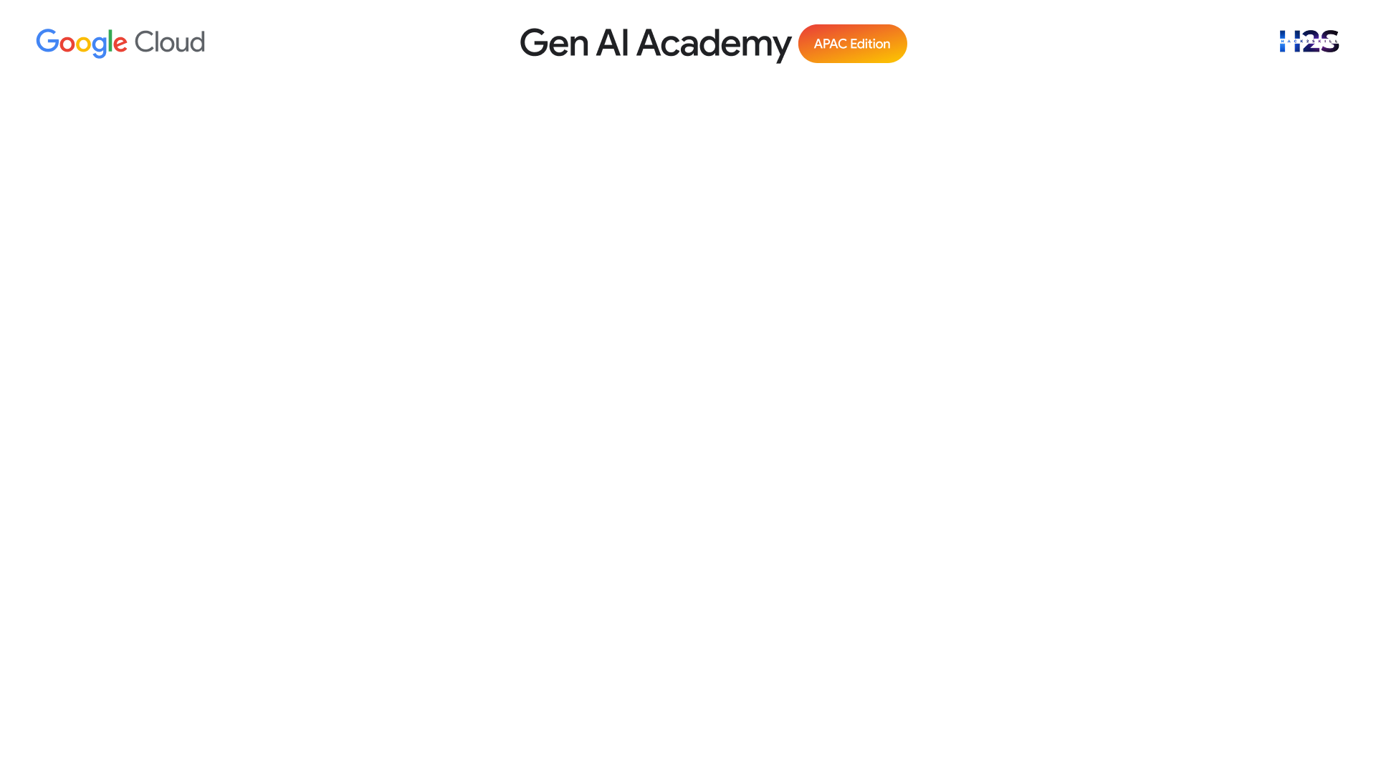
Sūtradhāra
Cross-Tool, Reversible AI Productivity Orchestrator — 7 Specialist Agent Roles, One Workday
"My calendar said one thing. My tasks said another. My Sequoia call started in five minutes and no single tool could see both."
The Core Idea
Google ADK sequential-crew pattern: root Manager orchestrates 6 specialist sub-agents — Calendar, Notion, Planner, Focus, Anticipator, Research. 15 registered tools span Calendar (5), Notion (5), research (2), rollback (3). Every write is staged as a PendingAction — 0 silent writes.
The Manager
The Anticipator
Research Specialist
Chief of Staff
Proactive Auditor
Web Intelligence
High-agency, proactive AI executive assistant. Orchestrates the user's workflow with foresight — routes intent to the right specialist instantly.
Scans upcoming 24–48 hours. Identifies meeting conflicts, missing context, productivity risks — without being asked.
Gathers real-time info via Google Search + web scraping. Synthesises into executive reports with citations, surfaced through Manager.
Cross-tool intelligence · Reversible by design · Every action staged — so nothing surprises you

Slide 3
The Solution
How we approached the problem — ADK + MCP architecture, real-world impact, and workflow mechanics
Q1: Approach & Tech Stack
Q2: Impact & Problem Solving
Q3: Workflow & Mechanics
Google ADK sequential-crew pattern with 7 agent roles. 15 registered tools: Calendar (5), Notion (5), research (2), rollback (3). Data layer: 5 production SQLAlchemy models — PendingAction, ActionLog, UserPreference, MemoryEntry, DashboardAlert — backed by SQLite/Cloud SQL. Primary model: gemini-2.5-flash with 2-model fallback chain.
Solves the space between apps — the calendar conflict that nobody linked to the investor call. Impact Panel calculates value live: (conflicts × 15) + (tasks × 5) = minutes reclaimed. 9 APScheduler background jobs run proactively: Daily Briefing 08:00, Meeting Prep every 15 min, Conflict Detection every 30 min, Proactive Audit every 4 hours.
Every request: POST /api/v1/query → Manager → specialist → tool → write intent detected → PendingAction created (status: staged) → DraftCard on Canvas via WebSocket. User clicks Approve → write executes → ActionLog records reversible snapshot. Undo: RollbackService reverses Calendar delete/patch or Notion archive/patch. No other system can undo what its AI did.
ADK · 15 MCP tools · gemini-2.5-flash · Cloud Run — orchestrating the full workday, not just one corner of it.

Slide 4
Opportunities
"The only AI productivity system that works across your entire workday — not just one corner of it."
How is it different?
Demo Scenario — Daily Briefing
Dimension | Single-App Tools | Sūtradhāra
Tool scope | One app only | Calendar + Notion + Web simultaneously
Write safety | Silent execution | 0 silent writes — all staged
Memory | Cold start | Persistent Gemini-extracted DNA
Recovery | No undo | Full rollback — Calendar + Notion
→ evt_001: Series A Partner Call — Sequoia, 09:00
→ evt_002: Engineering Standup, 09:15 ← 30-min overlap
→ "Give me my daily briefing" → Manager delegates
→ list_events called → conflict detected automatically
→ CONFLICT_RED_ZONE card rendered on Canvas
USP — Built on Trust by Design
→ Resolution staged: move evt_002 to 10:15
1
Every write is staged: PendingAction model stores proposed_payload. Both Calendar and Notion tools call create_draft() before touching any external API.
✓ User clicks Approve → Calendar patched → ActionLog written
2
Every action is reversible: RollbackService.execute_undo() covers Calendar delete/patch and Notion archive/property patch. ActionLog holds the reverse snapshot.
→ Impact Panel: 1 conflict × 15 min = 15 min reclaimed
3
Every session learns: memory_service.extract_preferences() runs a Gemini pattern-recognition pass, storing ctx_dna injected into every future session.
→ Undo available: one command reverses the patch
Context-aware · Reversible · Learning · Built for the whole workday.

Slide 5








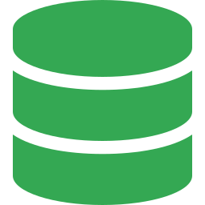
Feature Suite
9 core capabilities — the 3 anchors (positions 1, 5, 9) are features no competitor has
Draft-Approval
6-Agent ADK Crew
9 Background Jobs
Calendar & Notion
Multi-Agent Orchestration
Proactive Intelligence
Every write to Calendar or Notion is staged as a PendingAction and requires explicit approval before execution.
Root Manager routes intent across 6 specialists via Google ADK sequential-crew delegation pattern.
APScheduler runs 9 autonomous jobs — Daily Briefing 08:00 to Conflict Detection every 30 minutes.
Research Specialist
Full Undo — Cal + Notion
Token Streaming
Web Intelligence
Rollback Engine
Real-Time WebSocket
Google Search + live scraping delivers real-time intelligence, synthesised into executive reports with citations.
ActionLog stores a reversible snapshot of every approved action; RollbackService reverses on demand.
Every agent response streams token-by-token via WebSocket — rendered live in chat, no loading spinner.
Voice & Image Input
D3.js v7 Live Graph
Persistent Memory DNA
Multimodal
Interactive Workflow
Learning Loop
Browser Speech Recognition enables voice commands; Gemini Vision processes uploaded images as context.
Force-directed graph renders agent pipeline — click nodes to filter Loom logs by agent.
Gemini extracts scheduling habits after every session; ctx_dna injected into every future agent prompt.
7 specialist agent roles · 15 MCP tools · one workday — fully coordinated.

Slide 6
Process Flow
From natural language to approved, reversible action — across Calendar and Notion simultaneously
1
2
3
4
User Input
Memory Inject
Manager Routes
Specialist Acts
Voice or text command sent from Chat UI (POST /api/v1/query)
get_productivity_dna() fetches UserPreference → ctx_dna set into Manager session
Parses intent → record_thought → record_handoff → transfer_to_agent
Calls MCP tool (list_events, query_notion_database, google_search…) → result streamed
5
6
7
8
Write Staged
DraftCard
User Approves
Logged + Learns
create_event/create_notion_page → pending_actions_service.create_draft() → status: staged
emit_canvas_event(DRAFT_ACTION) via WebSocket → DraftCard with Approve/Reject rendered
POST /actions/{id}/approve → external Calendar/Notion write executes
ActionLog row with forward+reverse_data. memory_service.extract_preferences() → smarter next session
The only pipeline where Step 5 exists — staged, approved, logged, reversible. Zero silent writes.

Slide 7
Wireframe: The Loom — Live Agent Cortex
Every agent decision streamed in real time before the response arrives
THE LOOM — Live Agent Trace
THOUGHT & DELEGATION Events
THOUGHT
User wants daily briefing. Delegating to calendar_specialist...
Before the answer, the Loom streams THOUGHT and DELEGATION events in real time via trace_service. Each entry shows agent name (colour-coded) and reasoning text with typewriter animation.
DELEGATION
→ transfer_to_agent: calendar_specialist
TOOL CALL
list_events(start=today, days=1, tz=IST)
Tool Call Events
RESULT
Found 8 events. Conflict detected: evt_001 ∩ evt_002
When list_events or google_search fires, emit_tool_call() logs the tool name and input args. Judges see exactly which MCP tool is executing and with what parameters.
CANVAS
emit_canvas_event(CONFLICT_RED_ZONE)
TOOL CALL
create_event → status: staged ← PendingAction created
The DraftCard — the trust moment
DRAFT
emit_canvas_event(DRAFT_ACTION) → DraftCard rendered
Approve → POST /actions/{id}/approve → external write executes, ActionLog records snapshot. Reject → zero side effects. Reset → retry without re-running pipeline.
RESPONSE
Streaming: 'I found a conflict and staged a resolution…'
"The Loom isn't logging — it's narrating. You watch the AI think, delegate, and stop at the door waiting for your key."

Slide 8
Wireframe: Workflow Interface — D3.js v7 Interactive Graph
Live force-directed agent pipeline — not a static flowchart
WORKFLOW GRAPH — D3.js v7 Live
renderD3Workflow() — app.js L590
Force-directed graph using D3.js v7. Nodes: agents + tool-call ops + DraftCard staging. Edges show delegation direction. Supports zoom, drag, click-to-filter Loom logs.
Node-to-Action Mapping
Manager
Manager (purple) = root. Specialist nodes appear on transfer_to_agent. Tool nodes on emit_tool_call. DraftCard node (amber) = human decision required. Approved node (green) = ActionLog written.
Calendar
Research
Live, Not Static
Notion
Updates as IMPACT_UPDATE and canvas_event WebSocket messages arrive. Clicking a node calls filterLoomLogs(agentName), fading all other agents — narrable in 90 seconds.
list_events
DRAFT
google_search
Click node → filter Loom by agent
Zoom · Drag · Click-to-filter · Updates live via WebSocket
"Not a static flowchart — a live map of your workday being actively coordinated."

Slide 9
Wireframe: History & Audit Trail
Reversible by design — every action staged, logged, and undoable
ARCHIVE — Session History
Session Archive
Give me my daily briefing
Lists every Conversation row: user_query, status, source (api / scheduler:daily_briefing), created_at. Expands to WorkflowRun rows with agent_name, tool_called, input/output, duration_ms.
completed
api · 08:02 AM
Mark Q2 Metrics Deck as In Progress
completed
api · 10:14 AM
Reversible ActionLog
Research Series A funding in SaaS
completed
api · 11:30 AM
Every Approved action has ActionLog row with forward_data (what was done) + reverse_data (how to undo). POST /query/{id}/undo calls RollbackService.execute_undo() — Calendar delete/patch + Notion archive/patch.
Daily Briefing Job
completed
scheduler:daily_briefing · 08:00 AM
PendingAction Status Badges:
Enterprise Closing Argument
Pending
Approved
Rejected
Reset
"If Sūtradhāra made a mistake, you can undo it. No other AI assistant in this competition can say that." The full trust loop: Approve → Log → Undo.
Reset: retry a rejected action without re-running the pipeline — no competitor exposes this.
Approved. Logged. Reversible. Every action, every time.

Slide 10
Architecture Diagram
From voice command to approved, reversible write — 7 agent roles, 15 MCP tools, 0 silent actions
Frontend — Presentation
Three-column OS: Command (chat + voice + image) · Theater (DraftCards, conflicts) · Loom (live trace + D3 workflow graph). SpeechRecognition + FileReader API for multimodal input.
1
Vanilla JS · D3.js v7 · Mermaid v11 · WebSocket
Core Backend — Orchestration
18 API routes + 1 WebSocket endpoint. ADK Runner with InMemorySessionService. Manager wires 6 sub-agents. run_async() streams partial events via trace_service.emit_response_chunk().
2
Python 3.12 · FastAPI ≥0.115.0 · Google ADK ≥1.0.0
Integration Layer — MCP Tools
Calendar (5): list_events, create_event, update_event, delete_event, find_free_slots. Notion (5): query/create/update/search/read. Research (2): google_search, scrape_website. Rollback (3). RULE: every write tool returns {status:staged}.
3
15 registered tools across 3 domains
Data & Intelligence — Persistence
11 models. Core 5: PendingAction, ActionLog, UserPreference, MemoryEntry, DashboardAlert. After every query: extract_preferences() upserts UserPreference → ctx_dna injected next session.
4
SQLAlchemy ≥2.0 · aiosqlite/asyncpg · Gemini pattern recognition
Cloud Run — Deployment
Service: sutradhara-backend. 9 APScheduler background jobs run serverlessly. DEMO_MODE auto-activates via K_SERVICE env var — full experience without credentials.
5
Docker python:3.12-slim · Google Cloud Run · us-central1
Modular by design — every new integration is a new tool function, not a code change. Every write requires human approval. Every action can be undone.

Slide 11
Technologies Used
Every choice traces back to the same principle: the user controls what the AI does
Framework
Google ADK ≥1.0.0
Protocol
MCP ≥1.0.0
ADK Runner + InMemorySessionService powers 7-role, 11-instance crew. transfer_to_agent delegation enables cross-tool coordination — Calendar, Notion, Research in one session without context loss.
15 Python function bridges as MCP tools. Critical decision: every write-class tool calls pending_actions_service.create_draft() → returns {status: staged}. MCP enforces human-in-the-loop at tool boundary.
Model
gemini-2.5-flash
Backend
Python 3.12 + FastAPI ≥0.115.0
Primary model for all 11 agent instances. Silent second use: memory_service.extract_preferences() calls Gemini after every session — extracts CATEGORY|KEY|VALUE|CONFIDENCE patterns into UserPreference rows.
18 REST routes + 1 WebSocket endpoint. run_async() ADK loop feeds emit_response_chunk() for token streaming. AsyncIOScheduler runs 9 proactive background jobs on the same event loop.
Container
Docker python:3.12-slim
Platform
Google Cloud Run
Reproducibility is critical for 15 tool functions bridging two external APIs, persistent SQLite/PostgreSQL, and 9 scheduler jobs — container ensures identical known state on every deployment.
Deployed to us-central1 as sutradhara-backend via deploy_cloudrun.sh. Hosts WebSocket streaming + APScheduler jobs + Gemini API. DEMO_MODE auto-activates via K_SERVICE env detection.
7 agent roles · 15 tools · 11 SQLAlchemy models · 0 silent writes. This is what full-stack AI orchestration looks like.

Slide 12
Prototype Snapshot 1 — Command Center
One natural language command. Six agents activate. The Loom fills before the response arrives.
[Screenshot placeholder — insert prototype screenshot here]
Chat Input
Canvas (Theater)
Loom Trace
Impact Panel
Natural language or voice command, both supported
Staged DraftCards, Calendar data, Notion tasks — nothing auto-executed
Every agent decision live — THOUGHT and DELEGATION before the answer
(conflicts × 15) + (tasks × 5) = minutes reclaimed, live

Slide 13
Prototype Snapshot 2 — The Loom Trace
Agent delegation chain streams live — Manager hands to Calendar Specialist before the final word appears.
[Screenshot placeholder — insert prototype screenshot here]
THOUGHT Event
Tool Call
DraftCard Trigger
Streaming Text
Manager routes to calendar_specialist — reasoning visible before response
list_events executing — date range, timezone, result count all logged
No silent write — create_event returned {status:staged}, not a write
Token-by-token response — emit_response_chunk fires per ADK event part

Slide 14
Prototype Snapshot 3 — Stage, Approve, Undo
Approve: Calendar updates. Reject: nothing changes. Undo: the update reverses. All three in 90 seconds.
[Screenshot placeholder — insert prototype screenshot here]
Approve Button
Reject Button
ActionLog Entry
Undo Command
One click — POST /actions/{id}/approve — Calendar patch executes, ActionLog records
Zero side effects — PendingAction status set to rejected, API never called
forward_data + reverse_data in one row, recorded automatically
POST /query/{id}/undo — RollbackService.execute_undo() reverses the patch

Slide 15
Prototype Snapshot 4 — Proactive Intelligence
Before you asked, it found the conflict. Before you asked, it prepared the meeting brief.
[Screenshot placeholder — insert prototype screenshot here]
Proactive Alert
Conflict Card
Memory Context
Research Card
conflict_detection_job fires every 30 minutes autonomously — no user prompt
Series A Call overlaps Engineering Standup 09:15 — 30-min overlap detected
ctx_dna injected from UserPreference rows extracted by Gemini
google_search → scrape_website → synthesis into executive report

Slide 16
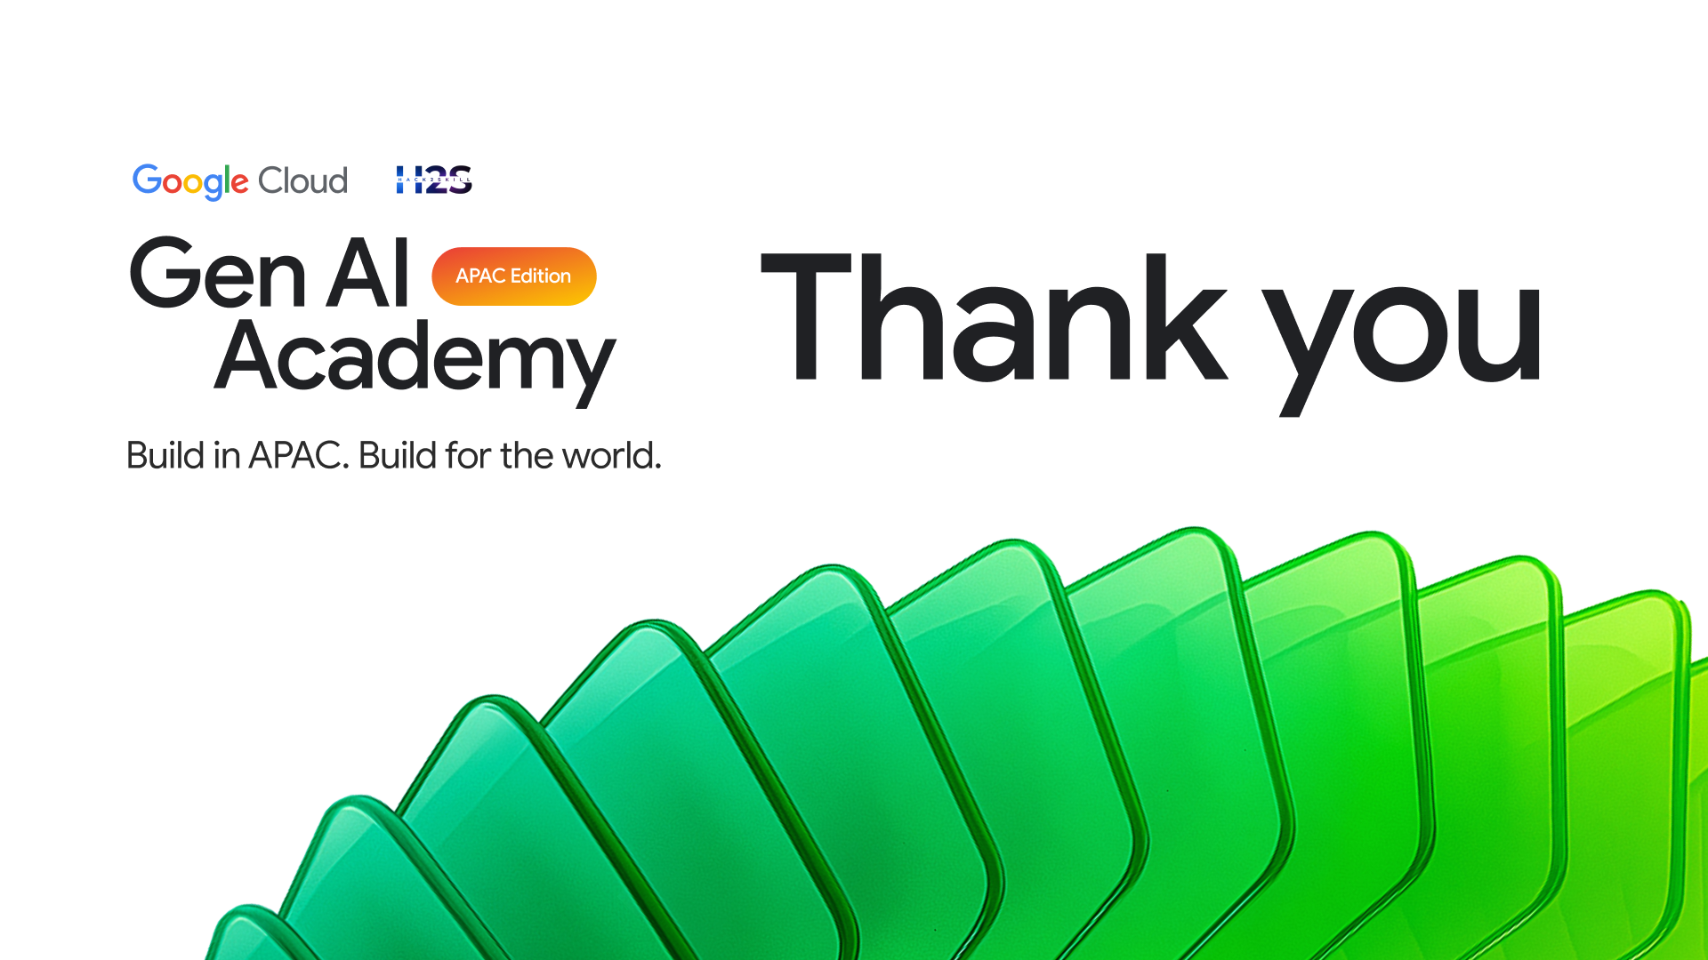
The coordination tax across tools is real.
Cross-tool orchestration. Every write staged. Every action reversible.
7 agent roles. 15 tools. Zero silent writes.
7
15
9
0
Agent Roles
MCP Tools
Background Jobs
Silent Writes
Deployed on Google Cloud Run · Click Demo Mode for full experience without credentials
https://sutradhara-backend-[hash]-uc.a.run.app

