Slide 1

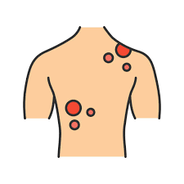
SKIN CANCER CLASSIFICATION
NEIL GOGTE INSTITUTE OF TECHNOLOGY
Kachavanisingaram Village, Hyderabad, Telangana 500058.
DEPARTMENT OF CSE(AIML)
PRESENTED BY :-
ANUMALLA KARTHIKEYAN 245321748006
ACHYUTUNI LAKSHMAN ANIRUDH 245321748004
BEERLA VARSHITH 245321748013
UNDER THE GUIDANCE OF:-
Mr PAREPALLI NAGESHWARA RAO
ASSISTANT PROFESSOR

Slide 2
TABLE OF CONTENTS
INTRODUCTION
EXISTING SYSTEM
PROPOSED SYSTEM
OPERATING ENVIRONMENT
FUNCTIONAL REQUIREMENTS
SYSTEM DESIGN
RESULTS
CONCLUSION
REFERENCES

Slide 3
INTRODUCTION
Skin cancer poses a significant global health burden, with early detection being pivotal for successful treatment outcomes.
Manual diagnosis of skin lesions is prone to subjectivity and inconsistency.
Leveraging Convolutional Neural Networks (CNNs) offers a promising solution to enhance the accuracy and efficiency of skin cancer classification.
This presentation explores the transformative potential of CNNs in revolutionizing skin cancer diagnosis, ultimately saving lives and improving patient care.

Slide 4
EXISTING SYSTEM
DermAID: Developed by researchers at Stanford University, DermAID uses CNNs to classify skin lesions with high accuracy, aiding dermatologists in diagnosis.
SkinVision: An AI-powered mobile application that employs CNNs to analyze photos of skin lesions, providing users with instant risk assessments and recommendations for further action.
MoleMapper: Developed by researchers at Oregon Health & Science University, MoleMapper utilizes CNNs to track changes in skin lesions over time, assisting in the early detection of melanoma.

Slide 5
LIMITATIONS
Due to the usage of ML algorithms , the accuracy of predictions of model is very low compared to the other classification models.
The cancer types which the existing systems are using are relatively low.

Slide 6
PROPOSED SYSTEM
We are trying to develop a User-Friendly UI, where the user can upload image of the skin(up to 200MB in size) and can predict the type of cancer.
Relatively, low number of earlier models have provided with such a feature.
In this model we are using Skin Cancer ISIC dataset for classification of images.
Using EffientNetB0 pretrained model based on Convolutional Neural Network (CNN) algorithm, we would be getting better results in terms of accuracy.

Slide 7
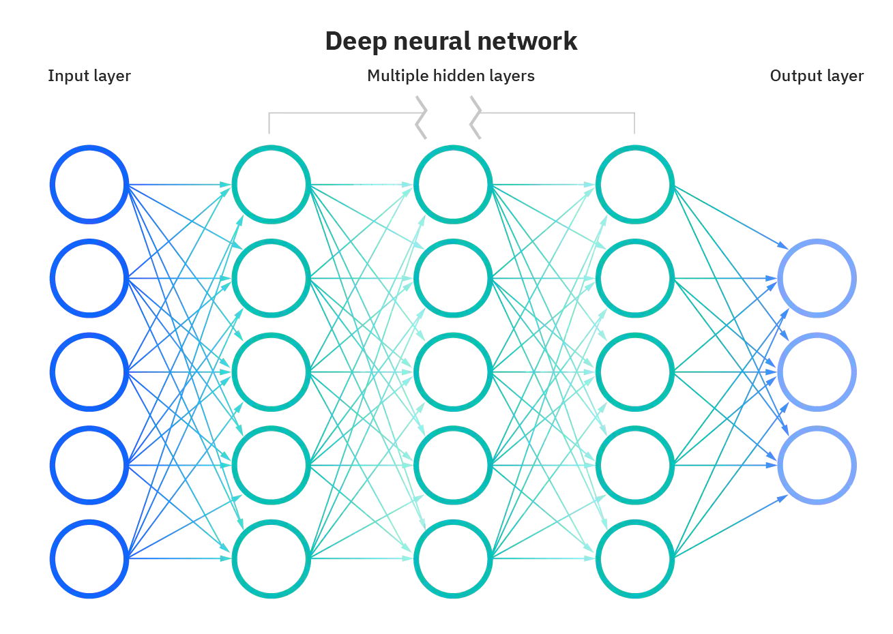

Slide 8
ADVANTAGES OF PROPOSED SYSTEM
This system can predict up to 9 different types of Skin Cancer.
Instead of Machine Learning, we are implementing Deep Learning.
Unlike ML, accuracy of DL algorithm increases as data is increased. Hence making this project future-ready.
DL handles big data or heavy data better than ML.
The usage of Skin Cancer ISIC results in better accuracy and classification which was missing in previous systems.
Compared to previous models, we are developing a better UI(User Interface).

Slide 9
OPERATING ENVIRONMENT
Software Requirements:
Operating System : Windows 11
Front End : Streamlit
Back End : Python
Hardware Requirements:
Processor : Intel Pentium® Dual Core Processor (Min)
Speed : 2.9 GHz (Min)
RAM : 2 GB (Min)
Hard Disk : 2 GB (Min)

Slide 10
FUNCTIONAL REQUIREMENTS
User Functionality:
The user will be able to upload images regarding the Cancer types he/she wants to find.
The user will be able to insert images up to 200MB in size as mentioned before.
Admin Functionality:
The admin manages the website.
The admin can make changes to the website such as modifying the UI and making it more interactive than earlier.
The admin can implement a better algorithm if at all a better algorithm is created in near future.

Slide 11
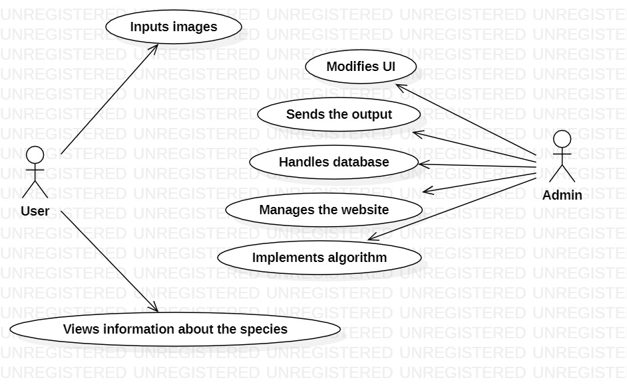
SYSTEM DESIGN
USE CASE DIAGRAM:

Slide 12
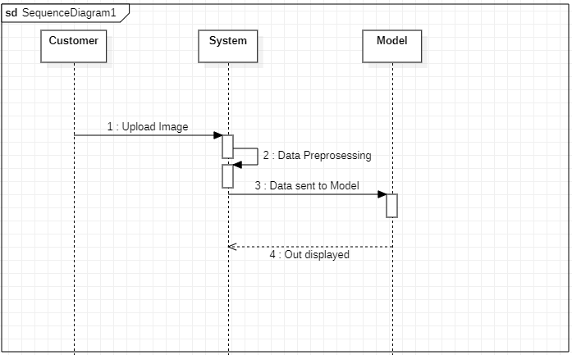
SEQUENCE DIAGRAM:

Slide 13
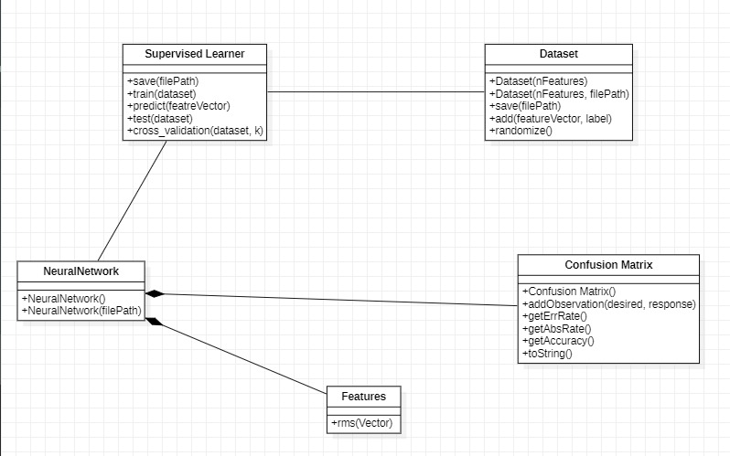
CLASS DIAGRAM:

Slide 14
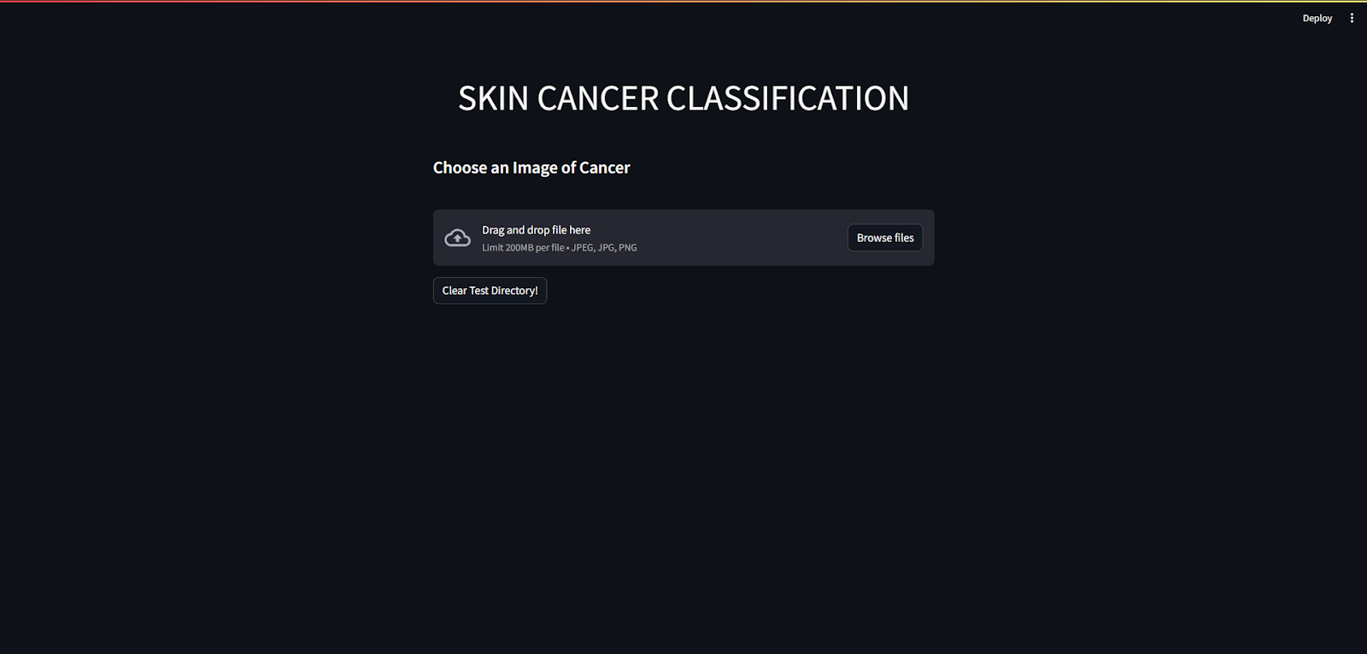
RESULTS
WEB APPLICATION HOME PAGE

Slide 15
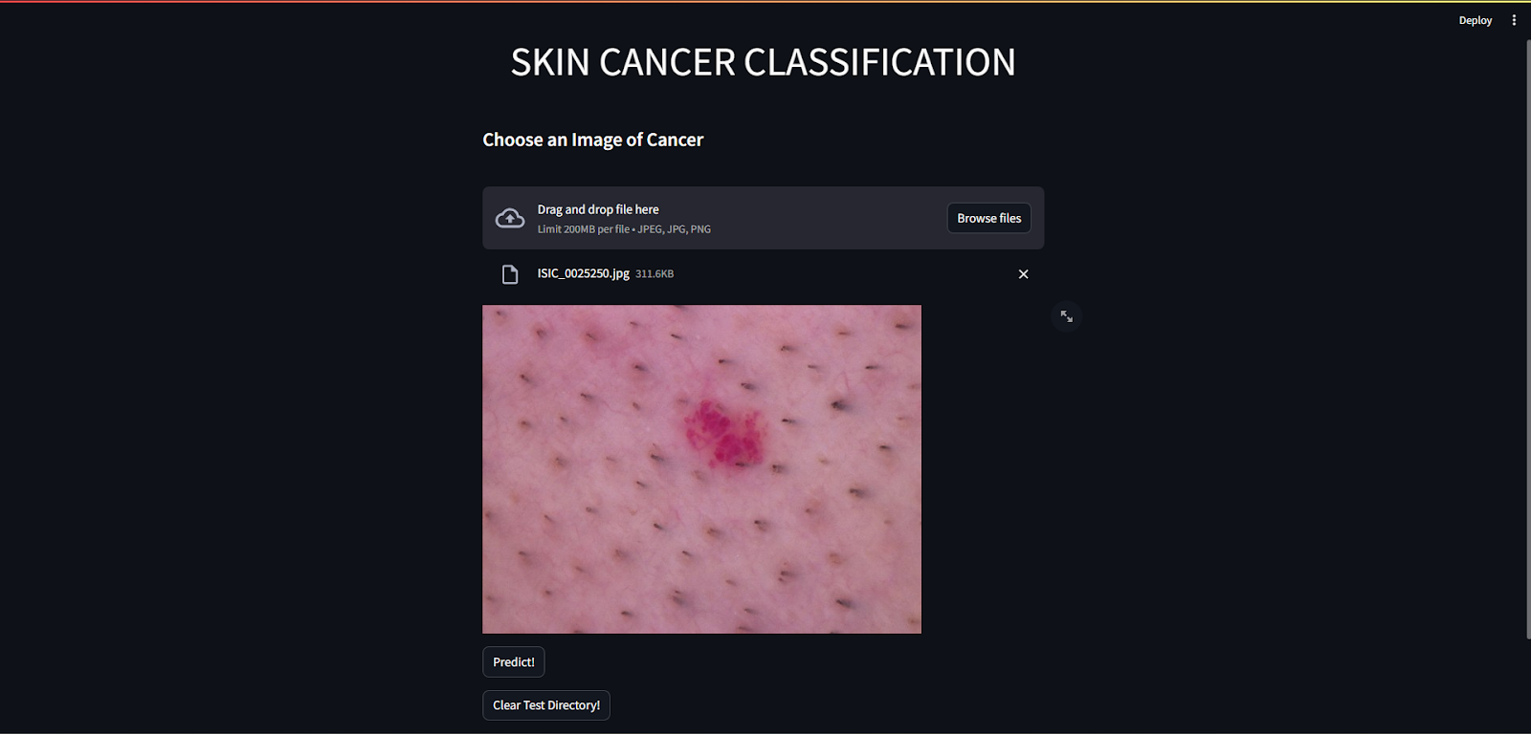
APPLICATION PREDICTING “Vascular Lesion”

Slide 16
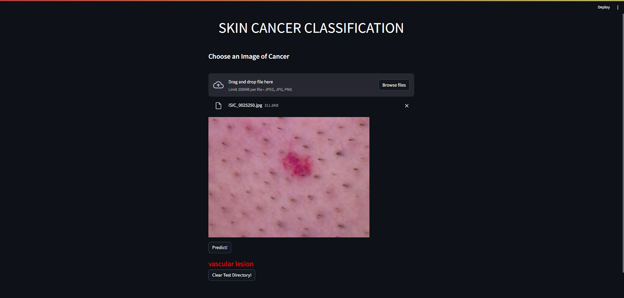
APPLICATION PREDICTING “Vascular Lesion”

Slide 17
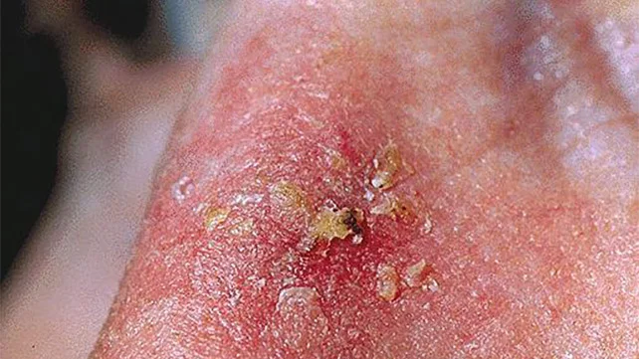
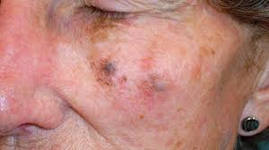
Conclusion: AI-driven skin cancer detection enhances early diagnosis, aiding healthcare professionals and improving patient outcomes .challenges like ethical considerations must be addressed for responsible deployment Future Scope: The future involves multi model approaches, explainable AI, personalized medicine, global accessibility, and real time monitoring ,fostering collaboration between AI systems and healthcare professionals

Slide 18
Thank You!!!

