Slide 1


IMAGE BASED BIRD SPECIES IDENTIFICATION
NEIL GOGTE INSTITUTE OF TECHNOLOGY
Kachavanisingaram Village, Hyderabad, Telangana 500058.
DEPARTMENT OF CSE(AIML)
PRESENTED BY :-
KARTHIK P. 245320748039
SRIMANTH M. 245320748045
T. SHYAMPREETH 245320748051
UNDER THE GUIDANCE OF:-
Mrs. M. Deepika
ASSISTANT PROFESSOR

Slide 2
TABLE OF CONTENTS
INTRODUCTION
EXISTING SYSTEM
PROPOSED SYSTEM
OPERATING ENVIRONMENT
FUNCTIONAL REQUIREMENTS
SYSTEM DESIGN
RESULTS
CONCLUSION
REFERENCES

Slide 3
INTRODUCTION
This problem is not only challenging but also its solution is applicable to other classification problems .
Ultimately, we found bird species to be most interesting class to experiment with, due to their immense diversity. Also, due to increasing deforestation, some species may go extinct, and this algorithm may help us identify them if they are found again.
We are trying to build a model using deep learning algorithms and image processing to predict the species of birds among the 450 species of birds by taking their image as input.
We use transfer learning to build a model that recognizes up to 450 different bird species.

Slide 4
EXISTING SYSTEM
Most of the existing models deal with MACHINE LEARNING (ML) algorithms , because of which the model is highly dependent on the size of data.
There’s an example of the existing system mentioned in the reference page.

Slide 5
LIMITATIONS
Due to the usage of ML algorithms , the accuracy of predictions of model is very low compared to the other classification models.
The number of species which the existing systems are using are relatively low.

Slide 6
PROPOSED SYSTEM
We are trying to develop a User-Friendly UI, where the user can upload image of the bird(up to 200MB in size) and can predict the type of bird species. Relatively, low number of earlier models have provided with such a feature.
In this model we are using VGG16 for classification of images.
As VGG16 is a convolutional neural network (CNN) algorithm, we would be getting better results in terms of accuracy.

Slide 7
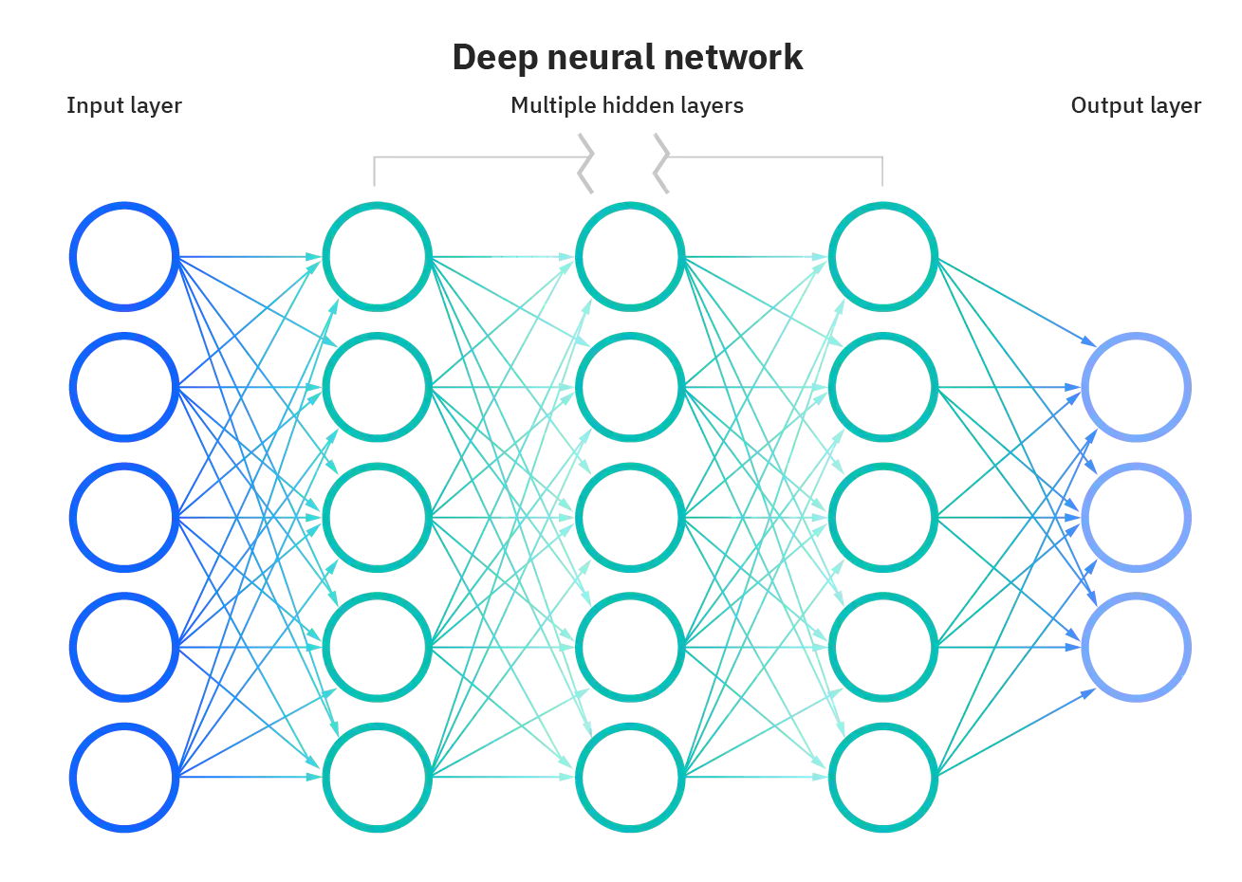

Slide 8
ADVANTAGES OF PROPOSED SYSTEM
This system can predict up to 450 different species of birds.
Instead of Machine Learning, we are implementing Deep Learning.
Unlike ML, accuracy of DL algorithm increases as data is increased. Hence making this project future-ready.
DL handles big data or heavy data better than ML.
The usage of VGG16 results in better accuracy and classification which was missing in previous systems.
Compared to previous models, we are developing a better UI(User Interface).

Slide 9
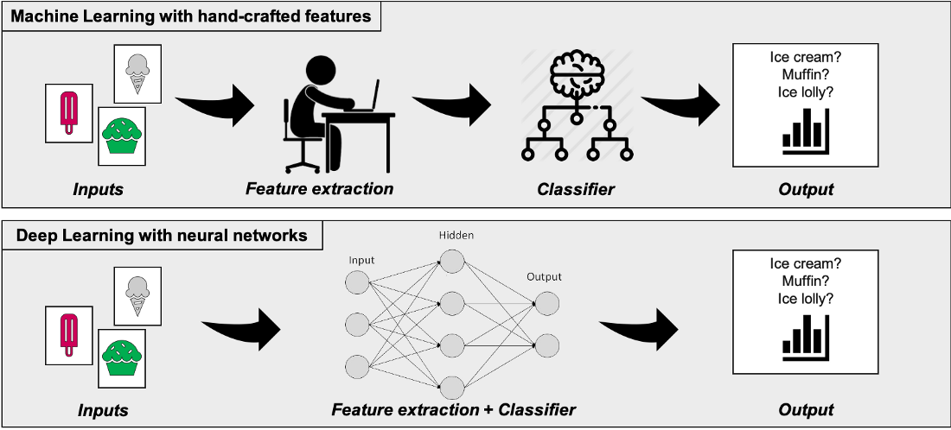
DIFFERENCES

Slide 10
OPERATING ENVIRONMENT
Software Requirements:
Operating System : Windows 7 (Min)
Front End : Streamlit
Back End : Python
Database : File System
Hardware Requirements:
Processor : Intel Pentium® Dual Core Processor (Min)
Speed : 2.9 GHz (Min)
RAM : 2 GB (Min)
Hard Disk : 2 GB (Min)

Slide 11
FUNCTIONAL REQUIREMENTS
User Functionality:
The user will be able to upload images regarding the species he/she wants to find.
The user will be able to insert images up to 200MB in size as mentioned before.
Admin Functionality:
The admin manages the website.
The admin can increase database size.
The admin can make changes to the website such as modifying the UI and making it more interactive than earlier.
The admin can implement a better algorithm if at all a better algorithm is created in near future.

Slide 12
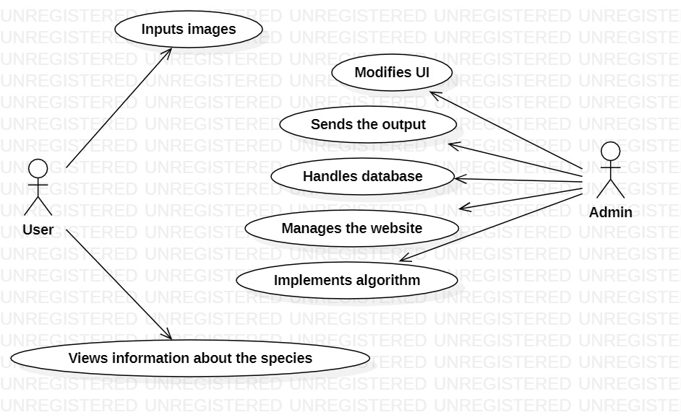
USE CASE DIAGRAM:
SYSTEM DESIGN

Slide 13
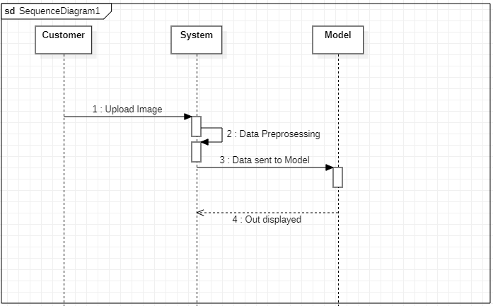
SEQUENCE DIAGRAM:

Slide 14
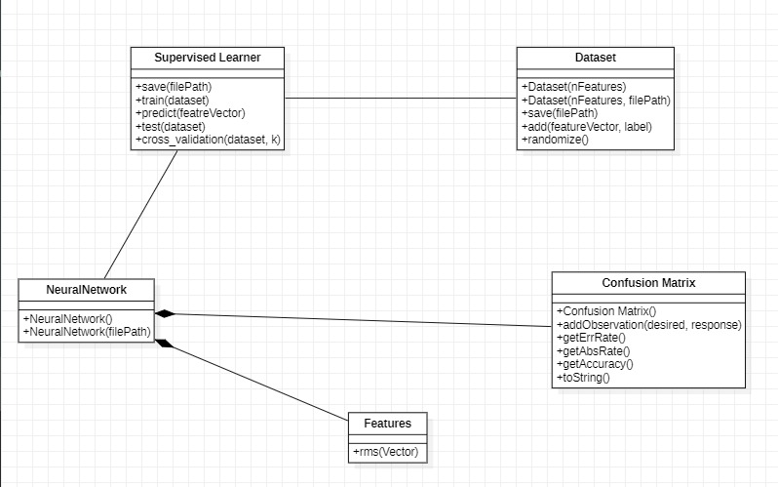
CLASS DIAGRAM:

Slide 15
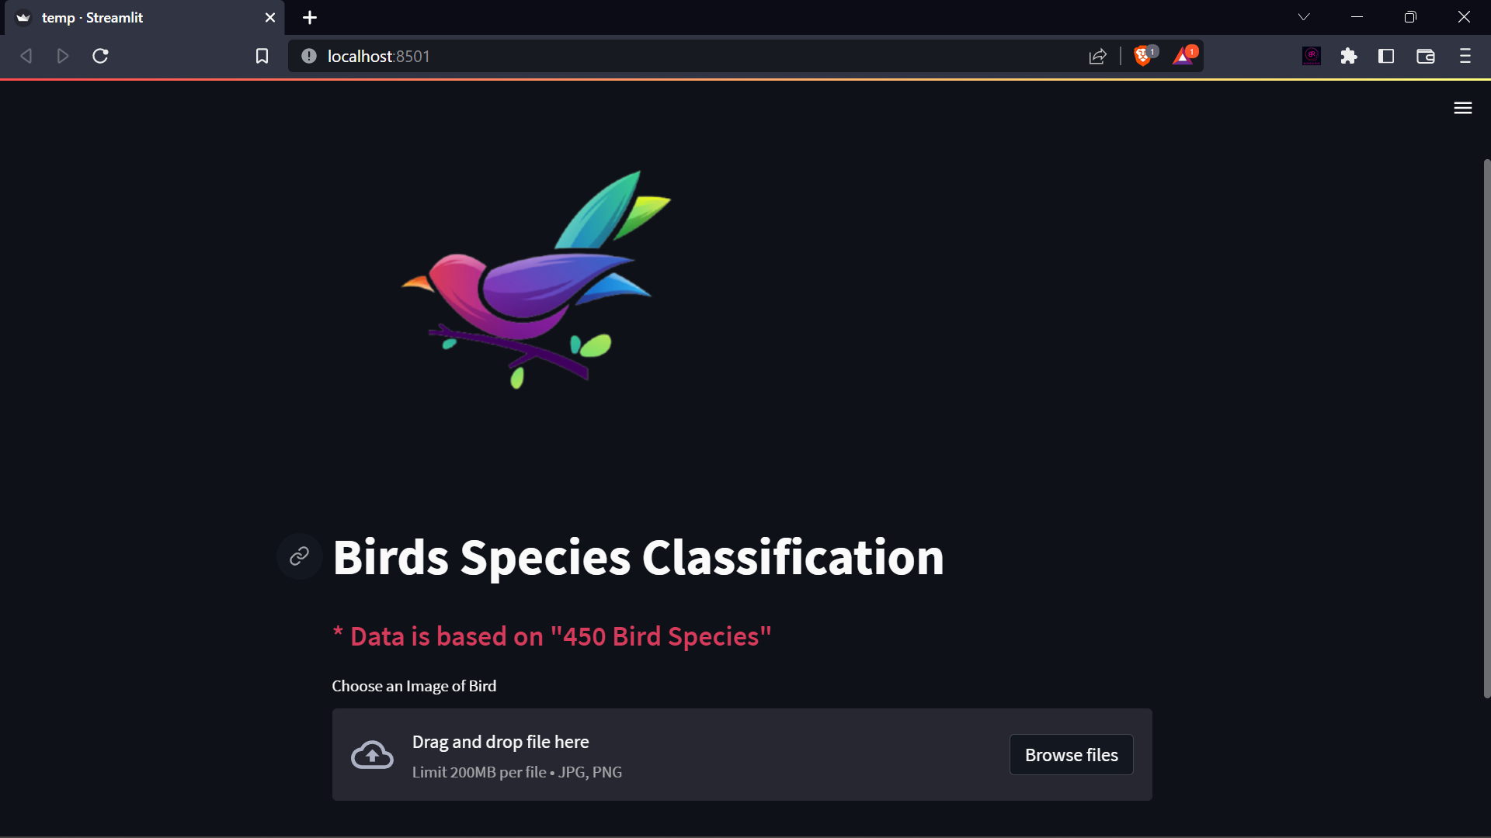
RESULTS
WEB APPLICATION HOME PAGE

Slide 16
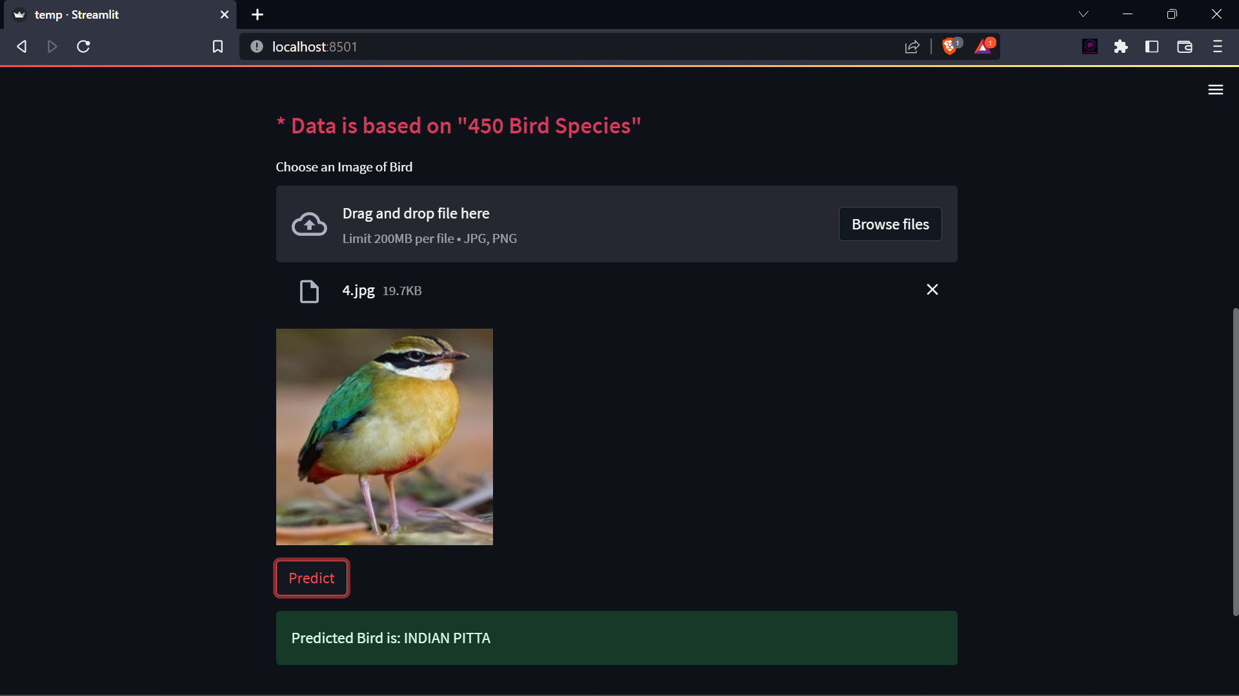
APPLICATION PREDICTING “INDIAN PITTA”

Slide 17
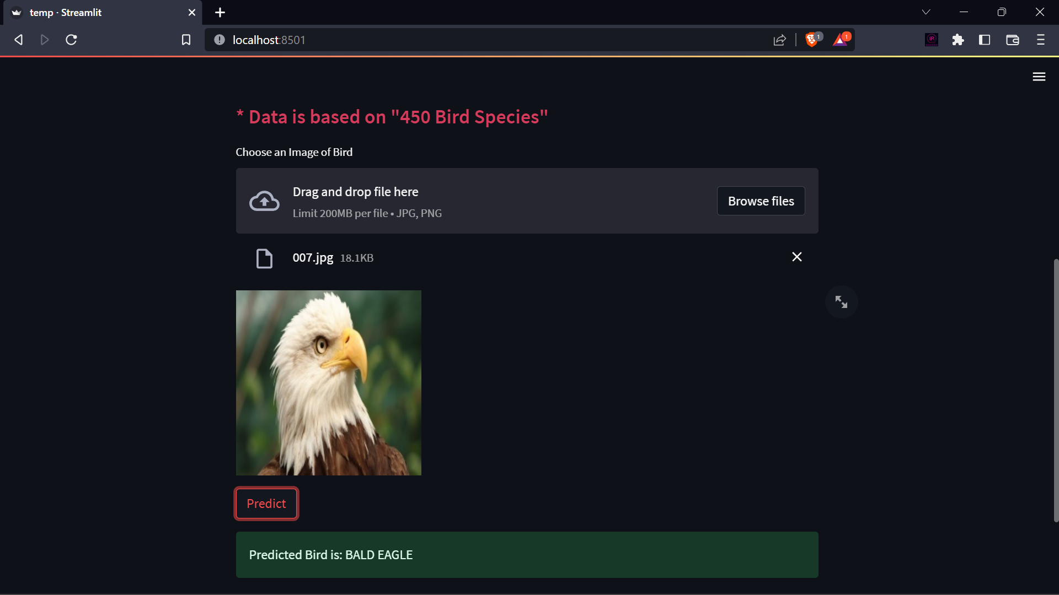
APPLICATION PREDICTING “BALD EAGLE”

Slide 18
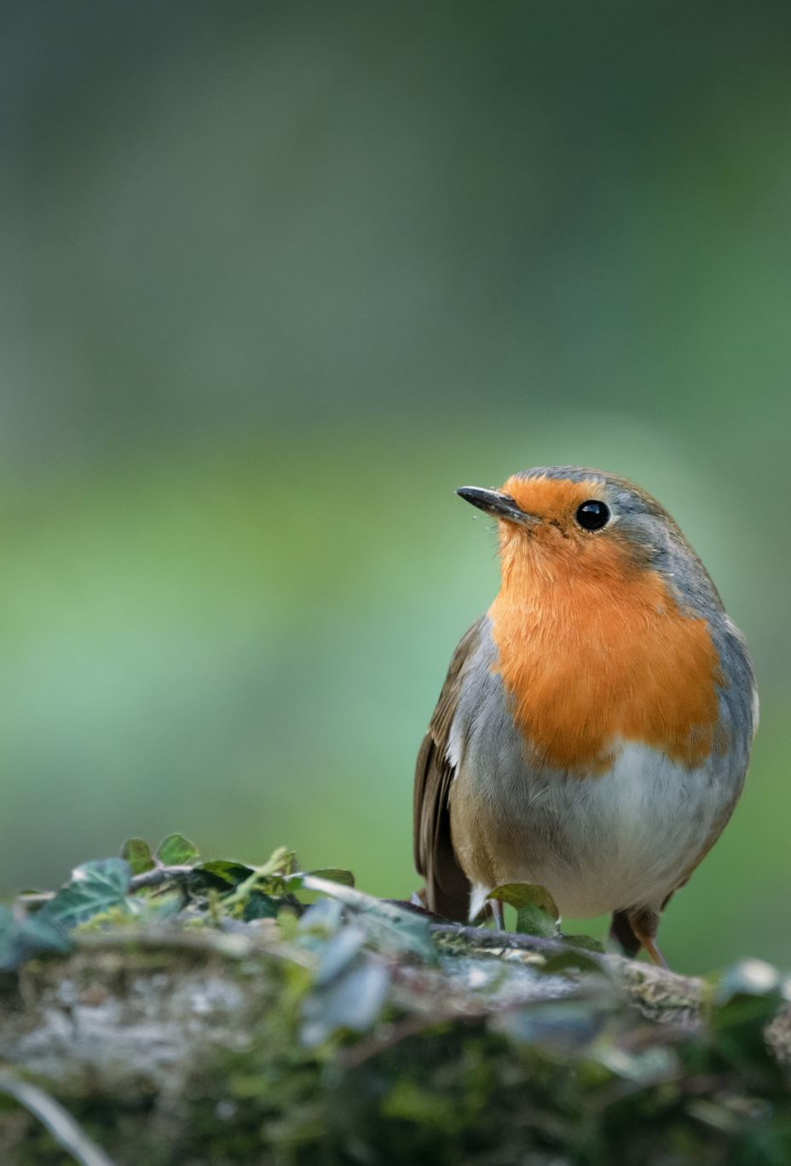
CONCLUSION AND FUTURE SCOPE
The main idea behind developing the “Bird Species Identification” website is to build awareness regarding different species of birds. It also caters to the need of simplifying the bird identification process and thus making birdwatching or species identification much easier
This application is not a complete model as it has room for improvement as and when requirements appear soon. One of the major reasons why we chose this subject is, since deforestation is happening rapidly, certain species of birds may go extinct, if at all such situation appears, this application is useful in identifying such species if they were to be still alive

Slide 19
REFERENCES:
Existing System:
https://towardsdatascience.com/bird-species-classification-with-machine-learning-914cbc0590b
Proposed System:
https://www.kaggle.com/code/vencerlanz09/bird-classification-using-cnn-mobilenetv2
Datasets:
https://www.kaggle.com/datasets/gpiosenka/100-bird-species
CNN:
https://towardsdatascience.com/a-comprehensive-guide-to-convolutional-neural-networks-the-eli5-way-3bd2b1164a53

Slide 20
Thank You!!!

