Slide 1






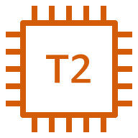

AWS Cloud
VPC-1 (us-east-1) 10.0.0.0/16
VPC-2 (ap-southeast-1) 172.0.0.0/16
IGW2-VPC2
IGW1-VPC1
internet
SUBNET1-VPC1
10.0.1.0/24
SUBNET1-VPC1
172.0.1.0/24
v
EC2
EC2
SG1-VPC1
Security group
rules
Ssh
All traffic
SG2-VPC2
Security group
rules
Ssh
All traffic
Instance1-vpc1
Instance2-vpc2
route table1-vpc1 route table2-vpc2
Destination Target
Destination Target
10.0.0.0/16 local
172.0.0.0/16 local
0.0.0.0/0 IGW1-VPC1
0.0.0.0/0 IGW1-VPC1
172.0.0.0/16 PCX1
10.0.0.0/16 PCX1
PCX1

