Slide 1
Shopify Winter Internship 2019
Project Presentation

Slide 2
Reasons for choosing MedAccess for presentation
Favorite Academic Project
Leading a group – aware and accommodative
Swam new waters
TDD, Agile and Design Patterns

Slide 3
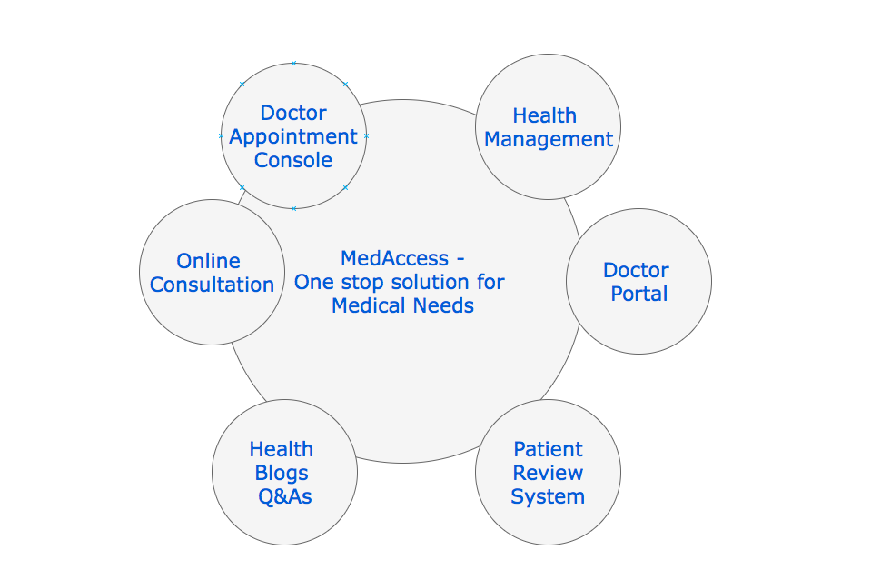
Vision

Slide 4
Objectives
Initial Survey and feasibility study.
Protocol testing
Working Prototype
Technical Debt and Review
Scope for Enhancement

Slide 5
Technologies Used
Front End Framework Angular 6 with HTML and CSS
Bank End Framework Spring Boot REST API
Version Control GitHub
Testing Tools Mokito, JUnit
Database MySQL
Host Server Heroku
CI Jenkins
Collaboration Trello, Slack

Slide 6
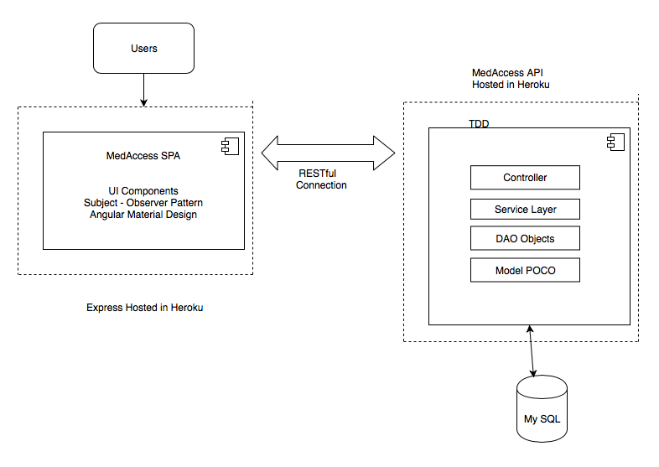
Application Architecture

Slide 7
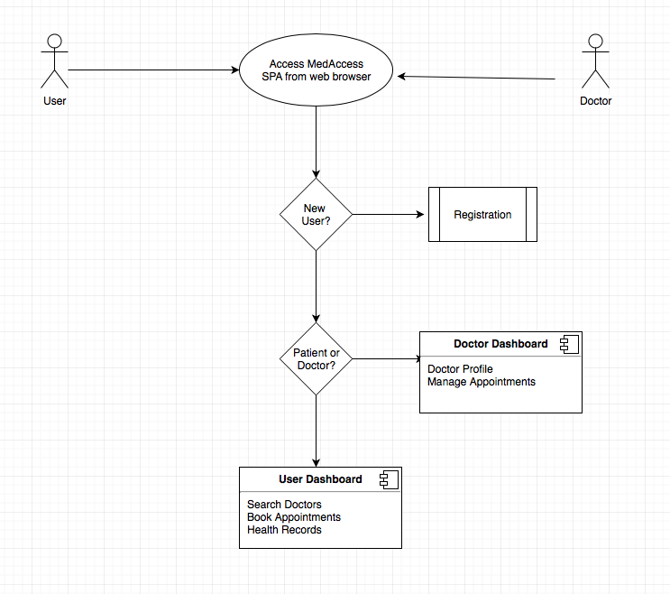
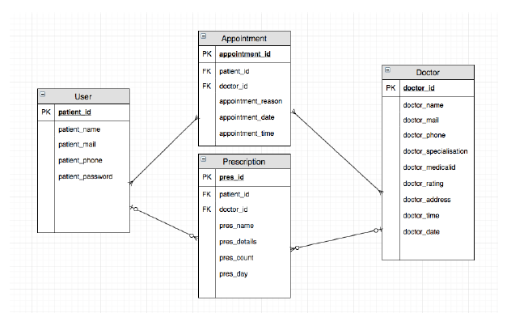
Process Flow

Slide 8
Roles and Responsibilities
Scrum Master
Setting up the project skeleton
Appointment Booking, Registration, Search doctor, Dashboard modules.
Configurable Business Logic
Hosting in Heroku

Slide 9
Code Walkthrough

Slide 10
Scope for Improvement
Repository Pattern
Authentication
Reduce coupling
Online chat
Design Patterns
Code First approach

