Slide 1

CRYPTOCURRENCY FORECASTING
2010030329 SIVA KARTHIK REDDY
2010030051 E.R SUMANTH
2010030341 K.SNEHITH

Slide 2
TABLE OF CONTENTS
INTRODUCTION
PROBLEM STATEMENT
PROBLEM DOMAIN
MOTIVATION
OBJECTIVES
LITERATURE SURVEY
DATASET
TECHNIQUES
CONCLUSION
REFRENCES

Slide 3
PROBLEM STATEMENT
Trading in cryptocurrency (digital currencies, ICOs, tokens) is trading in a lot of uncertainty and different variables need to be kept in mind as compared to trading in fiat currencies. Fiat currencies generally are less volatility compared to cryptocurrencies. Traders who have traded in other markets like Stocks and Commodities have repeatedly mentioned that the cryptocurrency market is the most unpredictable place in the world right now. The forecasting of cryptocurrency comes under domain of “TIME SERIES ANALYSIS”.

Slide 4
PROBLEM DOMAIN
Time series analysis is a specific way of analyzing a sequence of data points collected over an interval of time. In time series analysis, analysts record data points at consistent intervals over a set period of time rather than just recording the data points intermittently or randomly. What sets time series data apart from other data is that the analysis can show how variables change over time.. It provides an additional source of information and a set order of dependencies between the data. Time series analysis typically requires a large number of data points to ensure consistency and reliability. An extensive data set ensures you have a representative sample size and that analysis can cut through noisy data.. Additionally, time series data can be used for forecasting—predicting future data based on historical data.

Slide 5
MOTIVATION
Due to more people have rapidly moving towards crypto market due to its security and compatibility for the new changing era while some people believe that crypto can the future of the money flow while some people cannot trust crypto currencies because its new method and which may change the current form of money which many people are adopted and because of that crypto market is always unstable so that’s why we want to develop a project using AI in timeseries domain which can forecast the crypto currencies value .

Slide 6
OBJECTIVES
Forecasting of the prices of cryptocurrencies.
Analysing the past data and using various models to predict the prices of crypto currencies

Slide 7
LITERATURE SURVEY
Sno | AUTHOR | TITLE | PUBLICATION | DATASET/ ALGORTHIM | CONCLUSION
1 | Rama k.malladi,Praksh deeriya | "Time Series Analysis of Cryptocurrency Returns and Volatilities" | RESEARCHGATE | ARMAX,GARCH,VAR | In this report prediction of cryptocurrency is done using ARMAX,GARC,VAR models
2 | Ioannis E. Livieris , Niki Kiriakidou , Stavros Stavroyiannis and Panagiotis Pintelas | An Advanced CNN-LSTM Model for Cryptocurrency Forecasting | MDPI | CNN-LSTM | In this report prediction was done using cnn-lstm model

Slide 8
sno | author | title | publications | Dataset/ algorithms | conclusion
3 | Do-Hyung Kwon, Ju-Bong Kim, Ju-Sung Heo, Chan-Myung Kim, and Youn-Hee Han | Time Series Classification of Cryptocurrency Price Trend Based on a Recurrent LSTM Neural Network | JOURNAL OF INFORMATION PRESSING SYSTEMS | LSTM | In this report prediction of crypto currencies is done using LSTM model
4 | Nashirah Abu Bakar1 , Sofian Rosbi2 | ARIMA Model for Forecasting Cryptocurrency Exchange Rate in High Volatility Environment: A New Insight of Bitcoin | International Journal of Advanced Engineering Research and Science (IJAERS) | ARIMA | This report shows the prediction of bitcoin using ARIMA model

Slide 9
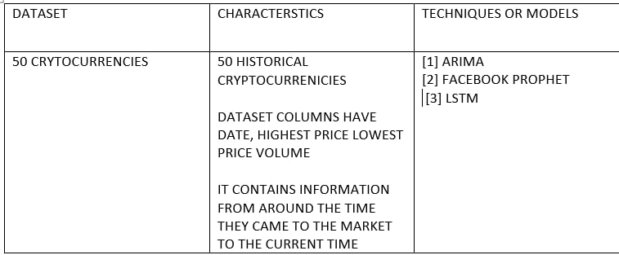
DATASET

Slide 10
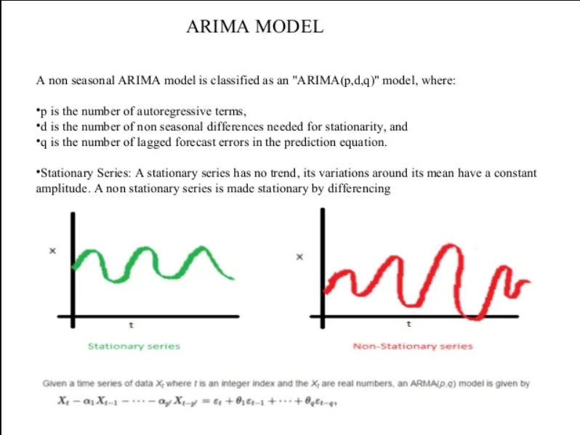
TECHNIQUES
ARIMA(Autoregressive integrated moving average):
An autoregressive integrated moving average – ARIMA model is a generalization of a simple autoregressive moving average – ARMA model. Both of these models are used to forecast or predict future points in the time-series data. ARIMA is a form of regression analysis that indicates the strength of a dependent variable relative to other changing variables.

Slide 11

FACEBOOK PROPHET:
Prophet is a procedure for forecasting time series data based on a additive model .It works best with Time-series that have strong seasonal effects and several seasons of historical data prophet is robust to missing data and shifts in the trend and typically handles outliers well.

Slide 12
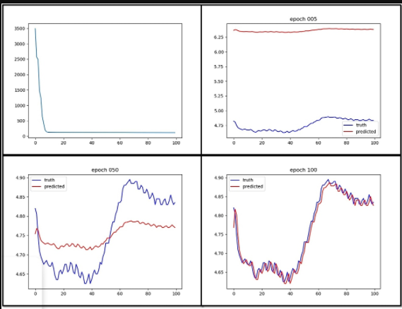
LSTM
The expression long short-term refers to the fact that LSTM is a model for the short-term memory which can last for a long period of time. An LSTM is well-suited to classify, process and predict time series given time lags of unknown size and duration between important events. LSTMs were developed to deal with the exploding and vanishing gradient problem when training traditional RNNs. Relative insensitivity to gap length gives an advantage to LSTM over alternative RNNs, hidden Markov models and other sequence learning methods in numerous applications.

Slide 13
CONCLUSION
Crypto currency Forecasting is a important process in recent days due to many people are
interested in cryptocurrency and also many people cannot trust it properly due to this the
crypto market is unstable and having cryptocurrency forecasting can help us to estimate market
rates and invest and trade in it properly.

Slide 14
REFRENCES
[1] Olufunke G. Darley, *, Abayomi I. O. Yussuff, Adetokunbo A. Adenowo: Price Analysis and Forecasting for Bitcoin Using Auto Regressive Integrated Moving Average Model
https://sciendo.com/pdf/10.2478/ast-2021-0009
[2] Murat AKDAĞ1 & Hatıra SADEGHZADEH: EFFECT OF MONETARY GROWTHIN USA ON SELECTED ASSETS: S&P500, GOLD & BITCOIN ESTIMATES WITH FACEBOOK PROPHET
[3] Ioannis E. Livieris 1,* ,Niki Kiriakidou 2 , Stavros Stavroyiannis 3 and Panagiotis Pintelas 1:An Advanced CNN-LSTM Model for Cryptocurrency Forecasting
https://www.mdpi.com/2079-9292/10/3/287

