Slide 1

CRYPTOCURRENCY FORECASTING
2010030329 SIVA KARTHIK REDDY
2010030051 E.R SUMANTH
2010030341 K.SNEHITH

Slide 2
ABSTRACT
Trading in cryptocurrency (digital currencies, ICOs, tokens) is trading in a lot of uncertainty and different variables need to be kept in mind as compared to trading in fiat currencies. Fiat currencies generally are less volatility compared to cryptocurrencies. Traders who have traded in other markets like Stocks and Commodities have repeatedly mentioned that the cryptocurrency market is the most unpredictable place in the world right now. The forecasting of cryptocurrency comes under domain of “TIME SERIES ANALYSIS”.

Slide 3
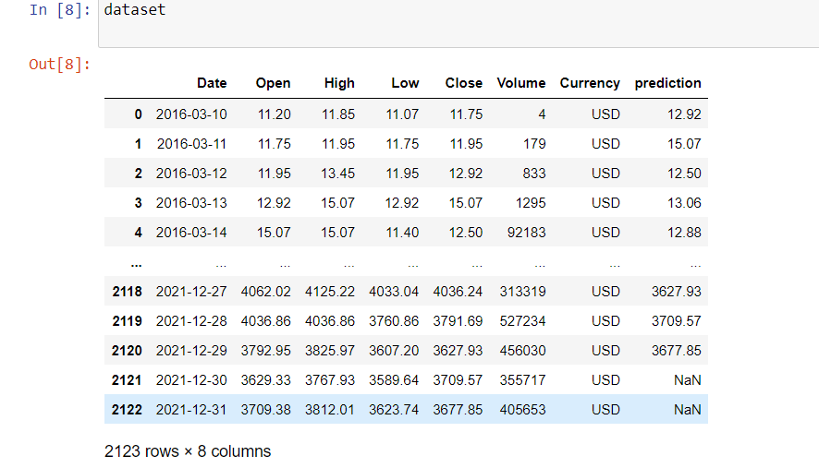
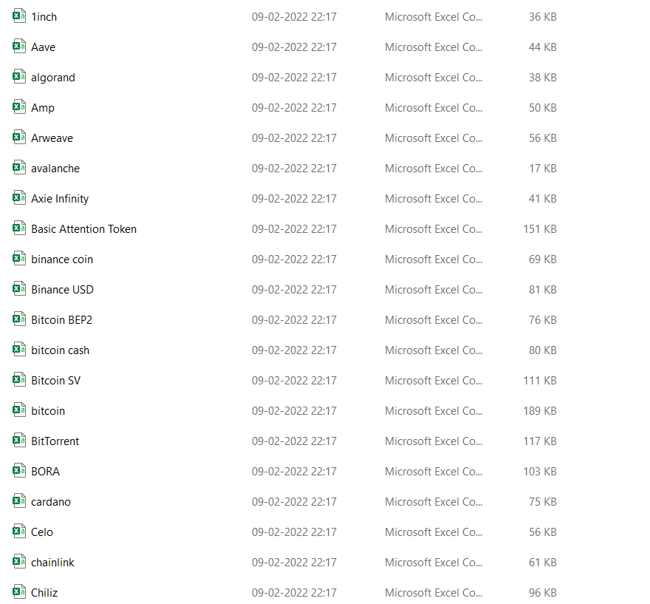
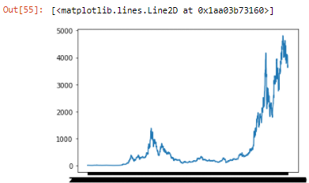
FLOWCHART
MODEL
PREPROCESSING
LSTM MODEL AND GRAPHICAL DATA
LSTM FORECASTING USING DENSE TWO LAYERED NEURAL NETWORKS
MODEL EVALUATION
WORKING PROTYPE

Slide 4
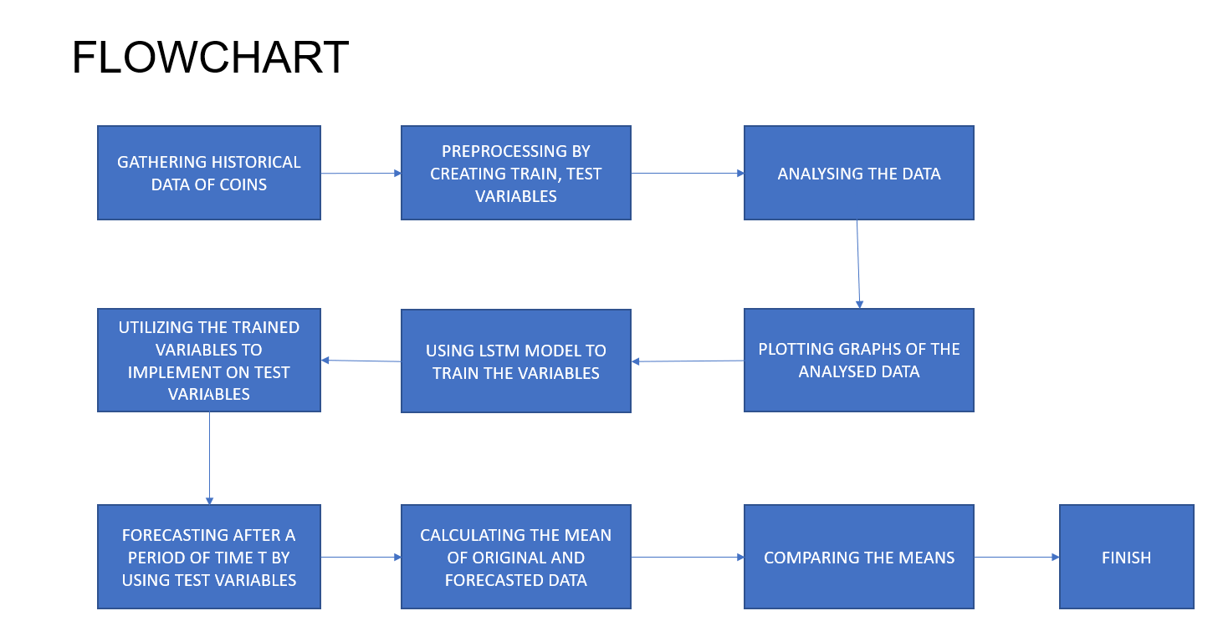

Slide 5
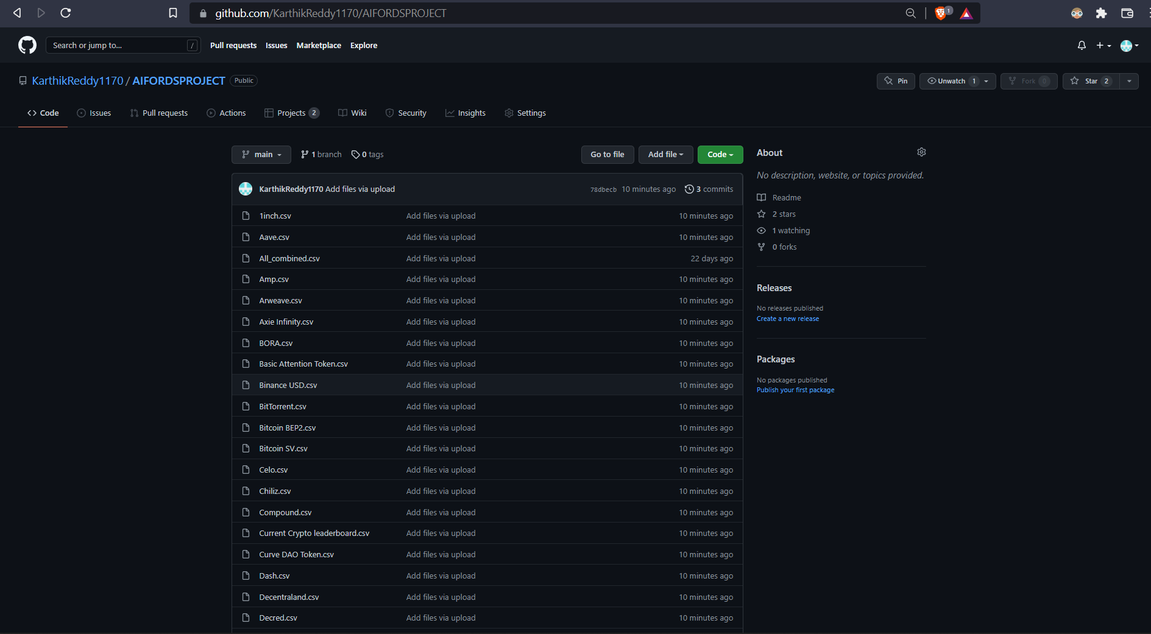
GITHUB COMMITS

Slide 6
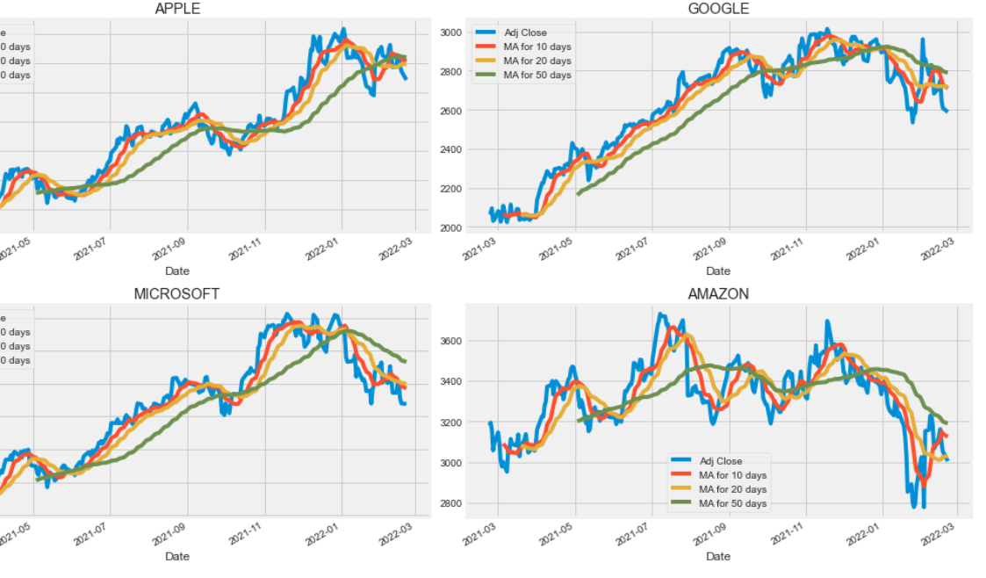
DATA PREPROCESSING

Slide 7
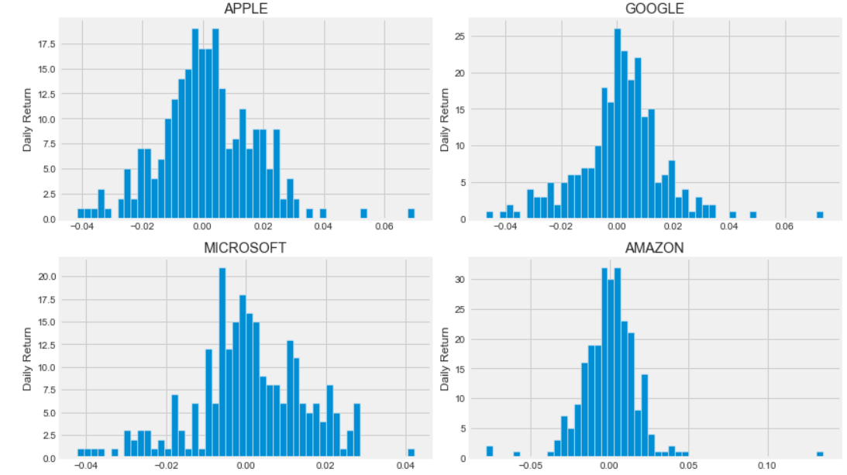

Slide 8

THANK YOU

