Slide 1

CRYPTOCURRENCY FORECASTING
S SIVA KARTHIK REDDY 2010030329
E R SUMANTH 2010030051
K SNEHITH 2010030341

Slide 2
ABSTRACT
Trading in cryptocurrency (digital currencies, ICOs, tokens) is trading in a lot of uncertainty and different variables need to be kept in mind as compared to trading in fiat currencies. Fiat currencies generally are less volatility compared to cryptocurrencies. Traders who have traded in other markets like Stocks and Commodities have repeatedly mentioned that the cryptocurrency market is the most unpredictable place in the world right now. The forecasting of cryptocurrency comes under domain of “TIME SERIES ANALYSIS”.

Slide 3
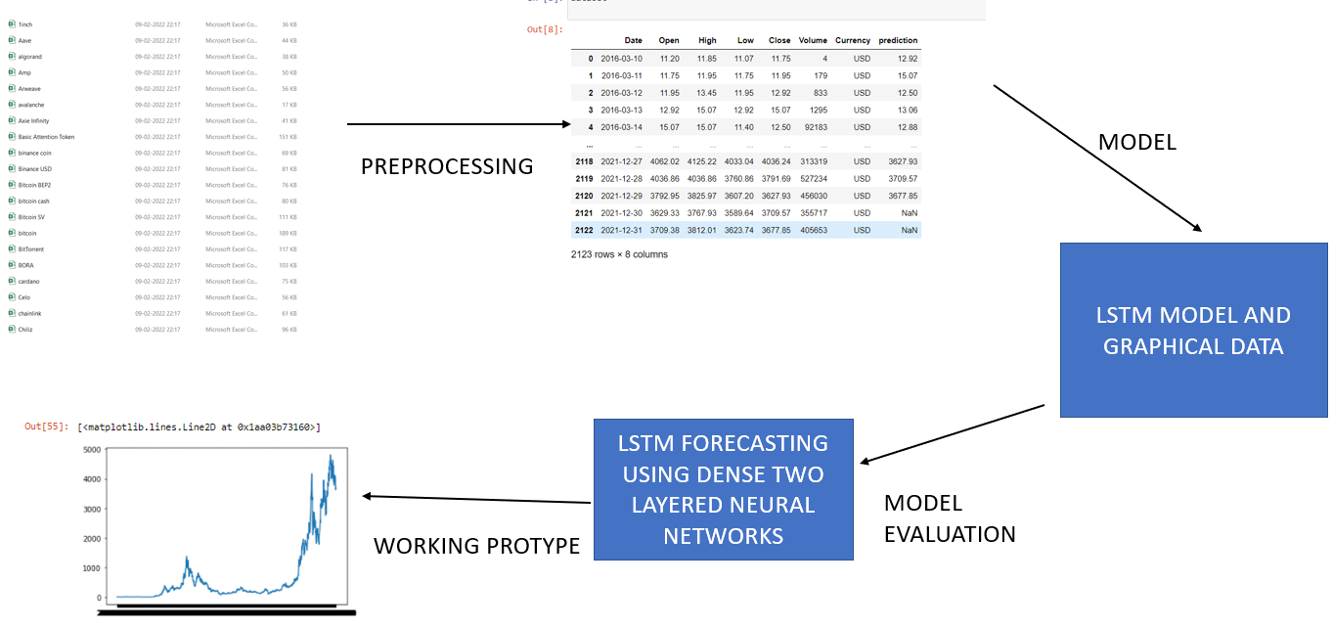
FLOWCHART

Slide 4
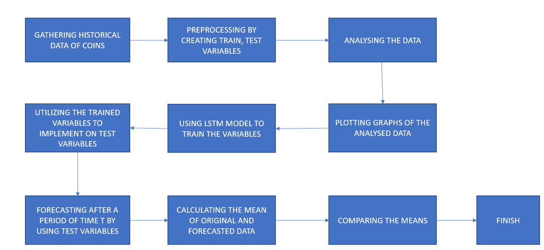
FLOWCHART

Slide 5
Predicted values
ETHERUM PREDICTED PRICE
BITCOIN PREDICTED PRICE

Slide 6
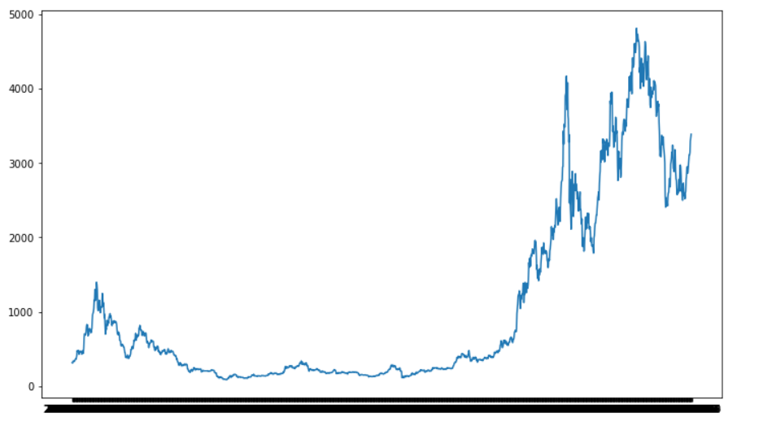
GRAPHICAL NOTATION FOR ETHERUM

Slide 7
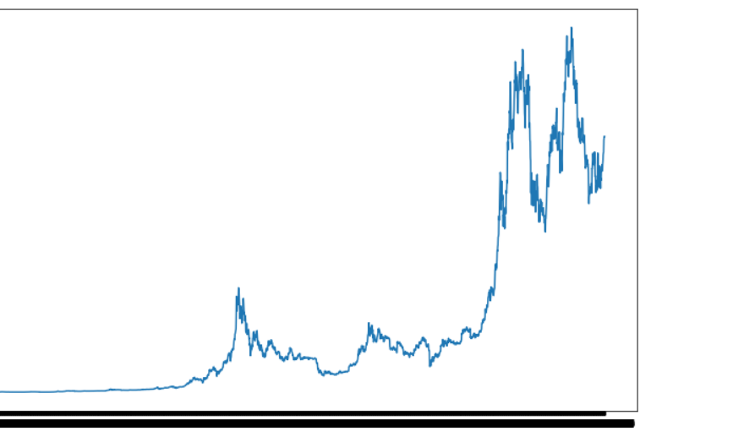
GRAPHICAL NOTATION OF BITCOIN

Slide 8
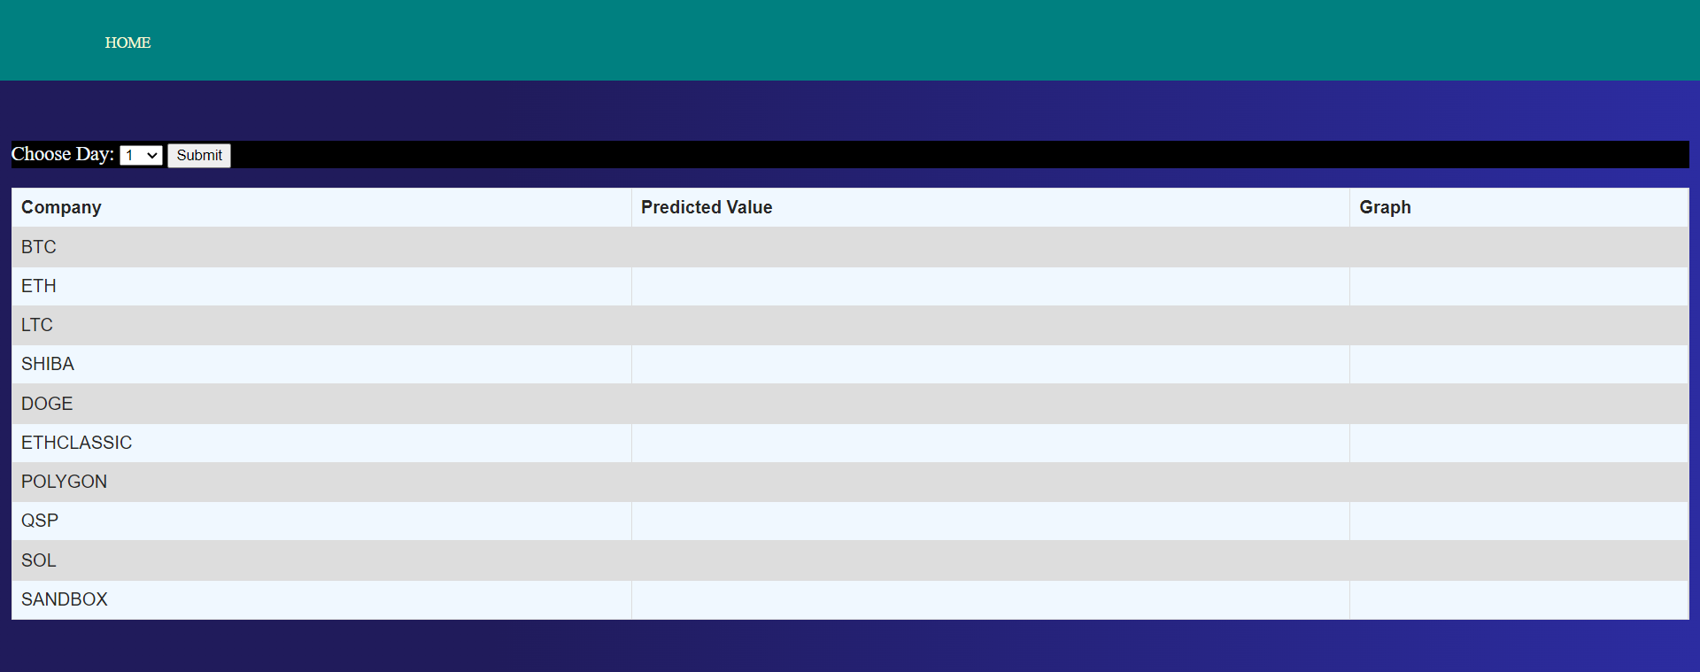
WEBSITE FOR DEPLOYING

Slide 9
SUGGESTIONS

Slide 10
THANK YOU

