Slide 1




Team Name: TECH HUB
Project Title: SCENE WEAVER
Domain: Creative
Team Members:
R.KARTHIK
AKSHITHA NAMAJI
B.AARTHIK

Slide 2
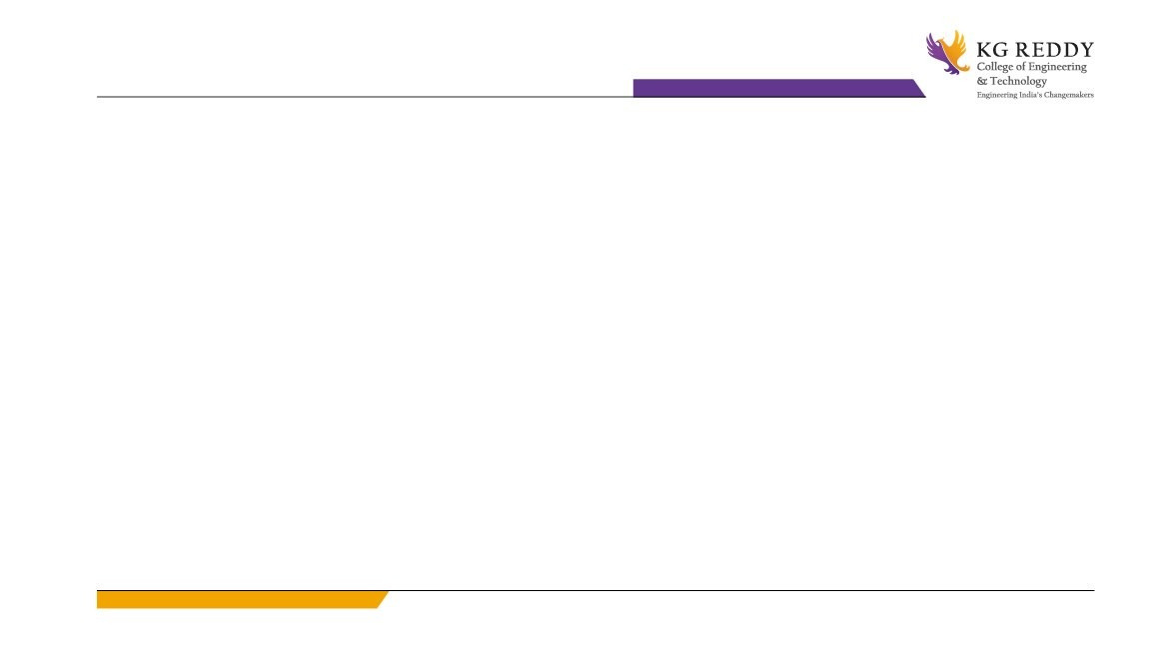
PROBLEM STATEMENT
Scriptwriting is often a collaborative effort, involving multiple writers contributing different drafts for the same scene. This process frequently leads to inconsistencies in tone, style, and narrative flow. Coordinating edits, providing feedback, and maintaining version control across contributors is time-consuming and inefficient, often resulting in delays and reduced script quality.
Year 1Year 2 Year 3 Year 4
Students

Slide 3
SOLUTION
Scene Weaver is an intelligent AI-powered collaboration platform designed to revolutionize the scriptwriting process. It not only automates the analysis and synthesis of multiple drafts into a cohesive and polished scene, but also provides real-time collaboration tools for writers, editors, and producers.
Scene Weaver ensures a smooth, unified writing experience, enhancing both productivity and creative quality.
Year 1Year 2 Year 3 Year 4
Students

Slide 4
FEATURES
🔹 Room Creation and Project Management
Create new collaboration rooms or seamlessly access and manage existing scriptwriting projects.
Organize your workspaces efficiently for streamlined team collaboration.
🔹 Easy Room Access
Join collaboration rooms effortlessly using QR codes or direct access links, ensuring quick onboarding for all team members.
🔹 Real-Time Collaboration Room
Engage in a shared writing environment with team members for real-time editing and file exchange.
Upload, download, and collaborate on scripts, documents, or other creative assets in a centralized workspace.
🔹 Instant Notifications
Receive live updates for participant activity, file uploads, edits, or new comments, keeping everyone in sync.
Never miss a change or a new collaborator joining the project.
🔹 Edit History and Version Control
Maintain a detailed history of script edits with the ability to roll back to previous versions, ensuring creative control and recovery options.

Slide 5
FEATURES
🔹 @Genius Bot – AI Chat Support
Get on-demand help through the @Genius Bot, a built-in chatbot that offers:
Answers to writing-related queries
Scriptwriting recommendations
🔹 Genius AI Tool
Leverage an advanced AI assistant for 1. Real-time script analysis. 2. Intelligent enhancements. 3. Script editing. 4. Draft comparison.

Slide 6
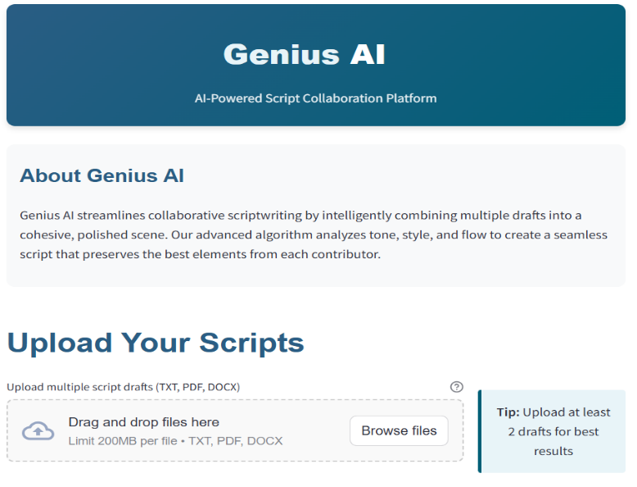
GENERATIVE AI
Claude AI – Sonnet 3.5 is a highly advanced large language model developed by Anthropic, designed for natural language understanding, text generation, reasoning, and safety-aligned interactions. As part of the Claude series, Sonnet 3.5 builds upon its predecessors with improved speed, accuracy, and contextual awareness, enabling more coherent and contextually relevant responses.
Llama 3, a large language model developed by Meta AI, is a highly advanced generative AI designed for tasks like natural language understanding, text generation, and complex problem-solving. It is an evolution of the Llama (Large Language Model Meta AI) series, optimized for efficiency and scalability.

Slide 7
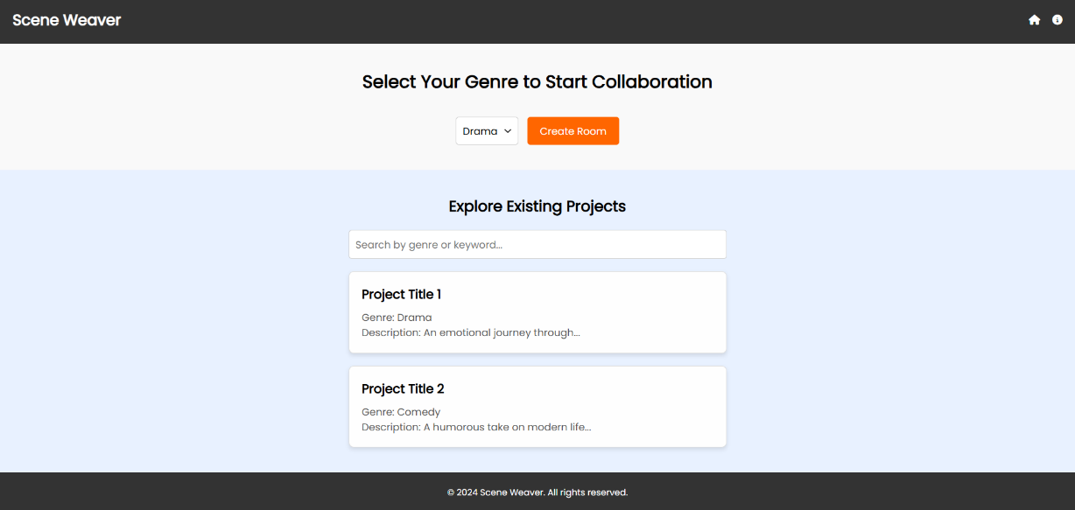
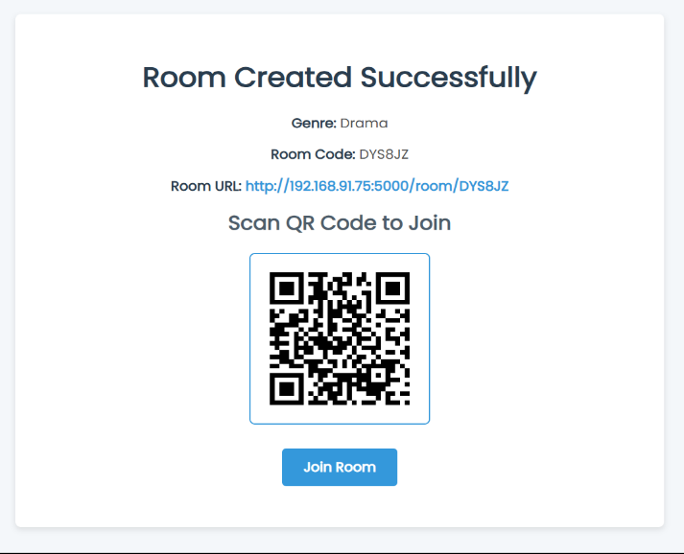
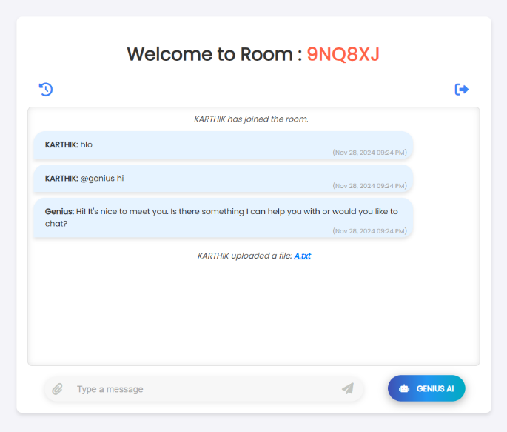
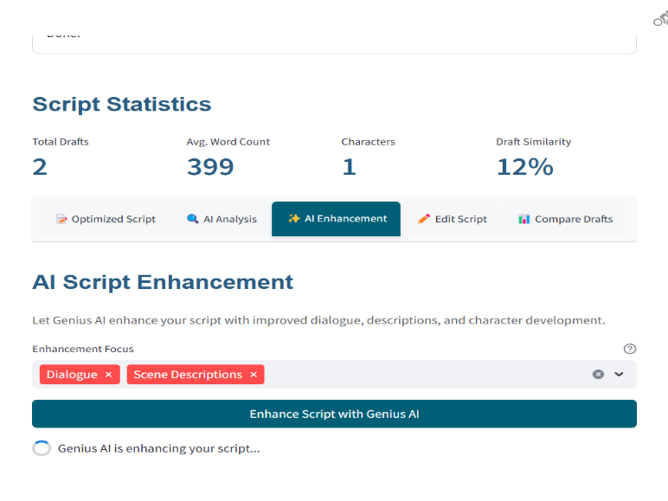
USER INTERFACE DESIGN

Slide 8
TECHNOLOGIES USED
Frontend:
HTML: Markup language for structuring content on the web.
CSS: Styling language for designing the layout and appearance of web pages.
JavaScript: Programming language for dynamic and interactive behavior on web pages.
Backend:
Flask: A micro web framework for building web applications in Python.
SQLite3: A lightweight, disk-based database used for storing data in the application.
Socket.IO: A library for real-time, bidirectional communication between the web client and server.
Authentication: Custom implementation with password hashing (PBKDF2 with SHA-256)
Security: CSRF protection, secure cookies, and password hashing.
Utilities & Libraries:
Werkzeug: A comprehensive WSGI web application library, used by Flask for various utilities.
Requests: A Python HTTP library for making requests to APIs and handling web data.
QR Code: Technology for generating QR codes (likely using a Python library like qrcode).
5

Slide 9
Environment Configuration:
.env: A file used to store environment variables securely.
PDF & Document Handling:
PDFPlumber: A Python library for extracting text, tables, and metadata from PDF files.
python-docx (docx): A Python library for creating and modifying Word documents.
Data Processing:
Difflib : A Python library for comparing sequences, often used for text comparison or finding similarities.
GroqAPI: Likely referring to an API service for interacting with Groq, a company providing AI hardware solutions.
Machine Learning & AI:
Claude AI (Sonnet 3.5): Advanced AI model by Anthropic, known for context-aware, safe, and intelligent conversations and content generation.
Llama 3: Likely referring to a model or version of Llama, an open-source large language model developed by Meta (formerly Facebook).
Web Application:
Streamlit: An open-source app framework for building and sharing data apps, often used for creating interactive dashboards and visualizations.

Slide 10
THANK YOU!

