Slide 1
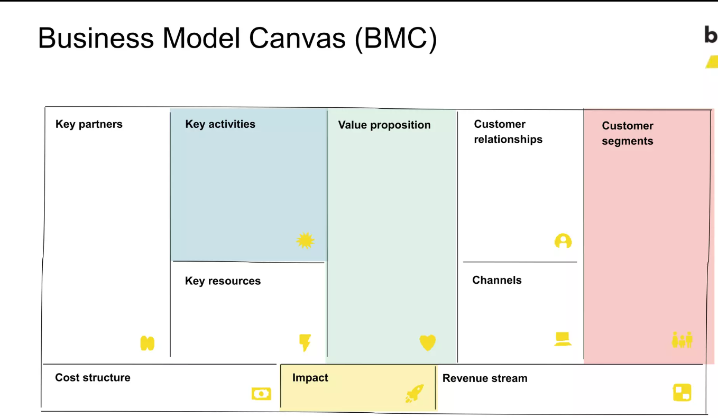
Business Model Canvas (BMC)
Research & Development
Prototype Development & Testing
Marketing & Distribution Strategies
Customer Support & Service
Financial Planning & Management
Enhanced Battery Performance
Cost-Effectiveness
Optimized cooling leading
Integration support for diverse battery setups
Efficient Heat Dissipation
Preventing Overheating
Peltier cooling and Heat Pipe Technology
Battery Pack Manufacturers
Technology Suppliers
Automotive OEMs
Research & Development Institutions
Financial Backers & Investors
Consultative Approach
Technical Support & Training
Continuous Communication
OEMs and Other Battery Pack Manufacturers

Slide 2
