Slide 1

LEARNING
SPRING BATCH

Slide 2

WHAT IS THIS ALL
ABOUT?

Slide 3

OVERVIEW OF
BATCH PROCESSING

Slide 4
WHAT IS
SPRING BATCH?

Slide 5

TAKE A
DEEP DIVE

Slide 6

LOOK AT RELATED
SPRING TECHNOLOGIES

Slide 7
1
SPRING BATCH ADMIN

Slide 8
2
SPRING HADOOP

Slide 9
3
SPRING XD

Slide 10

WHAT IS
BATCH PROCESSING?

Slide 11

Batch processing, … is defined as the processing of a finite amount of data data without interaction or interruption.

Slide 12
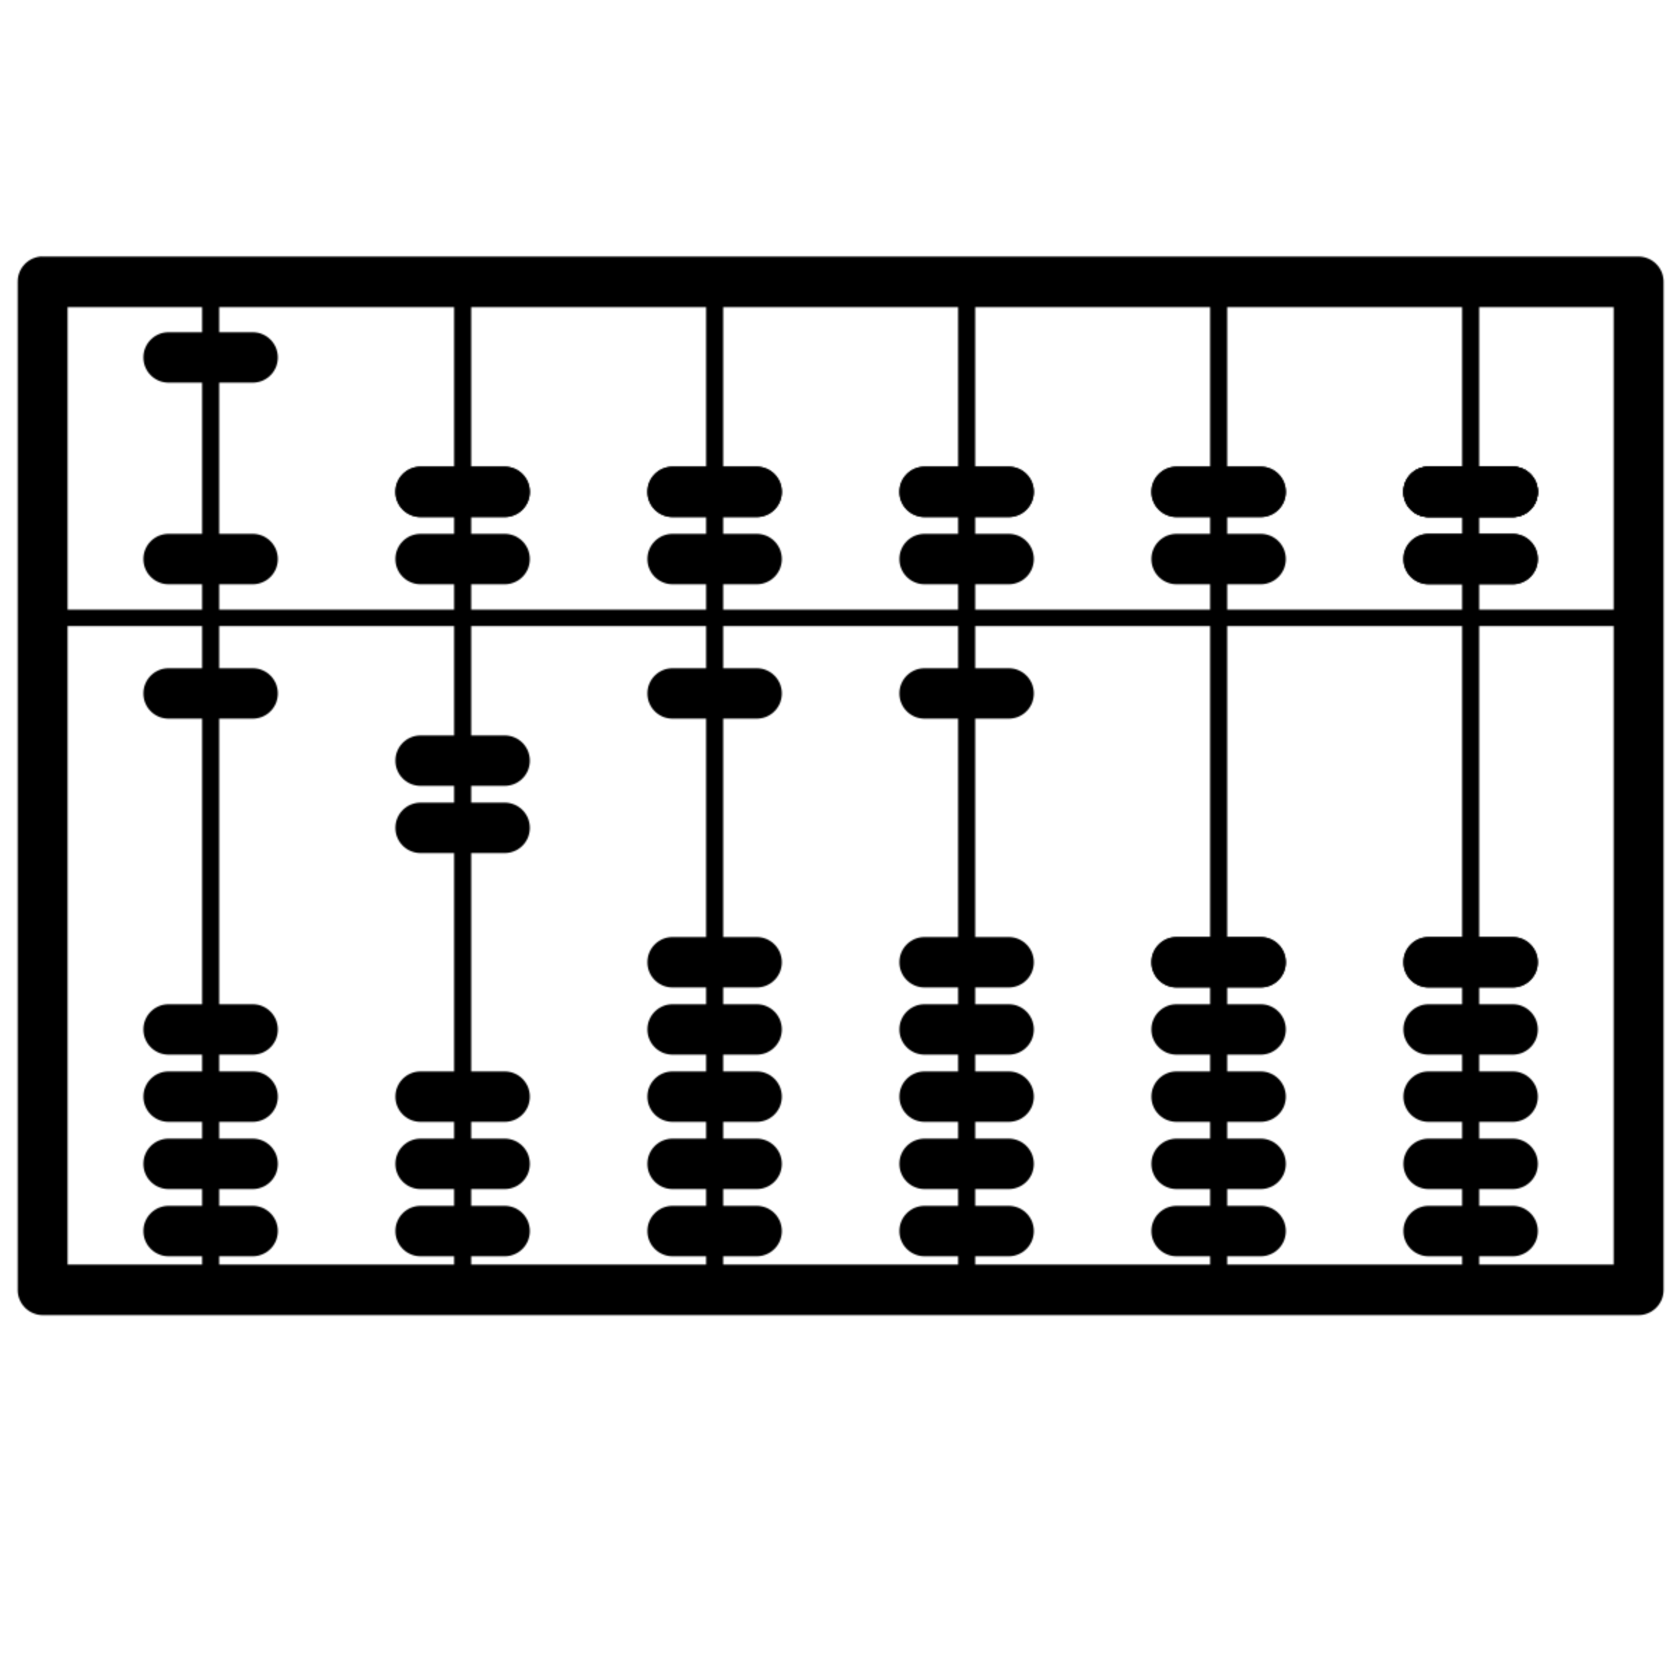
FINITE

Slide 13

WITHOUT INTERACTION
OR INTERRUPTION

Slide 14
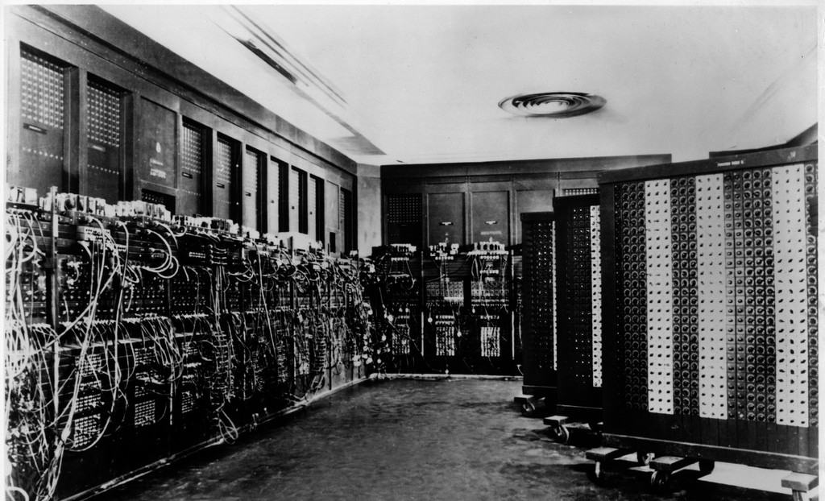
Notes:
ENIAC

Slide 15

WHAT WAS OLD
IS NOW NEW AGAIN

Slide 16



Slide 17
BATCH
USE CASES

Slide 18
1
ETL

Slide 19
2
REPORTING

Slide 20
3
DATA SCIENCE

Slide 21
4
BIG DATA

Slide 22
5
NON-INTERACTIVE PROCESSING

Slide 23
WHAT IS
SPRING BATCH?

Slide 24

THE LEADING BATCH
FRAMEWORK ON THE JVM

Slide 25
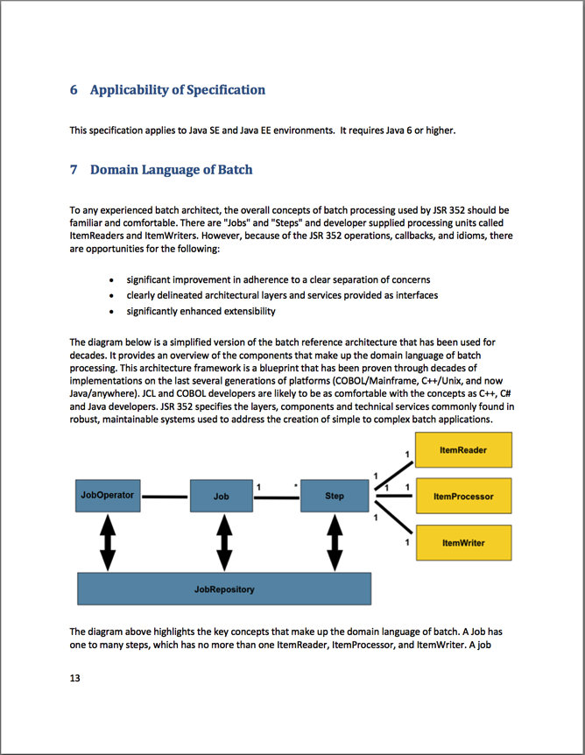
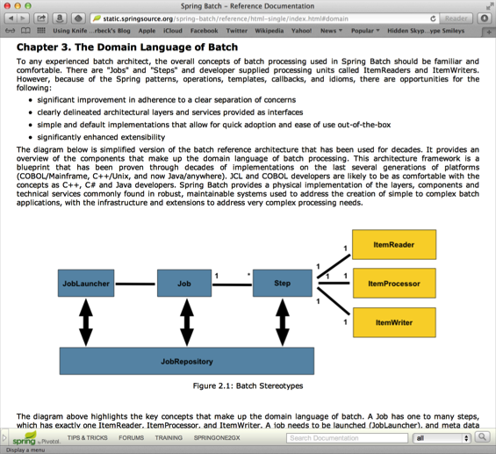
THE BASIS FOR JSR-352

Slide 26



Slide 27
1.0 RELEASED IN
2008

Slide 28
CURRENT VERSION
3.0.4

Slide 29

FEATURES

Slide 30
1
JOB FLOW STATE MACHINE

Slide 31
2
TRANSACTION HANDLING

Slide 32
3
DECLARITIVE I/O

Slide 33
4
ROBUST ERROR HANDLING

Slide 34
5
SCALABILITY OPTIONS

Slide 35
6
BATTLE TESTED

Slide 36
7
BUILT ON SPRING!

Slide 37
WHO USES
SPRING BATCH

Slide 38
1
MORGAN STANLEY
Notes:
http://europe.springone.com/dl/springone-amsterdam-2009/slides/MarkKralj-Taylor_CaseStudyMorganStanleySpringUsage.pdf

Slide 39
2
CARS.COM
Notes:
http://tech.cars.com/2015/01/20/AlertsSpringBatch1.html
http://tech.cars.com/2015/01/21/AlertsSpringBatch2.html

Slide 40
3
eHARMONY
Notes:
http://www.eharmony.com/engineering/tag/spring-batch/#.VcBADJNVj28

Slide 41
4
ORBITZ

Slide 42
5
FEDERAL RESERVE BANK

Slide 43
6
WALGREENS

Slide 44
7
MLB

Slide 45
8
NHL

Slide 46
9
HSBC

Slide 47
10
CBOE

Slide 48

WHO IS THIS
SERIES FOR?

Slide 49
<code/>
DEVELOPERS!

Slide 50

PREREQUISITES

Slide 51

JAVA

Slide 52

SPRING

Slide 53
<?xml version="1.0" encoding="UTF-8"?> <beans xmlns="http://www.springframework.org/schema/beans" xmlns:xsi="http://www.w3.org/2001/XMLSchema-instance" xsi:schemaLocation="http://www.springframework.org/schema/batch http://www.springframework.org/schema/batch/spring-batch.xsd http://www.springframework.org/schema/beans http://www.springframework.org/schema/beans/spring-beans.xsd"> <job id="ioSampleJob" xmlns="http://www.springframework.org/schema/batch"> <step id="step1"> <tasklet> <chunk reader="itemReader" processor="itemProcessor" writer="itemWriter" commit-interval="2" /> </tasklet> </step> </job> <bean id="itemProcessor" class="org.springframework.batch.sample.domain.trade.internal.CustomerCreditIncreaseProcessor" /> </beans>
XML

Slide 54

GIT/GITHUB

Slide 55
<int:service-activator id=“serviceActivator”
input-channel=“requests”
output-channel=“replies”
ref=“chunkProcessorChunkHandler”
method=“handleChunk”/>
<bean id=“chunkProcessorChunkHandler”
class=“o.sf.b.i.c.ChunkProcessorChunkHandler”>
<property name=“chunkProcessor”>
<bean class=“o.sf.b.c.s.i.SimpleChunkProcessor”>
<property name=“itemWriter”>
<bean class=“MyItemWriter”/>
</property>
<property name=“itemProcessor”>
<bean class=“MyItemProcessor”/>
NEXT THE CODE…

Slide 56





IMAGE CREDITS

