Slide 1

JOB

Slide 2

STEP

Slide 3

TASKLET

Slide 4

CHUNK

Slide 5
Step1
Step2
Step3
ItemReader
ItemReader
ItemReader
ItemProcessor
ItemProcessor
ItemProcessor
ItemWriter
ItemWriter
ItemWriter

Slide 8
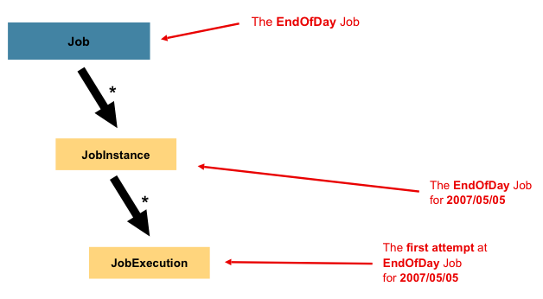
Job
The EndOfDay Job
*
The EndOfDay Job
for 09/01/2015
JobInstance
*
The first attempt at
EndOfDay Job
for 09/01/2015
JobExecution

Slide 9
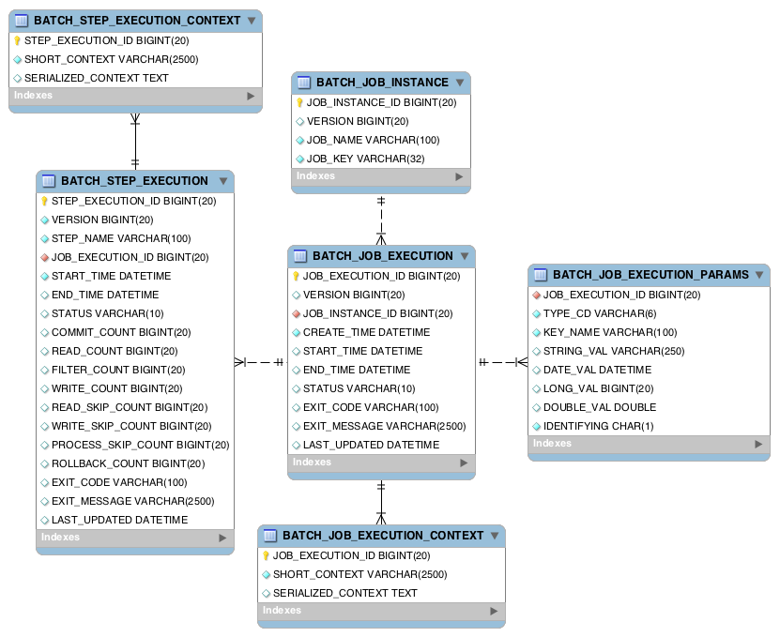

Slide 10
<customers> <customer> <id>1</id> <firstName>Ian</firstName> <lastName>Morse</lastName> <birthdate>1966-10-29 16:52:09</birthdate> </customer> <customer> <id>2</id> <firstName>Melodie</firstName> <lastName>Jimenez</lastName> <birthdate>1987-12-08 10:43:04</birthdate> </customer>
…

Slide 11
ItemStream
ExecutionContext
JobRepository

Slide 13

SCALING SPRING BATCH

Slide 14
1
MULTI-THREADED STEP

Slide 15
2
ASYNC ITEMPROCESSOR/
ASYNC ITEMWRITER

Slide 16
3
PARTITIONING

Slide 17
4
REMOTE CHUNKING

Slide 18

MULTIPLE
THREADS

Slide 19
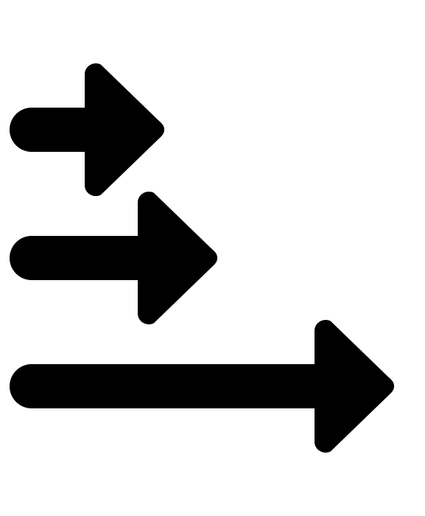
EACH CHUNK IS PROCESSED
ON IT’S OWN THREAD

Slide 20

ASYNC ITEMPROCESSOR
AND ASYNC ITEMWRITER

Slide 21
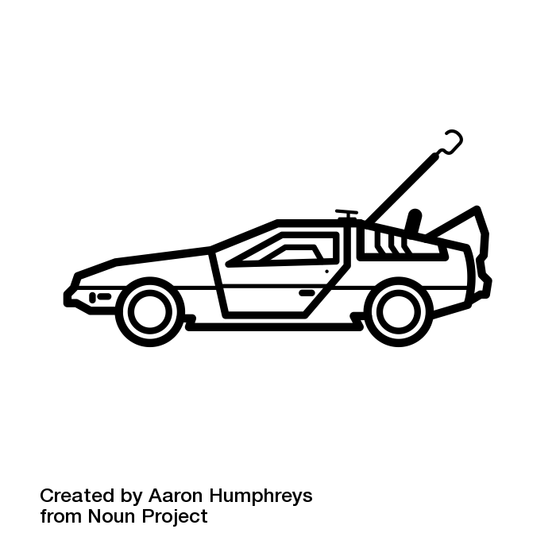
ITEMPROCESSOR
RETURNS A FUTURE

Slide 22

ITEMWRITER UNWRAPS
THE FUTURE

Slide 23

PARTITIONING

Slide 24

DIVIDING THE DATA
INTO PARTITIONS

Slide 25

REMOTE CHUNKING

Slide 26
PROCESSING AND WRITING
OCCUR IN A REMOTE SLAVE

