Slide 1


K.RAMAKRISHNAN COLLEGE OF TECHNOLOGY (AUTONOMOUS), TRICHY.
HOSPITAL MANAGEMENT SYSTEM
Presented by,
KARTHIKA R,
2303811710522028.
GUIDED BY,
Ms.P.KARTHIKA M.E.

Slide 2
ABSTRACT
The system simplifies key hospital processes such as patient registration, appointment scheduling, and billing, ensuring smooth daily operations.
It enables quick access to patient medical records, treatment history, and test results, helping healthcare providers deliver timely and accurate care.

Slide 3
INTRODUCTION
The project begins by identifying a specific issue or challenge that needs to be addressed.
It involves creating a solution or system to solve the identified problem using suitable technologies and methodologies.
The project moves into the phase of building, testing, and deploying the solution to ensure it works effectively.
After implementation, the project evaluates its success in addressing the problem and its potential for future improvements.

Slide 4
PROPOSED ARCHITECTURE
User interface
Layer
Application
Layer
Database
Layer
Start
Patient portal
Business logic
Patient table
Doctor portal
Authentication
Doctor table
Admin dashboard
API gateway
(if any)
Billing table
End
Medical records

Slide 5
PROPOSED SYSTEM EXPLANATION
A Hospital Management System (HMS) is a comprehensive software application designed to streamline and automate the various administrative and clinical processes of a healthcare facility.
It typically includes functionalities such as patient management, staff management, billing, inventory management, and more.

Slide 6
ADVANTAGES
Improved Efficiency and Time Savings: Automates administrative tasks such as patient registration, appointment scheduling, billing, and inventory management.
Enhanced Patient Care: Provides doctors with easy access to a patient’s medical history and current status, allowing for better treatment decisions.
Cost Savings: Reduces the need for paper-based records, printing, and administrative overhead.

Slide 7
MODULES
Patient Management
Staff & Doctor Management
Appointment & Scheduling
Billing & Payment
Medical Records & Reporting

Slide 8
EXPLANATION OF MODULES
Patient Management:
The Patient Management Module is a central component designed to handle all patient-related data and interactions efficiently. It allows for the registration of new patients, maintaining records such as personal information, medical history, and treatment details. This module ensures quick retrieval of patient data, enabling timely diagnosis and care. It supports appointment scheduling, visit tracking, and medical record updates. With secure data storage and structured profiles, it improves patient experience and streamlines communication between departments. Ultimately, it contributes to better healthcare delivery, continuity of care, and operational efficiency

Slide 9
Staff & Doctor Management:
The Staff & Doctor Management Module handles records related to medical and administrative personnel. It enables hospitals to maintain up-to-date profiles, schedules, specializations, and availability of doctors and staff. This module supports assigning duties, tracking attendance, and managing leaves, ensuring proper workforce allocation. It also facilitates communication between staff members and management for better coordination. The system allows performance tracking and document management, making it easier for administrators to oversee human resources. By improving organization and transparency, this module enhances service quality and staff productivity.

Slide 10
Appointment & Scheduling :
The Appointment & Scheduling Module allows patients to book, modify, and cancel appointments with doctors through a user-friendly interface. It manages time slots, doctor availability, and departmentspecific queues to minimize waiting times. The module sends automated notifications and reminders to both patients and doctors, reducing missed appointments and improving punctuality. It also allows for emergency or walk-in scheduling. With an organized calendar view, it aids receptionists and administrators in efficient planning and resource management. This module improves patient satisfaction and optimizes hospital workflow.

Slide 11
Billing & Payment :
The Billing & Payment Module manages financial operations including invoice generation, payment processing, and account summaries. It tracks services rendered, calculates charges, applies taxes or discounts, and supports multiple payment options such as cash, card, and insurance claims. The system ensures billing accuracy and transparency with real-time updates and printed or digital receipts. It also provides financial reports, outstanding balances, and daily revenue summaries. This module reduces billing errors, enhances compliance, and supports efficient hospital revenue management.

Slide 12
Medical Records & Reporting:
This module maintains detailed medical records, including diagnostic reports, prescriptions, lab results, and treatment plans. It supports uploading and accessing documents for easy reference by healthcare professionals. The system enables longitudinal tracking of a patient’s medical journey, ensuring informed clinical decisions. Custom reports can be generated for individual patients, departments, or overall hospital performance. Integration with diagnostic equipment and labs allows for real-time report updates. This enhances data accuracy, aids in research, and supports better patient outcomes.

Slide 13
System Specification
Software: Frontend: HTML, CSS, JavaScript (or React) Backend: PHP / Python / Java Database: MySQL / PostgreSQL Web Server: Apache / Nginx Version Control: Git / GitHub Browser Support: Chrome, Firefox, Edge

Slide 14
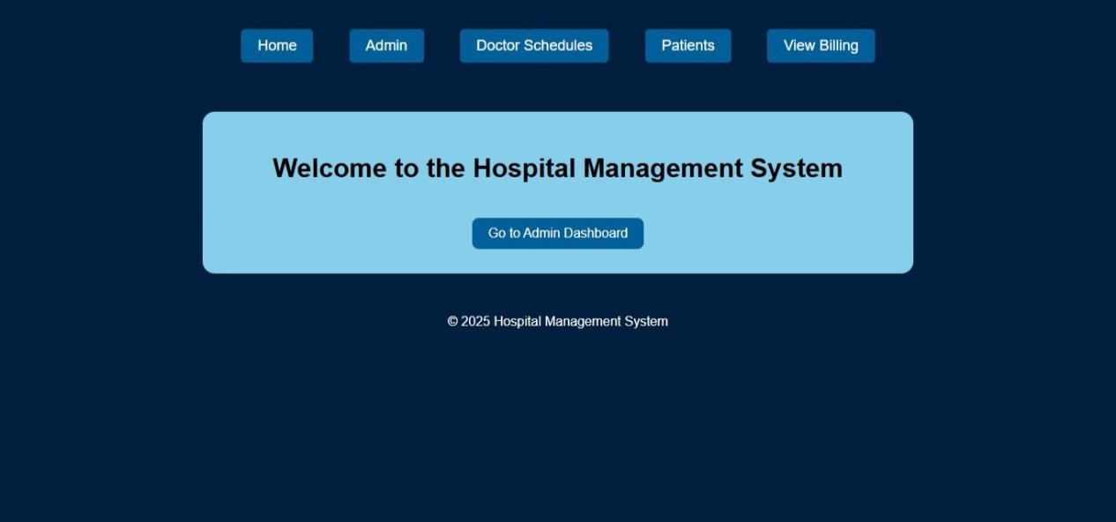
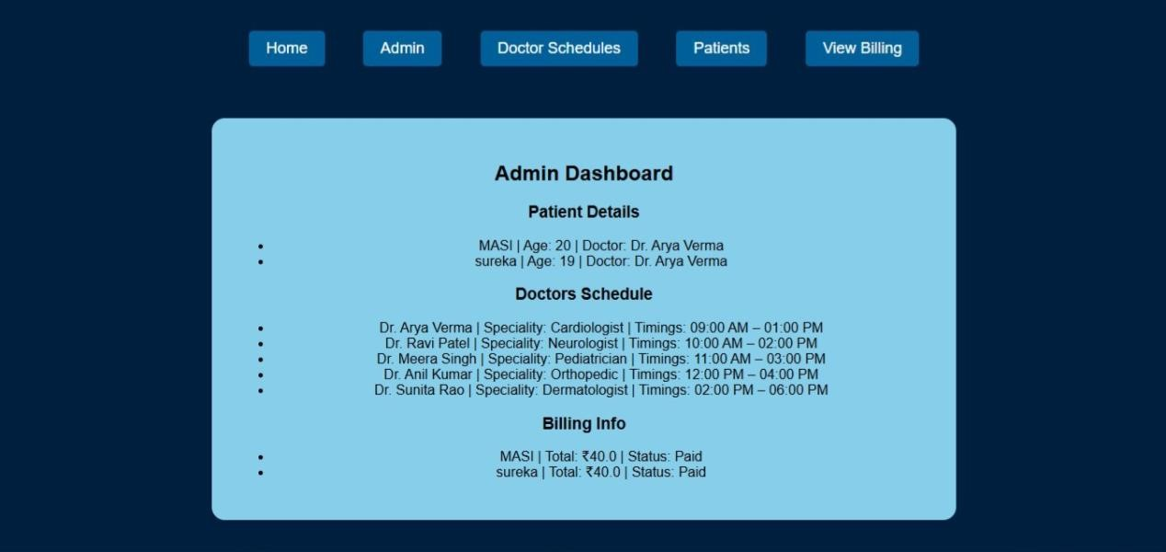
Output

Slide 15
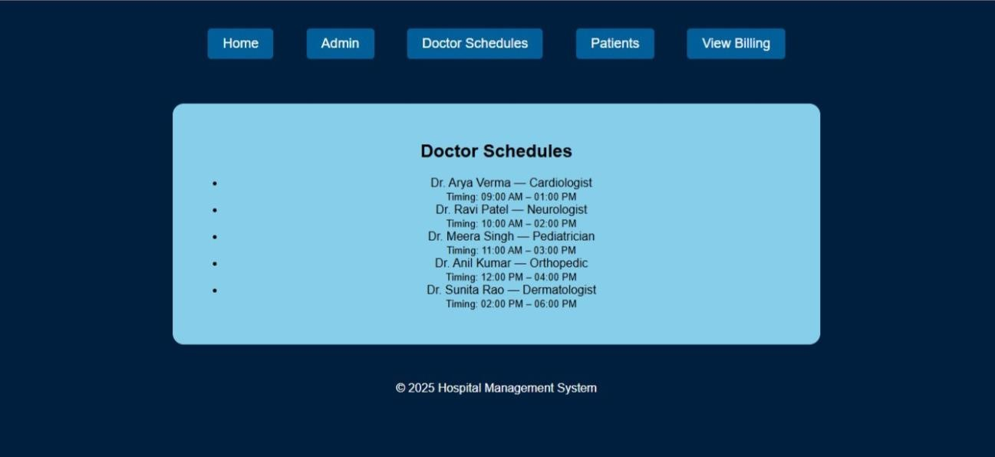
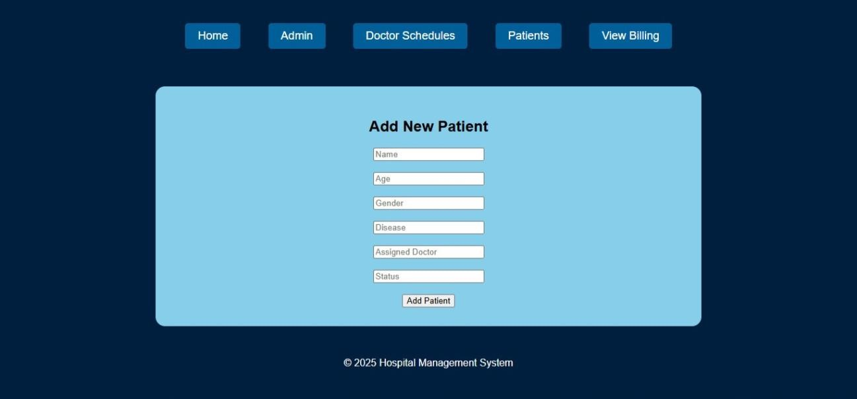

Slide 16
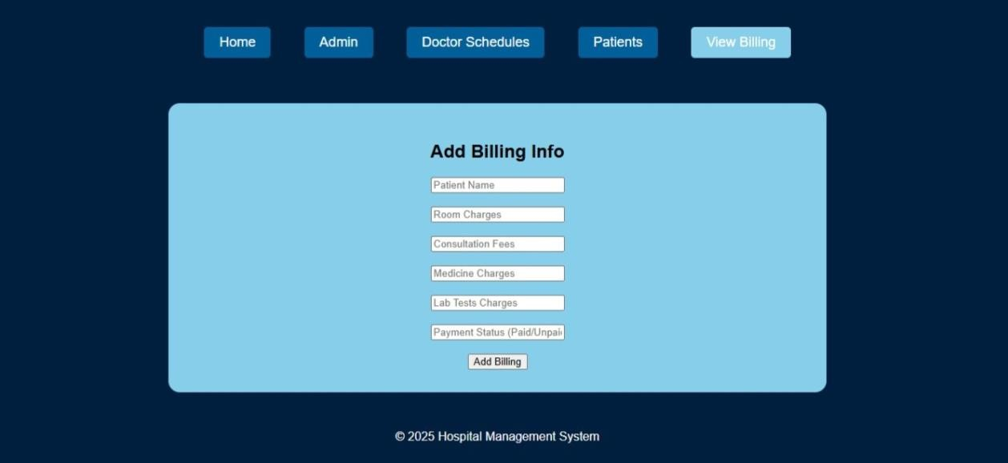

Slide 17
Conclusion The Hospital Management System simplifies patient registration, doctor assignments, and appointment tracking. It enhances operational efficiency, reduces paperwork, and ensures quick access to critical patient information, contributing to better healthcare service delivery. Future Work: In future, the system can be expanded with features like real-time notifications, billing and payment modules, electronic medical records (EMR), and mobile app integration to improve accessibility and automate more hospital workflows.

Slide 18
THANK YOU !!!!

